Slide 1
Information & instructions for e-poster
The next slides contain the e-poster template.
You may choose one of the two following formats for your presentation:
  A single landscape slide poster that contains all your content.
  A single landscape slide poster that is linked to additional slides via the Zoom effect in Power Point (Insert/Zoom/Slide zoom) for more detailed explanations or larger visuals.
Feel free to customize the template (e.g., font type, colors) to suit your content and style.
Ensure that font sizes are large enough to be easily readable from a distance.
Use complementary colors for a visually appealing design.
Present your content using figures, charts, and tables rather than large blocks of text.
You may delete the grey squares – they are just placeholders.
Please leave the rectangle with 000 – here the organizer will place your poster number.
Please review the e-poster guidelines for information about submission and presenting your poster.

Slide 2

28th Congress of SCTM, 23-26 September, Ohrid, Macedonia
000
TITLE (recommended font size 22)
Font size 14 Name Surname¹, Name Surname², Name Surname³
¹ Institution, City, Country, email of presenting author, ² Institution, City, Country, ³ Institution, City, Country
Introduction & Aim
Text: recommended font size 16
Text: recommended font size 16
Graphs
Tables
Text: recommended font size 16
Graphs
Tables
Experimental
Results and discussion
Text: recommended font size 16
Conclusions
Text: recommended font size 12
Acknowledgement

Slide 3
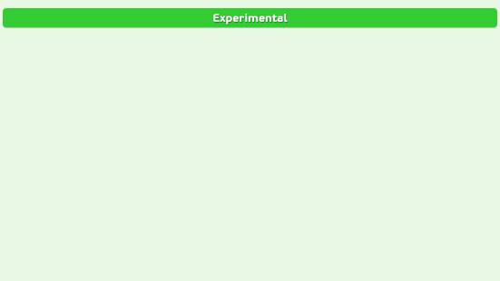



28th Congress of SCTM, 23-26 September, Ohrid, Macedonia
000
TITLE (recommended font size 22)
Font size 14 Name Surname¹, Name Surname², Name Surname³
¹ Institution, City, Country, email of presenting author, ² Institution, City, Country, ³ Institution, City, Country

Slide 4
Introduction & Aim

Slide 5
Experimental

Slide 6
Results and discussions

Slide 7
Conclusions

