Slide 1

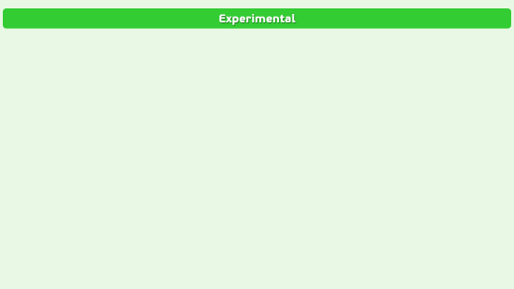
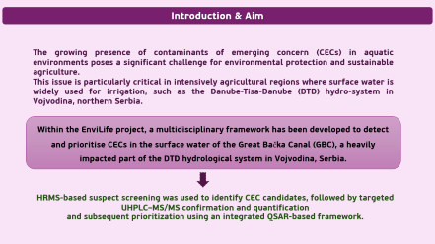
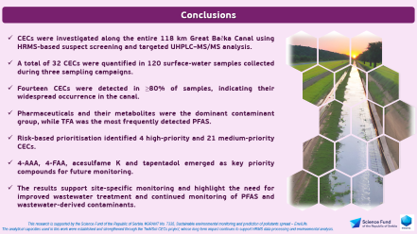
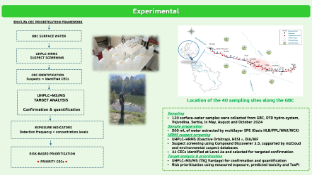
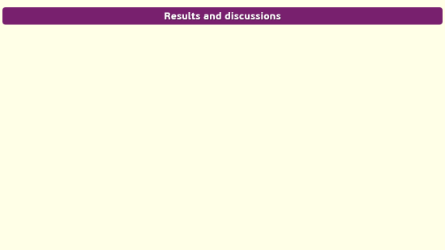

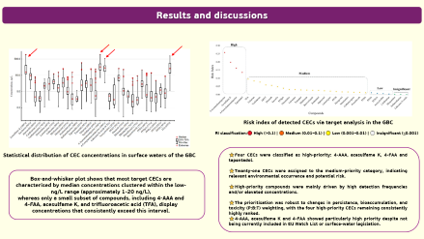
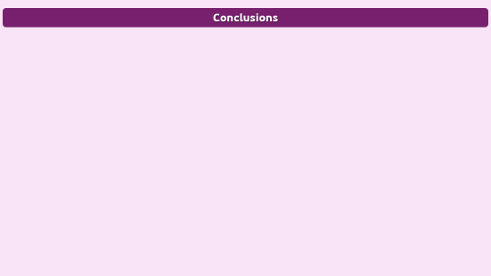
28th Congress of SCTM, 23-26 September, Ohrid, Macedonia
000
From Monitoring to Prioritisation: The EnviLife Framework
for Emerging Contaminants
Jelena Živančev, Igor Antić, Maja Buljovčić, Dušan Rakić, Nataša Đurišić-Mladenović
University of Novi Sad, Faculty of Technology Novi Sad, Serbia, jelena.zivancev@tf.uns.ac.rs

Slide 2
Introduction & Aim
The growing presence of contaminants of emerging concern (CECs) in aquatic environments poses a significant challenge for environmental protection and sustainable agriculture.
This issue is particularly critical in intensively agricultural regions where surface water is widely used for irrigation, such as the Danube-Tisa-Danube (DTD) hydro-system in Vojvodina, northern Serbia.
Within the EnviLife project, a multidisciplinary framework has been developed to detect and prioritise CECs in the surface water of the Great Bačka Canal (GBC), a heavily impacted part of the DTD hydrological system in Vojvodina, Serbia.
HRMS-based suspect screening was used to identify CEC candidates, followed by targeted
UHPLC–MS/MS confirmation and quantification
and subsequent prioritization using an integrated QSAR-based framework.

Slide 3
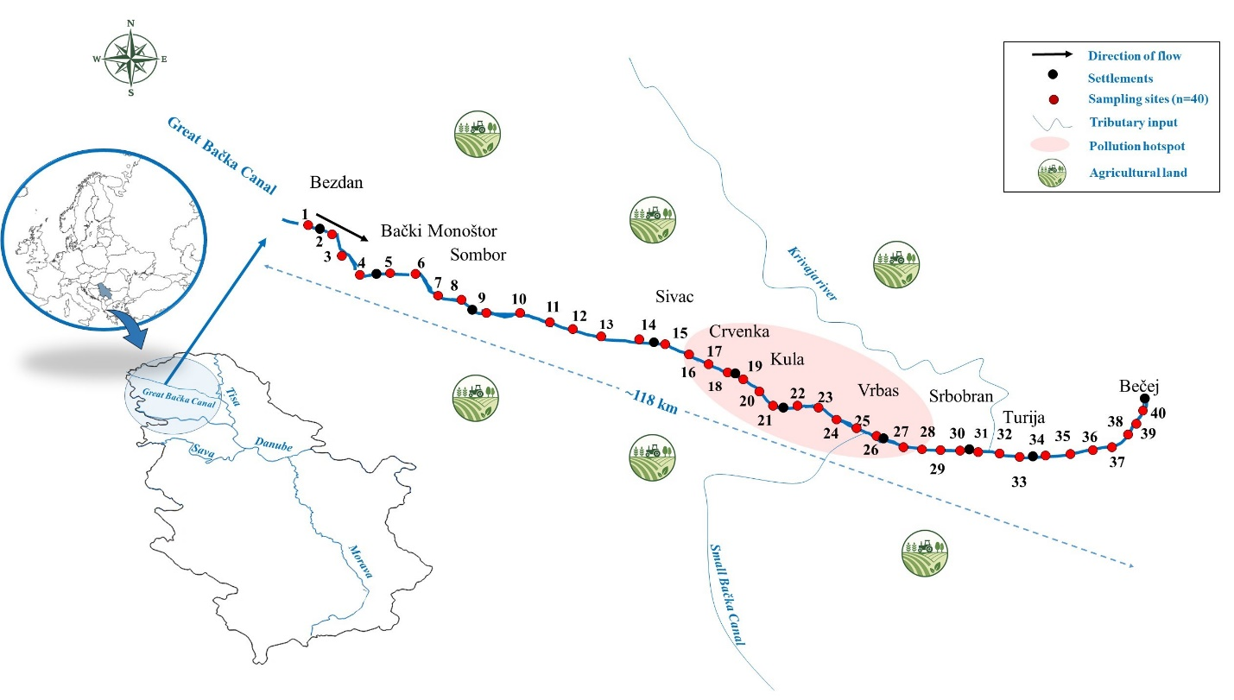
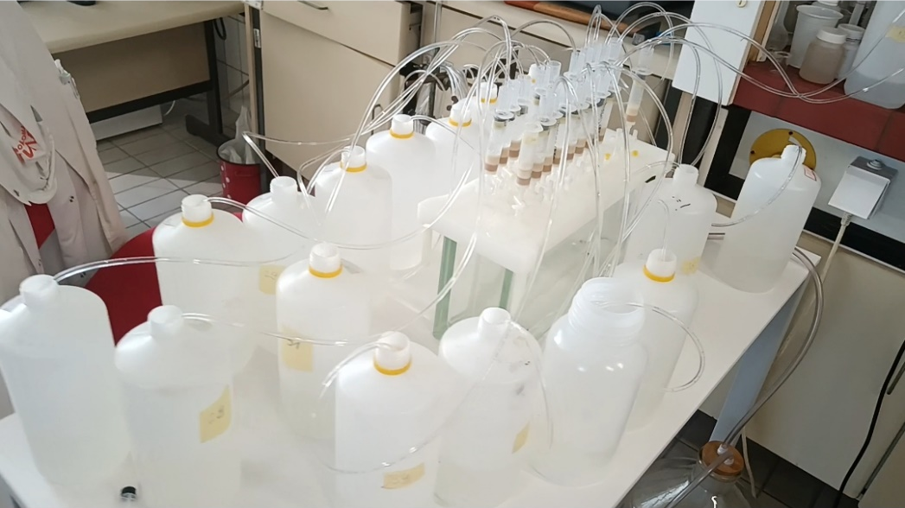
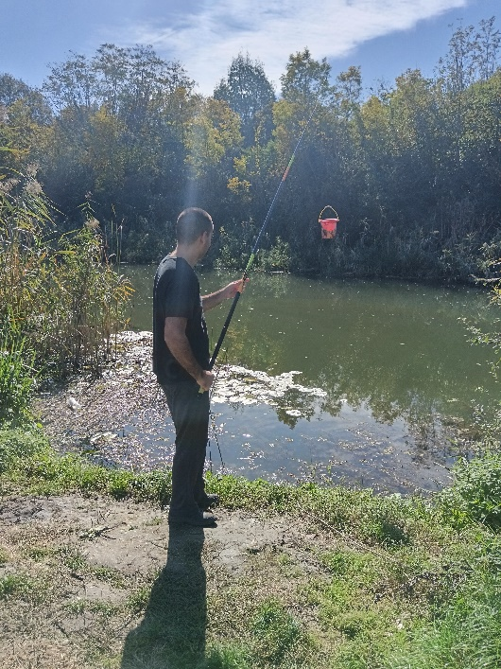
Experimental
ENViLife CEC PRIORITISATION FRAMEWORK
GBC SURFACE WATER
UHPLC–HRMS
SUSPECT SCREENING
CEC IDENTIFICATION
Suspects → identified CECs
UHPLC–MS/MS
TARGET ANALYSIS
Confirmation & quantification
Location of the 40 sampling sites along the GBC
Sampling
120 surface-water samples were collected from GBC, DTD hydro-system, Vojvodina, Serbia, in May, August and October 2024
Sample preparation
500 mL of water extracted by multilayer SPE (Oasis HLB/PPL/WAX/WCX)
HRMS suspect screening
UHPLC–HRMS (Exactive Orbitrap), HESI ±, DIA/AIF
Suspect screening using Compound Discoverer 3.5, supported by mzCloud and environmental suspect databases
32 CECs identified at Level 2a and selected for targeted confirmation
Target analysis & prioritisation
UHPLC–MS/MS (TSQ Vantage) for confirmation and quantification
Risk prioritisation using measured exposure, predicted toxicity and ToxPi.
EXPOSURE INDICATORS
Detection frequency + concentration levels
RISK-BASED PRIORITISATION
★ PRIORITY CECs ★

Slide 4
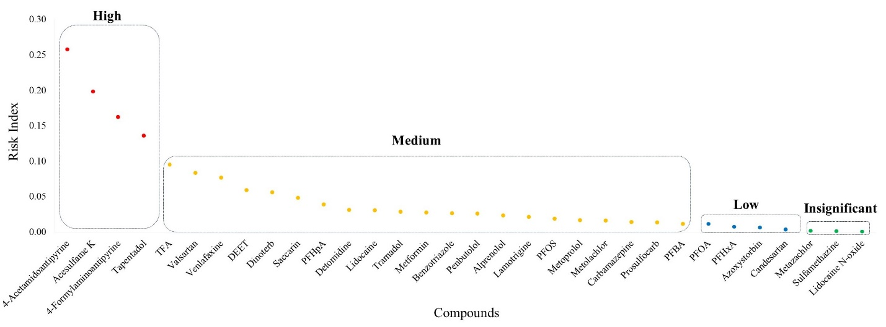
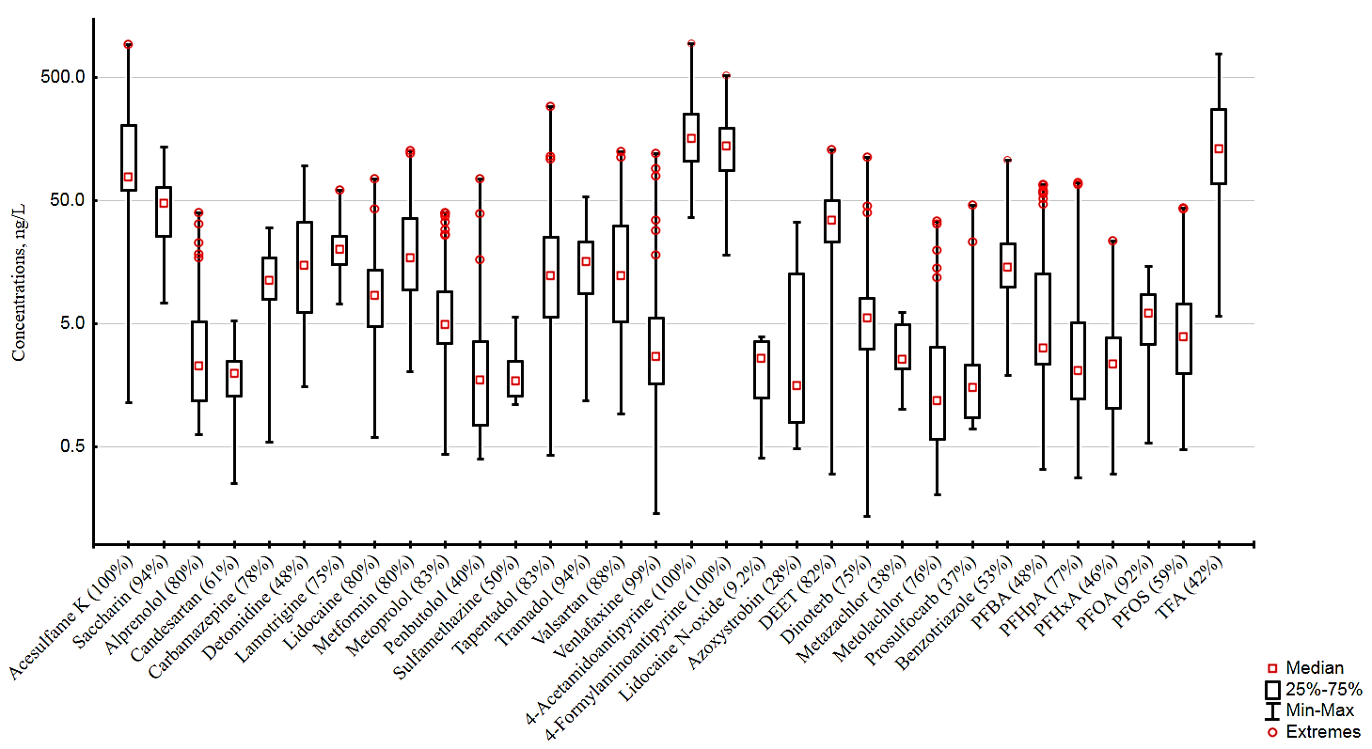
Results and discussions
Risk index of detected CECs via target analysis in the GBC
RI classification:🔴 High (>0.1) | 🟠 Medium (0.01–0.1) | 🟡 Low (0.001–0.01) | ⚪ Insignificant (≤0.001)
Statistical distribution of CEC concentrations in surface waters of the GBC
⭐Four CECs were classified as high-priority: 4-AAA, acesulfame K, 4-FAA and tapentadol.
⭐Twenty-one CECs were assigned to the medium-priority category, indicating relevant environmental occurrence and potential risk.
⭐High-priority compounds were mainly driven by high detection frequencies and/or elevated concentrations.
⭐The prioritisation was robust to changes in persistence, bioaccumulation, and toxicity (P:B:T) weighting, with the four high-priority CECs remaining consistently highly ranked.
⭐4-AAA, acesulfame K and 4-FAA showed particularly high priority despite not being currently included in EU Watch List or surface-water legislation.
Box-and-whisker plot shows that most target CECs are characterised by median concentrations clustered within the low-ng/L range (approximately 1-20 ng/L),
whereas only a small subset of compounds, including 4-AAA and
4-FAA, acesulfame K, and trifluoroacetic acid (TFA), display concentrations that consistently exceed this interval.

Slide 5



Conclusions
CECs were investigated along the entire 118 km Great Bačka Canal using HRMS-based suspect screening and targeted UHPLC–MS/MS analysis.
A total of 32 CECs were quantified in 120 surface-water samples collected during three sampling campaigns.
Fourteen CECs were detected in ≥80% of samples, indicating their widespread occurrence in the canal.
Pharmaceuticals and their metabolites were the dominant contaminant group, while TFA was the most frequently detected PFAS.
Risk-based prioritisation identified 4 high-priority and 21 medium-priority CECs.
4-AAA, 4-FAA, acesulfame K and tapentadol emerged as key priority compounds for future monitoring.
The results support site-specific monitoring and highlight the need for improved wastewater treatment and continued monitoring of PFAS and wastewater-derived contaminants.
This research is supported by the Science Fund of the Republic of Serbia, #GRANT No. 7335, Sustainable environmental monitoring and prediction of pollutants spread – EnviLife.
The analytical capacities used in this work were established and strengthened through the TwiNSol-CECs project, whose long-term impact continues to support HRMS data processing and environmental analysis.

