Slide 1
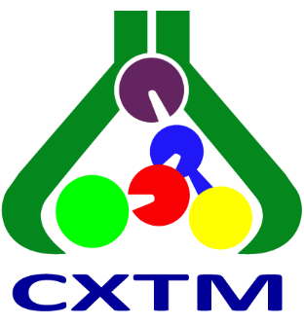
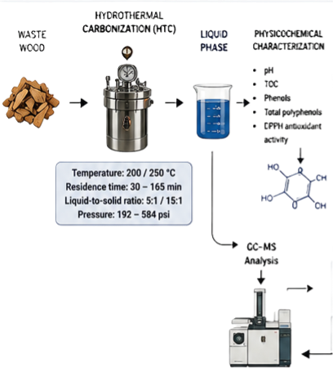
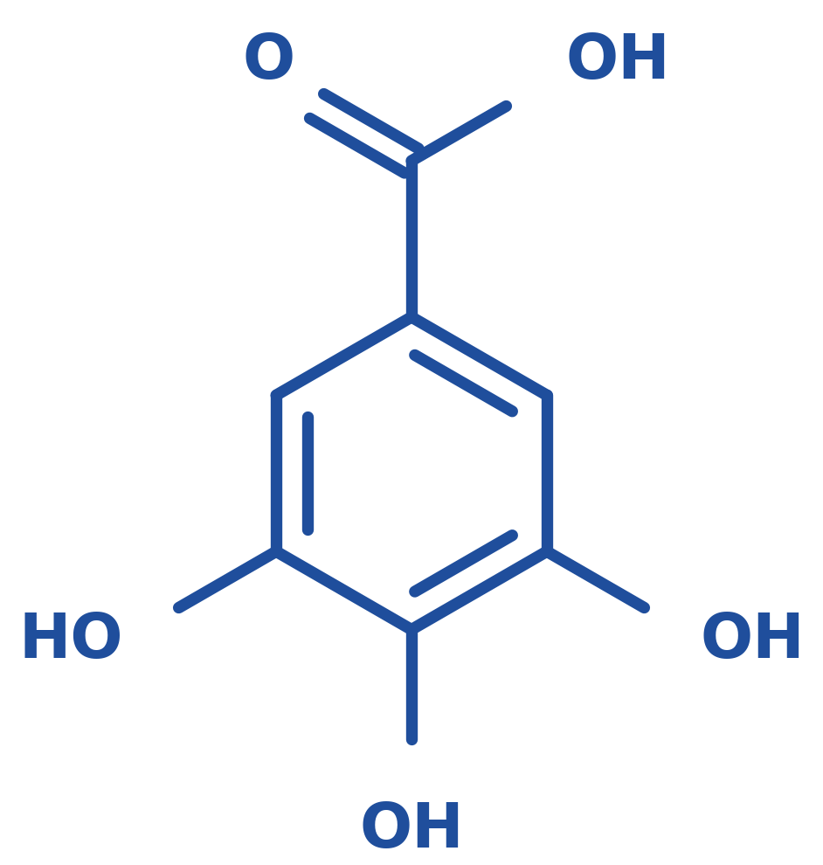
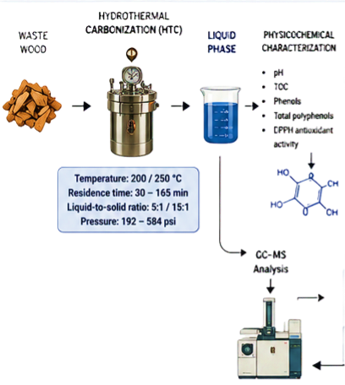
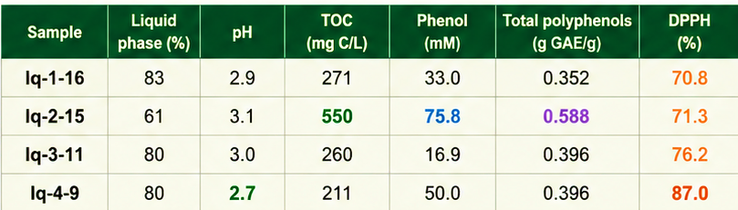
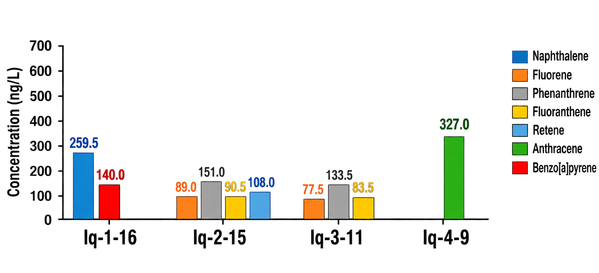
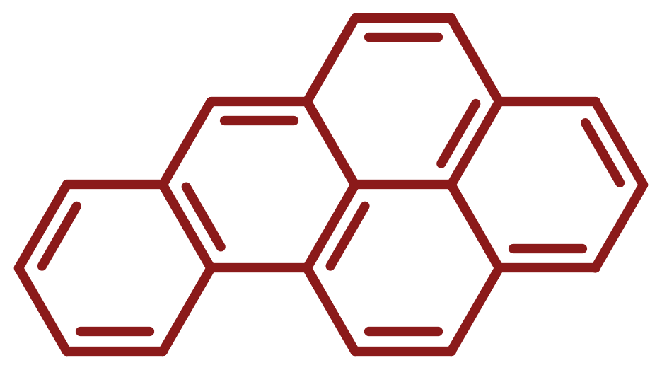
28th Congress of SCTM, 23–26 September, Ohrid, N. Macedonia
000
PROFILING OF THE LIQUID PHASE FROM HYDROTHERMAL CARBONIZATION OF WASTE WOOD: ANTIOXIDANT PROPERTIES AND PAH CONTENT
Maja Buljovčić¹, Mirjana Petronijević¹, Sanja Panić¹, Jelena Živančev¹, Igor Antić¹, Dušan Rakić¹, Nataša Đurišić-Mladenović¹
¹ University of Novi Sad, Faculty of Technology Novi Sad, Novi Sad, Serbia
Introduction & Aim
Hydrothermal carbonization (HTC) converts lignocellulosic biomass in hot compressed water into a carbon-rich solid (hydrochar) and a process liquid containing dissolved organic compounds (e.g. phenolics, furans, organic acids). The composition of this liquid governs its valorization potential and environmental impact. This study aimed to characterize the liquid phases from HTC of waste wood in terms of pH, total organic carbon (TOC), phenols, total polyphenols, antioxidant activity (DPPH assay) and polycyclic aromatic hydrocarbons (PAHs).
Experimental
Results and Discussion
Physicochemical characterization
All liquid phases were acidic (pH 2.7–3.1) and exhibited high DPPH radical scavenging activity (70.8–87.0%; Table 1). Sample lq-2-15 had the highest TOC, phenol and total polyphenol contents, whereas the highest DPPH activity was found in lq-4-9, indicating that antioxidant activity is not governed by total polyphenols alone.
pH
TOC
Phenols, total polyphenols
DPPH radical scavenging
Gallic acid
Table 1. Main characteristics of the HTC liquid phases
Figure 1. PAH concentrations in the liquid phases
Instrumental analysis of PAHs
Waste wood
Hydrothermal carbonization
Liquid phase
Benzo[a]pyrene
GAE – gallic acid equivalents; DPPH – 2,2-diphenyl-1-picrylhydrazyl radical scavenging activity.
Conclusions
Seven PAHs were detected (Figure 1): six US EPA priority PAHs and retene. The highest concentration was found for anthracene (327 ng/L, lq-4-9). Benzo[a]pyrene, an IARC Group 1 carcinogen, was present in lq-1-16 (140 ng/L), which warrants risk assessment.
The HTC liquid phase of waste wood is an acidic (pH 2.7–3.1) by-product with elevated TOC (211–550 mg C/L), high antioxidant activity (DPPH 70.8–87.0%) and considerable phenolic content, indicating valorization potential. However, the presence of seven PAHs, including carcinogenic benzo[a]pyrene, calls for risk assessment and appropriate treatment prior to reuse or disposal.
Acknowledgement
This work is accomplished within the Program of the Ministry of Science, Technological Development and Innovation of the Republic of Serbia (451-03-34/2026-03/200134, and 451-03-33/2026-03/200134), by the capacities reinforced through TwiNSol-CECs project (101059867).

