Slide 1

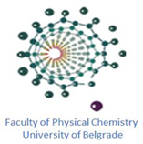


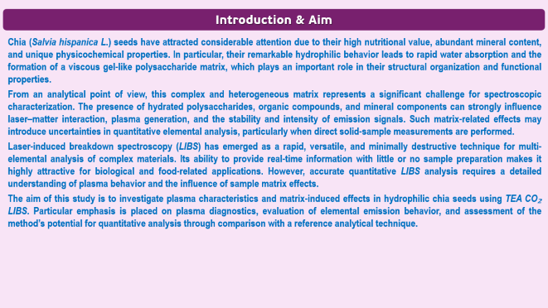
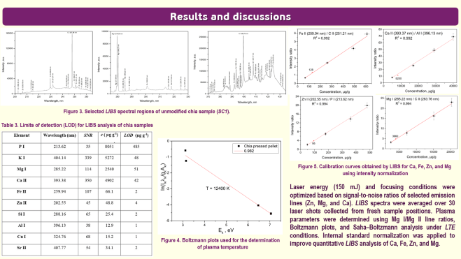
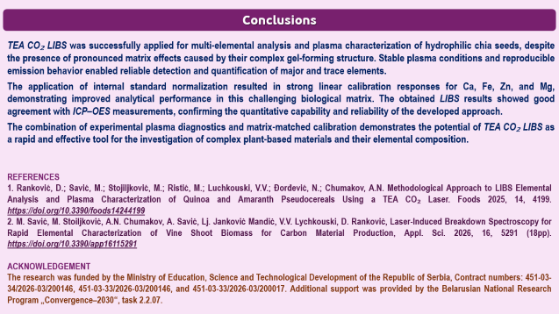

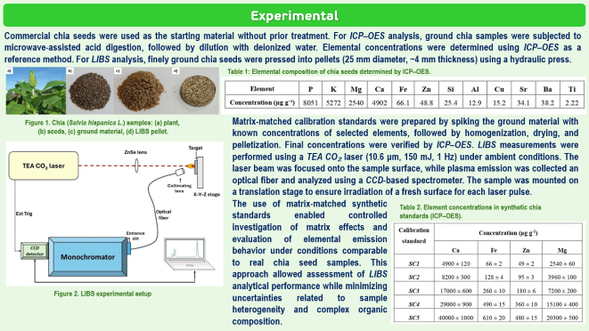
28th Congress of SCTM, 23-26 September, Ohrid, Macedonia
000
Plasma Characterization and Matrix Effects in Hydrophilic Chia Seeds Studied by TEA CO2 Laser-Induced Breakdown Spectroscopy
Dragan Ranković ¹, Marjetka Savić ¹, Aleksandra Šajić ², Milovan Stoiljković ¹, Aleksandr N. Chumakov ³, Аndrija Savić ¹, Slađana Meseldžija ¹
¹ VINCA Institute of Nuclear Sciences - National Institute of the Republic of Serbia, University of Belgrade, Mike Alasa 12-14, 11001 Belgrade, Serbia
dragan.rankovic@vin.bg.ac.rs
² Faculty for Physical Chemistry, University of Belgrade, Studentski trg 12, 11158 Belgrade, Serbia
³ B. I. Stepanov Institute of Physics, National Academy of Sciences of Belarus, Nezalezhnasci Ave. 68-2, 220072 Minsk, Belarus

Slide 2
Introduction & Aim
Chia (Salvia hispanica L.) seeds have attracted considerable attention due to their high nutritional value, abundant mineral content, and unique physicochemical properties. In particular, their remarkable hydrophilic behavior leads to rapid water absorption and the formation of a viscous gel-like polysaccharide matrix, which plays an important role in their structural organization and functional properties.
From an analytical point of view, this complex and heterogeneous matrix represents a significant challenge for spectroscopic characterization. The presence of hydrated polysaccharides, organic compounds, and mineral components can strongly influence laser–matter interaction, plasma generation, and the stability and intensity of emission signals. Such matrix-related effects may introduce uncertainties in quantitative elemental analysis, particularly when direct solid-sample measurements are performed.
Laser-induced breakdown spectroscopy (LIBS) has emerged as a rapid, versatile, and minimally destructive technique for multi-elemental analysis of complex materials. Its ability to provide real-time information with little or no sample preparation makes it highly attractive for biological and food-related applications. However, accurate quantitative LIBS analysis requires a detailed understanding of plasma behavior and the influence of sample matrix effects.
The aim of this study is to investigate plasma characteristics and matrix-induced effects in hydrophilic chia seeds using TEA CO₂ LIBS. Particular emphasis is placed on plasma diagnostics, evaluation of elemental emission behavior, and assessment of the method’s potential for quantitative analysis through comparison with a reference analytical technique.

Slide 3
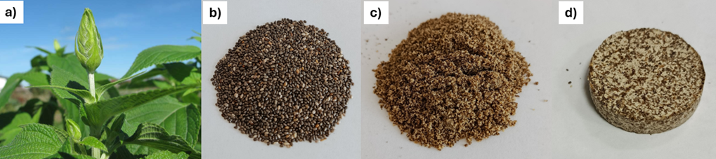
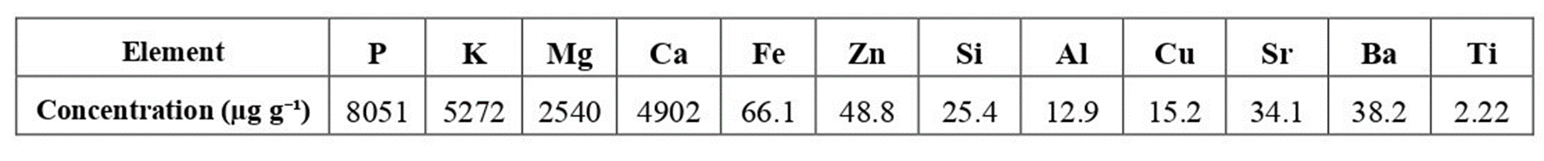
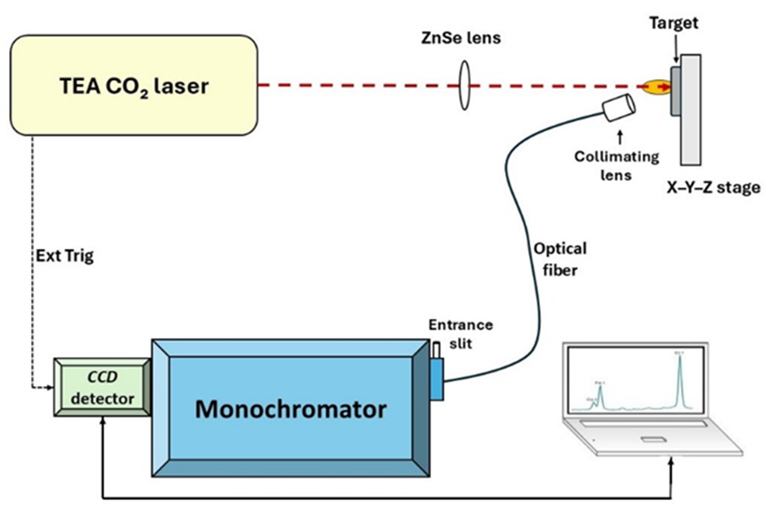
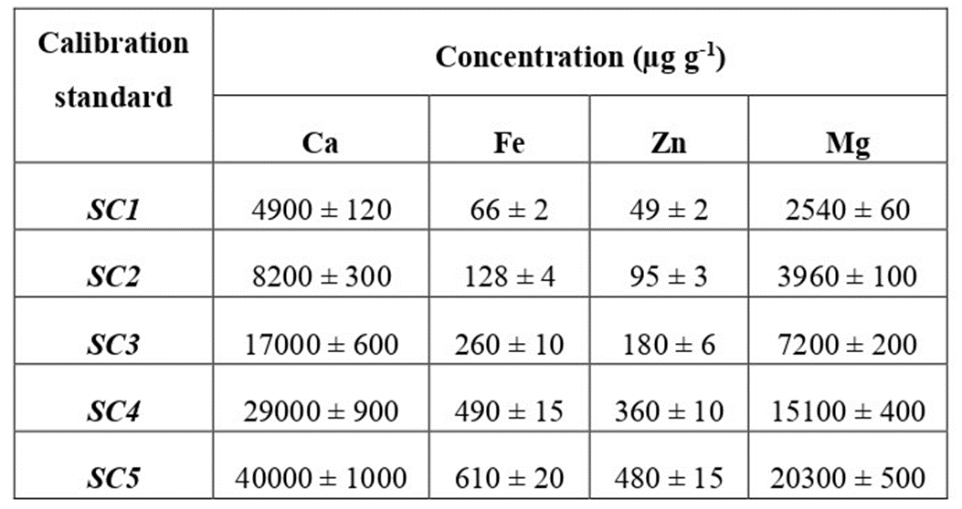
Experimental
Commercial chia seeds were used as the starting material without prior treatment. For ICP–OES analysis, ground chia samples were subjected to microwave-assisted acid digestion, followed by dilution with deionized water. Elemental concentrations were determined using ICP–OES as a reference method. For LIBS analysis, finely ground chia seeds were pressed into pellets (25 mm diameter, ~4 mm thickness) using a hydraulic press.
Table 1: Elemental composition of chia seeds determined by ICP–OES.
Figure 1. Chia (Salvia hispanica L.) samples: (a) plant,
(b) seeds, (c) ground material, (d) LIBS pellet.
Matrix-matched calibration standards were prepared by spiking the ground material with known concentrations of selected elements, followed by homogenization, drying, and pelletization. Final concentrations were verified by ICP–OES. LIBS measurements were performed using a TEA CO₂ laser (10.6 μm, 150 mJ, 1 Hz) under ambient conditions. The laser beam was focused onto the sample surface, while plasma emission was collected an optical fiber and analyzed using a CCD-based spectrometer. The sample was mounted on a translation stage to ensure irradiation of a fresh surface for each laser pulse.
The use of matrix-matched synthetic standards enabled controlled investigation of matrix effects and evaluation of elemental emission behavior under conditions comparable to real chia seed samples. This approach allowed assessment of LIBS analytical performance while minimizing uncertainties related to sample heterogeneity and complex organic composition.
Table 2. Element concentrations in synthetic chia standards (ICP–OES).
Figure 2. LIBS experimental setup

Slide 4
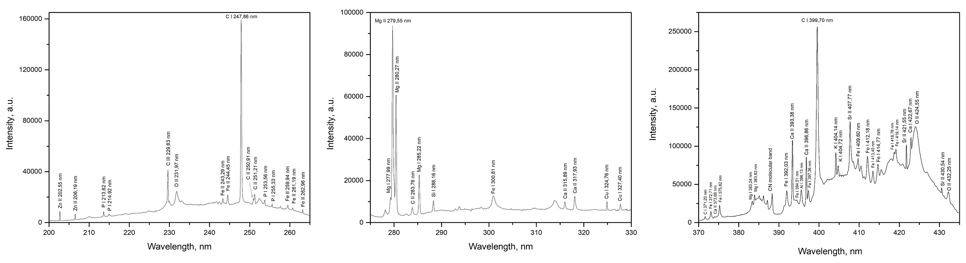
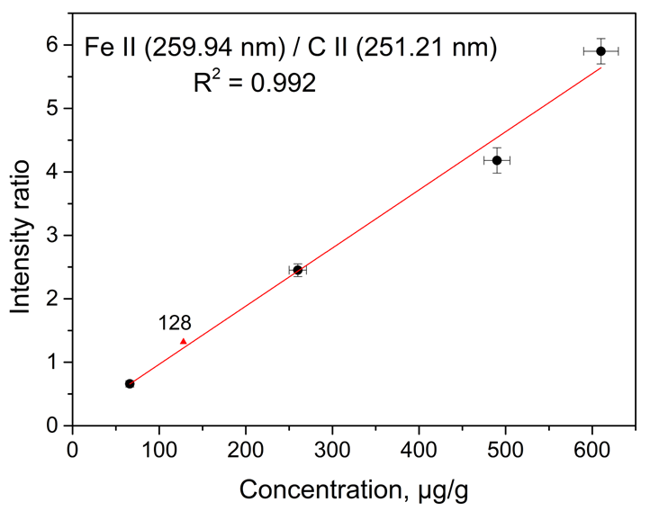
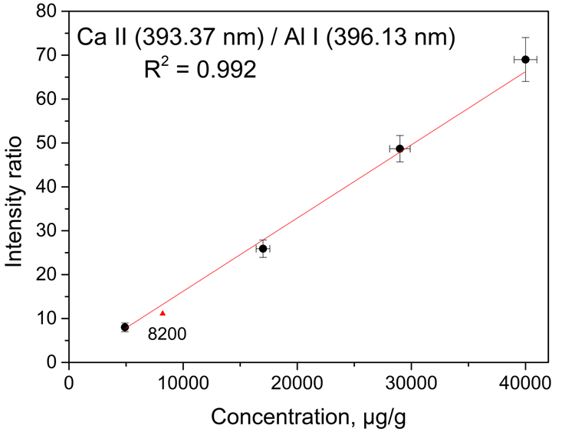
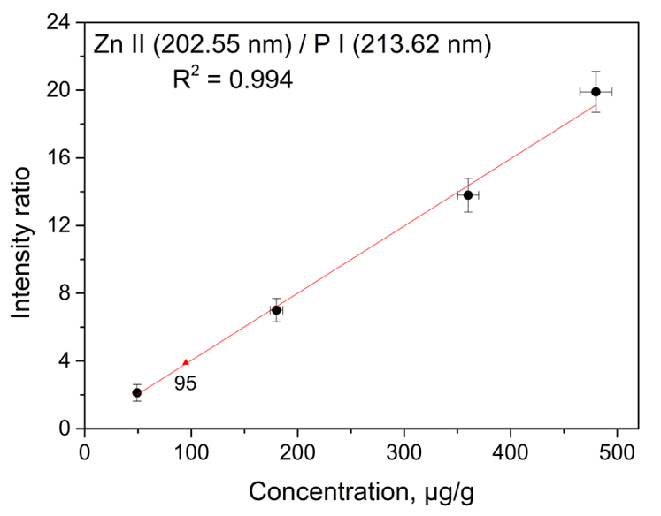
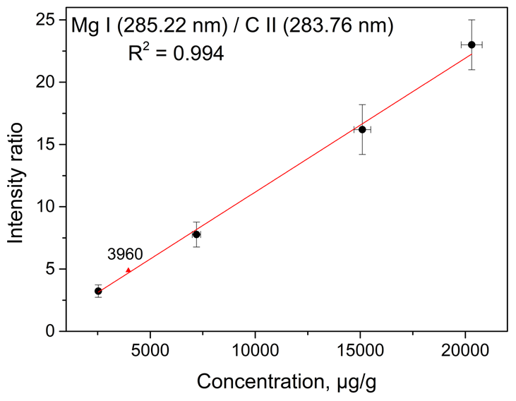
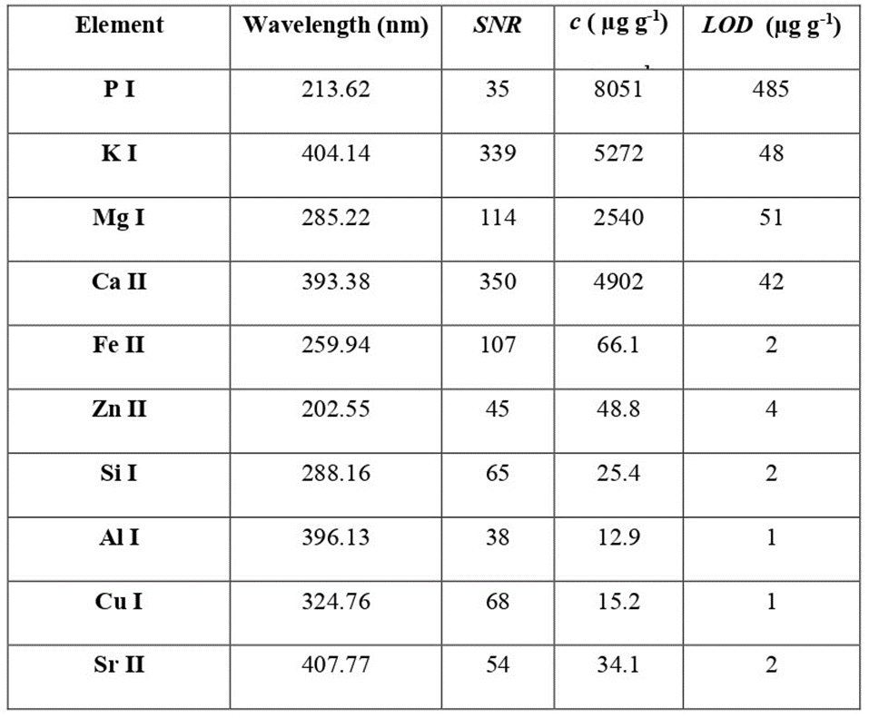
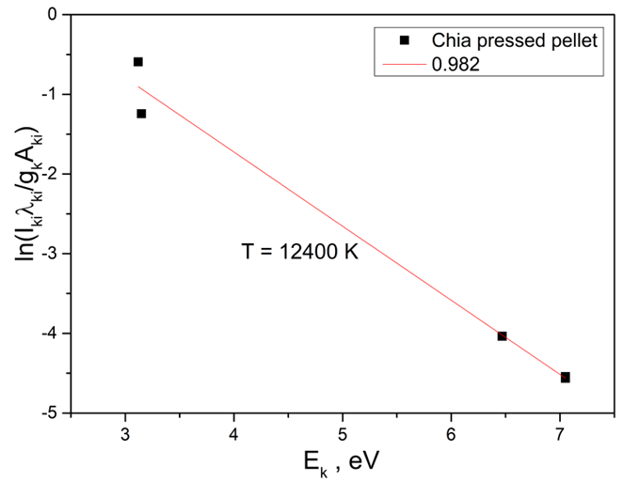
Results and discussions
Figure 3. Selected LIBS spectral regions of unmodified chia sample (SC1).
Table 3. Limits of detection (LOD) for LIBS analysis of chia samples
Figure 5. Calibration curves obtained by LIBS for Ca, Fe, Zn, and Mg
using intensity normalization
Laser energy (150 mJ) and focusing conditions were optimized based on signal-to-noise ratios of selected emission lines (Zn, Mg, and Ca). LIBS spectra were averaged over 30 laser shots collected from fresh sample positions. Plasma parameters were determined using Mg I/Mg II line ratios, Boltzmann plots, and Saha–Boltzmann analysis under LTE conditions. Internal standard normalization was applied to improve quantitative LIBS analysis of Ca, Fe, Zn, and Mg.
Figure 4. Boltzmann plots used for the determination
of plasma temperature

Slide 5
Conclusions
TEA CO₂ LIBS was successfully applied for multi-elemental analysis and plasma characterization of hydrophilic chia seeds, despite the presence of pronounced matrix effects caused by their complex gel-forming structure. Stable plasma conditions and reproducible emission behavior enabled reliable detection and quantification of major and trace elements.
The application of internal standard normalization resulted in strong linear calibration responses for Ca, Fe, Zn, and Mg, demonstrating improved analytical performance in this challenging biological matrix. The obtained LIBS results showed good agreement with ICP–OES measurements, confirming the quantitative capability and reliability of the developed approach.
The combination of experimental plasma diagnostics and matrix-matched calibration demonstrates the potential of TEA CO₂ LIBS as a rapid and effective tool for the investigation of complex plant-based materials and their elemental composition.
REFERENCES
1. Ranković, D.; Savić, M.; Stojiljković, M.; Ristić, M.; Luchkouski, V.V.; Đorđević, N.; Chumakov, A.N. Methodological Approach to LIBS Elemental Analysis and Plasma Characterization of Quinoa and Amaranth Pseudocereals Using a TEA CO₂ Laser. Foods 2025, 14, 4199. https://doi.org/10.3390/foods14244199
2. M. Savić, M. Stoiljković, A.N. Chumakov, A. Savić, Lj. Janković Mandić, V.V. Lychkouski, D. Ranković, Laser-Induced Breakdown Spectroscopy for Rapid Elemental Characterization of Vine Shoot Biomass for Carbon Material Production, Appl. Sci. 2026, 16, 5291 (18pp). https://doi.org/10.3390/app16115291
ACKNOWLEDGEMENT
The research was funded by the Ministry of Education, Science and Technological Development of the Republic of Serbia, Contract numbers: 451-03-34/2026-03/200146, 451-03-33/2026-03/200146, and 451-03-33/2026-03/200017. Additional support was provided by the Belarusian National Research Program „Convergence–2030“, task 2.2.07.

