Slide 1




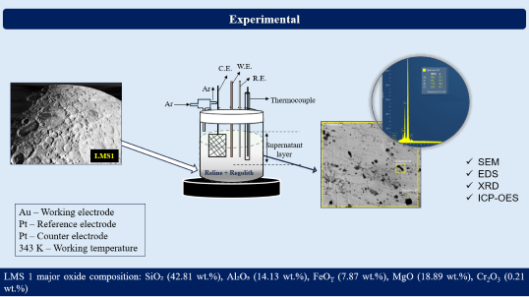
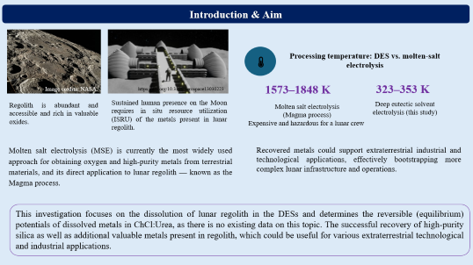
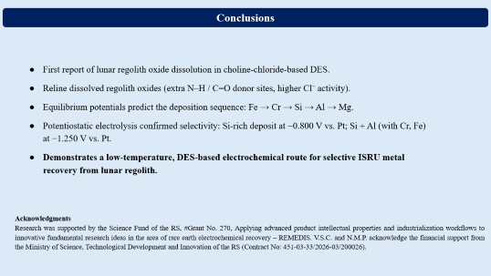
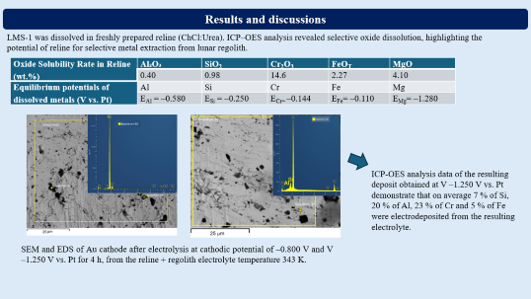

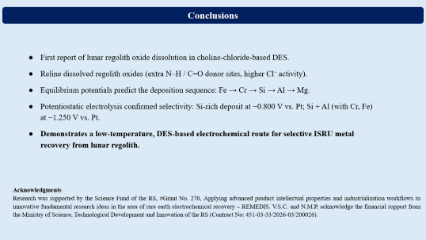
28th Congress of SCTM, 23-26 September, Ohrid, Macedonia
000
Electrodeposition of Metals from Lunar Regolith Dissolved in Reline
Vesna S. Cvetković¹, Nataša M. Petrović¹, Ksenija Milicevic Neumann², Bernd Friedrich³, Jovan N. Jovićević¹
¹Department of Electrochemistry, Institute of Chemistry, Technology and Metallurgy, National Institute of the RS, University of Belgrade, Serbia; v.cvetkovic@ihtm.bg.ac.rs; ²CEOS UG, Munich, Germany; ³IME Process Metallurgy and Metal Recycling, RWTH Aachen University, Intzestrasse 3, 52056 Aachen, Germany

Slide 2
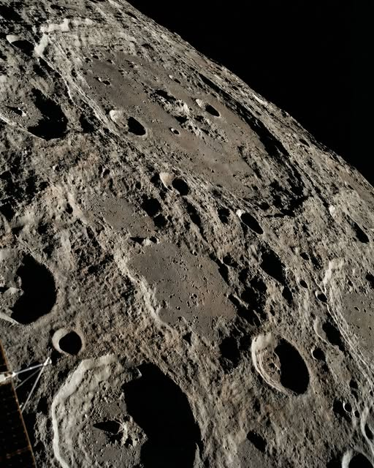


Introduction & Aim
Processing temperature: DES vs. molten-salt electrolysis
Image credits: NASA.
https://doi.org/10.3390/aerospace13030223
1573–1848 K
323–353 K
Regolith is abundant and accessible and rich in valuable oxides.
Sustained human presence on the Moon requires in situ resource utilization (ISRU) of the metals present in lunar regolith.
Deep eutectic solvent
electrolysis (this study)
Molten salt electrolysis
(Magma process)
Expensive and hazardous for a lunar crew
Molten salt electrolysis (MSE) is currently the most widely used approach for obtaining oxygen and high-purity metals from terrestrial materials, and its direct application to lunar regolith — known as the Magma process.
Recovered metals could support extraterrestrial industrial and technological applications, effectively bootstrapping more complex lunar infrastructure and operations.
This investigation focuses on the dissolution of lunar regolith in the DESs and determines the reversible (equilibrium) potentials of dissolved metals in ChCl:Urea, as there is no existing data on this topic. The successful recovery of high-purity silica as well as additional valuable metals present in regolith, which could be useful for various extraterrestrial technological and industrial applications.

Slide 3
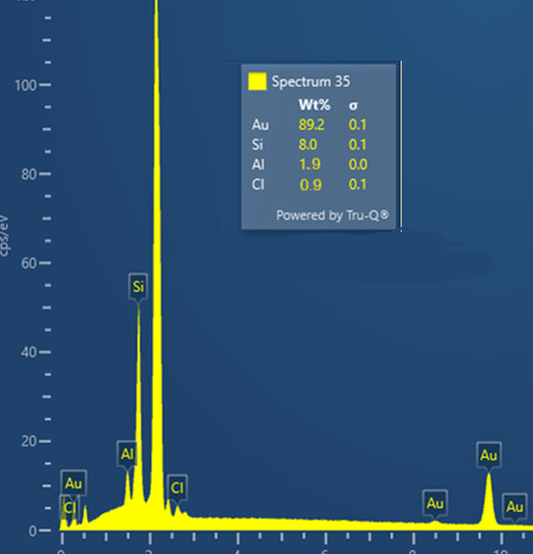
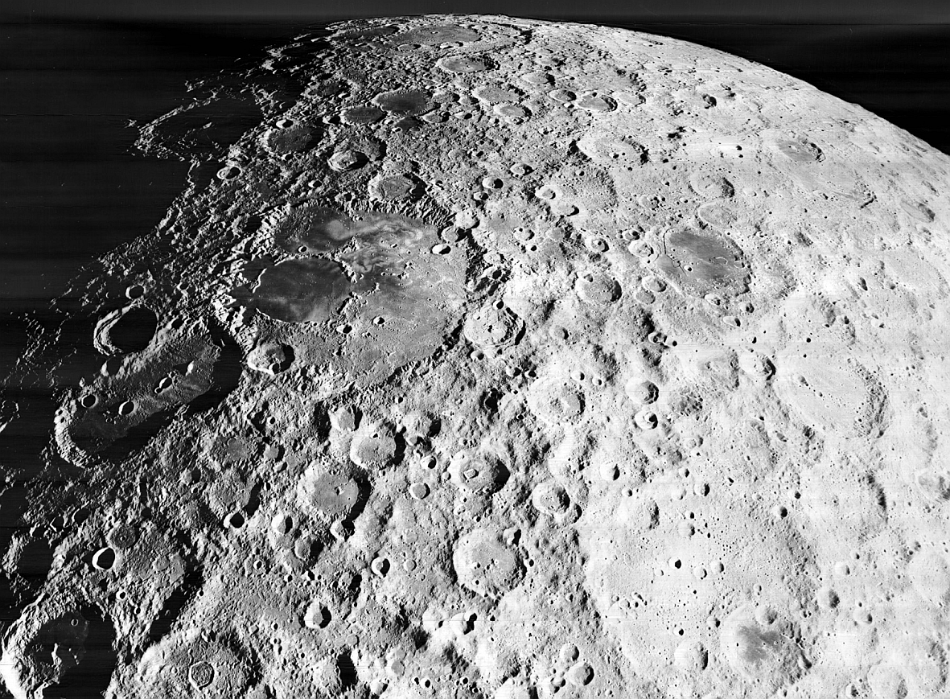
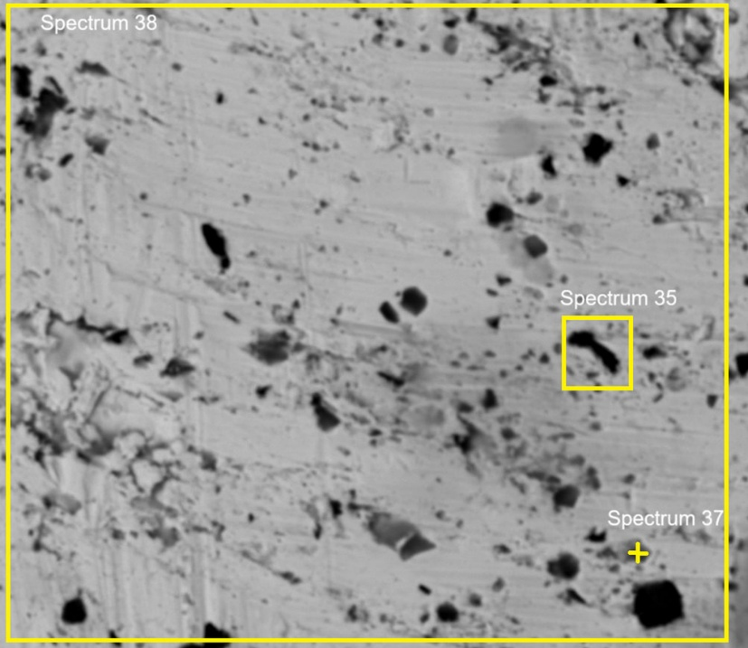
Experimental
C.E.
W.E.
R.E.
Ar
Ar
Thermocouple
Supernatant
layer
LMS1
SEM
EDS
XRD
ICP-OES
Reline + Regolith
Au – Working electrode
Pt – Reference electrode
Pt – Counter electrode
343 K – Working temperature
LMS 1 major oxide composition: SiO₂ (42.81 wt.%), Al₂O₃ (14.13 wt.%), FeO_{T} (7.87 wt.%), MgO (18.89 wt.%), Cr₂O₃ (0.21 wt.%)

Slide 4
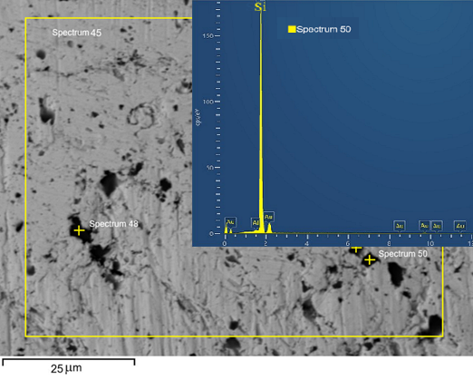
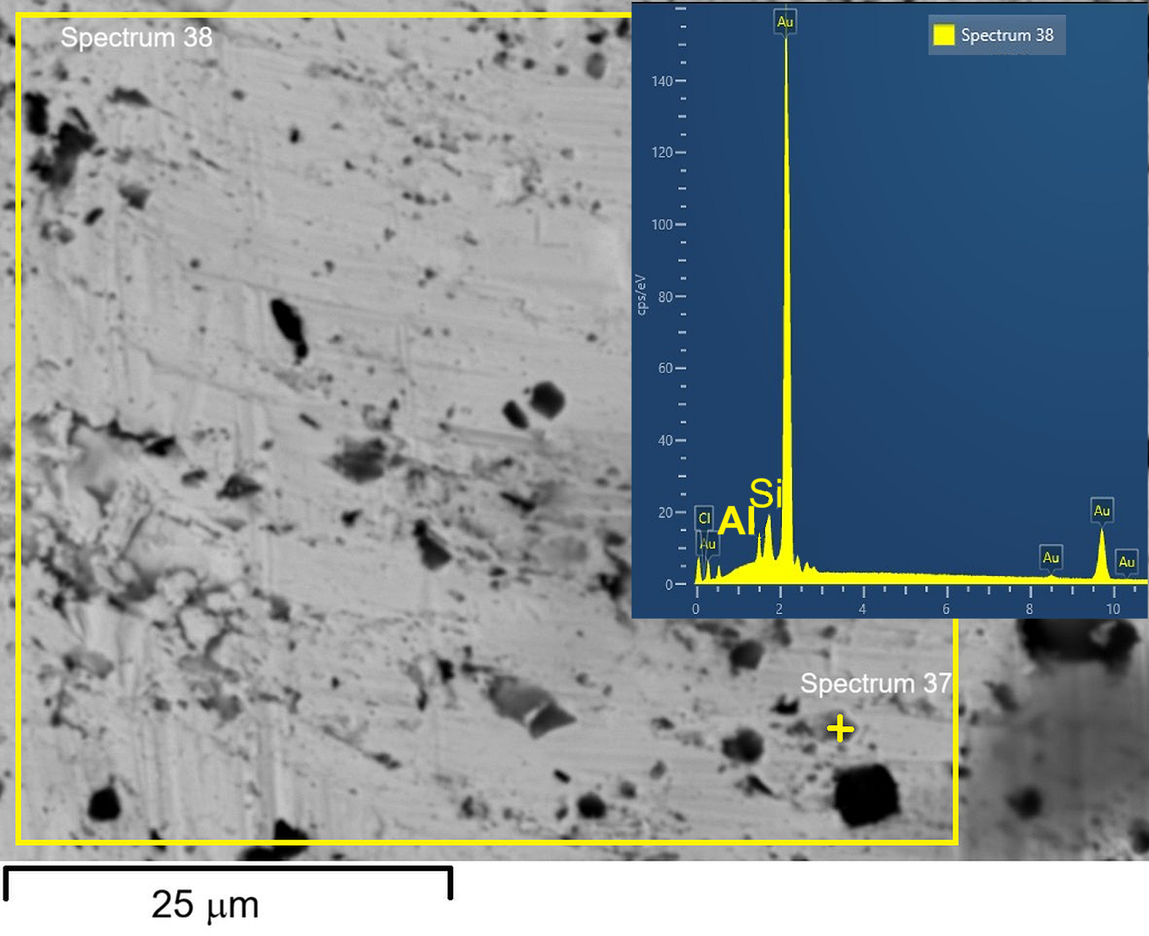
Results and discussions
LMS-1 was dissolved in freshly prepared reline (ChCl:Urea). ICP–OES analysis revealed selective oxide dissolution, highlighting the potential of reline for selective metal extraction from lunar regolith.
Oxide Solubility Rate in Reline (wt.%) | Al₂O₃ | SiO₂ | Cr₂O₃ | FeO_{T} | MgO
 | 0.40 | 0.98 | 14.6 | 2.27 | 4.10
Equilibrium potentials of dissolved metals (V vs. Pt) | Al | Si | Cr | Fe | Mg
 | E_{Al} = –0.580 | E_{Si} = –0.250 | E_{Cr=} –0.144 | E_{Fe}= –0.110 | E_{Mg}= –1.280
ICP-OES analysis data of the resulting deposit obtained at V –1.250 V vs. Pt demonstrate that on average 7 % of Si, 20 % of Al, 23 % of Cr and 5 % of Fe were electrodeposited from the resulting electrolyte.
SEM and EDS of Au cathode after electrolysis at cathodic potential of –0.800 V and V –1.250 V vs. Pt for 4 h, from the reline + regolith electrolyte, temperature 343 K.

Slide 5
Conclusions
First report of lunar regolith oxide dissolution in choline-chloride-based DES.
Reline dissolved regolith oxides (extra N–H / C=O donor sites, higher Cl⁻ activity).
Equilibrium potentials predict the deposition sequence: Fe → Cr → Si → Al → Mg.
Potentiostatic electrolysis confirmed selectivity: Si-rich deposit at −0.800 V vs. Pt; Si + Al (with Cr, Fe) at −1.250 V vs. Pt.
Demonstrates a low-temperature, DES-based electrochemical route for selective ISRU metal recovery from lunar regolith.
Acknowledgments
Research was supported by the Science Fund of the RS, #Grant No. 270, Applying advanced product intellectual properties and industrialization workflows to innovative fundamental research ideas in the area of rare earth electrochemical recovery – REMEDIS. V.S.C. and N.M.P. acknowledge the financial support from the Ministry of Science, Technological Development and Innovation of the RS (Contract No: 451-03-33/2026-03/200026).

