Slide 1




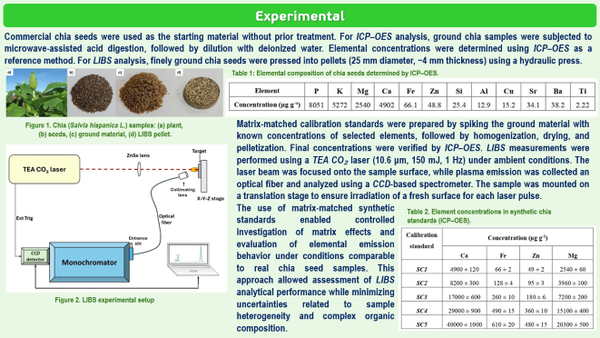
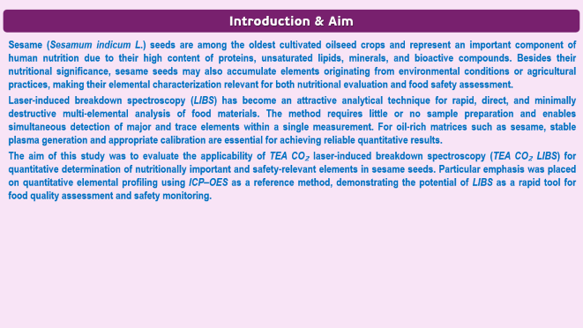
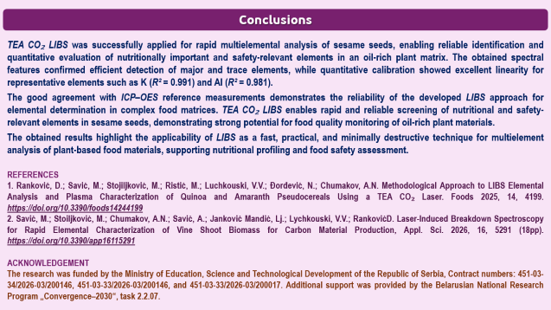
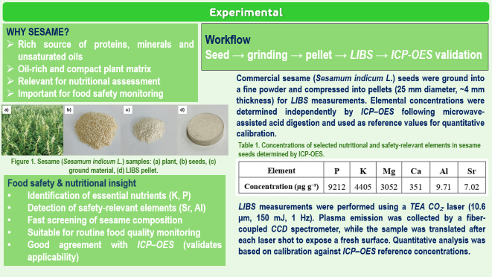

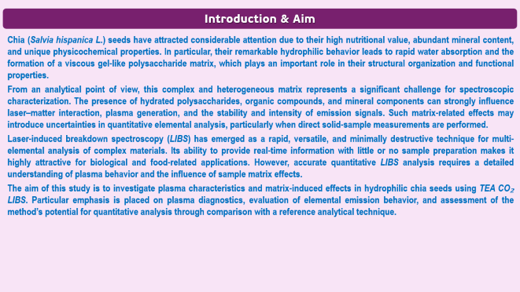
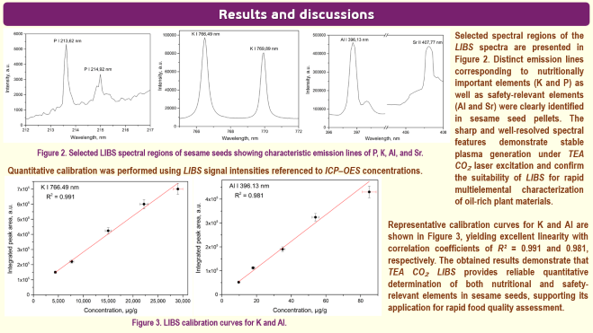
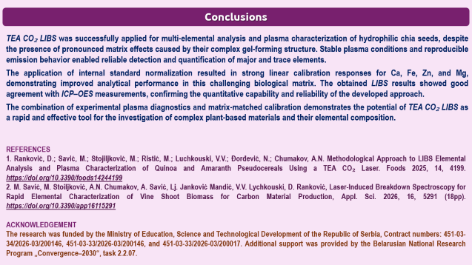
28th Congress of SCTM, 23-26 September, Ohrid, Macedonia
000
Quantitative Evaluation of Nutritional and Safety-Relevant Elements
in Sesame Seeds Using LIBS
Marjetka Savić ¹, Dragan Ranković ¹, Aleksandra Šajić ², Aleksandr N. Chumakov ³, Аndrija Savić ¹, Slađana Meseldžija ¹, Valentina Vukobrat ¹
¹ VINCA Institute of Nuclear Sciences - National Institute of the Republic of Serbia, University of Belgrade, Mike Alasa 12-14, 11001 Belgrade, Serbia
metk@vin.bg.ac.rs
² Faculty for Physical Chemistry, University of Belgrade, Studentski trg 12, 11158 Belgrade, Serbia
³ B. I. Stepanov Institute of Physics, National Academy of Sciences of Belarus, Nezalezhnasci Ave. 68-2, 220072 Minsk, Belarus

Slide 2
Introduction & Aim
Sesame (Sesamum indicum L.) seeds are among the oldest cultivated oilseed crops and represent an important component of human nutrition due to their high content of proteins, unsaturated lipids, minerals, and bioactive compounds. Besides their nutritional significance, sesame seeds may also accumulate elements originating from environmental conditions or agricultural practices, making their elemental characterization relevant for both nutritional evaluation and food safety assessment.
Laser-induced breakdown spectroscopy (LIBS) has become an attractive analytical technique for rapid, direct, and minimally destructive multi-elemental analysis of food materials. The method requires little or no sample preparation and enables simultaneous detection of major and trace elements within a single measurement. For oil-rich matrices such as sesame, stable plasma generation and appropriate calibration are essential for achieving reliable quantitative results.
The aim of this study was to evaluate the applicability of TEA CO₂ laser-induced breakdown spectroscopy (TEA CO₂ LIBS) for quantitative determination of nutritionally important and safety-relevant elements in sesame seeds. Particular emphasis was placed on quantitative elemental profiling using ICP–OES as a reference method, demonstrating the potential of LIBS as a rapid tool for food quality assessment and safety monitoring.

Slide 3
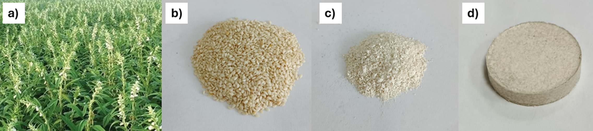
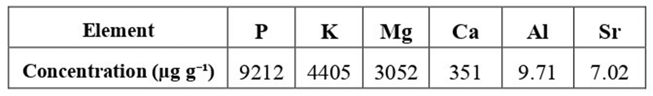
Experimental
WHY SESAME?
Rich source of proteins, minerals and unsaturated oils
Oil-rich and compact plant matrix
Relevant for nutritional assessment
Important for food safety monitoring
Workflow
Seed → grinding → pellet → LIBS → ICP-OES validation
Commercial sesame (Sesamum indicum L.) seeds were ground into a fine powder and compressed into pellets (25 mm diameter, ~4 mm thickness) for LIBS measurements. Elemental concentrations were determined independently by ICP–OES following microwave-assisted acid digestion and used as reference values for quantitative calibration.
Table 1. Concentrations of selected nutritional and safety-relevant elements in sesame seeds determined by ICP-OES.
Figure 1. Sesame (Sesamum indicum L.) samples: (a) plant, (b) seeds, (c) ground material, (d) LIBS pellet.
Food safety & nutritional insight
Identification of essential nutrients (K, P)
Detection of safety-relevant elements (Sr, Al)
Fast screening of sesame composition
Suitable for routine food quality monitoring
Good agreement with ICP–OES (validates applicability)
LIBS measurements were performed using a TEA CO₂ laser (10.6 μm, 150 mJ, 1 Hz). Plasma emission was collected by a fiber-coupled CCD spectrometer, while the sample was translated after each laser shot to expose a fresh surface. Quantitative analysis was based on calibration against ICP–OES reference concentrations.

Slide 4
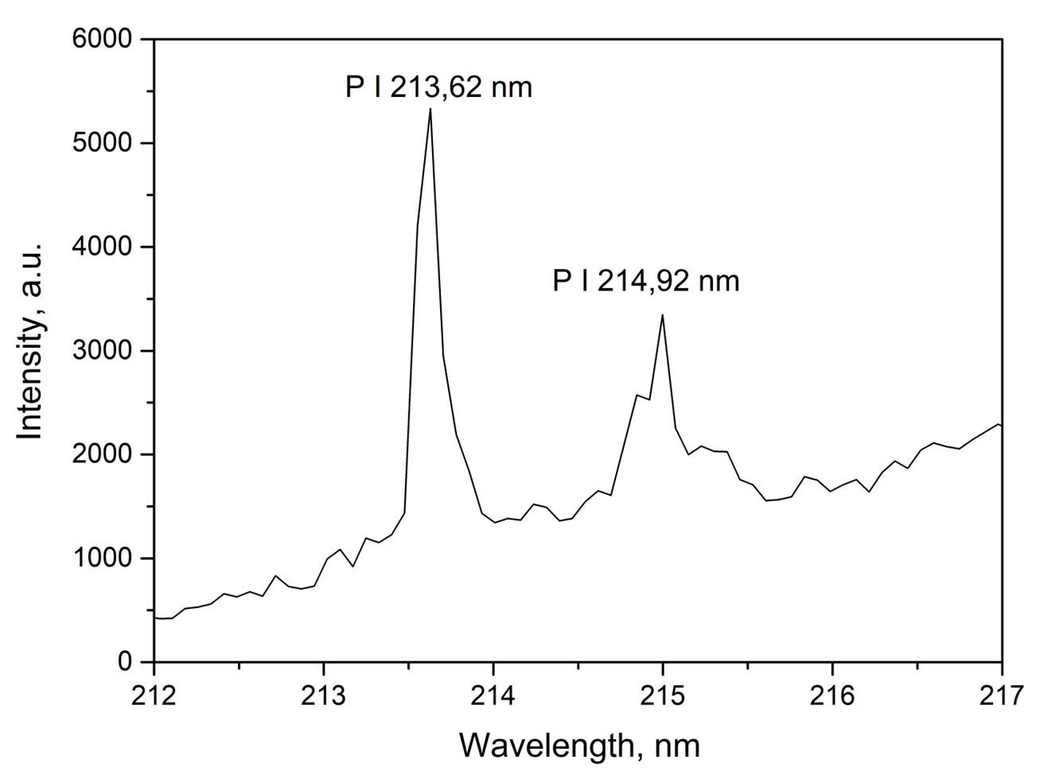
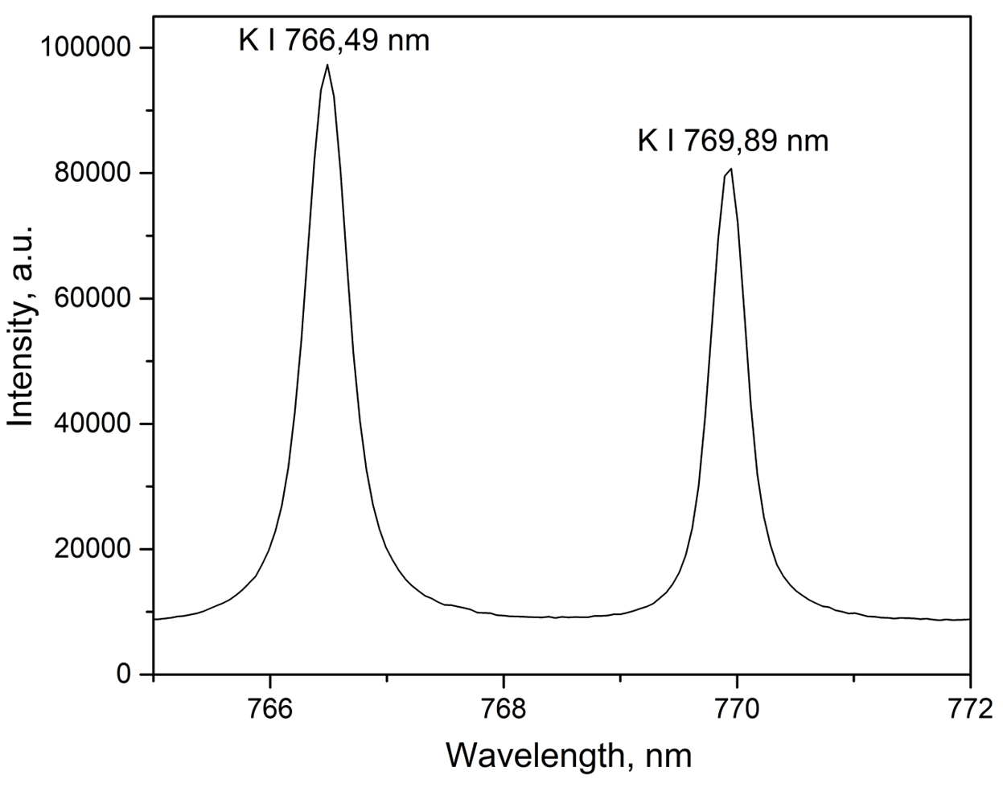
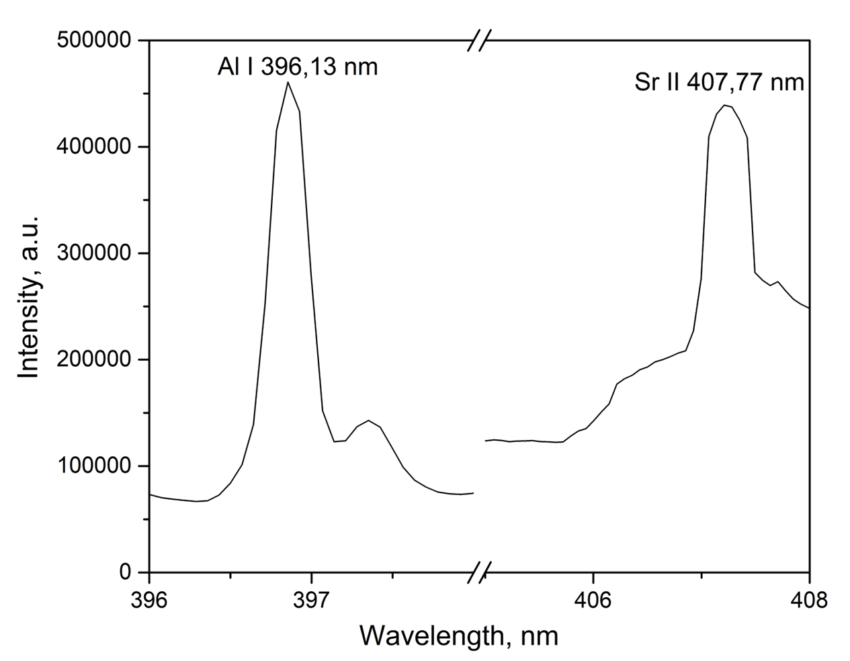
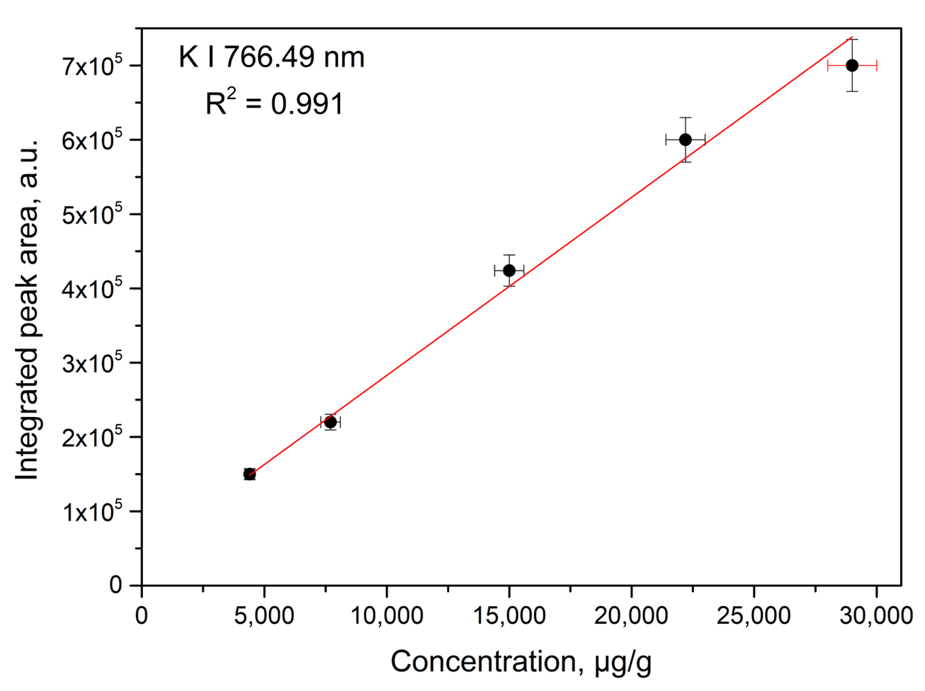
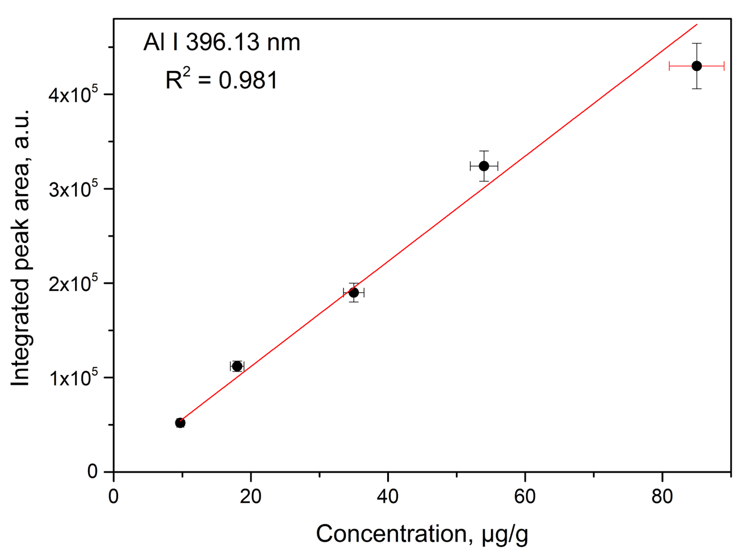
Results and discussions
Selected spectral regions of the LIBS spectra are presented in Figure 2. Distinct emission lines corresponding to nutritionally important elements (K and P) as well as safety-relevant elements (Al and Sr) were clearly identified in sesame seed pellets. The sharp and well-resolved spectral features demonstrate stable plasma generation under TEA CO₂ laser excitation and confirm the suitability of LIBS for rapid multielemental characterization of oil-rich plant materials.
Figure 2. Selected LIBS spectral regions of sesame seeds showing characteristic emission lines of P, К, Al, and Sr.
Quantitative calibration was performed using LIBS signal intensities referenced to ICP–OES concentrations.
Representative calibration curves for K and Al are shown in Figure 3, yielding excellent linearity with correlation coefficients of R² = 0.991 and 0.981, respectively. The obtained results demonstrate that TEA CO₂ LIBS provides reliable quantitative determination of both nutritional and safety-relevant elements in sesame seeds, supporting its application for rapid food quality assessment.
Figure 3. LIBS calibration curves for K and Al.

Slide 5
Conclusions
TEA CO₂ LIBS was successfully applied for rapid multielemental analysis of sesame seeds, enabling reliable identification and quantitative evaluation of nutritionally important and safety-relevant elements in an oil-rich plant matrix. The obtained spectral features confirmed efficient detection of major and trace elements, while quantitative calibration showed excellent linearity for representative elements such as K (R² = 0.991) and Al (R² = 0.981).
The good agreement with ICP–OES reference measurements demonstrates the reliability of the developed LIBS approach for elemental determination in complex food matrices. TEA CO₂ LIBS enables rapid and reliable screening of nutritional and safety-relevant elements in sesame seeds, demonstrating strong potential for food quality monitoring of oil-rich plant materials.
The obtained results highlight the applicability of LIBS as a fast, practical, and minimally destructive technique for multielement analysis of plant-based food materials, supporting nutritional profiling and food safety assessment.
REFERENCES
1. Ranković, D.; Savić, M.; Stojiljković, M.; Ristić, M.; Luchkouski, V.V.; Đorđević, N.; Chumakov, A.N. Methodological Approach to LIBS Elemental Analysis and Plasma Characterization of Quinoa and Amaranth Pseudocereals Using a TEA CO₂ Laser. Foods 2025, 14, 4199. https://doi.org/10.3390/foods14244199
2. Savić, M.; Stoiljković, М.; Chumakov, A.N.; Savić, А.; Janković Mandić, Lj.; Lychkouski, V.V.; RankovićD. Laser-Induced Breakdown Spectroscopy for Rapid Elemental Characterization of Vine Shoot Biomass for Carbon Material Production, Appl. Sci. 2026, 16, 5291 (18pp). https://doi.org/10.3390/app16115291
ACKNOWLEDGEMENT
The research was funded by the Ministry of Education, Science and Technological Development of the Republic of Serbia, Contract numbers: 451-03-34/2026-03/200146, 451-03-33/2026-03/200146, and 451-03-33/2026-03/200017. Additional support was provided by the Belarusian National Research Program „Convergence–2030“, task 2.2.07.

