Slide 1



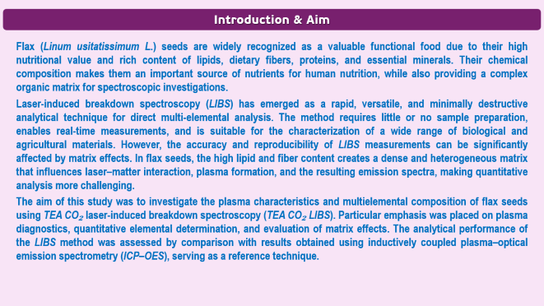
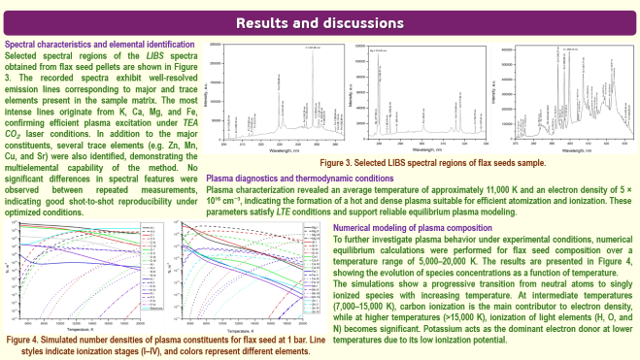
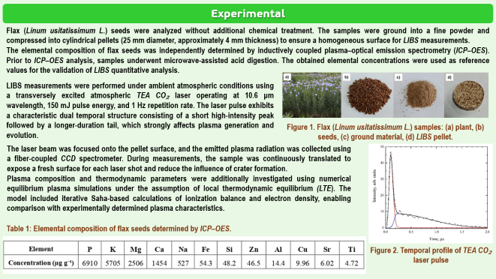
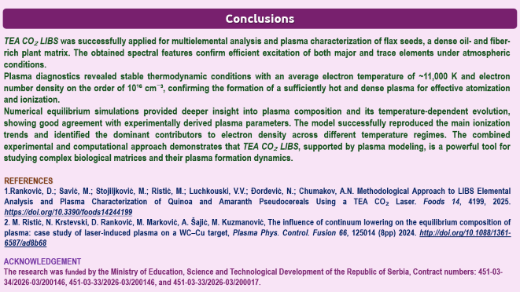
28th Congress of SCTM, 23-26 September, Ohrid, Macedonia
000
Plasma Properties and Multielemental Profiling of Flax
Seeds via TEA CO2 LIBS
Dragan Ranković ¹, Milovan Stoiljković ¹, Marjetka Savić ¹, Ljiljana Janković Mandić ¹, Miroslav Ristić ², Аndrija Savić ¹, Aleksandra Šajić²
¹ VINCA Institute of Nuclear Sciences - National Institute of the Republic of Serbia, University of Belgrade, Mike Alasa 12-14, 11001 Belgrade, Serbia
dragan.rankovic@vin.bg.ac.rs
² Faculty for Physical Chemistry, University of Belgrade, Studentski trg 12, 11158 Belgrade, Serbia

Slide 2
Introduction & Aim
Flax (Linum usitatissimum L.) seeds are widely recognized as a valuable functional food due to their high nutritional value and rich content of lipids, dietary fibers, proteins, and essential minerals. Their chemical composition makes them an important source of nutrients for human nutrition, while also providing a complex organic matrix for spectroscopic investigations.
Laser-induced breakdown spectroscopy (LIBS) has emerged as a rapid, versatile, and minimally destructive analytical technique for direct multi-elemental analysis. The method requires little or no sample preparation, enables real-time measurements, and is suitable for the characterization of a wide range of biological and agricultural materials. However, the accuracy and reproducibility of LIBS measurements can be significantly affected by matrix effects. In flax seeds, the high lipid and fiber content creates a dense and heterogeneous matrix that influences laser–matter interaction, plasma formation, and the resulting emission spectra, making quantitative analysis more challenging.
The aim of this study was to investigate the plasma characteristics and multielemental composition of flax seeds using TEA CO₂ laser-induced breakdown spectroscopy (TEA CO₂ LIBS). Particular emphasis was placed on plasma diagnostics, quantitative elemental determination, and evaluation of matrix effects. The analytical performance of the LIBS method was assessed by comparison with results obtained using inductively coupled plasma–optical emission spectrometry (ICP–OES), serving as a reference technique.

Slide 3
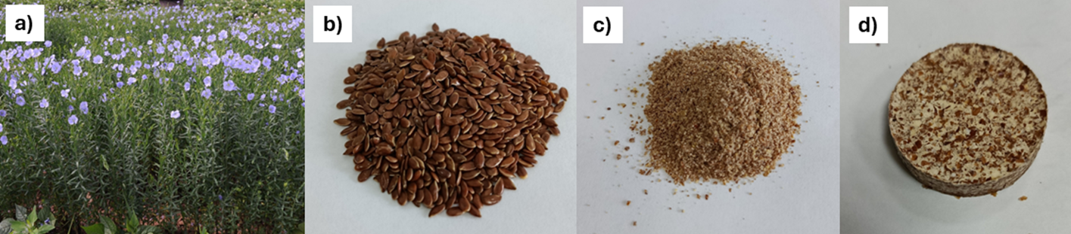
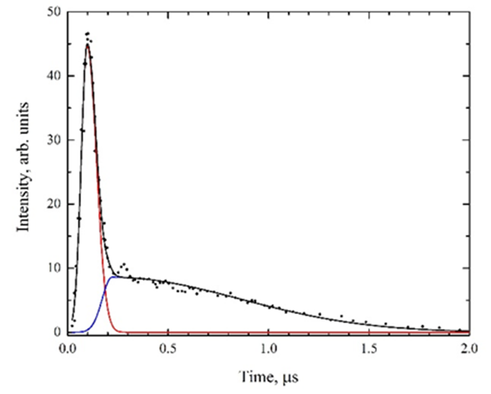
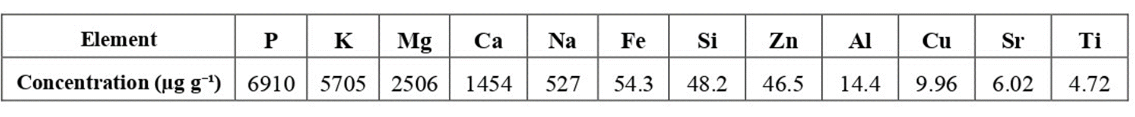
Experimental
Flax (Linum usitatissimum L.) seeds were analyzed without additional chemical treatment. The samples were ground into a fine powder and compressed into cylindrical pellets (25 mm diameter, approximately 4 mm thickness) to ensure a homogeneous surface for LIBS measurements.
The elemental composition of flax seeds was independently determined by inductively coupled plasma–optical emission spectrometry (ICP–OES). Prior to ICP–OES analysis, samples underwent microwave-assisted acid digestion. The obtained elemental concentrations were used as reference values for the validation of LIBS quantitative analysis.
LIBS measurements were performed under ambient atmospheric conditions using a transversely excited atmospheric TEA CO₂ laser operating at 10.6 μm wavelength, 150 mJ pulse energy, and 1 Hz repetition rate. The laser pulse exhibits a characteristic dual temporal structure consisting of a short high-intensity peak followed by a longer-duration tail, which strongly affects plasma generation and evolution.
Figure 1. Flax (Linum usitatissimum L.) samples: (a) plant, (b) seeds, (c) ground material, (d) LIBS pellet.
The laser beam was focused onto the pellet surface, and the emitted plasma radiation was collected using a fiber-coupled CCD spectrometer. During measurements, the sample was continuously translated to expose a fresh surface for each laser shot and reduce the influence of crater formation.
Plasma composition and thermodynamic parameters were additionally investigated using numerical equilibrium plasma simulations under the assumption of local thermodynamic equilibrium (LTE). The model included iterative Saha-based calculations of ionization balance and electron density, enabling comparison with experimentally determined plasma characteristics.
Table 1: Elemental composition of flax seeds determined by ICP–OES.
Figure 2. Temporal profile of TEA CO₂ laser pulse

Slide 4
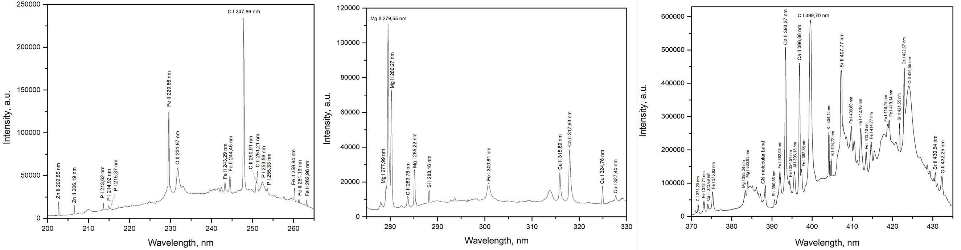
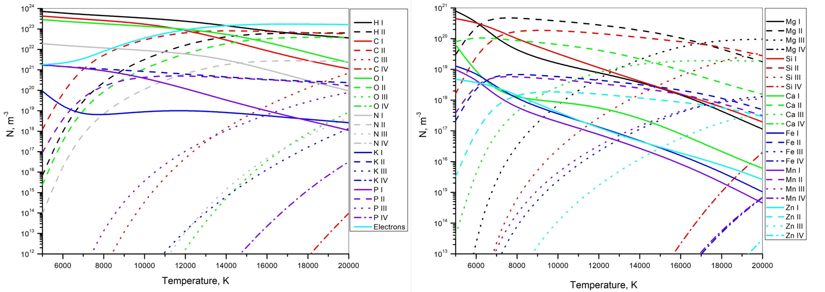
Results and discussions
Spectral characteristics and elemental identification
Selected spectral regions of the LIBS spectra obtained from flax seed pellets are shown in Figure 3. The recorded spectra exhibit well-resolved emission lines corresponding to major and trace elements present in the sample matrix. The most intense lines originate from K, Ca, Mg, and Fe, confirming efficient plasma excitation under TEA CO₂ laser conditions. In addition to the major constituents, several trace elements (e.g. Zn, Mn, Cu, and Sr) were also identified, demonstrating the multielemental capability of the method. No significant differences in spectral features were observed between repeated measurements, indicating good shot-to-shot reproducibility under optimized conditions.
Figure 3. Selected LIBS spectral regions of flax seeds sample.
Plasma diagnostics and thermodynamic conditions
Plasma characterization revealed an average temperature of approximately 11,000 K and an electron density of 5 × 10¹⁶ cm⁻³, indicating the formation of a hot and dense plasma suitable for efficient atomization and ionization. These parameters satisfy LTE conditions and support reliable equilibrium plasma modeling.
Numerical modeling of plasma composition
To further investigate plasma behavior under experimental conditions, numerical equilibrium calculations were performed for flax seed composition over a temperature range of 5,000–20,000 K. The results are presented in Figure 4, showing the evolution of species concentrations as a function of temperature.
Тhe simulations show a progressive transition from neutral atoms to singly ionized species with increasing temperature. At intermediate temperatures (7,000–15,000 K), carbon ionization is the main contributor to electron density, while at higher temperatures (>15,000 K), ionization of light elements (H, O, and N) becomes significant. Potassium acts as the dominant electron donor at lower temperatures due to its low ionization potential.
Figure 4. Simulated number densities of plasma constituents for flax seed at 1 bar. Line styles indicate ionization stages (I–IV), and colors represent different elements.

Slide 5
Conclusions
TEA CO₂ LIBS was successfully applied for multielemental analysis and plasma characterization of flax seeds, a dense oil- and fiber-rich plant matrix. The obtained spectral features confirm efficient excitation of both major and trace elements under atmospheric conditions.
Plasma diagnostics revealed stable thermodynamic conditions with an average electron temperature of ~11,000 K and electron number density on the order of 10¹⁶ cm⁻³, confirming the formation of a sufficiently hot and dense plasma for effective atomization and ionization.
Numerical equilibrium simulations provided deeper insight into plasma composition and its temperature-dependent evolution, showing good agreement with experimentally derived plasma parameters. The model successfully reproduced the main ionization trends and identified the dominant contributors to electron density across different temperature regimes. The combined experimental and computational approach demonstrates that TEA CO₂ LIBS, supported by plasma modeling, is a powerful tool for studying complex biological matrices and their plasma formation dynamics.
REFERENCES
Ranković, D.; Savić, M.; Stojiljković, M.; Ristić, M.; Luchkouski, V.V.; Đorđević, N.; Chumakov, A.N. Methodological Approach to LIBS Elemental Analysis and Plasma Characterization of Quinoa and Amaranth Pseudocereals Using a TEA CO₂ Laser. Foods 14, 4199, 2025. https://doi.org/10.3390/foods14244199
M. Ristić, N. Krstevski, D. Ranković, M. Marković, A. Šajić, M. Kuzmanović, The influence of continuum lowering on the equilibrium composition of plasma: case study of laser-induced plasma on a WC–Cu target, Plasma Phys. Control. Fusion 66, 125014 (8pp) 2024. http://doi.org/10.1088/1361-6587/ad8b68
ACKNOWLEDGEMENT
The research was funded by the Ministry of Education, Science and Technological Development of the Republic of Serbia, Contract numbers: 451-03-34/2026-03/200146, 451-03-33/2026-03/200146, and 451-03-33/2026-03/200017.

