Slide 1
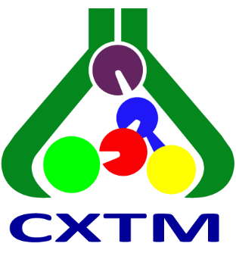



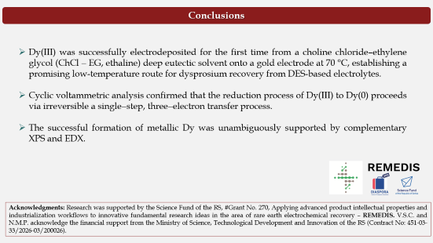
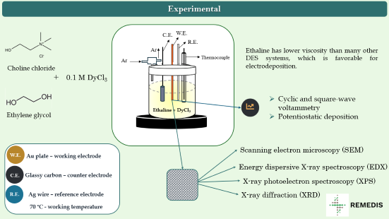


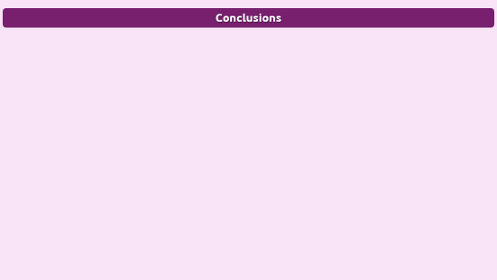
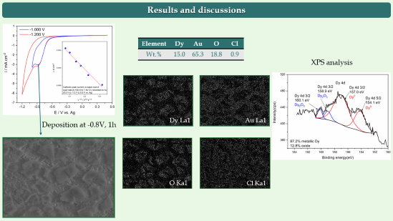
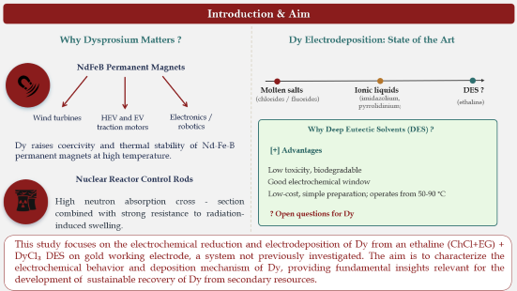

28th Congress of SCTM, 23-26 September, Ohrid, Macedonia
000
Deposition of Dysprosium from Ethaline deep eutectic solvent
Nataša M. Petrović¹, Vesna S. Cvetković¹, Branislava Vučetić², Jovan N. Jovićević¹
¹Department of Electrochemistry, Institute of Chemistry, Technology and Metallurgy, National Institute of the RS, University of Belgrade, Serbia, vukicevic@ihtm.bg.ac.rs
²Faculty of Physics, University of Belgrade, Serbia

Slide 2


Introduction & Aim
Why Dysprosium Matters ?
Dy Electrodeposition: State of the Art
NdFeB Permanent Magnets
Molten salts
Ionic liquids
DES ?
(chlorides / fluorides)
(imidazolium, pyrrolidinium)
(ethaline)
Wind turbines
HEV and EV traction motors
Electronics / robotics
Why Deep Eutectic Solvents (DES) ?
Dy raises coercivity and thermal stability of Nd-Fe-B permanent magnets at high temperature.
[+] Advantages
Low toxicity, biodegradable
Good electrochemical window
Low-cost, simple preparation; operates from 50-90 °C
Nuclear Reactor Control Rods
High neutron absorption cross - section combined with strong resistance to radiation-induced swelling.
? Open questions for Dy
This study focuses on the electrochemical reduction and electrodeposition of Dy from an ethaline (ChCl+EG) + DyCl₃ DES on gold working electrode, a system not previously investigated. The aim is to characterize the electrochemical behavior and deposition mechanism of Dy, providing fundamental insights relevant for the development of sustainable recovery of Dy from secondary resources.

Slide 3
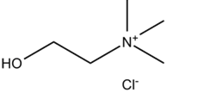




Experimental
W.E.
C.E.
W.E.
R.E.
Ar
Ethaline has lower viscosity than many other DES systems, which is favorable for electrodeposition.
Ar
Thermocouple
Choline chloride
+
0.1 M DyCl₃
Cyclic and square-wave voltammetry
Potentiostatic deposition
Ethylene glycol
Ethaline + DyCl₃
W.E.
Au plate – working electrode
Scanning electron microscopy (SEM)
Energy dispersive X-ray spectroscopy (EDX)
C.E.
Glassy carbon – counter electrode
X-ray photoelectron spectroscopy (XPS)
R.E.
Ag wire – reference electrode
X-ray diffraction (XRD)
70 °C - working temperature
Gamry Interface 1010E potentiostat/galvanostat with Echem Analyst software — CV, SWV, and potentiostatic electrodeposition, all at 70 °C under Ar.

Slide 4
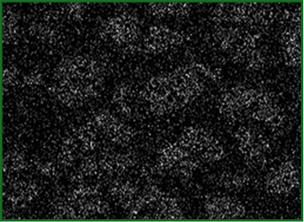
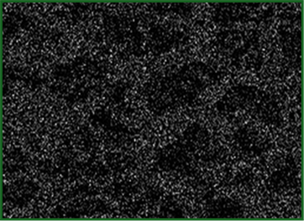
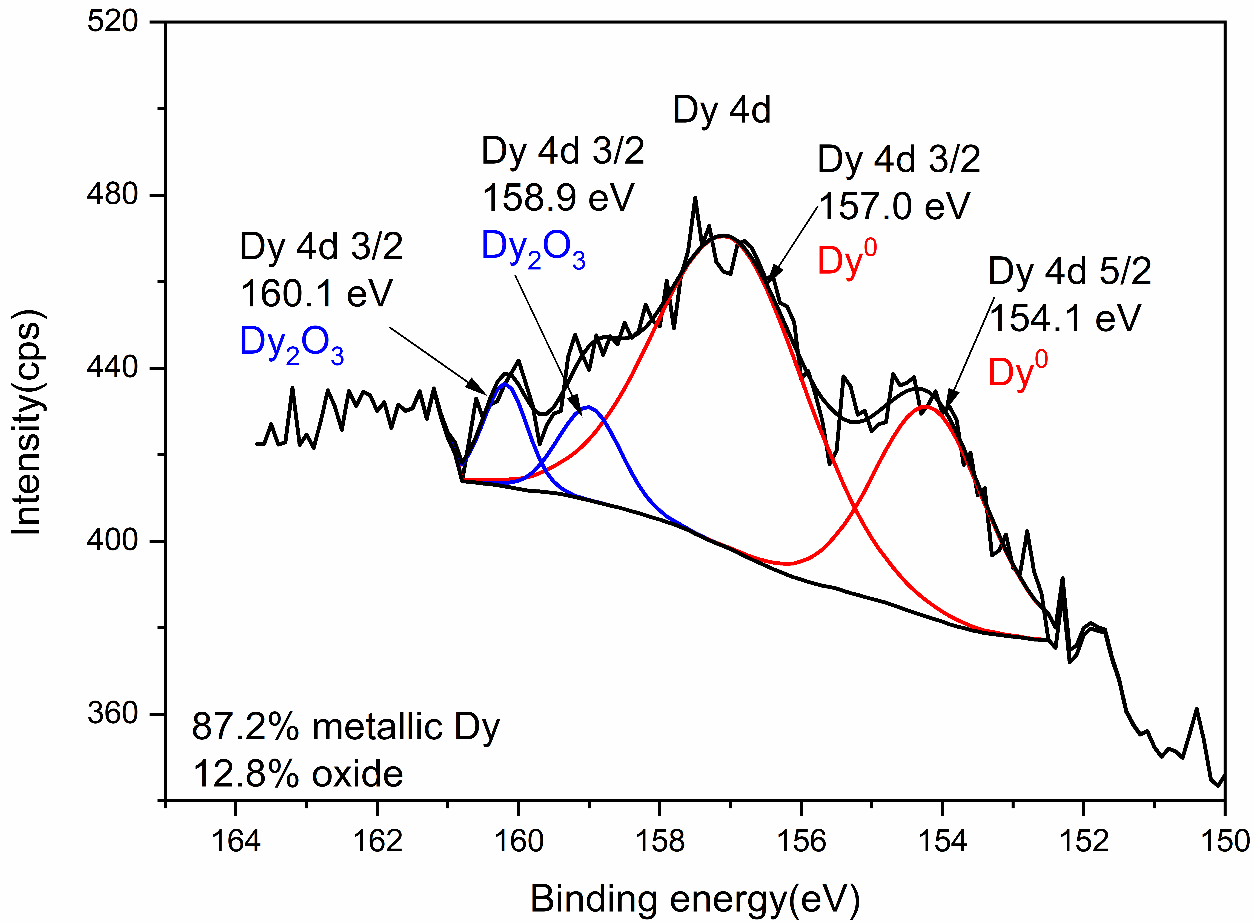
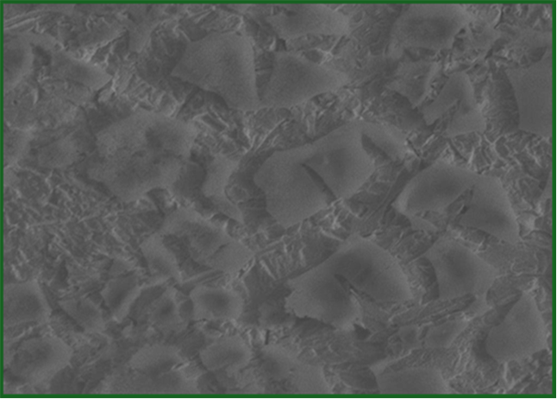
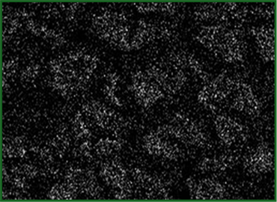
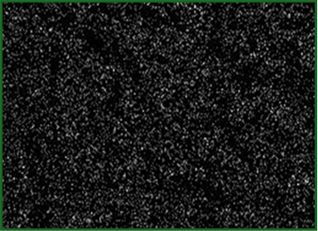
Results and discussions
Element | Dy | Au | O | Cl
Wt.% | 15.0 | 65.3 | 18.8 | 0.9
XPS analysis
Deposition at -0.8V, 1h
Dy La1
Au La1
O Ka1
Cl Ka1

Slide 5




Conclusions
Conclusions
Dy(III) was successfully electrodeposited for the first time from a choline chloride–ethylene glycol (ChCl − EG, ethaline) deep eutectic solvent onto a gold electrode at 70 °C, establishing a promising low-temperature route for dysprosium recovery from DES-based electrolytes.
Cyclic voltammetric analysis confirmed that the reduction process of Dy(III) to Dy(0) proceeds via irreversible a single−step, three−electron transfer process.
The successful formation of metallic Dy was unambiguously supported by complementary XPS and EDX.
Acknowledgments: Research was supported by the Science Fund of the RS, #Grant No. 270, Applying advanced product intellectual properties and industrialization workflows to innovative fundamental research ideas in the area of rare earth electrochemical recovery – REMEDIS. V.S.C. and N.M.P. acknowledge the financial support from the Ministry of Science, Technological Development and Innovation of the RS (Contract No: 451-03-33/2026-03/200026).

