Slide 1



28th Congress of Chemists and Technologists of Macedonia
23-26 September, 2026, Metropol Lake Resort, Ohrid, Macedonia
Photocatalytic degradation of 2,5-diphenyl-1,3-oxazole and 2-(4-biphenyl)-5-phenyl-1,3,4-oxadiazole using ZnO nanoflowers
Trajce Trajkov¹, Dobrina Ivanova¹,Veronika Mihaylova², Georgi Hadzhichristov³, Nina Kaneva¹
¹ Laboratory of Nanoparticle Science and Technology, Department of General and Inorganic Chemistry, Faculty of Chemistry and Pharmacy, University of Sofia, 1 James Bourchier Blvd., 1164 Sofia, Bulgaria
² Department of Analytical chemistry, Faculty of Chemistry and Pharmacy, University of Sofia, 1 James Bourchier Blvd., 1164 Sofia, Bulgaria
³ Laboratory of Optics and and Spectroscopy, Institute Of Solid State Physics, Bulgarian Academy of Sciences, 72, Tzarigradsko Chaussee Blvd., 1784 Sofia, Bulgaria

Slide 2
AIMS
Synthesizing 3D-flower like ZnO powders with rare-earth oxides modification.
Characterization of the surface morphology and crystallite size of the ZnO powders by Scanning Electron Microscopy (SEM), Energy-Dispersive X-ray Spectroscopy (EDS), X-ray Diffraction (XRD).
Investigating how the differences in conjugation and heterocyclic functional groups of PPO and PBD affect their photocatalytic degradation.
Comparing the effect of pure and rare-earth modified ZnO.

Slide 3
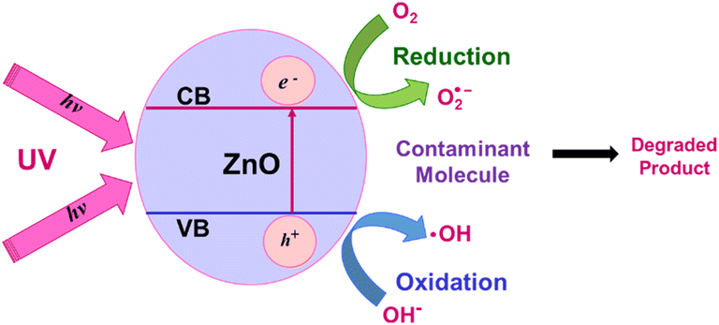
PHOTOCATALYSIS
UV/Visible light activates the photocatalyst to break down contaminants;
Excitation of electrons from valence to conductive band
ZnO+hυ= e⁻_{CB} + h⁺_{VB}
PPO/PBD + .O₂⁻ (OH.)→ CO₂+H₂O

Slide 4
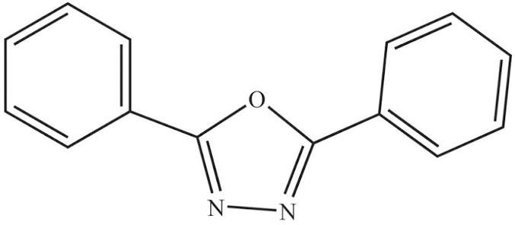
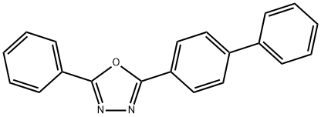
PHOTOCATALYST AND CONTAMINANTS
Pristine ZnO | Modified ZnO | 2,5-diphenyl-1,3-oxazole (PPO)
Advantages: Low cost; Non-toxicity; Strong UV absorbtion; High electron mobility Disadvantages: Rapid electron-hole recombination; photocorrosion | Modification with rare-earth oxides: ZnO/Gd₂O₃ ZnO/Sm₂O₃ ZnO/Eu₂O₃ Improved charge carrier separation; Suppress recombination(4f electronic configuration)
 |  | 2-(4-biphenyl)-5-phenyl-1,3,4-oxadiazole (PBD)

Slide 5
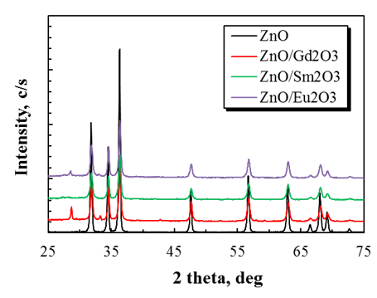
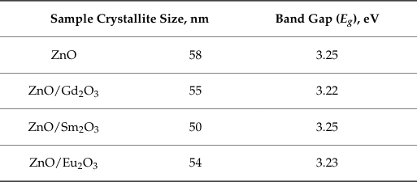
X-RAY DIFFRACTION
Table 1. Crystallite size and optical band gap calculated for pure and rare-earth modified ZnO nanoflower photocatalysts.
Figure 1. XRD scans for the synthesized pure ZnO and rare-earth modified ZnO powders.

Slide 6
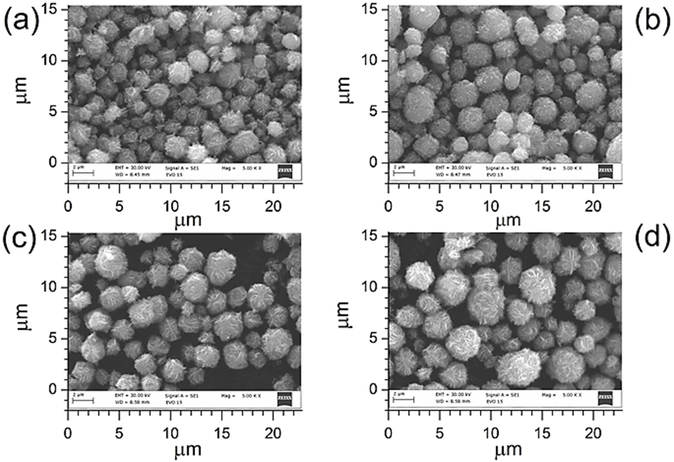
SCANNING ELECTRON MICROSCOPY
Figure 2. SEM images (along with real image scale) for the studied hierarchical flower-like microstructures of pristine and rare-earth-modified ZnO photocatalysts: (a) ZnO; (b) ZnO/Gd2O3; (c) ZnO/Sm2O3, and (d) ZnO/Eu2O3.

Slide 7
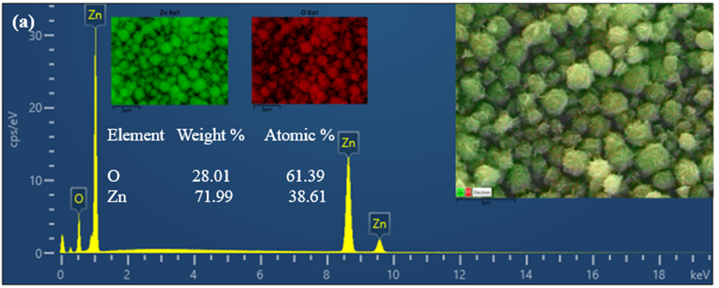
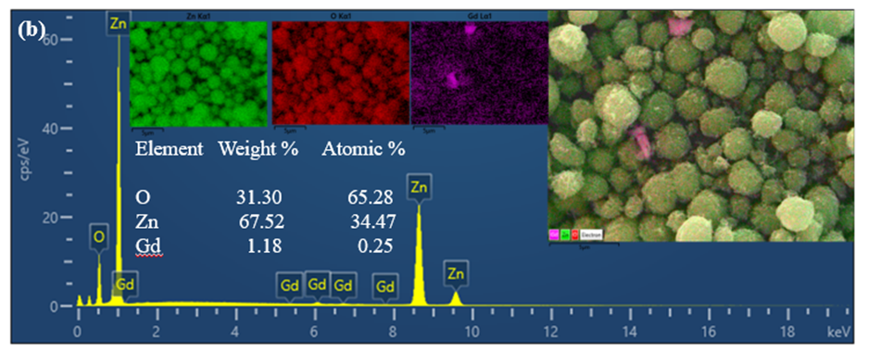
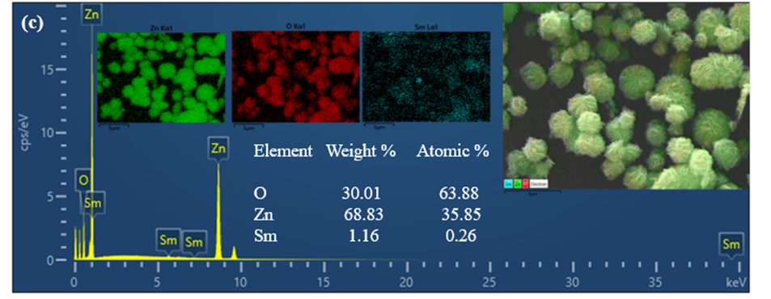
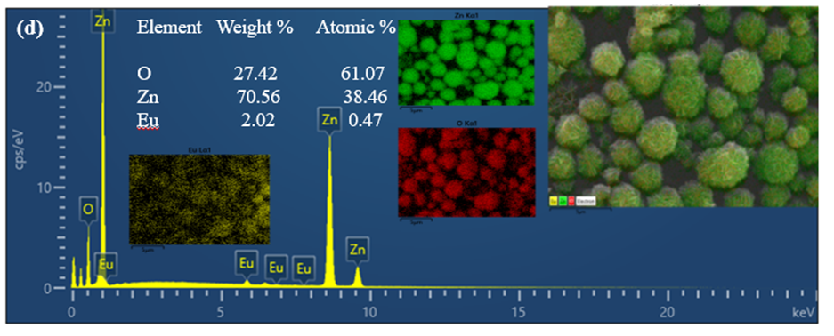
ENERGY-DISPERSIVE SPECTROSCOPY
Figure 3. EDS spectra of pure ZnO (a) and ZnO modified with Gd2O3 (b); Sm2O3 (c); Eu2O3 (d)

Slide 8
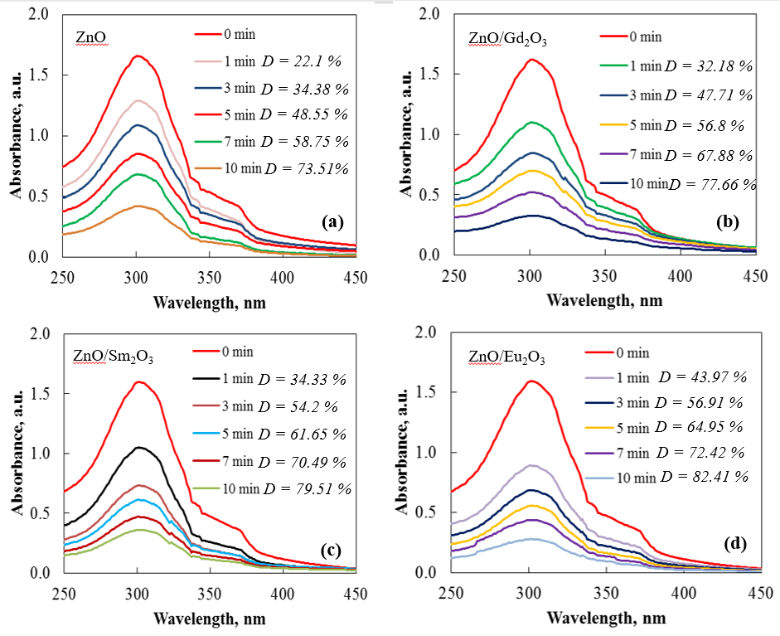
PHOTOCATALYTIC DEGRADATION OF PBD
Figure 4. UV–Vis absorption spectra during the photocatalytic degradation of PBD under UV irradiation using pure (a) and rare earth-modified ZnO photocatalysts ((b) ZnO/Gd2O3, (c) ZnO/Sm2O3, and (d) ZnO/Eu2O3

Slide 9
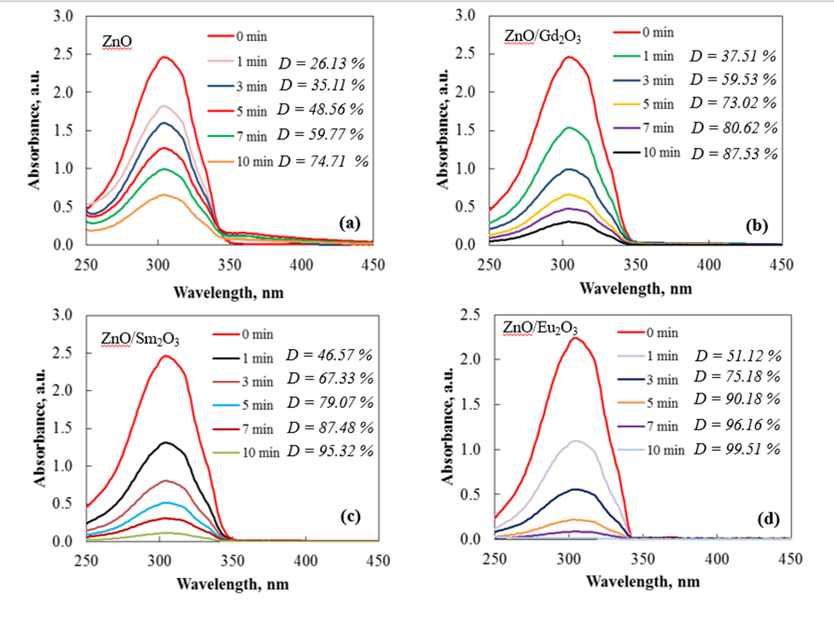
PHOTOCATALYTIC DEGRADATION OF PPO
Figure 5. UV–Vis absorption spectra of PPO during photocatalytic degradation under UV irradiation in the presence of pure and rare-earth-modified ZnO nanoflowers: (a) ZnO, (b) ZnO/Gd2O3, (c) ZnO/Sm2O3, and (d) ZnO/Eu2O3.

Slide 10
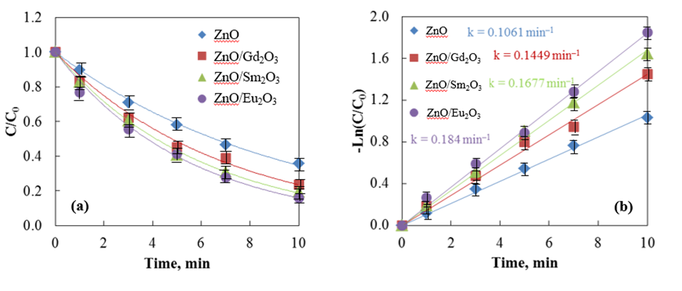
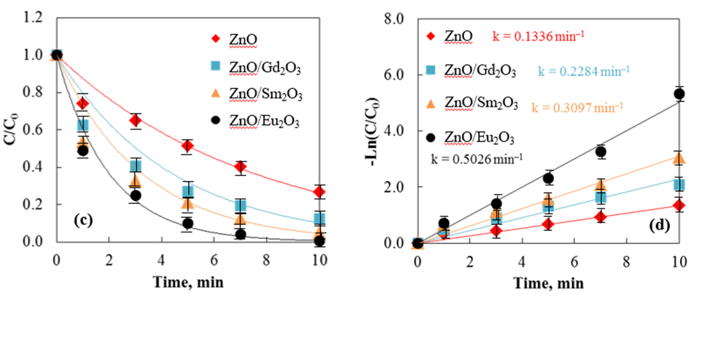
KINETIC ANALYSIS
Figure 6. Concentration ratio (C/C0) of PBD (a,b) and PPO (c,d) as a function of UV irradiation time in the presence of pristine and rare-earth-modified ZnO photocatalysts; (b,d) Pseudo-first-order kinetic plots represented as–ln(C0/C) vs irradiation time for the photocatalytic degradation of PBD(b) and PPO(d)

Slide 11
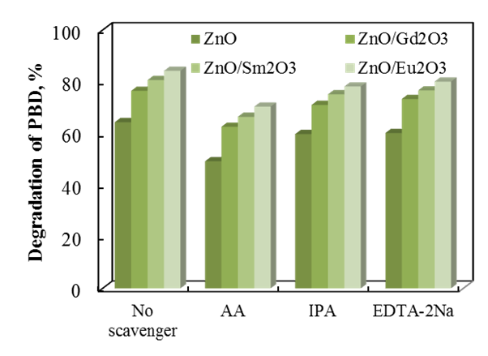
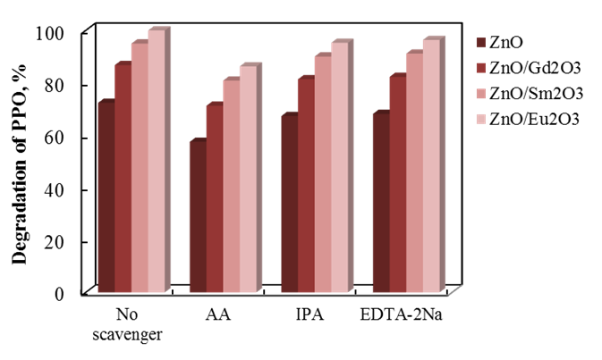
RADICAL SCAVENGER EXPERIMENT
AA-Ascorbic acid
IPA-Isopropyl alcohol
EDTA-2Na-Ethylenediaminetetraacetic acid disodium salt
AA-superoxide radicals
IPA-hydroxyl radicals
EDTA-2Na-photogenerated holes

Slide 12
CONCLUSION
This work reports, for the first time, the photocatalytic degradation of the laser dyes/scintillators PPO and PBD using hierarchical rare-earth modified ZnO nanoflowers under UV irradiation within the emission range 350-400nm for 10 minutes. A comparative evaluation of Sm₂O₃, Eu₂O₃ and Gd₂O₃ modified ZnO demonstrates the influence of rare-earth induced modifications of the electronic structure on the resulting photocatalytic performance. Among the investigated materials ZnO/Eu₂O₃ exhibited the highest activity, achieving nearly complete degradation of PPO 99.5% and 82.4% degradation of PBD within 10min, together with the highest degradation rate and photodegradation quantum efficiency.

Slide 13
Thank you for your attention!

