Slide 1


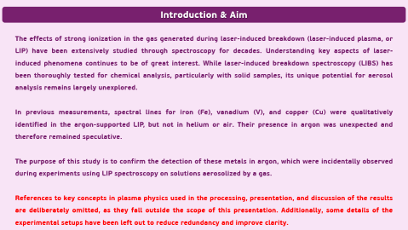
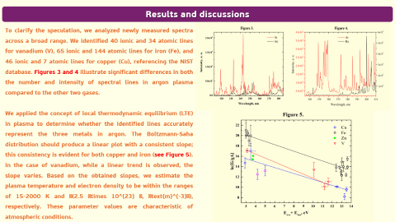

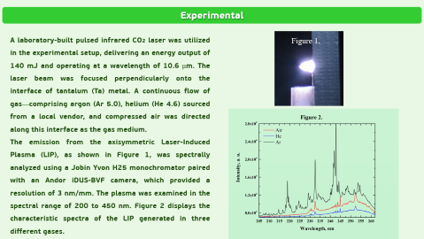


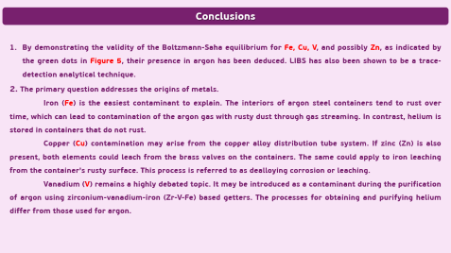
28th Congress of SCTM, 23-26 September, Ohrid, Macedonia
000
WHERE DO METALLIC IMPURITIES IN INDUSTRIAL GASES DETECTED BY LASER-INDUCED PLASMA SPECTROSCOPY COME FROM?
Milovan Stoiljković*, Drag an Ranković, Suzana Veličković, Filip Veljković
VINČA Institute of Nuclear Sciences, P. O. Box 522, Belgrade, Serbia; *missa@vinca.rs

Slide 2
Introduction & Aim
The effects of strong ionization in the gas generated during laser-induced breakdown (laser-induced plasma, or LIP) have been extensively studied through spectroscopy for decades. Understanding key aspects of laser-induced phenomena continues to be of great interest. While laser-induced breakdown spectroscopy (LIBS) has been thoroughly tested for chemical analysis, particularly with solid samples, its unique potential for aerosol analysis remains largely unexplored.
In previous measurements, spectral lines for iron (Fe), vanadium (V), and copper (Cu) were qualitatively identified in the argon-supported LIP, but not in helium or air. Their presence in argon was unexpected and therefore remained speculative.
The purpose of this study is to confirm the detection of these metals in argon, which were incidentally observed during experiments using LIP spectroscopy on solutions aerosolized by a gas.
References to key concepts in plasma physics used in the processing, presentation, and discussion of the results are deliberately omitted, as they fall outside the scope of this presentation. Additionally, some details of the experimental setups have been left out to reduce redundancy and improve clarity.

Slide 3
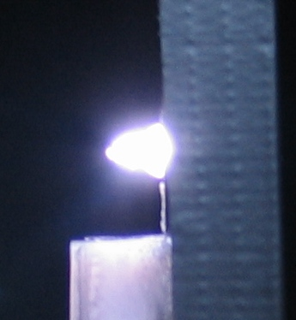
Experimental
A laboratory-built pulsed infrared CO2 laser was utilized in the experimental setup, delivering an energy output of 140 mJ and operating at a wavelength of 10.6 µm. The laser beam was focused perpendicularly onto the interface of tantalum (Ta) metal. A continuous flow of gas—comprising argon (Ar 5.0), helium (He 4.6) sourced from a local vendor, and compressed air was directed along this interface as the gas medium.
The emission from the axisymmetric Laser-Induced Plasma (LIP), as shown in Figure 1, was spectrally analyzed using a Jobin Yvon H25 monochromator paired with an Andor iDUS-BVF camera, which provided a resolution of 3 nm/mm. The plasma was examined in the spectral range of 200 to 450 nm. Figure 2 displays the characteristic spectra of the LIP generated in three different gases.
Figure 1.

Slide 4
Results and discussions
To clarify the speculation, we analyzed newly measured spectra across a broad range. We identified 40 ionic and 34 atomic lines for vanadium (V), 65 ionic and 144 atomic lines for iron (Fe), and 46 ionic and 7 atomic lines for copper (Cu), referencing the NIST database. Figures 3 and 4 illustrate significant differences in both the number and intensity of spectral lines in argon plasma compared to the other two gases.
We applied the concept of local thermodynamic equilibrium (LTE) in plasma to determine whether the identified lines accurately represent the three metals in argon. The Boltzmann-Saha distribution should produce a linear plot with a consistent slope; this consistency is evident for both copper and iron (see Figure 5). In the case of vanadium, while a linear trend is observed, the slope varies. Based on the obtained slopes, we estimate the plasma temperature and electron density to be within the ranges of 15-2000 K and \(2.5 \times 10^{23} \, \text{m}^{-3}\), respectively. These parameter values are characteristic of atmospheric conditions.

Slide 5
Conclusions
By demonstrating the validity of the Boltzmann-Saha equilibrium for Fe, Cu, V, and possibly Zn, as indicated by the green dots in Figure 5, their presence in argon has been deduced. LIBS has also been shown to be a trace-detection analytical technique.
2. The primary question addresses the origins of metals.
Iron (Fe) is the easiest contaminant to explain. The interiors of argon steel containers tend to rust over time, which can lead to contamination of the argon gas with rusty dust through gas streaming. In contrast, helium is stored in containers that do not rust.
Copper (Cu) contamination may arise from the copper alloy distribution tube system. If zinc (Zn) is also present, both elements could leach from the brass valves on the containers. The same could apply to iron leaching from the container's rusty surface. This process is referred to as dealloying corrosion or leaching.
Vanadium (V) remains a highly debated topic. It may be introduced as a contaminant during the purification of argon using zirconium-vanadium-iron (Zr-V-Fe) based getters. The processes for obtaining and purifying helium differ from those used for argon.

