Slide 1

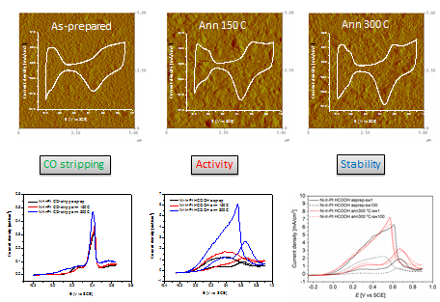
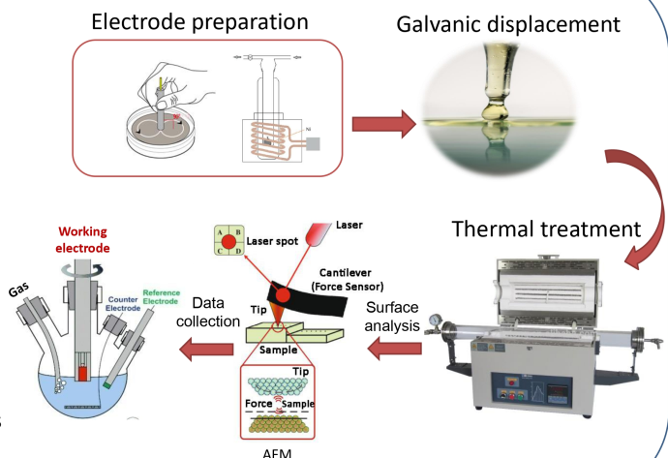
28th Congress of SCTM, 23-26 September, Ohrid, Macedonia
000
Ternary thin film catalyst obtained by galvanic displacement method for formic acid electrooxidation
Dušan Tripković, Sanja Stevanović, Dragana Milosević
University of Belgrade - Institute of Chemistry, Technology and Metallurgy, National Institute of the Republic of Serbia, Belgrade, Serbia, dusan@ihtm.bg.ac.rs
Introduction & Aim
To develop new materials that can be used in electrochemical systems for energy conversion
The goal is to design an advanced electrocatalyst for formic acid oxidation with a minimal amount of precious metal used
Focus is on utilization of Pt and Ir over Ni support and additional thermal treatment to increase activity and stability of the final catalyst
Experimental
Results and Discussion
Conclusions
Catalysts obtained using this approach, in addition to being very active and stable, contain extremely small amounts of precious metal, thereby lowering the overall cost and bringing fuel cell technology closer to full commercialization
Acknowledgement
This research has been financially supported by the Ministry of Science, Technological Development and Innovation of Republic of Serbia (Contract No. 451-03-33/2026-03/200026)

Slide 2

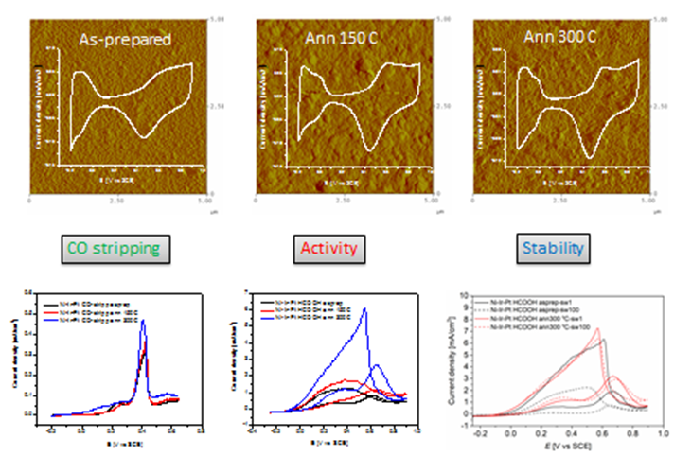




28th Congress of SCTM, 23-26 September, Ohrid, Macedonia
000
Ternary thin film catalyst obtained by galvanic displacement method for formic acid electrooxidation
Dušan Tripković, Sanja Stevanović, Dragana Milošević
University of Belgrade - Institute of Chemistry, Technology and Metallurgy, National Institute of the Republic of Serbia, Belgrade, Serbia, dusan@ihtm.bg.ac.rs
To develop new materials that can be used in electrochemical systems for energy conversion
The goal is to design an advanced electrocatalyst for formic acid oxidation with a minimal amount of precious metal used
Focus is on utilization of Pt and Ir over Ni support and additional thermal treatment to increase activity and stability of the final catalyst
Catalysts obtained using this approach, in addition to being very active and stable, contain extremely small amounts of precious metal, thereby lowering the overall cost and bringing fuel cell technology closer to full commercialization.

Slide 3
Introduction & Aim
Pollution from fossil fuels resulting from industrialization, urbanization and technological progress greatly affects the environment and human health. Thus, the main challenge confronting both the scientific community and humanity is to reduce reliance on fossil fuels by shifting energy production and consumption to renewable energy sources.
To develop new materials that can be used in electrochemical systems for energy conversion
The goal is to design an advanced electrocatalyst for formic acid oxidation with a minimal amount of precious metal used
Focus is on utilization of Pt and Ir over Ni support and additional thermal treatment to increase activity and stability of the final catalyst

Slide 4
Experimental

Slide 5
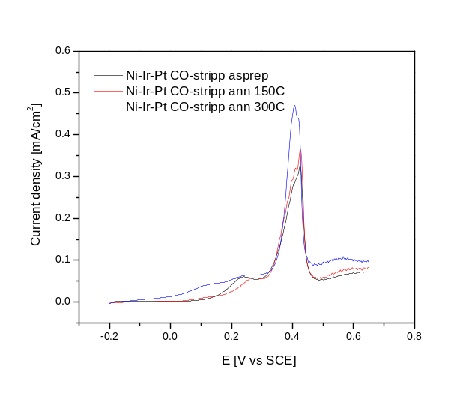
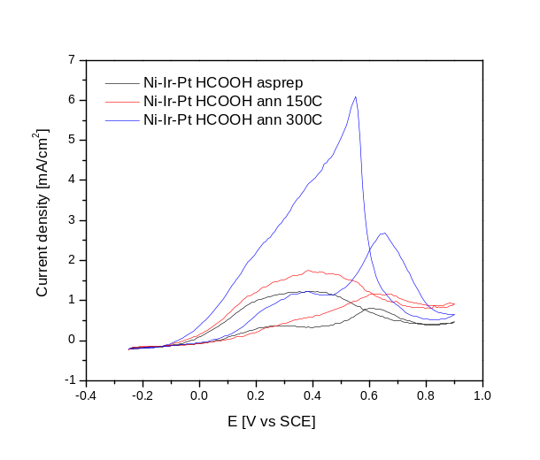
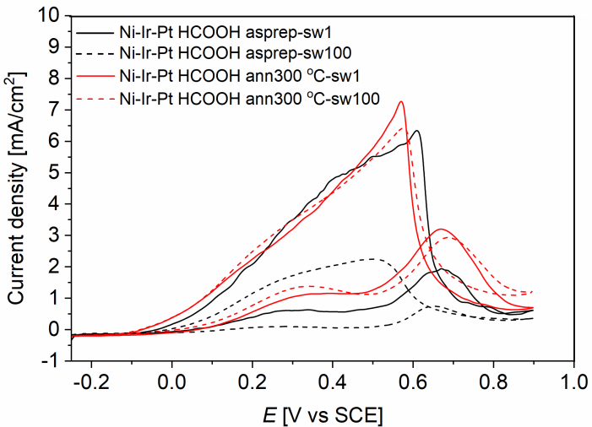
Results and discussions
As-prepared
Ann 150 C
Ann 300 C
Current density [mA/cm2]
Current density [mA/cm2]
Current density [mA/cm2]
E [V vs SCE]
E [V vs SCE]
E [V vs SCE]
CO stripping
Activity
Stability

Slide 6
Conclusions
Catalysts obtained using this approach, in addition to being very active and stable, contain extremely small amounts of precious metal, thereby lowering the overall cost and bringing fuel cell technology closer to full commercialization.
The addition of a third metal, specifically iridium, has made the catalysts more resistant to CO poisoning

