Slide 1
Introduction & Aim
This work investigates the structural as well as spectroscopic characteristics of the molecules in 15 aquachloro complexes, which are analyzed with N-diffraction and analyzes the dynamics of bonding in crystalline environments. Structural and spectroscopic data from selected aquachloro complexes are analyzed, systematically extracted from crystallographic publications for comparative analysis. Methodologically, the study combines a review of the fundamental principles of solid-state chemistry, with particular emphasis on the molecule bonding in confined systems, with statistical processing of structural parameters (bond lengths, coordination geometry) as well as spectroscopic data, in order to establish certain spectrum–structure correlations. The conclusions emphasize the role of lattice geometry in determining the efficiency of the molecule bonding.
The aim is to see to what extent the data collected from the scientific articles will match the theory of events that occuring in the crystalline systems.

Slide 2
Experimental/ Methodolgy
CuCl₂·2H₂O
1. | Crystal system | Orthorombic
2. | Space group | (D_{2h}⁷)
3. | Number of units contained inside a unit cell | 4
4. | R-factor | 3,2%
5. | Packing factor q/V(4r³π) | 0,2922
6. | Volume of the cell | 22,756 nm³
7. | Types of water and coordination | 1 type of trigonal coordinated water (C₂)
8. | R(O···Cl)/pm | 320,7
9. | R(О–H)/pm | 94,8
10. | R(H···Cl)/pm | 225,9
11. | R(M–O)/pm | 194,7
12. | О–H ···Cl/° | 169,94
13. | Н–О–H/° | 108,2
14. | Cl ···О···Cl/° | 97,5
In order to study and confirm the postulates of the theory of crystalline systems, data from 15 aquachloro complexes were extracted from the relevant source articles and placed in tables, each table separately. The obtained data were further processed from a statistical aspect and discussed in order to study some common trends in the structure of these compounds, such as the structural and spectroscopic correlations.
The table on the right is an example of how the data was arranged from the scientific articles.

Slide 3
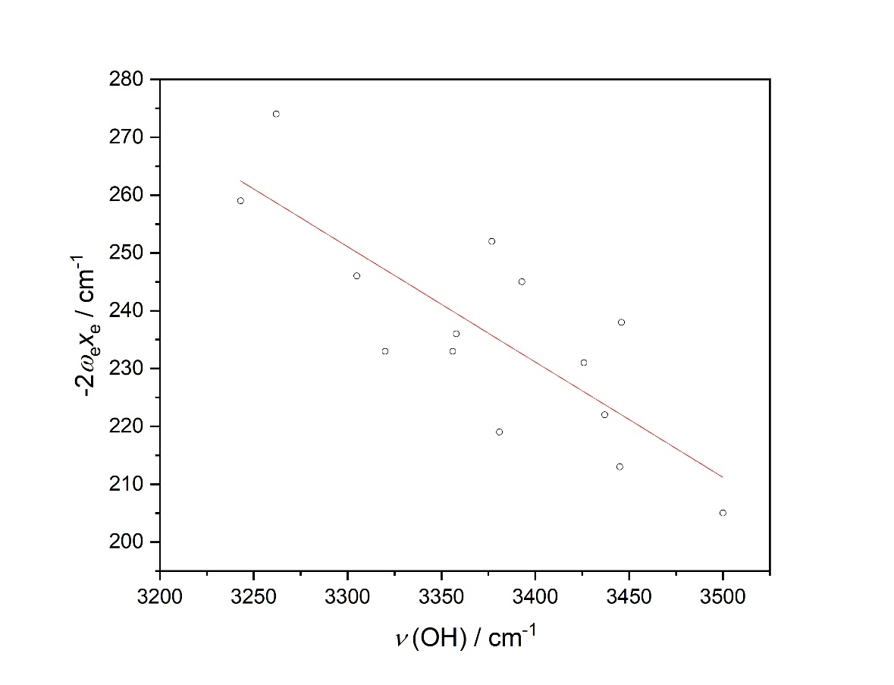
Results and discussions

Slide 4
Conclusions
The goal of this work was to provide a thorough review of the structural and spectroscopic trends for a series of selected aquachloro complexes. The data, which were taken from the original structural articles, appropriately grouped and analyzed, led to a series of conclusions.
The environment, which in principle is reduced to a series of electrostatic interactions and limited space, has a significant influence on other crystallographic parameters, which further direct the behavior of the corresponding hydrogen bonds in the solid phase.
In practically every second analyzed aquachloro complex, or 57% of the number of compounds, water belongs to a position with C₁ symmetry. In 30% of the remaining 43%, water lies on a plane or axis of rotation. This means that in 13% of the number of analyzed compounds, water has C_{2v} symmetry of higher, which indicates the influence of the environment on its symmetry when it is confined in a solid phase.
A regularity was observed in the variation of hydrogen bond length and its angle. Two important conclusions can be drawn. First, the majority of hydrogen bonds have angles close to 180°. This means that shorter hydrogen bonds are stronger and generally tend to be linear. Second, in the right-hand part of the graph, we notice that relatively longer hydrogen bonds tend to be bent.
The negative correlation observed between the O-H stretching frequency and the calculated anharmonicity value indicates that for these aqua chloro complexes, a stronger O-H bond is linked with greater vibrational anharmonicity.

