Slide 1

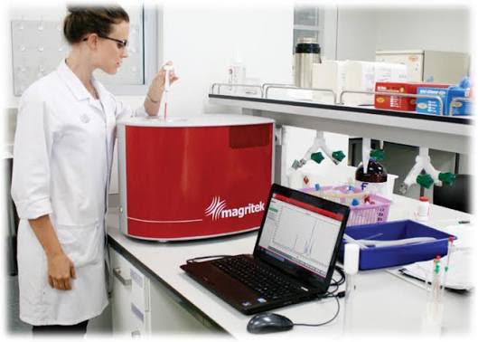
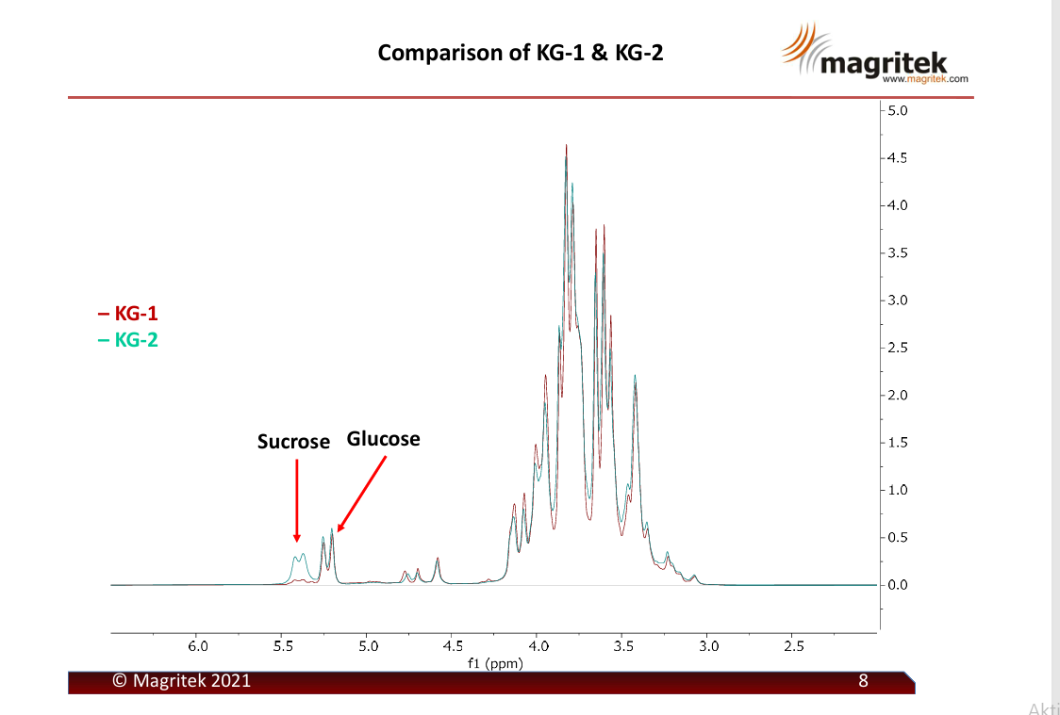
28th Congress of SCTM, 23-26 September, Ohrid, Macedonia
000
BENCHTOP NMR AS A FEASIBILE AND RELIABLE TECHNIQUE FOR DETECTION OF HONEY ADULTERATION
Vesna Cvetković¹, Biljana Šmit², Petar Stanić², Jovana Delić²
¹ Institute of Chemistry, Technology and Metalurgy, Belgrade, Serbia, v.cvetkovic@ihtm.bg.ac.rs, ² Institute for Information Technologies Kragujevac, Kragujevac, Serbia
Introduction & Aim
Honey is a natural product produced by honey bees from floral nectar or honeydew secretions, highly valued for its nutritional and functional properties. Due to its high market value, honey is frequently adulterated with inexpensive sugar syrups or through indirect bee feeding practices, making the development of reliable methods for authenticity assessment and adulteration detection increasingly important. NMR and infrared spectroscopy have been developed during the last three decades for the detection of honey adulterants. However, these techniques require highly trained stuff and special conditions. Compared to conventional high-field NMR systems, benchtop NMR spectrometer instruments offer several advantages, including lower cost, compact size, easier operation, minimal maintenance requirements, and no need for liquid helium or other cryogens. In addition, they enable rapid, non-destructive analysis on site, making them highly suitable for routine quality control and honey authenticity studies at honey collection points.
Experimental
The ¹H NMR spectra revealed clear differences between the pure honey sample and the adulterated one with sucrose. Increased signal intensity in the sucrose region (around 5.4 ppm) was observed in the adulterated sample, while the glucose signals remained relatively similar in both samples.
Results and discussion
Two different polyfloral honeys (pure: KG-1 and adulterated: KG-2) were submitted to NMR analysis in order to demonstrate feasibility of benchtop NMR as a fast and easy-to-use method for adulteration determination. Prior analysis, 200 mg of samples were dissolved in 1 mL D₂O. 1H NMR spectra were recorded using a Magritek Spinsolve 60 MHz PLUS Multi X benchtop spectrometer operating at 60 MHz. Measurements were performed with a signal-to-noise ratio of 120:1 (1% ethylbenzene in CDCl₃) and a spectral resolution characterized by a linewidth at 50% of ≤0.35 Hz and linewidth at 0.55% of ≤10 Hz. CDCl₃ and acetone-d₆ were used as deuterated solvents.
These results demonstrate the potential of benchtop NMR spectroscopy as a rapid and non-destructive tool for detecting honey adulteration.
Conclusions
Acknowledgement
This research is funded by the Ministry of Science, Technological Development and Innovation,
This research is funded by the Ministry of Science, Technological Development and Innovation,
Republic of Serbia, Grants: No. 451-03-33/2026-03/200378 and 451-03-66/2026-03/200026.
Republic of Serbia, Grants: No. 451-03-33/2026-03/200378 and 451-03-66/2026-03/200026.

