Slide 1


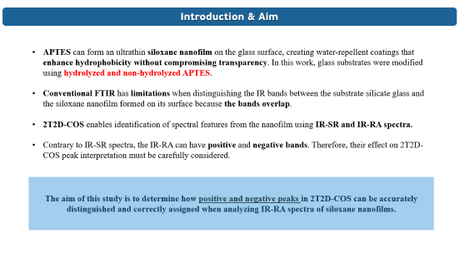
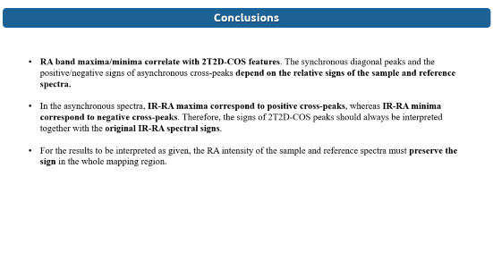
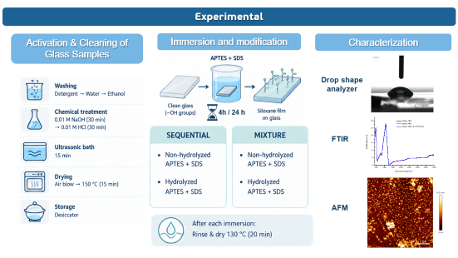
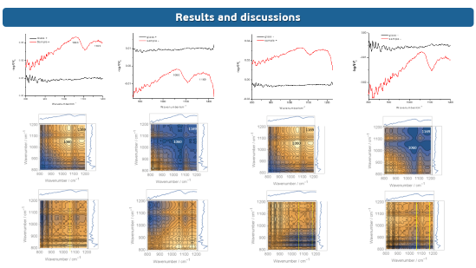
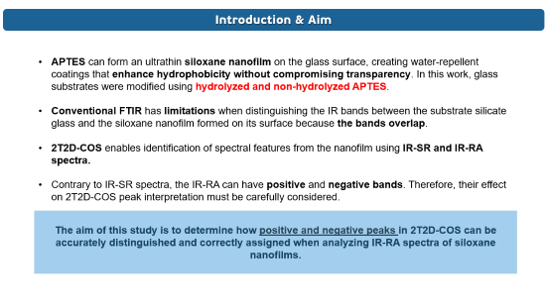
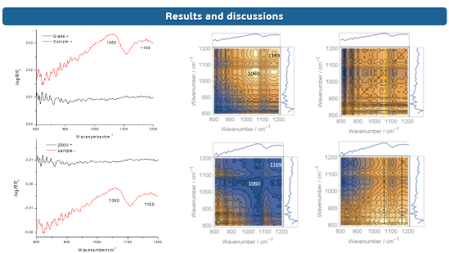

28th Congress of SCTM, 23-26 September, Ohrid, Macedonia
INTERPRETING POSITIVE AND NEGATIVE IR REFLECTANCE-ABSORBANCE INTENSITIES IN 2T2D CORRELATION SPECTROSCOPY OF SILOXANE FILMS ON SILICATE GLASS
000
Katerina Kraljevska , Vladimir Ivanovski
Ss. Cyril and Methodius University in Skopje, Faculty of Natural Science and Mathematics, Skopje, Macedonia,
kraljevskakaterina0808@gmail.com

Slide 2
Introduction & Aim
APTES can form an ultrathin siloxane nanofilm on the glass surface, creating water‑repellent coatings that enhance hydrophobicity without compromising transparency. In this work, glass substrates were modified using hydrolyzed and non-hydrolyzed APTES.
Conventional FTIR has limitations when distinguishing the IR bands between the substrate silicate glass and the siloxane nanofilm formed on its surface because the bands overlap.
2T2D-COS enables identification of spectral features from the nanofilm using IR-SR and IR-RA spectra.
Contrary to IR-SR spectra, the IR-RA can have positive and negative bands. Therefore, their effect on 2T2D-COS peak interpretation must be carefully considered.
The aim of this study is to determine how positive and negative peaks in 2T2D-COS can be accurately distinguished and correctly assigned when analyzing IR-RA spectra of siloxane nanofilms.

Slide 3
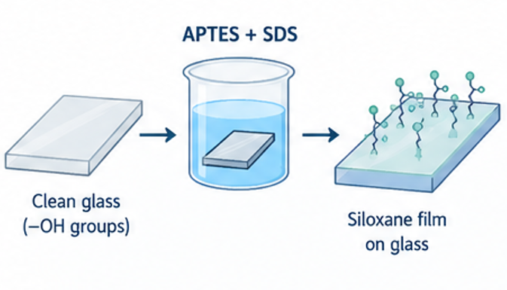
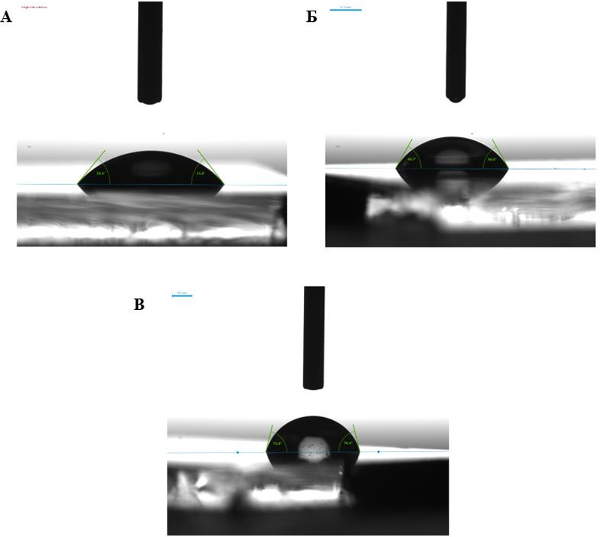
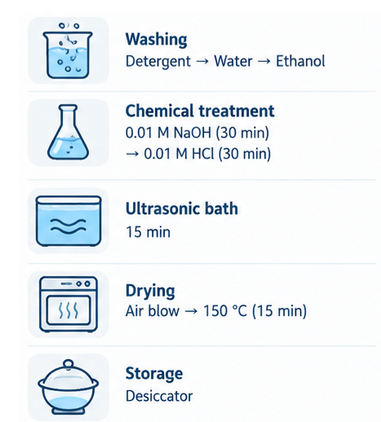

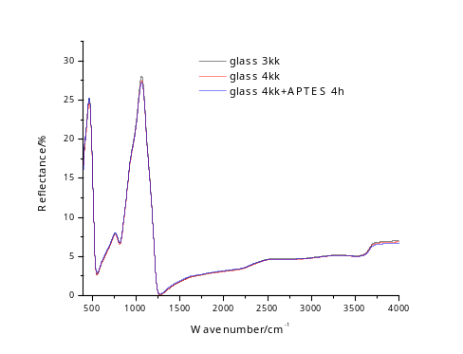
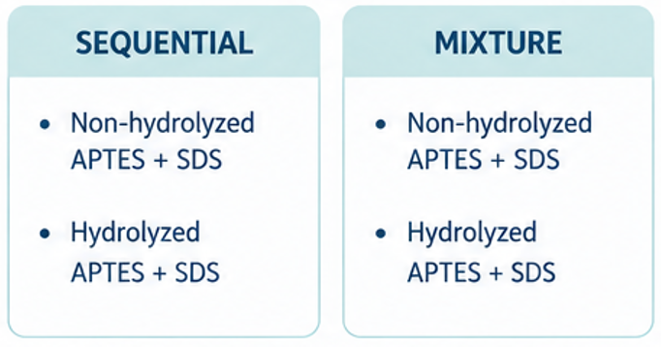
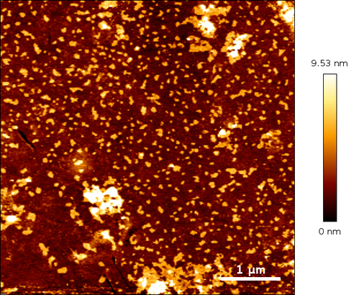

Experimental
Activation & Cleaning of Glass Samples
Immersion and modification
Characterization
Drop shape analyzer
4h / 24 h
FTIR
AFM

Slide 4
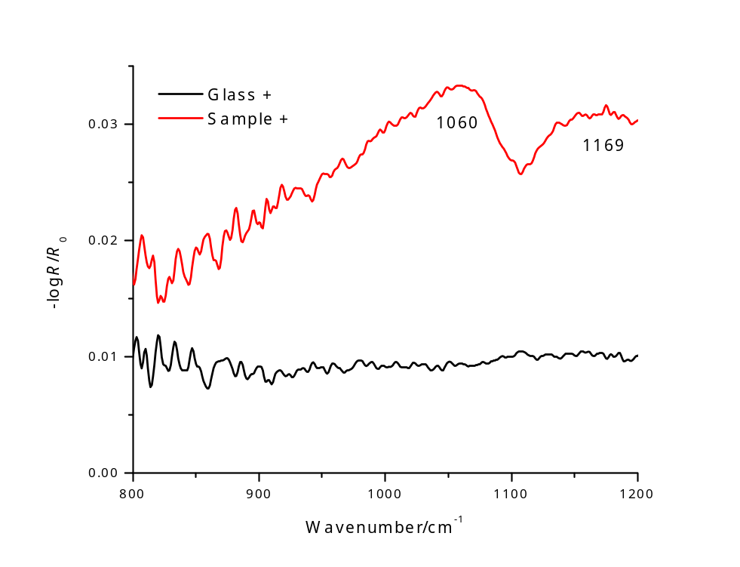
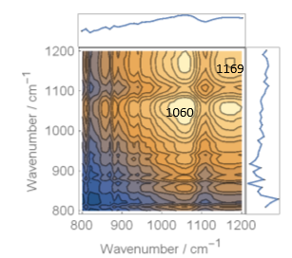
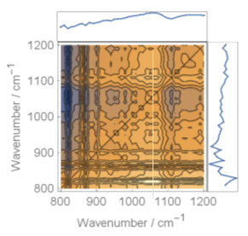
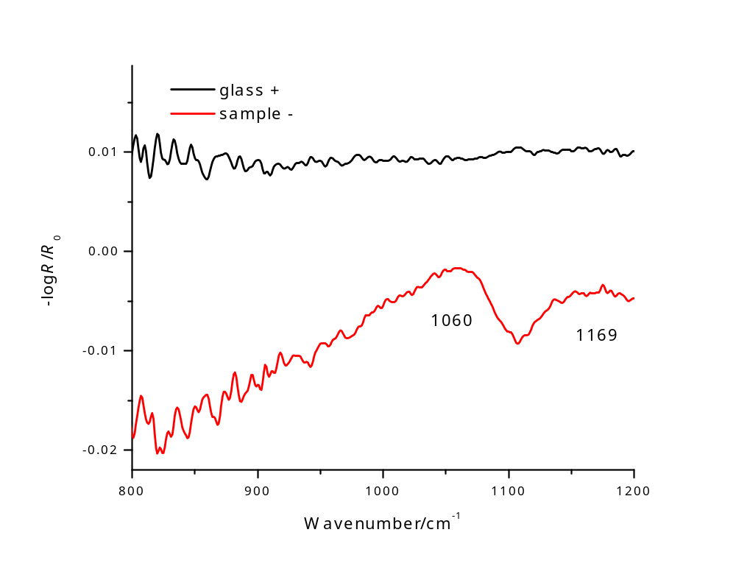
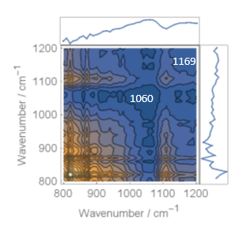
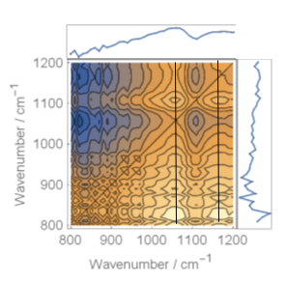
Results and discussions

Slide 5
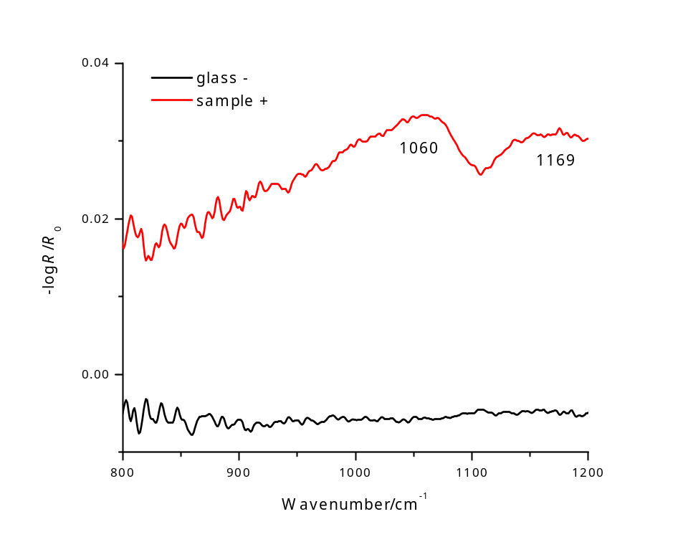
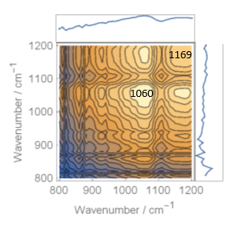
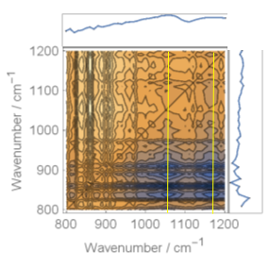
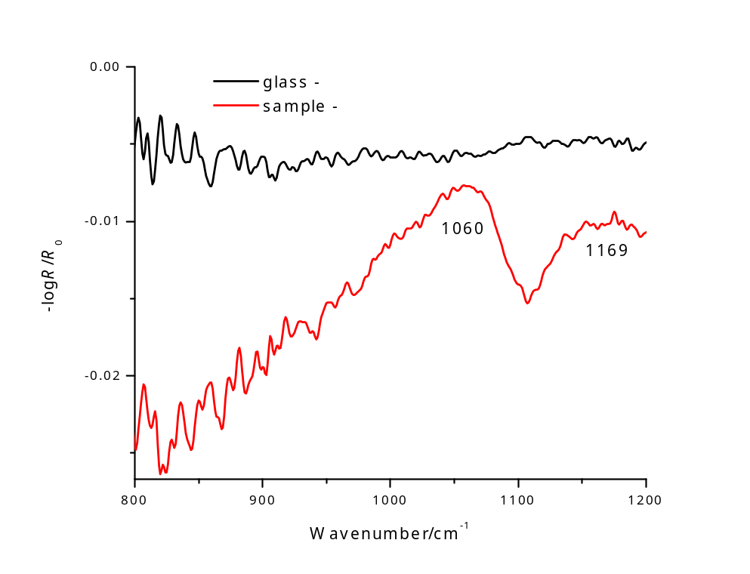
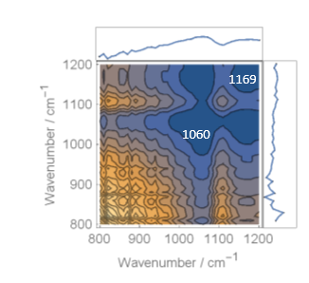
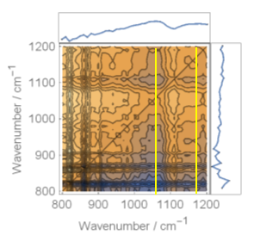
Results and discussions

Slide 6
Results and discussions
Table 1. The correlation between the RA band maxima and minima of the reference IR-RA spectrum and the maxima and minima of the 2T2D-COS synchronous map diagonal positive peaks, in connection to the signs of the sample and reference spectrum.
 | RA band maxima/minima
 | max/min | max/min | max/min | max/min
 | RA intensity sign
Sample | + | - | + | -
Reference | + | + | - | -
 | 2T2D-COS diagrams diagonal positive peaks
2T2D-COS diagram | max/min | min/max | max/min | min/max
Table 2. The correlation between the RA band maxima and minima of the reference spectrum and the sign of the peaks (positive or negative) of the 2T2D-COS asynchronous map cross peaks, depending on the signs of the sample and reference spectrum.
 | RA band maxima/minima
 | max/min | max/min | max/min | max/min
 | RA intensity sign
Sample | + | - | + | -
Reference | + | + | - | -
 | 2T2D-COS diagrams cross peak signs
2T2D-COS diagrams | +/- | +/- | -/+ | -/+

Slide 7
Conclusions
RA band maxima/minima correlate with 2T2D-COS features. The synchronous diagonal peaks and the positive/negative signs of asynchronous cross-peaks depend on the relative signs of the sample and reference spectra.
In the asynchronous spectra, IR-RA maxima correspond to positive cross-peaks, whereas IR-RA minima correspond to negative cross-peaks. Therefore, the signs of 2T2D-COS peaks should always be interpreted together with the original IR-RA spectral signs.
For the results to be interpreted as given, the RA intensity of the sample and reference spectra must preserve the sign in the whole mapping region.

