Slide 1

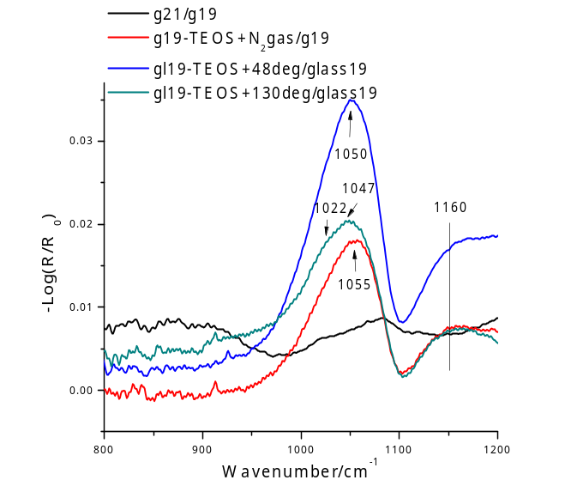
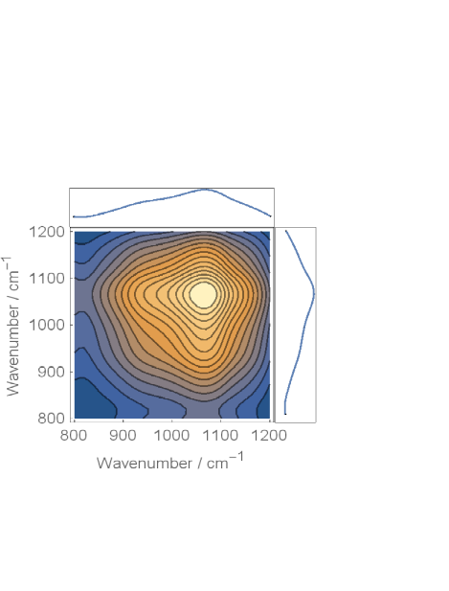
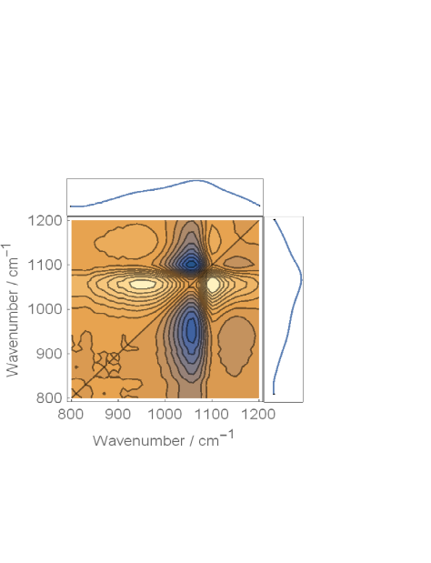
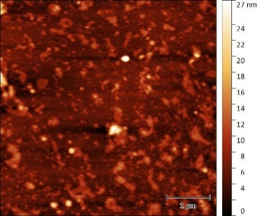
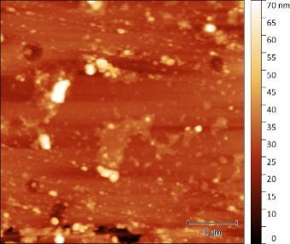
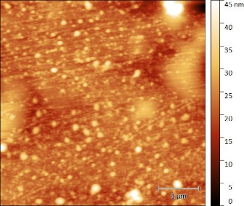
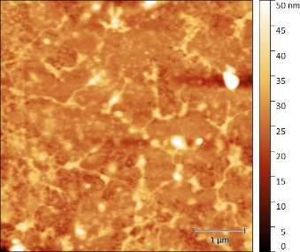
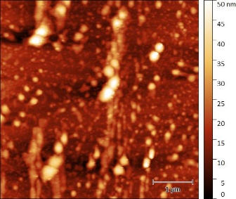
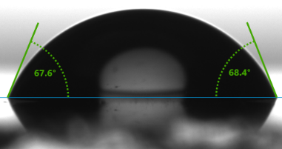
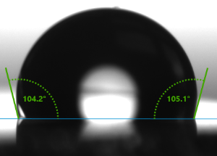
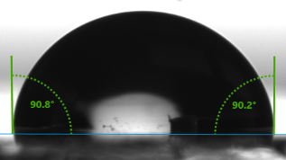
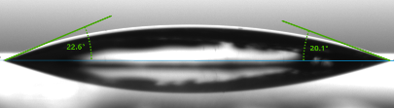
28th Congress of SCTM, 23-26 September, Ohrid, Macedonia
000
INVESTIGATION OF THE HYDROPHOBICITY OF MODIFIED GLASS
IN GLASS–TEOS–HDTMS SANDWICH STRUCTURES
Vladimir Grujovski, Amin Idrizovski, Biljana Pejova, Vladimir Ivanovski
Ss. Cyril and Methodius University in Skopje, Faculty of Natural Sciences and Mathematics, Arhimedova 5, 1000 Skopje, Macedonia
Introduction & Aim
Obtaining hydrophobic glass surface, retaining its transparency, and avoiding toxic fluorinated chemicals is a rather challenging task. It is possible to use alkoxysilanes as monomers for the purpose, among which TEOS is the mostly used. Previous investigations showed that using pure TEOS, hydrophobic surface can not be obtained. However, anchoring TEOS as support, should provide an increase in the OH groups on the glass surface, playing the role as centers for further condensation and polymerization. The aim of this work was to investigate the possibility of increasing the hydrophobicity of glass surface by modifying it by hydrolyzed TEOS followed by HDTMS.
Experimental
From a microscopy soda-lime-silicate glass slide, samples of dimensions 7 x 12 mm were cut. The samples were cleaned using a standard procedure. Three samples labeled here as g19, g20 and g21 were treated by dip coating in a solution of TEOS in water/2-propanol, having mass fraction of 1.817%, pH = 2.04, and hydrolyzed for 3 d. Sample g19T was dipped for 30 min and cured at 130 °C, g20T was dipped for 60 min and dried with N₂ gas, while g21T was dipped for 120 min and dried with N₂ gas. These samples were further dip coated with HDTMS, using 10 mL solution prepared by mixing 0.229 mL of 85% HDTMS with wet toluene. Samples g19T-H and g20T-H were dip coated for 30 min, while g21T-H for 120 min, followed by curing at 120 °C.
MIR IR-SR spectra of the samples were recorded for each step of the modification, using Perkin-Elmer Spectrum 3 FTIR, with resolution of 4 cm⁻¹ and 32 scans. Contact angles were measured using the DSA 25S Standard Drop Shape Analyzer. The AFM images were obtained employing phase mode using an SPM-9700HT scanning probe microscope (Shimadzu Co.) equipped with an AFM tip having a nominal resonance frequency of 320 kHz and a force constant of 42 N/m.
Figure 2. Synchronous (left) and asynchronous (right) 2T2D-COS maps of g19T sample obtained from IR-SR spectra.
Results and discussion
Table 1. Water contact angle wCA and calculated surface energies of pure glass samples (g19, g20, g21), modified with TEOS (g19T, g20T, g21T) and further modified with HDTMS (g19T-H, g20T-H, g21T-H). The sample g3-H belongs to a direct modification of glass with HDTMS.
Figure 1. IR-RA spectra of glass (for comparison) and TEOS modified glass, cured at different temperatures.
Sample | g19 | g20 | g21 | g19T | g20T | g21T | g19T-H | g20T-H | g21T-H | g3-H
wCA/° | 20.81 ± 0.98 | 31.95 ± 8.45 | 24.58 ± 4.06 | 62.13 ± 11.87 | 44.55 ± 3.99 | 33.57 ± 5.28 | 104.51 ± 2.14 | 102.30 ± 2.69 | 103.63 ± 2.06 | 89.73 ± 6.57
SFE/(mN/m) |  |  |  | 47.22 ± 7.88 | 57.72 ± 2.86 | 64.37 ± 4.86 | 25.26 ± 0.86 | 26.72 ± 2.78 | 27.12 ± 1.35 | 33.18 ± 5.61
SFE_{P}/(mN/m) |  |  |  | 13.61 ± 6.90 | 24.76 ± 2.49 | 30.98 ± 3.10 | 0.31 ± 0.21 | 0.43 ± 0.37 | 0.26 ± 0.20 | 2.20 ± 1.85
SFE_{D}/(mN/m) |  |  |  | 33.61 ± 0.97 | 32.96 ± 0.37 | 33.38 ± 1.76 | 24.95 ± 0.65 | 26.29 ± 2.41 | 26.86 ± 1.15 | 30.98 ± 3.76
A
B
C
D
E
Figure 3. AFM images of: A) glass, B) g19T-H, C) g20T-H, D) g21T-H, E) g3-H
Conclusions
Conclusions
Hydrolysis of TEOS strongly depends on time, pH, and the solvent used. Larger time, lower pH and enough water is favorable.
Increase in the curing temperature plays pivotal role in the increase of hydrophobicity, proved by the IR-RA spectra and wCA.
2T2D-COS maps, together with IR-RA spectra and AFM, proved the formation of the thin film on the glass surface
Sandwich structure of glass-TEOS-HDTMS gives higher wCA then glass treated with HDTMS only.

