Slide 1

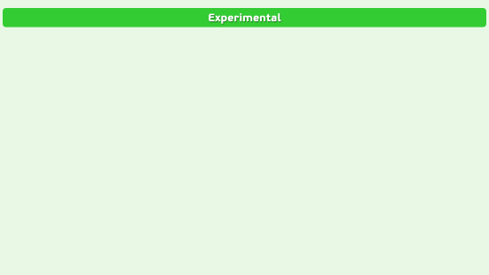
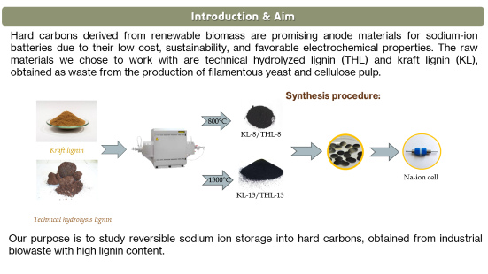
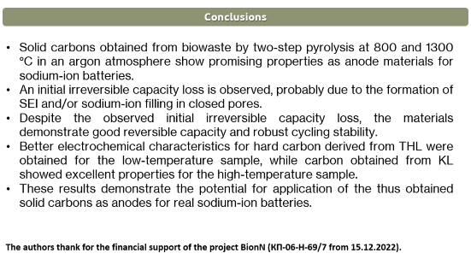
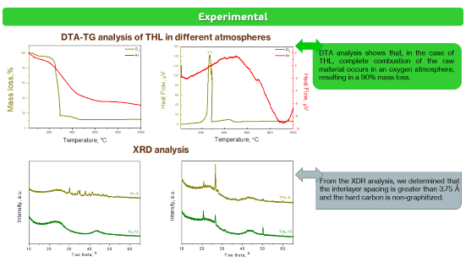
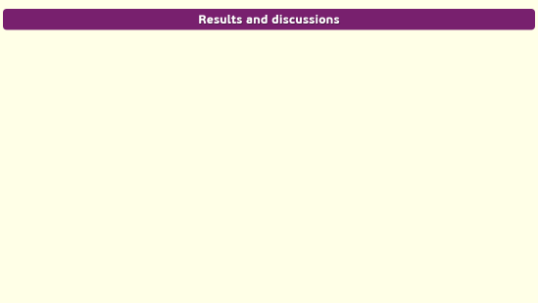

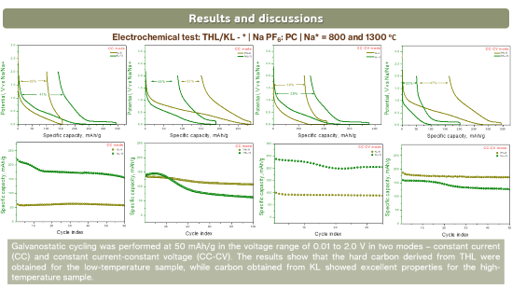
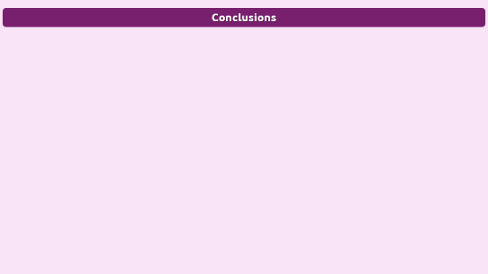
28th Congress of SCTM, 23-26 September, Ohrid, Macedonia
000
Electrochemical sodium storage in hard carbons derived
from industrial lignin waste
Ts. Gerasimova¹, M. Kalapsazova^{1,2} and R. Stoyanova^{1,2} e-mail: gerasimova@svr.igic.bas.bg
¹Institute of General and Inorganic Chemistry – Bulgarian Academy of Sciences, Sofia, Bulgaria
²National Centre of Excellence “Mechatronics and Clean Technologies”, Sofia, Bulgaria

Slide 2
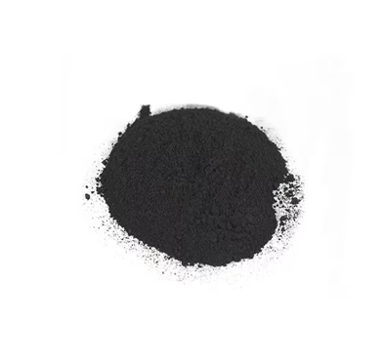
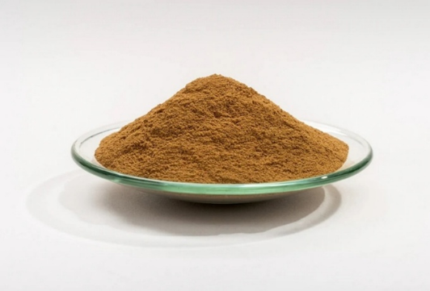

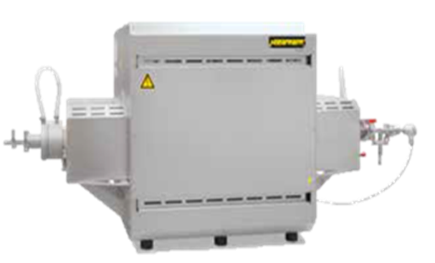
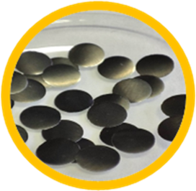
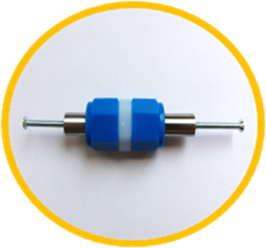
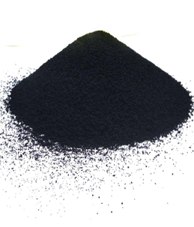
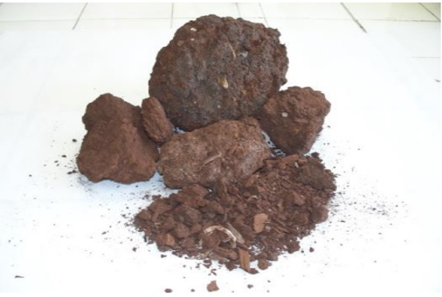
Introduction & Aim
Hard carbons derived from renewable biomass are promising anode materials for sodium-ion batteries due to their low cost, sustainability, and favorable electrochemical properties. The raw materials we chose to work with are technical hydrolyzed lignin (THL) and kraft lignin (KL), obtained as waste from the production of filamentous yeast and cellulose pulp.
Synthesis procedure:
800°C
KL-8/THL-8
Kraft lignin
1300°C
Na-ion cell
KL-13/THL-13
Technical hydrolysis lignin
Our purpose is to study reversible sodium ion storage into hard carbons, obtained from industrial biowaste with high lignin content.

Slide 3
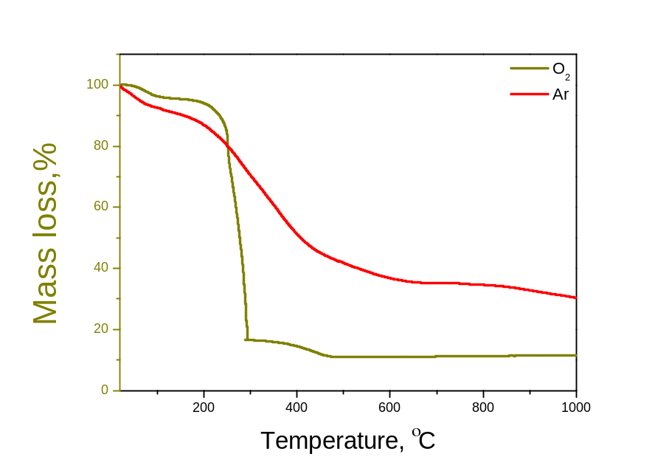
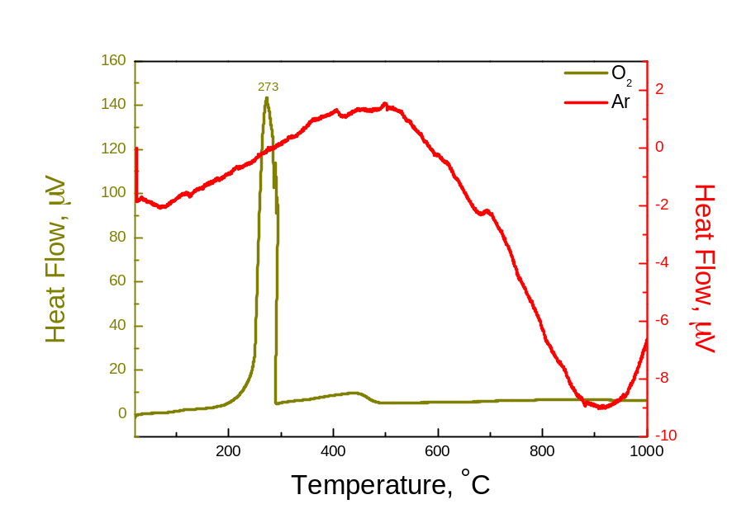
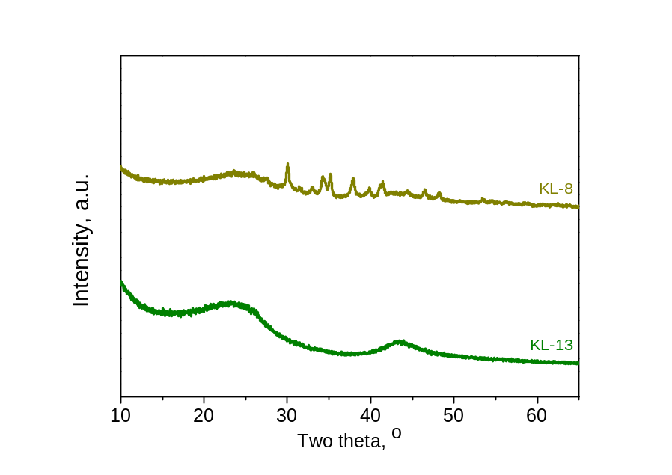
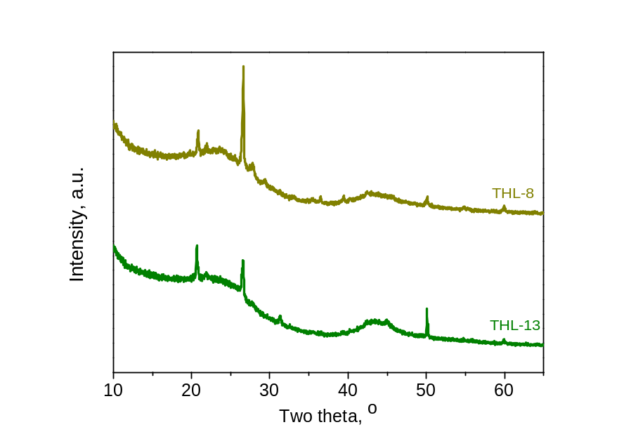
Experimental
DTA-TG analysis of THL in different atmospheres
DTA analysis shows that complete combustion of the raw material occurs in an oxygen atmosphere, resulting in a 90% mass loss. In contrast in argon atmosphere process slow carbonization with about 40 % yield.
XRD analysis
XRD analysis reveals obtaining of amorphous non-graphitized carbonaceous materials (i.e. hard carbons), with the interlayer spacing is greater than 3.75 Å.

Slide 4
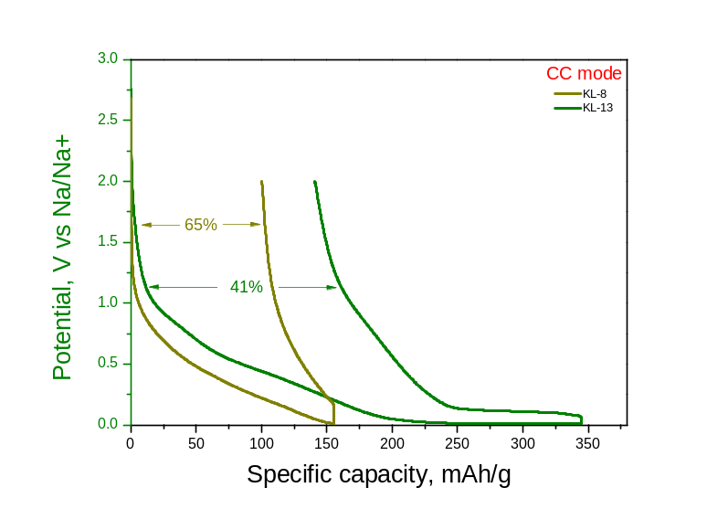
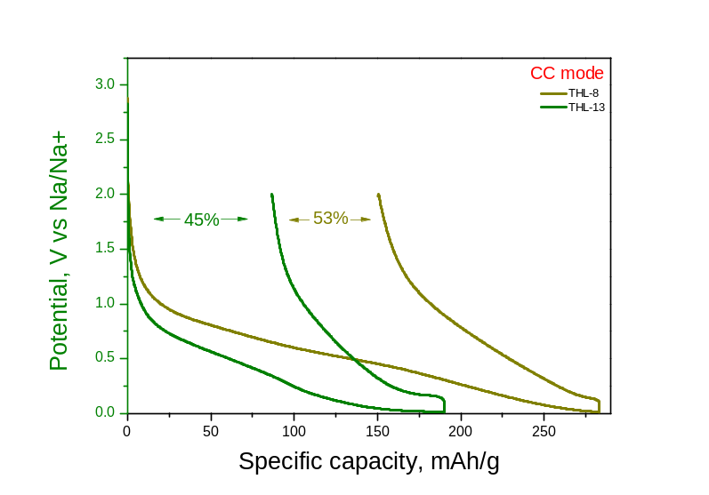
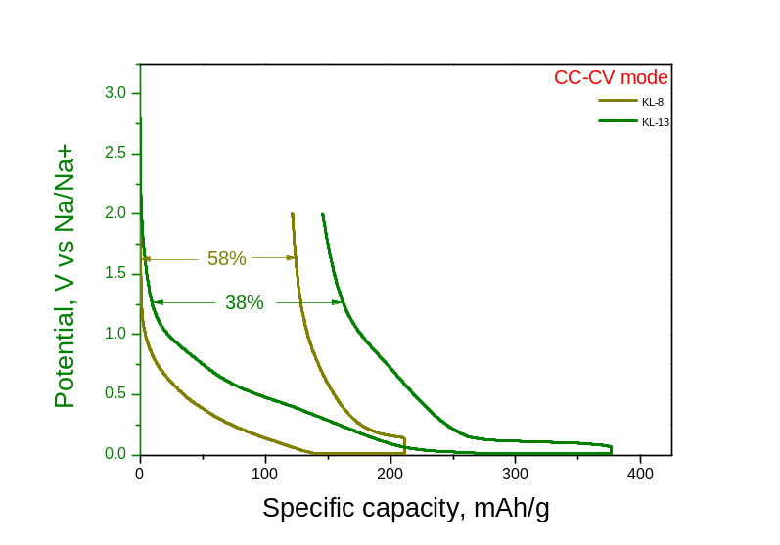
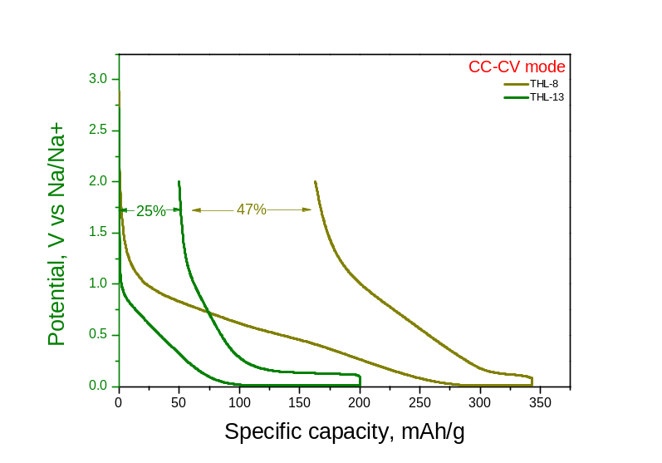
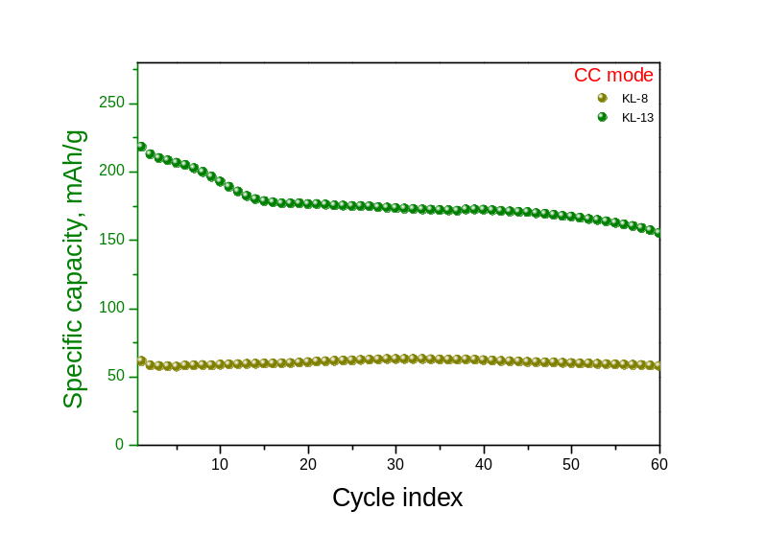
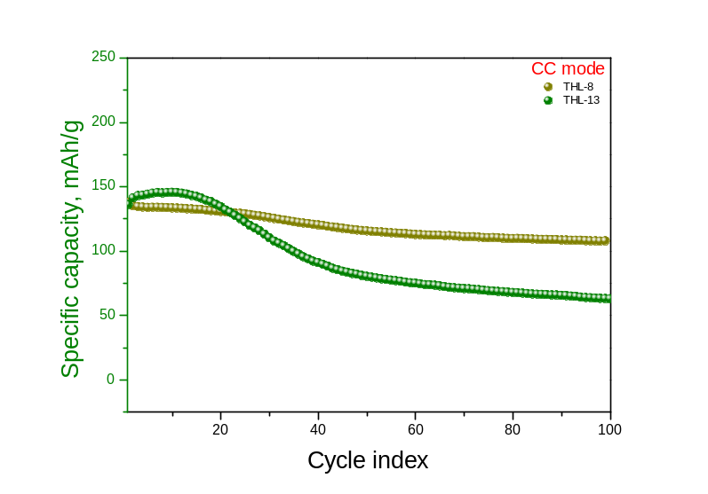
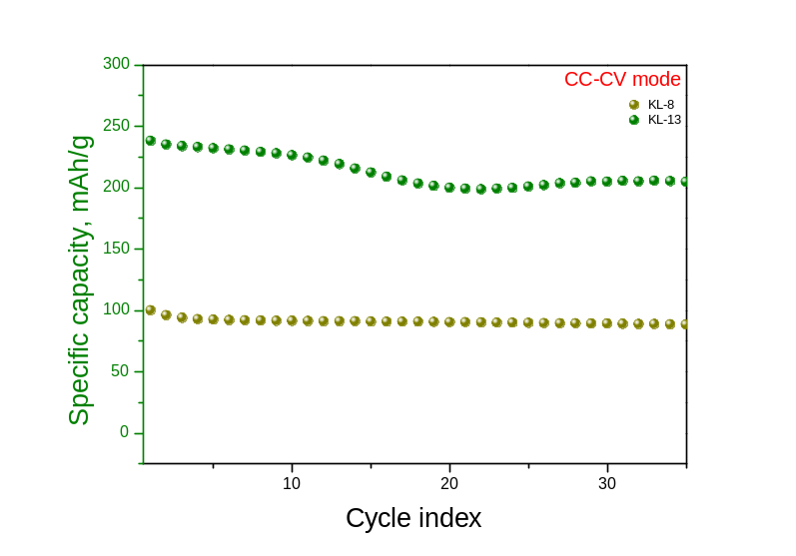
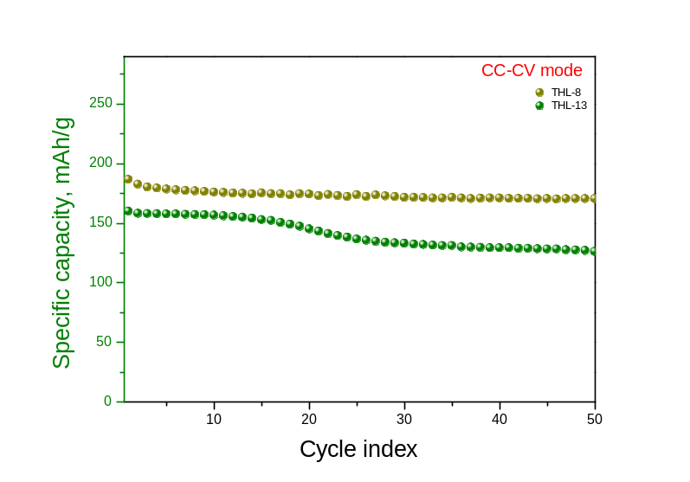
Results and discussions
Electrochemical test in half cells: THL/KL–(8/13) | Na PF₆: PC | Na
Galvanostatic cycling was performed at 50 mAh/g in the voltage range of 0.01 to 2.0 V in two modes – constant current (CC) and constant current-constant voltage (CC-CV). The results show that the hard carbon derived from THL were obtained for the low-temperature sample, while carbon obtained from KL showed excellent properties for the high-temperature sample.

Slide 5
Conclusions
Hard carbons derived from industrial biowaste by two-step pyrolysis at 800 and 1300 °C in an argon atmosphere show promising properties as anode materials for sodium-ion batteries.
An initial irreversible capacity loss is observed, probably due to the formation of SEI and/or sodium-ion filling in closed pores.
Despite the observed initial irreversible capacity loss, the materials demonstrate good reversible capacity and robust cycling stability.
Better electrochemical characteristics for hard carbon derived from THL were obtained for the low-temperature sample, while carbon obtained from KL showed excellent properties for the high-temperature sample.
These results demonstrate the potential for practical application of the thus obtained hard carbons as anodes for real sodium-ion batteries.
The authors thank for the financial support of the project BionN (КП-06-Н-69/7 from 15.12.2022).

