Slide 1

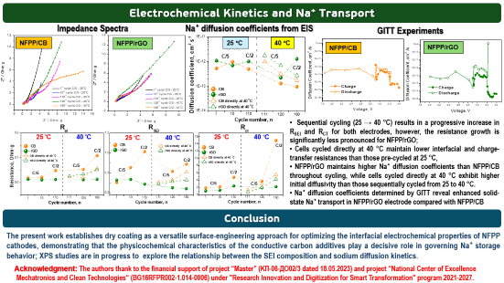
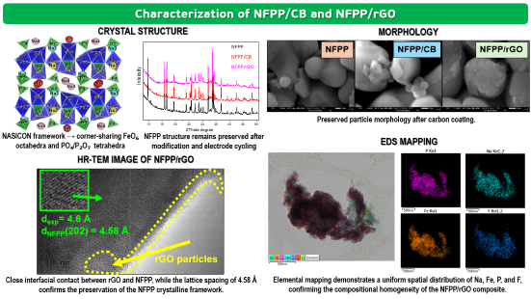
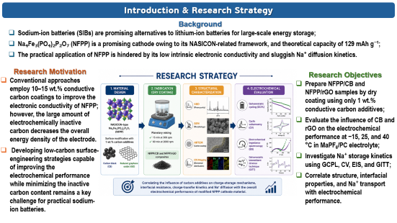
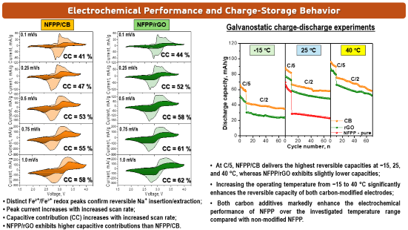
28th Congress of SCTM, 23-26 September, Ohrid, Macedonia
Sodium Ion Mobility In Carbon Decorated Na₄Fe₃(PO₄)₂P₂O₇ Electrode Material: Comparative Study
PSSE-P6
Trajche Tushev¹, Violeta Koleva^{1,2}, José L. Tirado³, Pedro Lavela³, Sergio Lavela³, Sonya Harizanova^{1,2}, Radostina Stoyanova^{1,2}
¹1Institute of General and Inorganic Chemistry, Bulgarian Academy of Sciences, Sofia-Bulgaria, ²National Centre of Excellence Mechatronics and Clean Technologies, Sofia-Bulgaria, ³Departamento de Química Inorgánica e Ingeniería Química, Universidad de Córdoba, Córdoba, Spain

Slide 2
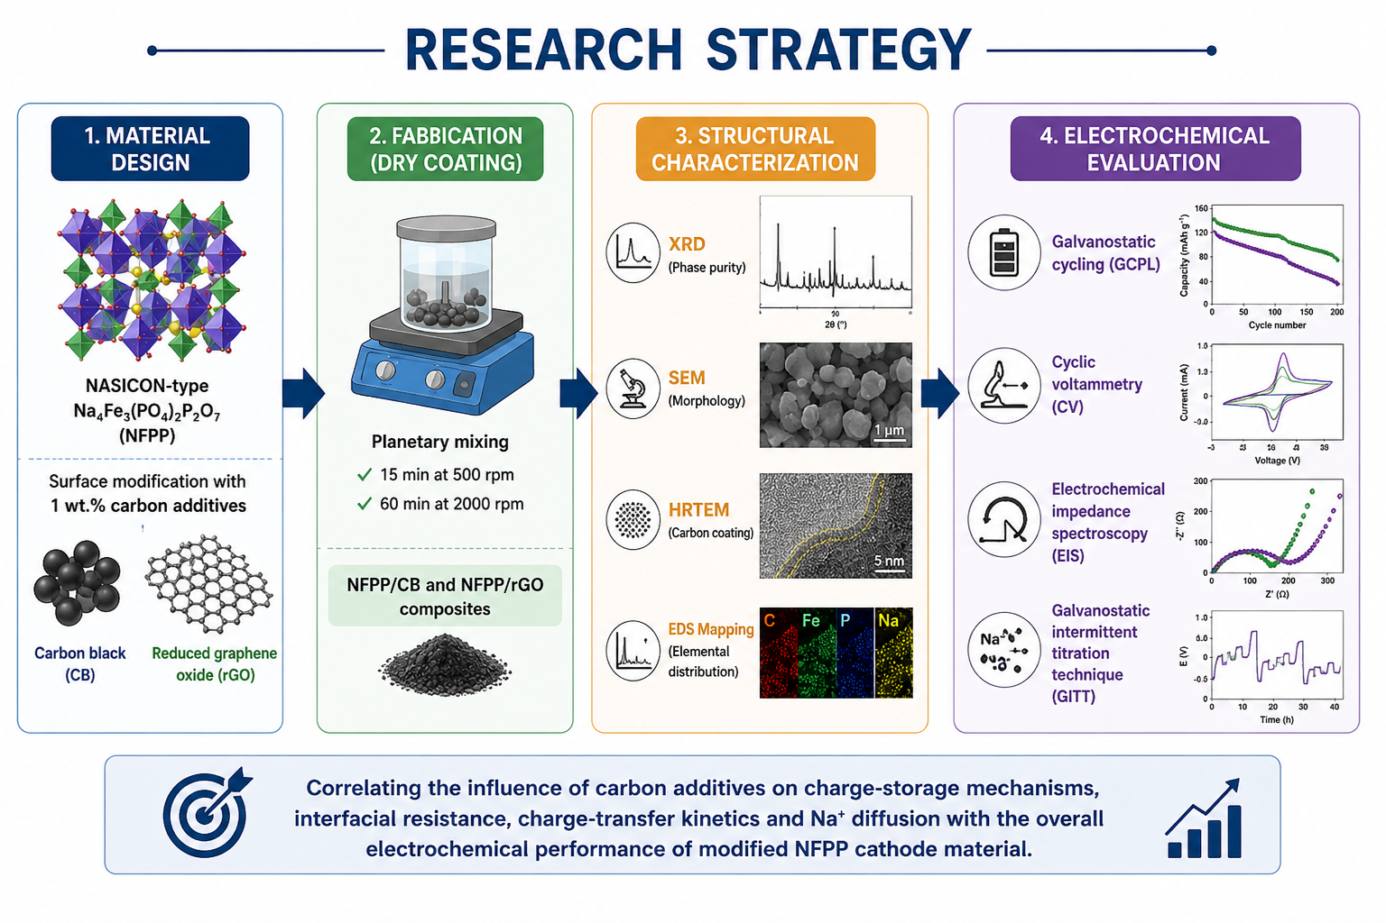
Introduction & Research Strategy
Background
Sodium-ion batteries (SIBs) are promising alternatives to lithium-ion batteries for large-scale energy storage;
Na₄Fe₃(PO₄)₂P₂O₇ (NFPP) is a promising cathode owing to its NASICON-related framework, and theoretical capacity of 129 mAh g⁻¹;
The practical application of NFPP is hindered by its low intrinsic electronic conductivity and sluggish Na⁺ diffusion kinetics.
Research Motivation
Conventional approaches employ 10–15 wt.% conductive carbon coatings to improve the electronic conductivity of NFPP; however, the large amount of electrochemically inactive carbon decreases the overall energy density of the electrode.
Developing low-carbon surface-engineering strategies capable of improving the electrochemical performance while minimizing the inactive carbon content remains a key challenge for practical sodium-ion batteries.
Research Objectives
Prepare NFPP/CB and NFPP/rGO samples by dry coating using only 1 wt.% conductive carbon additives;
Evaluate the influence of CB and rGO on the electrochemical performance at −15, 25, and 40 °C in MaPF₆/PC electrolyte;
Investigate Na⁺ storage kinetics using GCPL, CV, EIS, and GITT;
Correlate structure, interfacial properties, and Na⁺ transport with electrochemical performance.

Slide 3
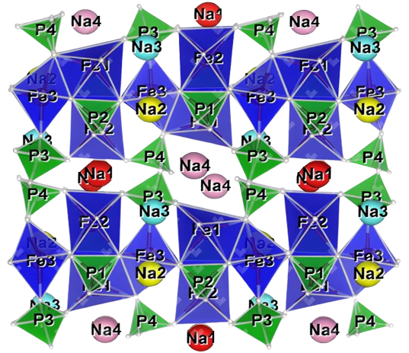
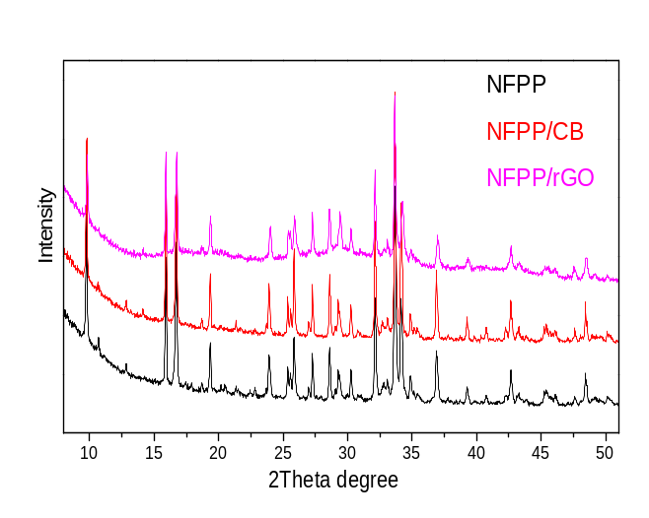
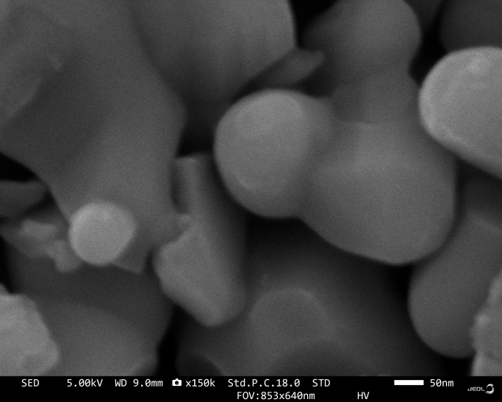
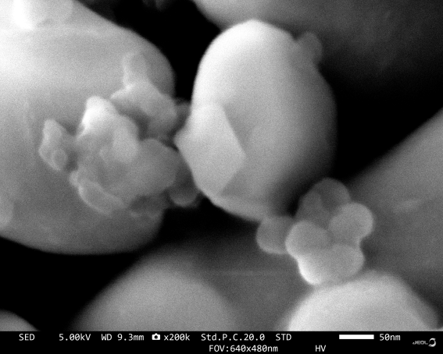
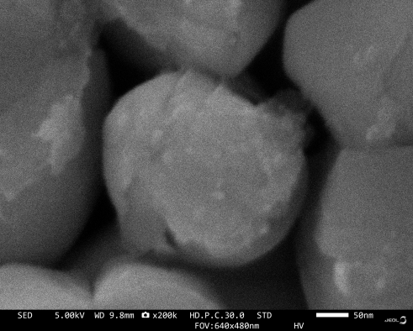
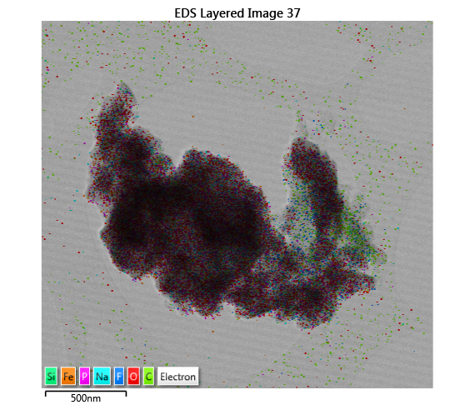
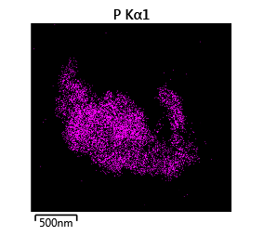
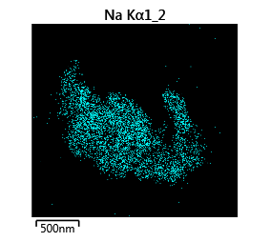
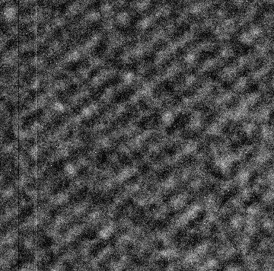
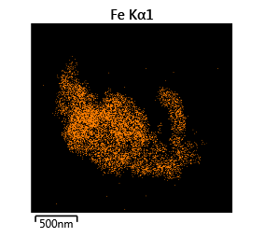
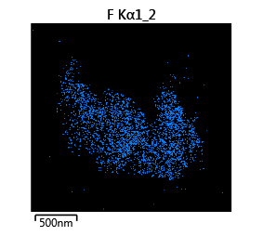
Characterization of NFPP/CB and NFPP/rGO
CRYSTAL STRUCTURE
MORPHOLOGY
NFPP
NFPP/CB
NFPP/rGO
Preserved particle morphology after carbon coating.
NASICON framework → corner-sharing FeO₆ octahedra and PO₄/P₂O₇ tetrahedra
NFPP structure remains preserved after modification and electrode cycling
EDS MAPPING
HR-TEM IMAGE OF NFPP/rGO
d_{exp}= 4.6 Å
d_{NFPP}(202) = 4.58 Å
rGO particles
Close interfacial contact between rGO and NFPP, while the lattice spacing of 4.58 Å confirms the preservation of the NFPP crystalline framework.
Elemental mapping demonstrates a uniform spatial distribution of Na, Fe, P, and F, confirming the compositional homogeneity of the NFPP/rGO composite.

Slide 4
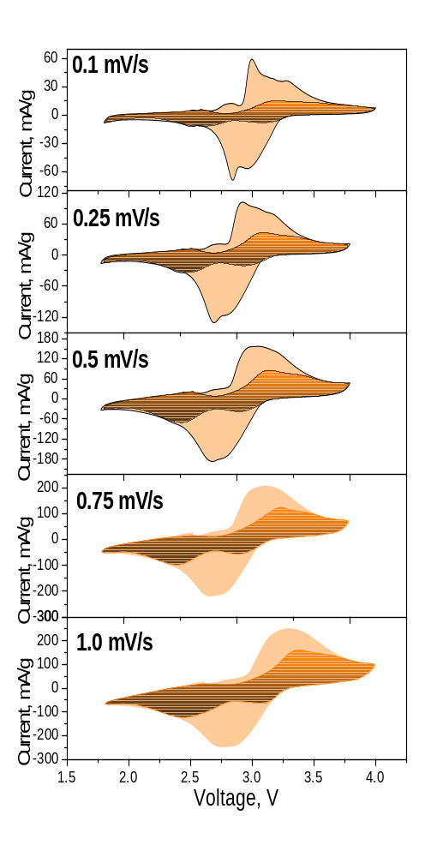
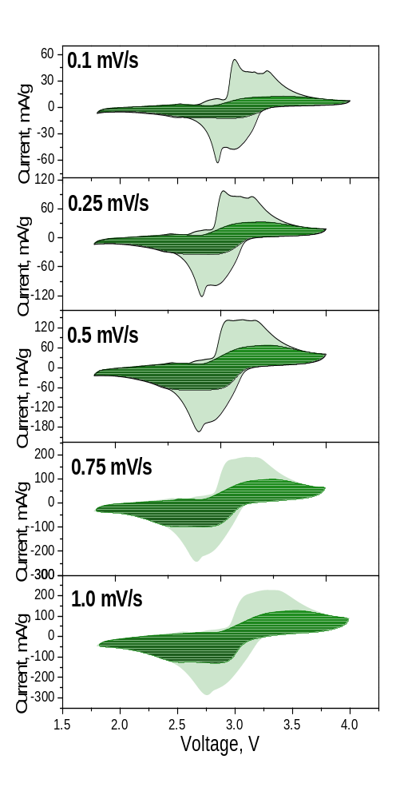
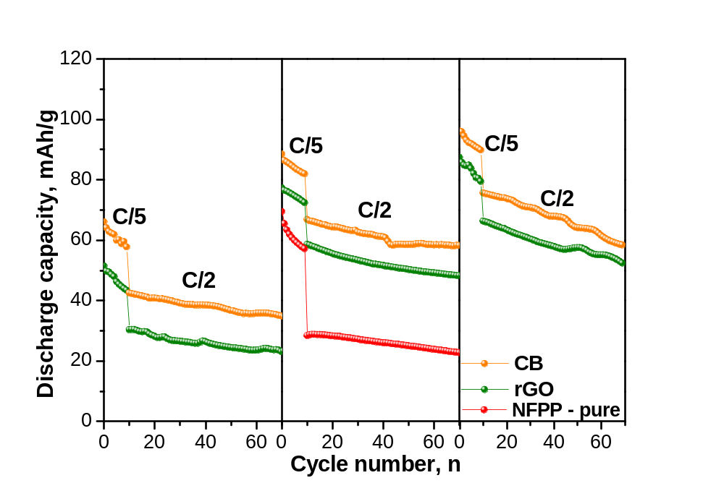
Electrochemical Performance and Charge-Storage Behavior
NFPP/CB
NFPP/rGO
Galvanostatic charge-discharge experiments
CC = 44 %
-15 °C
25 °C
40 °C
CC = 41 %
CC = 47 %
CC = 52 %
CC = 53 %
CC = 58 %
CC = 55 %
CC = 61 %
• At C/5, NFPP/CB delivers the highest reversible capacities at −15, 25, and 40 °C, whereas NFPP/rGO exhibits slightly lower capacities;
• Increasing the operating temperature from −15 to 40 °C significantly enhances the reversible capacity of both carbon-modified electrodes;
• Both carbon additives markedly enhance the electrochemical performance of NFPP over the investigated temperature range compared with non-modified NFPP.
CC = 58 %
CC = 62 %
• Distinct Fe²⁺/Fe³⁺ redox peaks confirm reversible Na⁺ insertion/extraction;
• Peak current increases with increased scan rate;
• Capacitive contribution (CC) increases with increased scan rate;
• NFPP/rGO exhibits higher capacitive contributions than NFPP/CB.

Slide 5
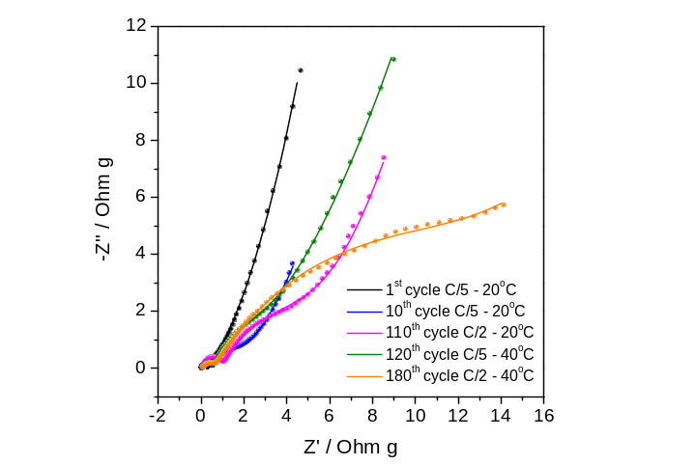
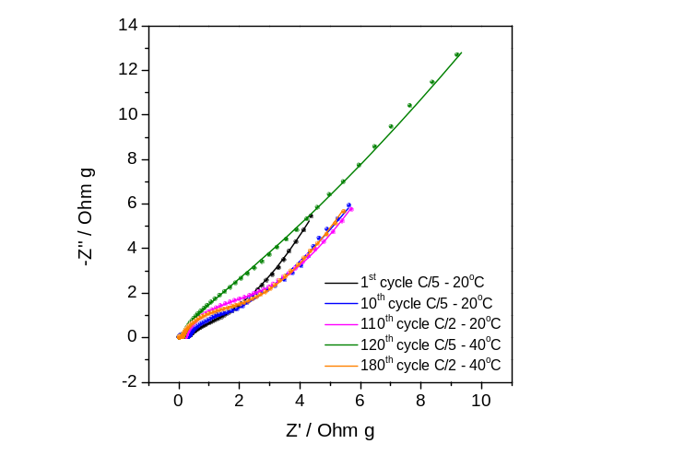
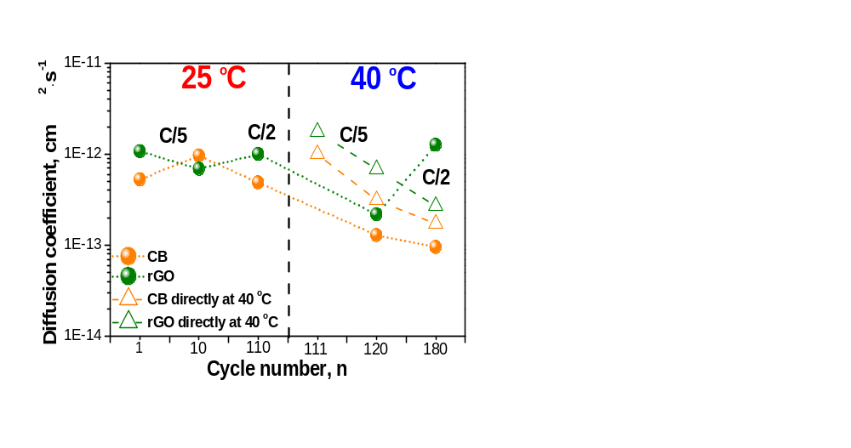
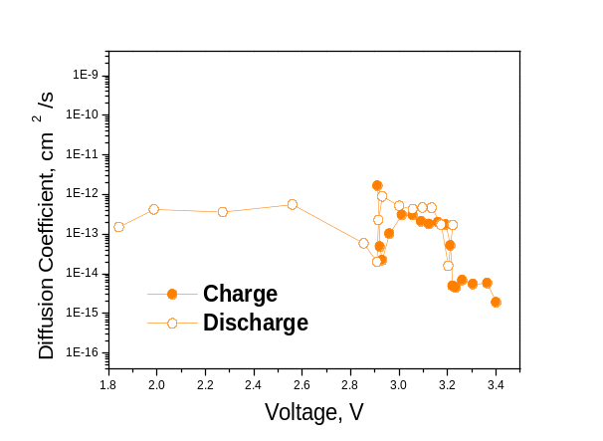
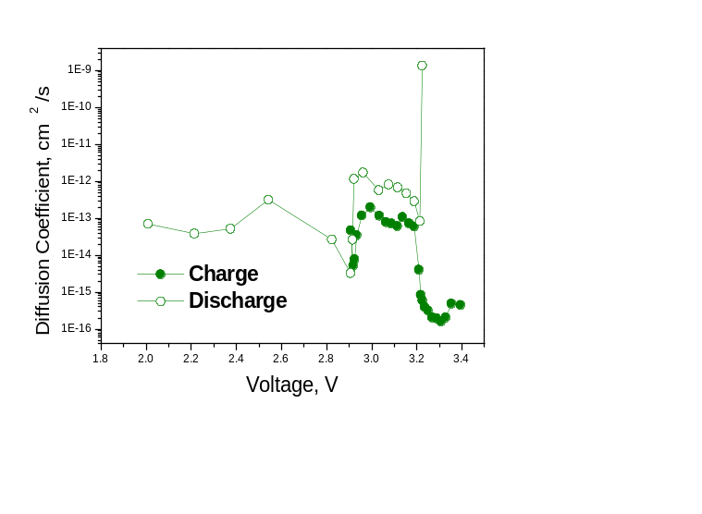
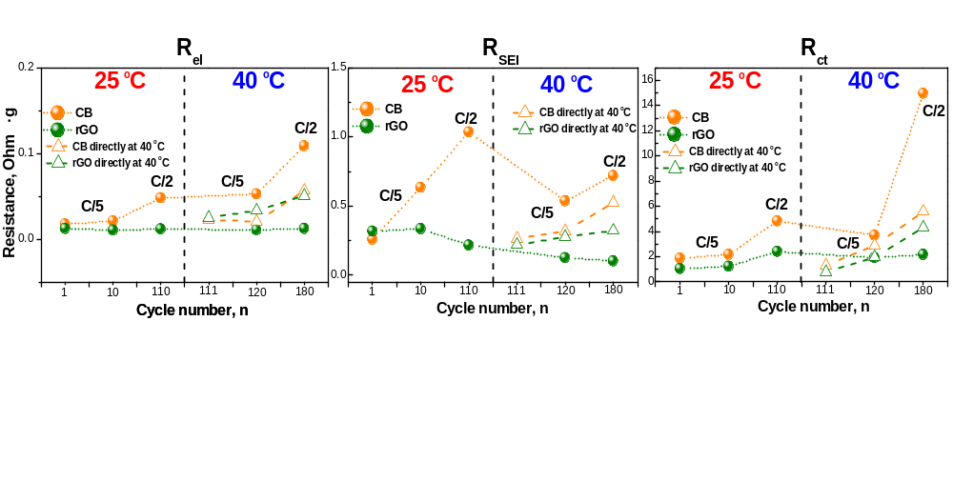
Electrochemical Kinetics and Na⁺ Transport
Impedance Spectra
Na⁺ diffusion coefficients from EIS
GITT Experiments
NFPP/CB
NFPP/rGO
25 °C
40 °C
NFPP/CB
NFPP/rGO
• Sequential cycling (25 → 40 °C) results in a progressive increase in R_{SEI} and R_{CT} for both electrodes, however, the resistance growth is significantly less pronounced for NFPP/rGO;
• Cells cycled directly at 40 °C maintain lower interfacial and charge-transfer resistances than those pre-cycled at 25 °C,
• NFPP/rGO maintains higher Na⁺ diffusion coefficients than NFPP/CB throughout cycling, while cells cycled directly at 40 °C exhibit higher initial diffusivity than those sequentially cycled from 25 to 40 °C.
• Na⁺ diffusion coefficients determined by GITT reveal enhanced solid-state Na⁺ transport in NFPP/rGO electrode compared with NFPP/CB
Conclusion
The present work establishes dry coating as a versatile surface-engineering approach for optimizing the interfacial electrochemical properties of NFPP cathodes, demonstrating that the physicochemical characteristics of the conductive carbon additives play a decisive role in governing Na⁺ storage behavior; XPS studies are in progress to explore the relationship between the SEI composition and sodium diffusion kinetics.
Acknowledgment: The authors thank to the financial support of project “Master” (KП-06-ДO02/3 dated 18.05.2023) and project “National Center of Excellence Mechatronics and Clean Technologies“ (BG16RFPR002-1.014-0006) under "Research Innovation and Digitization for Smart Transformation" program 2021-2027.

