Slide 1

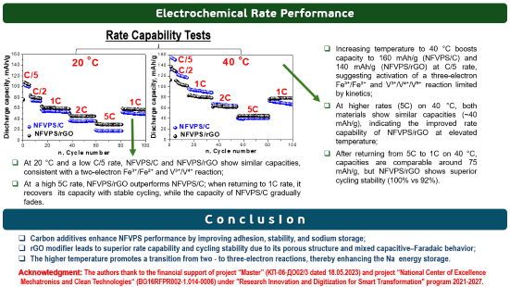
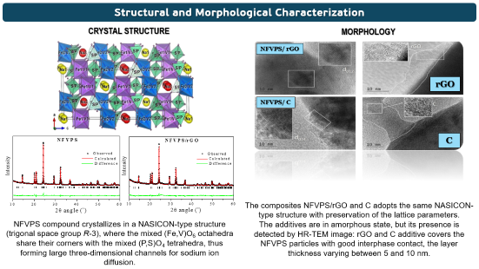
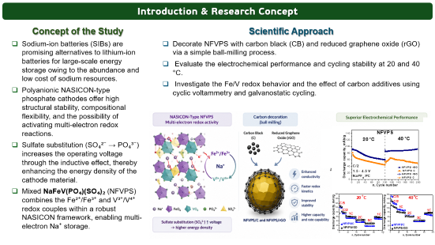
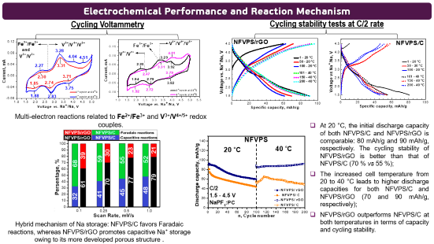
28th Congress of SCTM, 23-26 September, Ohrid, Macedonia
PSSE-P7
Еffect of Carbon Additives for Electrochemical Performance of Mixed Polyanion-Type Electrode Material NaFeVPO₄(SO₄)₂ for Sodium-Ion batteries
Trajche Tushev¹, Violeta Koleva^{1,2}, Sonya Harizanova^{1,2}, Radostina Stoyanova^{1,2}
¹Institute of General and Inorganic Chemistry, Bulgarian Academy of Sciences, Sofia-Bulgaria, ²National Centre of Excellence Mechatronics and Clean Technologies, Sofia-Bulgaria

Slide 2
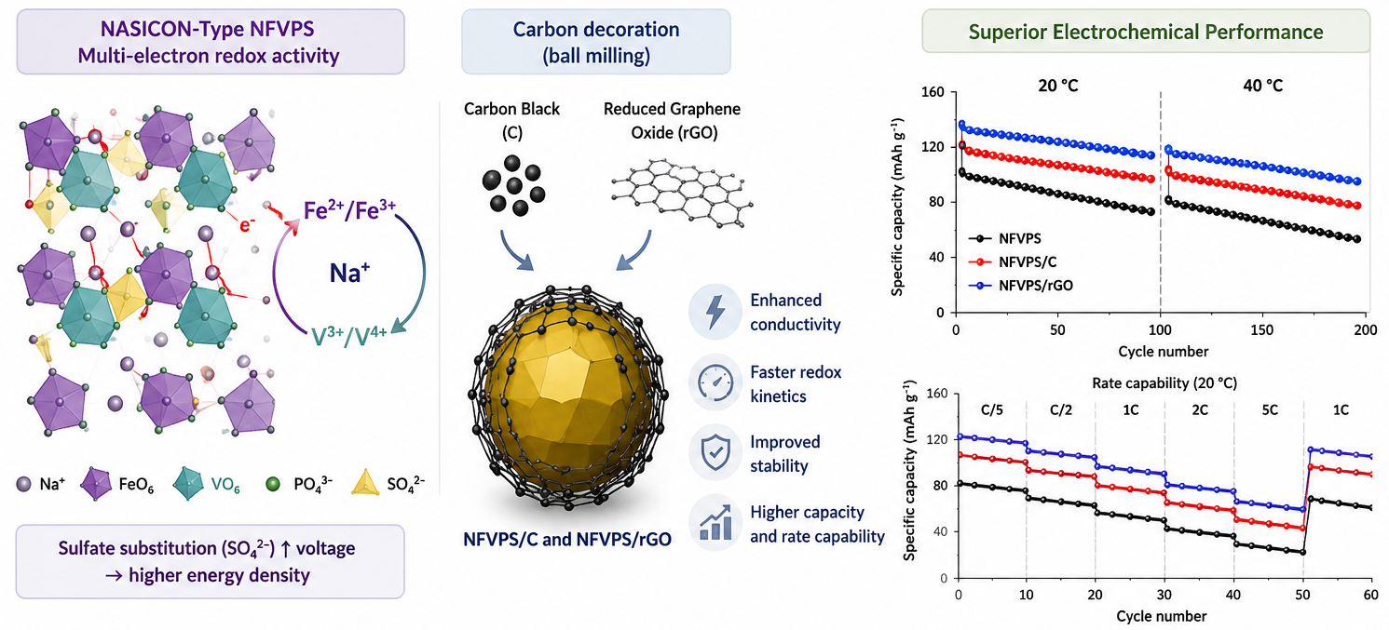

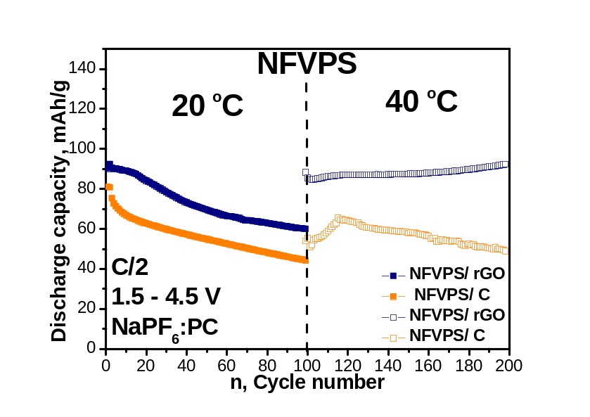
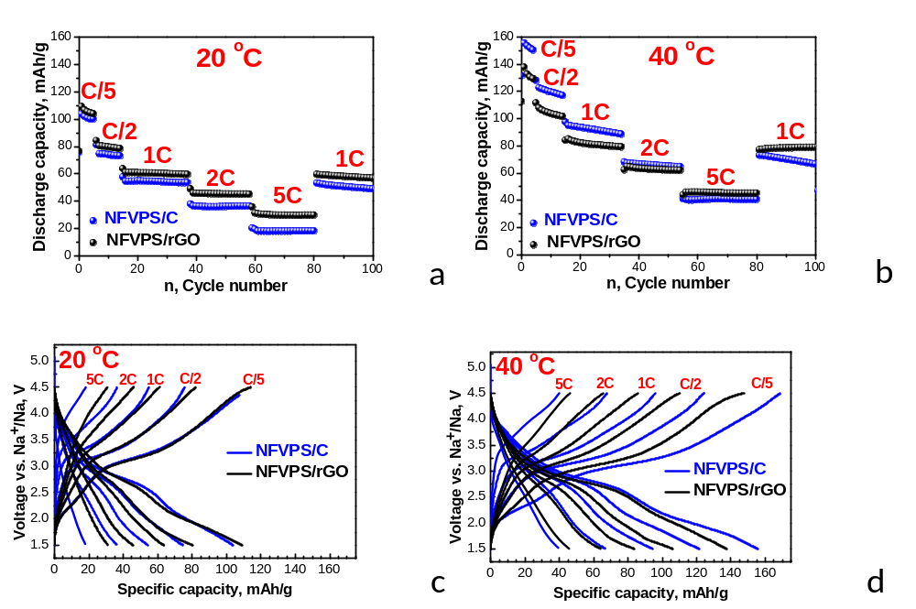
Introduction & Research Concept
Concept of the Study
Sodium-ion batteries (SIBs) are promising alternatives to lithium-ion batteries for large-scale energy storage owing to the abundance and low cost of sodium resources.
Polyanionic NASICON-type phosphate cathodes offer high structural stability, compositional flexibility, and the possibility of activating multi-electron redox reactions.
Sulfate substitution (SO₄²⁻ → PO₄³⁻) increases the operating voltage through the inductive effect, thereby enhancing the energy density of the cathode material.
Mixed NaFeV(PO₄)(SO₄)₂ (NFVPS) combines the Fe²⁺/Fe³⁺ and V³⁺/V⁴⁺ redox couples within a robust NASICON framework, enabling multi-electron Na⁺ storage.
Scientific Approach
Decorate NFVPS with carbon black (CB) and reduced graphene oxide (rGO) via a simple ball-milling process.
Evaluate the electrochemical performance and cycling stability at 20 and 40 °C.
Investigate the Fe/V redox behavior and the effect of carbon additives using cyclic voltammetry and galvanostatic cycling.

Slide 3
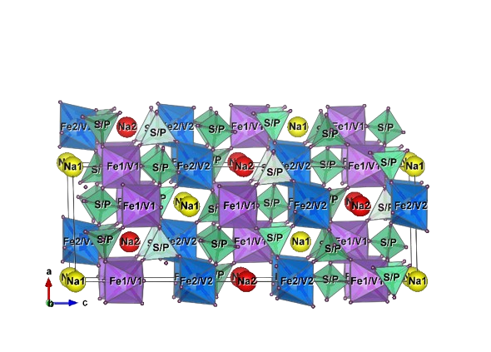
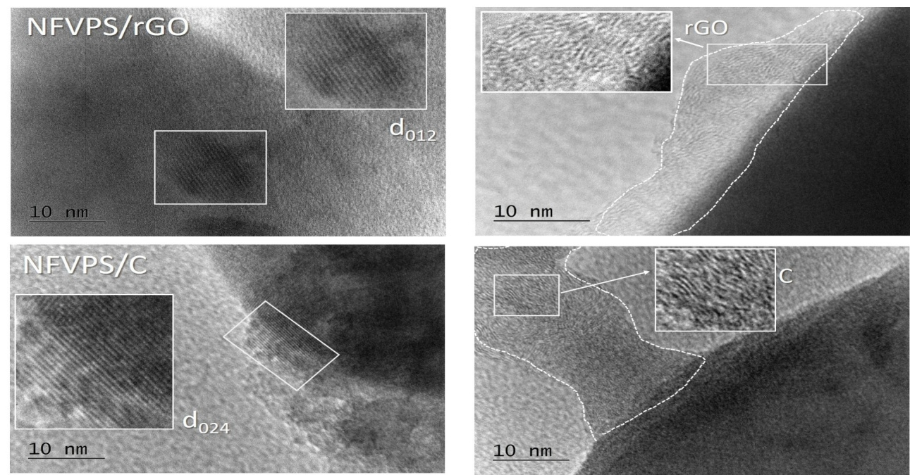
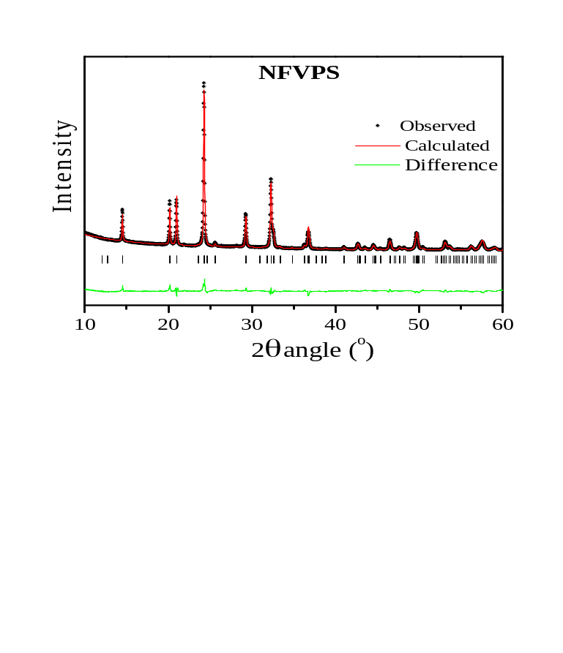
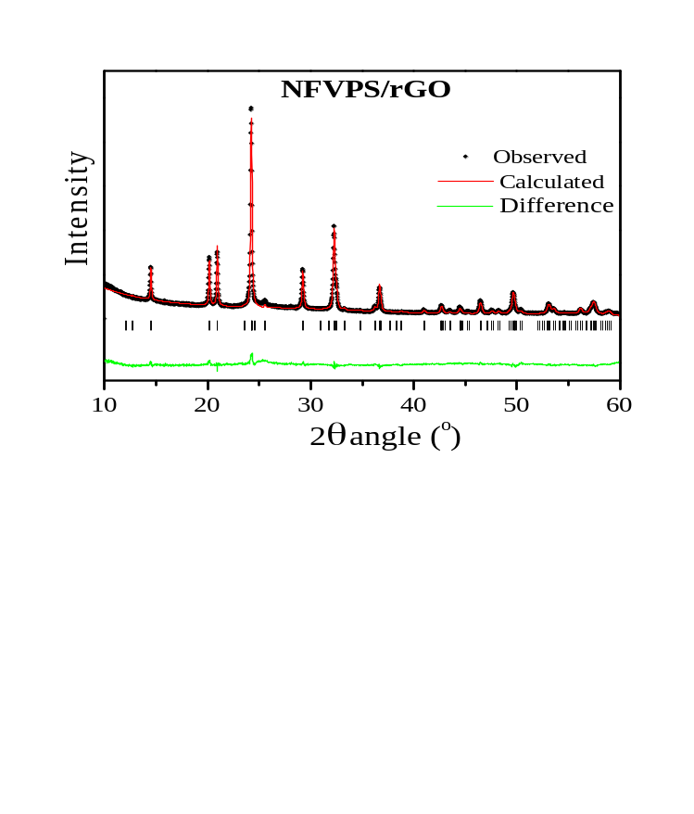
Structural and Morphological Characterization
CRYSTAL STRUCTURE
MORPHOLOGY
NFVPS/ rGO
rGO
NFVPS/ C
C
The composites NFVPS/rGO and C adopts the same NASICON-type structure with preservation of the lattice parameters.
The additives are in amorphous state, but its presence is detected by HR-TEM image: rGO and C additive covers the NFVPS particles with good interphase contact, the layer thickness varying between 5 and 10 nm.
NFVPS compound crystallizes in a NASICON-type structure (trigonal space group R-3), where the mixed (Fe,V)O₆ octahedra share their corners with the mixed (P,S)O₄ tetrahedra, thus forming large three-dimensional channels for sodium ion diffusion.

Slide 4
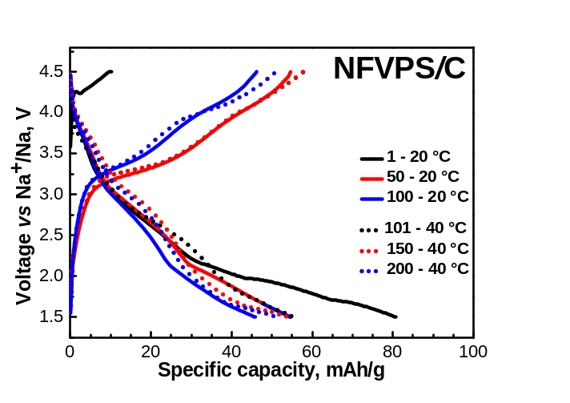
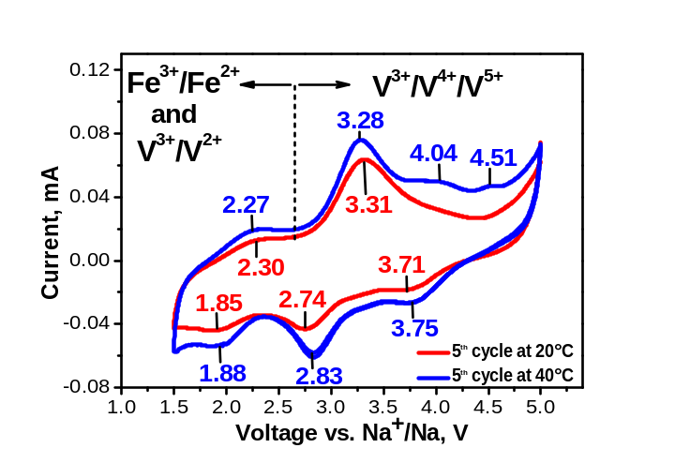
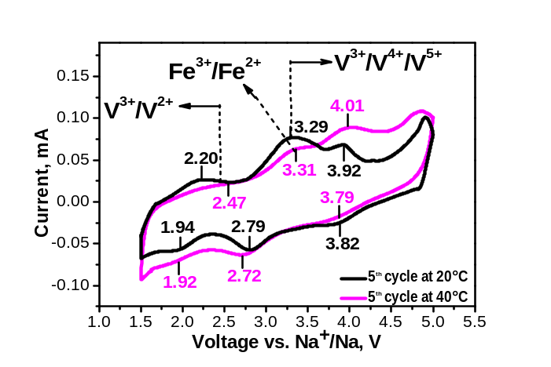
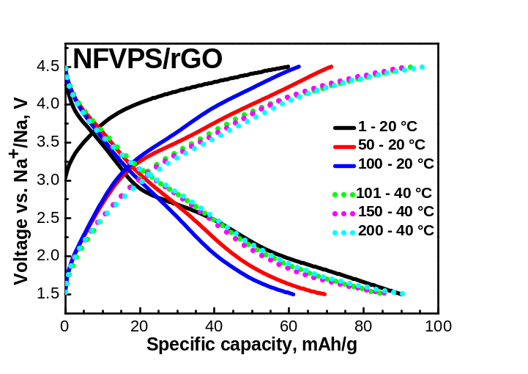
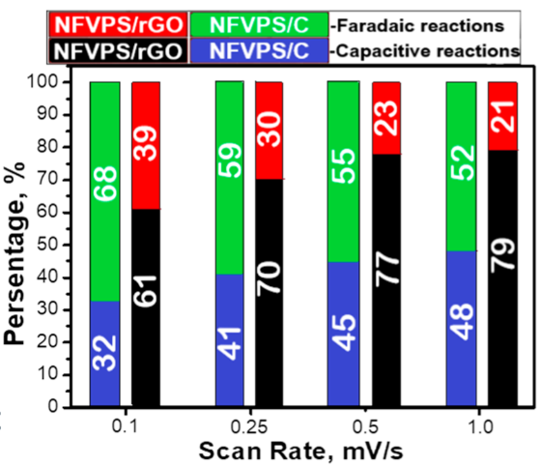
Electrochemical Performance and Reaction Mechanism
Cycling Voltammetry
Cycling stability tests at C/2 rate
Multi-electron reactions related to Fe²⁺/Fe³⁺ and V³⁺/V^{4+/5+} redox couples.
At 20 °C, the initial discharge capacity of both NFVPS/C and NFVPS/rGO is comparable: 80 mAh/g and 90 mAh/g, respectively. The cycling stability of NFVPS/rGO is better than that of NFVPS/C (70 % vs 55 %);
The increased cell temperature from 20 to 40 °C leads to higher discharge capacities for both NFVPS/C and NFVPS/rGO (70 and 90 mAh/g, respectively);
NFVPS/rGO outperforms NFVPS/C at both temperatures in terms of capacity and cycling stability.
Hybrid mechanism of Na storage: NFVPS/C favors Faradaic reactions, whereas NFVPS/rGO promotes capacitive Na⁺ storage owing to its more developed porous structure .

Slide 5
Electrochemical Rate Performance
Rate Capability Tests
Increasing temperature to 40 °C boosts capacity to 160 mAh/g (NFVPS/C) and 140 mAh/g (NFVPS/rGO) at C/5 rate, suggesting activation of a three-electron Fe³⁺/Fe²⁺ and V³⁺/V⁴⁺/V⁵⁺ reaction limited by kinetics;
At higher rates (5C) on 40 °C, both materials show similar capacities (~40 mAh/g), indicating the improved rate capability of NFVPS/rGO at elevated temperature;
After returning from 5C to 1C on 40 °C, capacities are comparable around 75 mAh/g, but NFVPS/rGO shows superior cycling stability (100% vs 92%).
At 20 °C and a low C/5 rate, NFVPS/C and NFVPS/rGO show similar capacities, consistent with a two-electron Fe³⁺/Fe²⁺ and V³⁺/V⁴⁺ reaction;
At a high 5C rate, NFVPS/rGO outperforms NFVPS/C; when returning to 1C rate, it recovers its capacity with stable cycling, while the capacity of NFVPS/C gradually fades.
C o n c l u s I o n
Carbon additives enhance NFVPS performance by improving adhesion, stability, and sodium storage;
rGO modifier leads to superior rate capability and cycling stability due to its porous structure and mixed capacitive–Faradaic behavior;
The higher temperature promotes a transition from two - to three-electron reactions, thereby enhancing the Na energy storage.
Acknowledgment: The authors thank to the financial support of project “Master” (KП-06-ДO02/3 dated 18.05.2023) and project “National Center of Excellence Mechatronics and Clean Technologies“ (BG16RFPR002-1.014-0006) under "Research Innovation and Digitization for Smart Transformation" program 2021-2027.

