Slide 1

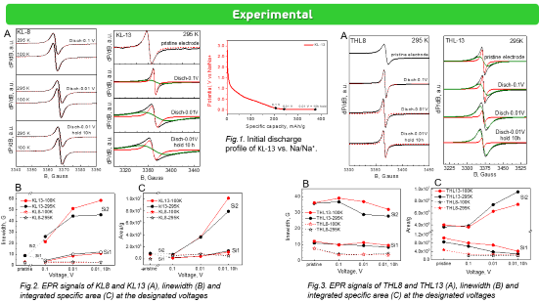
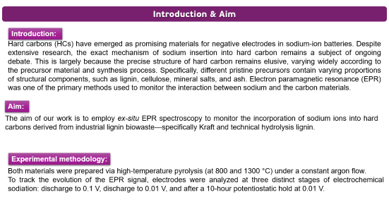
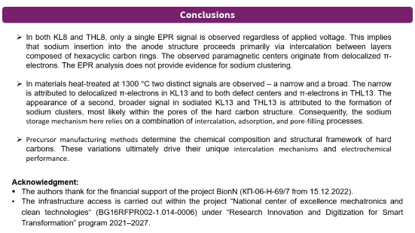
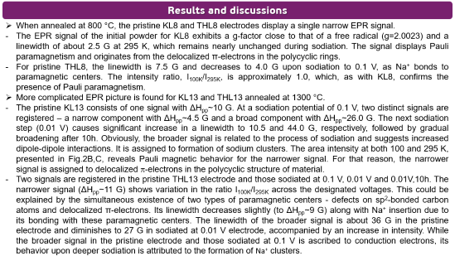
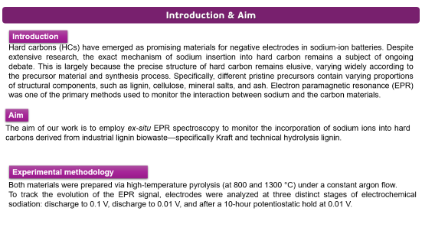
28th Congress of SCTM, 23-26 September, Ohrid, Macedonia
000
Deciphering sodium-ion insertion mechanism into hard carbon
by ex-situ EPR spectroscopy
Ts. Gerasimova¹, R. Kukeva^{1,2}, M. Kalapsazova^{1,2} and R. Stoyanova^{1,2}
¹Institute of General and Inorganic Chemistry – Bulgarian Academy of Sciences, Sofia, Bulgaria ,gerasimova@svr.igic.bas.bg
²National Centre of Excellence “Mechatronics and Clean Technologies”, Sofia, Bulgaria

Slide 2
Introduction & Aim
Introduction:
Hard carbons (HCs) have emerged as promising materials for negative electrodes in sodium-ion batteries. Despite extensive research, the exact mechanism of sodium insertion into hard carbon remains a subject of ongoing debate. This is largely because the precise structure of hard carbon remains elusive, varying widely according to the precursor material and synthesis process. Specifically, different pristine precursors contain varying proportions of structural components, such as lignin, cellulose, mineral salts, and ash. Electron paramagnetic resonance (EPR) was one of the primary methods used to monitor the interaction between sodium and the carbon materials.
Aim:
The aim of our work is to employ ex-situ EPR spectroscopy to monitor the incorporation of sodium ions into hard carbons derived from industrial lignin biowaste—specifically Kraft and technical hydrolysis lignin.
Experimental methodology:
Both materials were prepared via high-temperature pyrolysis (at 800 and 1300 °C) under a constant argon flow.
To track the evolution of the EPR signal, electrodes were analyzed at three distinct stages of electrochemical sodiation: discharge to 0.1 V, discharge to 0.01 V, and after a 10-hour potentiostatic hold at 0.01 V.

Slide 3
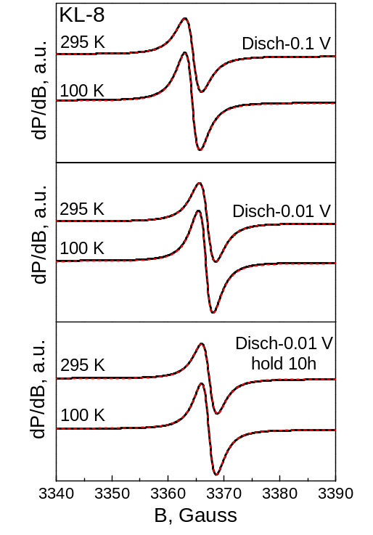
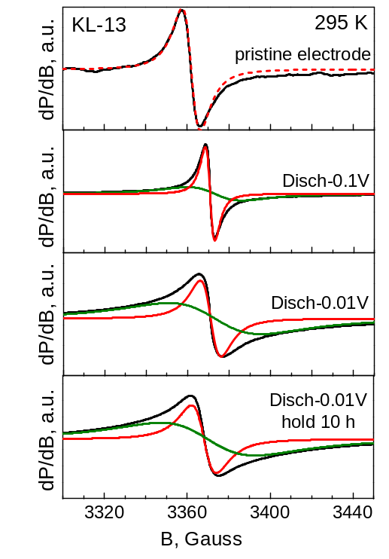
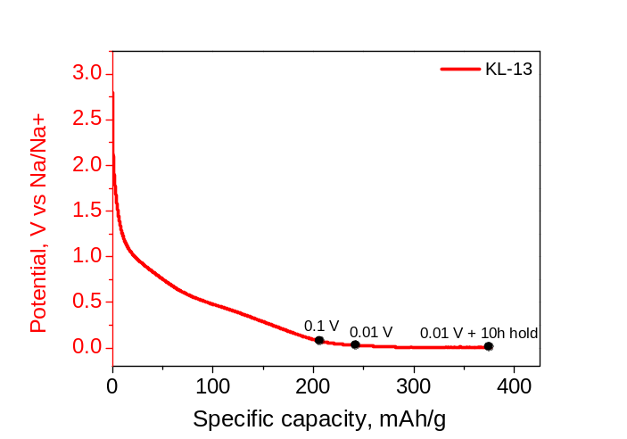
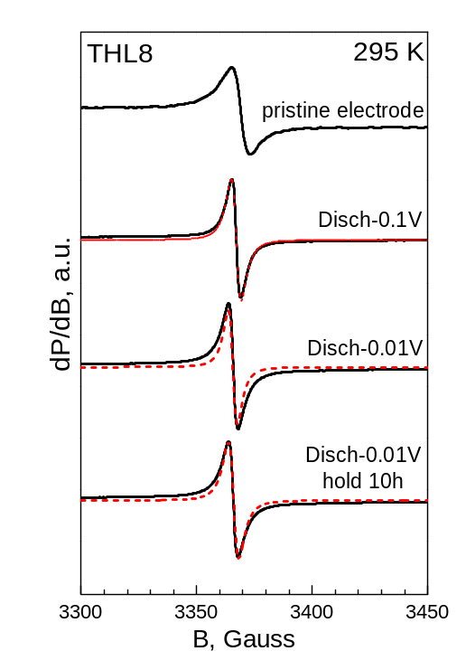
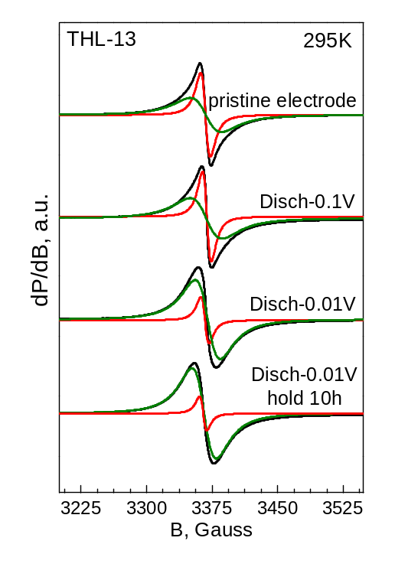
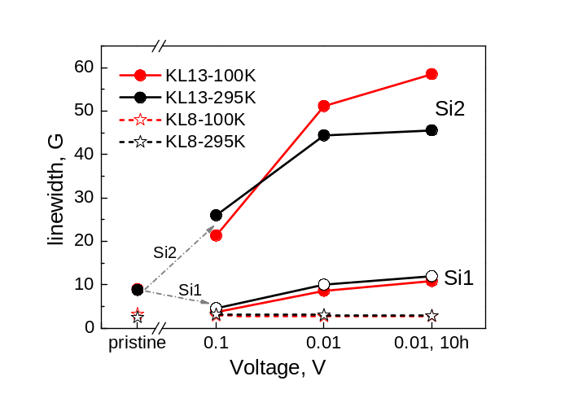
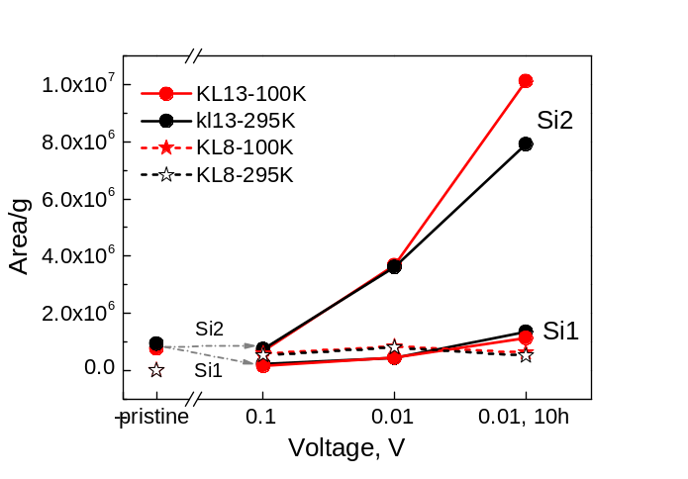
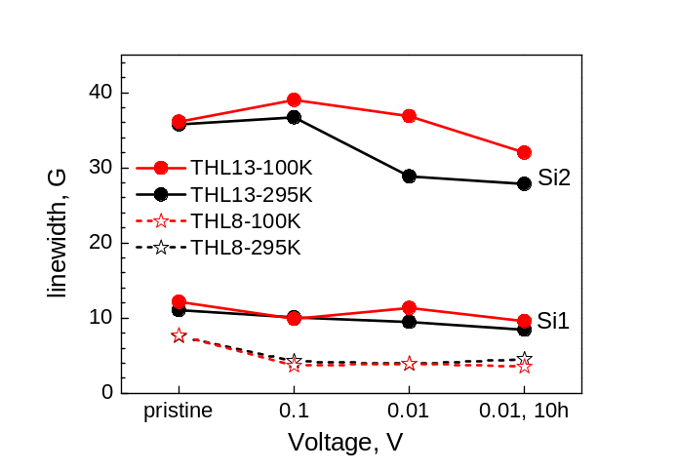
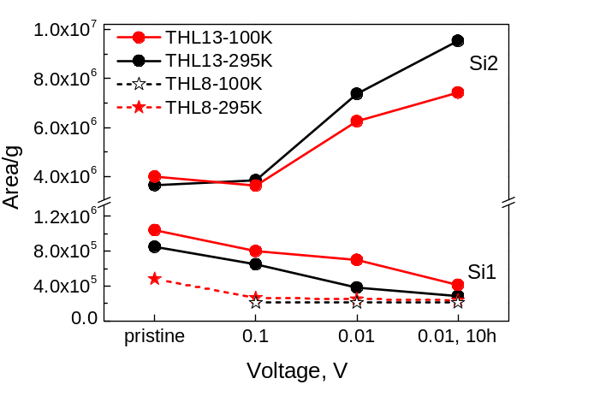
Experimental
A
A
Fig.1. Initial discharge profile of KL-13 vs. Na/Na⁺.
B
C
B
C
Fig.2. EPR signals of KL8 and KL13 (A), linewidth (B) and integrated specific area (C) at the designated voltages
Fig.3. EPR signals of THL8 and THL13 (A), linewidth (B) and integrated specific area (C) at the designated voltages

Slide 4
Results and discussions
When annealed at 800 °C, the pristine KL8 and THL8 electrodes display a single narrow EPR signal.
The EPR signal of the initial powder for KL8 exhibits a g-factor close to that of a free radical (g=2.0023) and a linewidth of about 2.5 G at 295 K, which remains nearly unchanged during sodiation. Thе signal displays Pauli paramagnetism and originates from the delocalized π-electrons in the polycyclic rings.
For pristine THL8, the linewidth is 7.5 G and decreases to 4.0 G upon sodiation to 0.1 V, as Na⁺ bonds to paramagnetic centers. The intensity ratio, I_{100K}/I_{295K}, is approximately 1.0, which, as with KL8, confirms the presence of Pauli paramagnetism.
More complicated EPR picture is found for KL13 and THL13 annealed at 1300 °C.
The pristine KL13 consists of one signal with ΔH_{pp}~10 G. At a sodiation potential of 0.1 V, two distinct signals are registered – a narrow component with ΔH_{pp}~4.5 G and a broad component with ΔH_{pp}~26.0 G. The next sodiation step (0.01 V) causes significant increase in a linewidth to 10.5 and 44.0 G, respectively, followed by gradual broadening after 10h. Obviously, the broader signal is related to the process of sodiation and suggests increased dipole-dipole interactions. It is assigned to formation of sodium clusters. The area intensity at both 100 and 295 K, presented in Fig.2B,C, reveals Pauli magnetic behavior for the narrower signal. For that reason, the narrower signal is assigned to delocalized π-electrons in the polycyclic structure of material.
Two signals are registered in the pristine THL13 electrode and those sodiated at 0.1 V, 0.01 V and 0.01V,10h. The narrower signal (ΔH_{pp}~11 G) shows variation in the ratio I_{100K}/I_{295K} across the designated voltages. This could be explained by the simultaneous existence of two types of paramagnetic centers - defects on sp²-bonded carbon atoms and delocalized π-electrons. Its linewidth decreases slightly (to ΔH_{pp}~9 G) along with Na⁺ insertion due to its bonding with these paramagnetic centers. The linewidth of the broader signal is about 36 G in the pristine electrode and diminishes to 27 G in sodiated at 0.01 V electrode, accompanied by an increase in intensity. While the broader signal in the pristine electrode and those sodiated at 0.1 V is ascribed to conduction electrons, its behavior upon deeper sodiation is attributed to the formation of Na⁺ clusters.

Slide 5
Conclusions
In both KL8 and THL8, only a single EPR signal is observed regardless of applied voltage. This implies that sodium insertion into the anode structure proceeds primarily via intercalation between layers composed of hexacyclic carbon rings. The observed paramagnetic centers originate from delocalized π-electrons. The EPR analysis does not provide evidence for sodium clustering.
In materials heat-treated at 1300 °C two distinct signals are observed – a narrow and a broad. The narrow is attributed to delocalized π-electrons in KL13 and to both defect centers and π-electrons in THL13. The appearance of a second, broader signal in sodiated KL13 and THL13 is attributed to the formation of sodium clusters, most likely within the pores of the hard carbon structure. Consequently, the sodium storage mechanism here relies on a combination of intercalation, adsorption, and pore-filling processes.
Precursor manufacturing methods determine the chemical composition and structural framework of hard carbons. These variations ultimately drive their unique intercalation mechanisms and electrochemical performance.
Acknowledgment:
The authors thank for the financial support of the project BionN (КП-06-Н-69/7 from 15.12.2022).
The infrastructure access is carried out within the project “National center of excellence mechatronics and clean technologies“ (BG16RFPR002-1.014-0006) under “Research Innovation and Digitization for Smart Transformation” program 2021–2027.

