Slide 1


Why the Peak Is Not Enough: Univariate Calibration Beyond the Beer–Lambert Approximation
Thomas G. Mayerhöfer, Johanna Mayerhöfer, Dominik Weber, Jürgen Popp

Slide 2
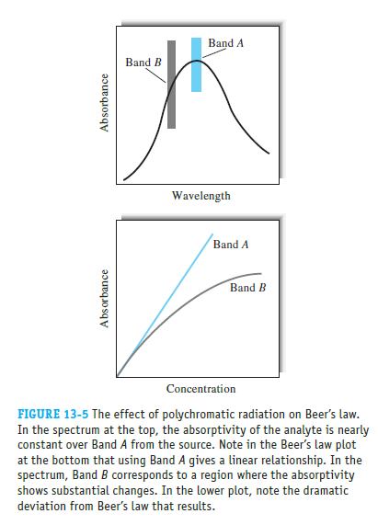

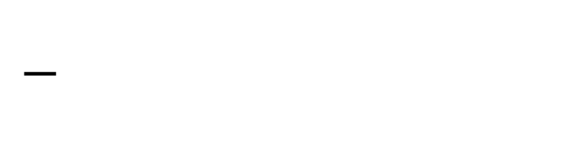
The Bouguer-Beer-Lambert approximation
$$−\log_{10}\frac{I}{I_{0}}=A=ε⋅c⋅d$$

Slide 3
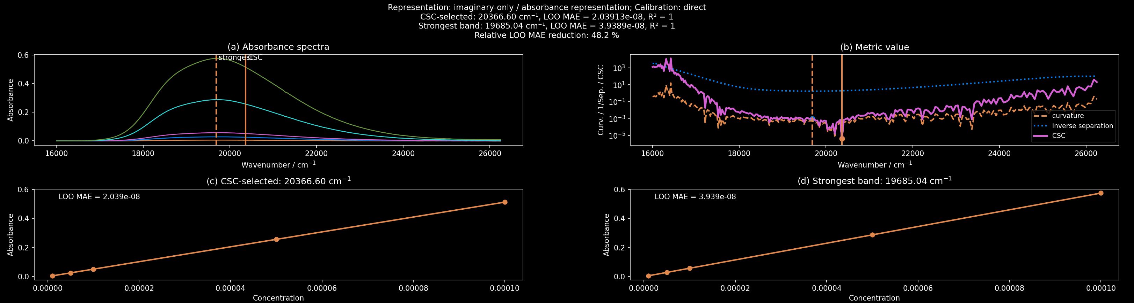
The Bouguer-Beer-Lambert approximation
Methylorange

Slide 4
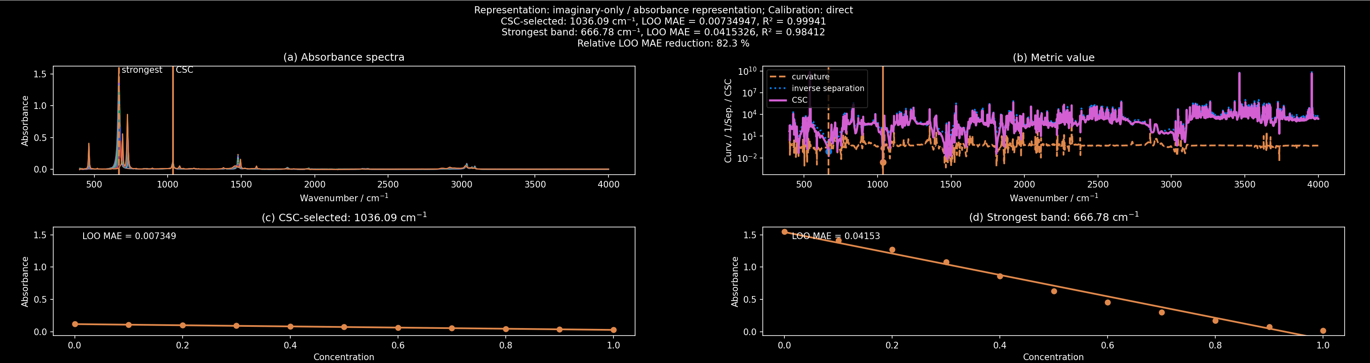
The Bouguer-Beer-Lambert approximation
Benzene-Toluene

Slide 5
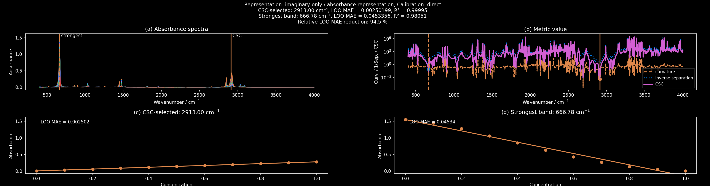
The Bouguer-Beer-Lambert approximation
Benzene-Cyclohexane

Slide 6
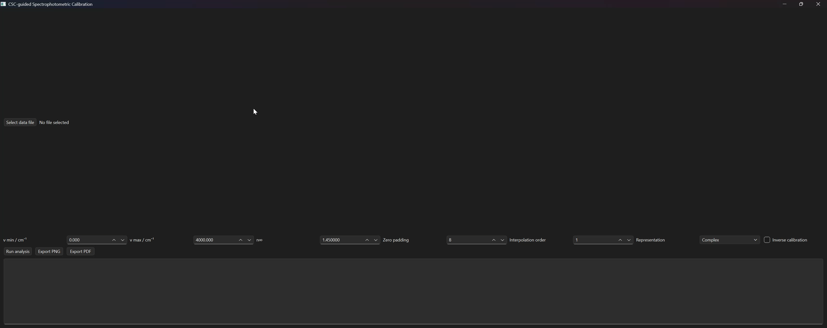
The Bouguer-Beer-Lambert approximation
ɛ-caprolactam

Slide 7
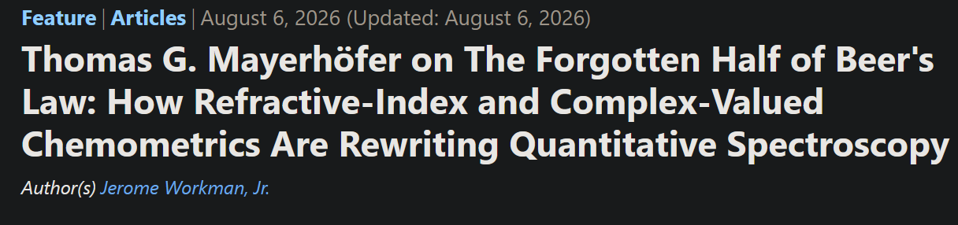
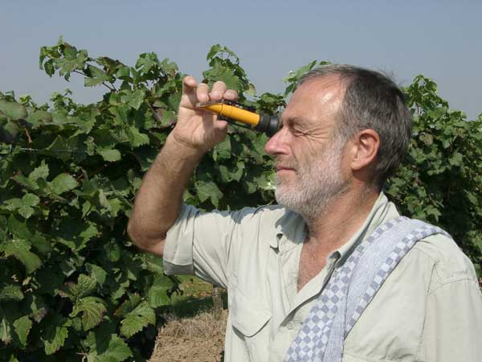

The other/forgotten/better half of Beer’s law
https://www.weingut-fuchs.de/bildergalerie/refraktometer.php
No additional measurement necessary!!!

Slide 8

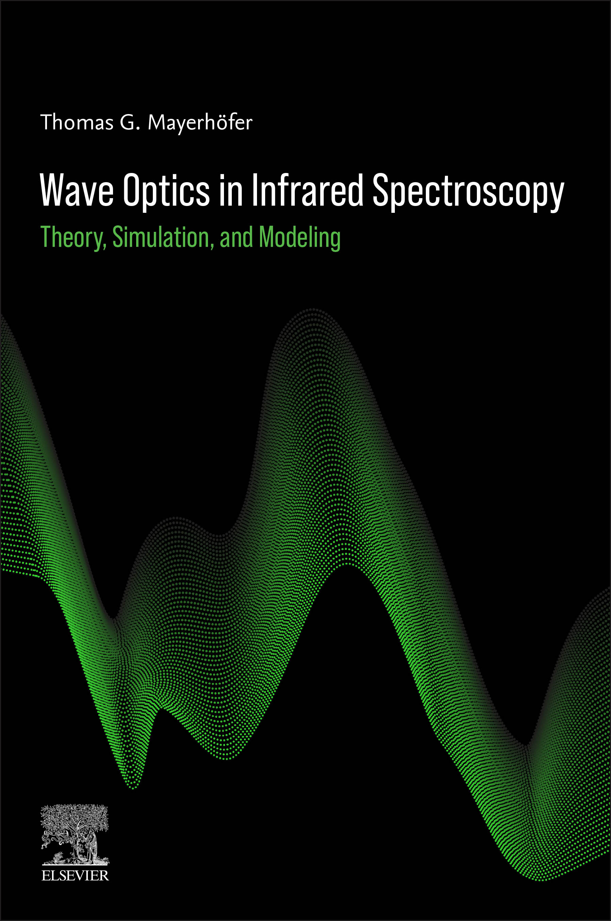
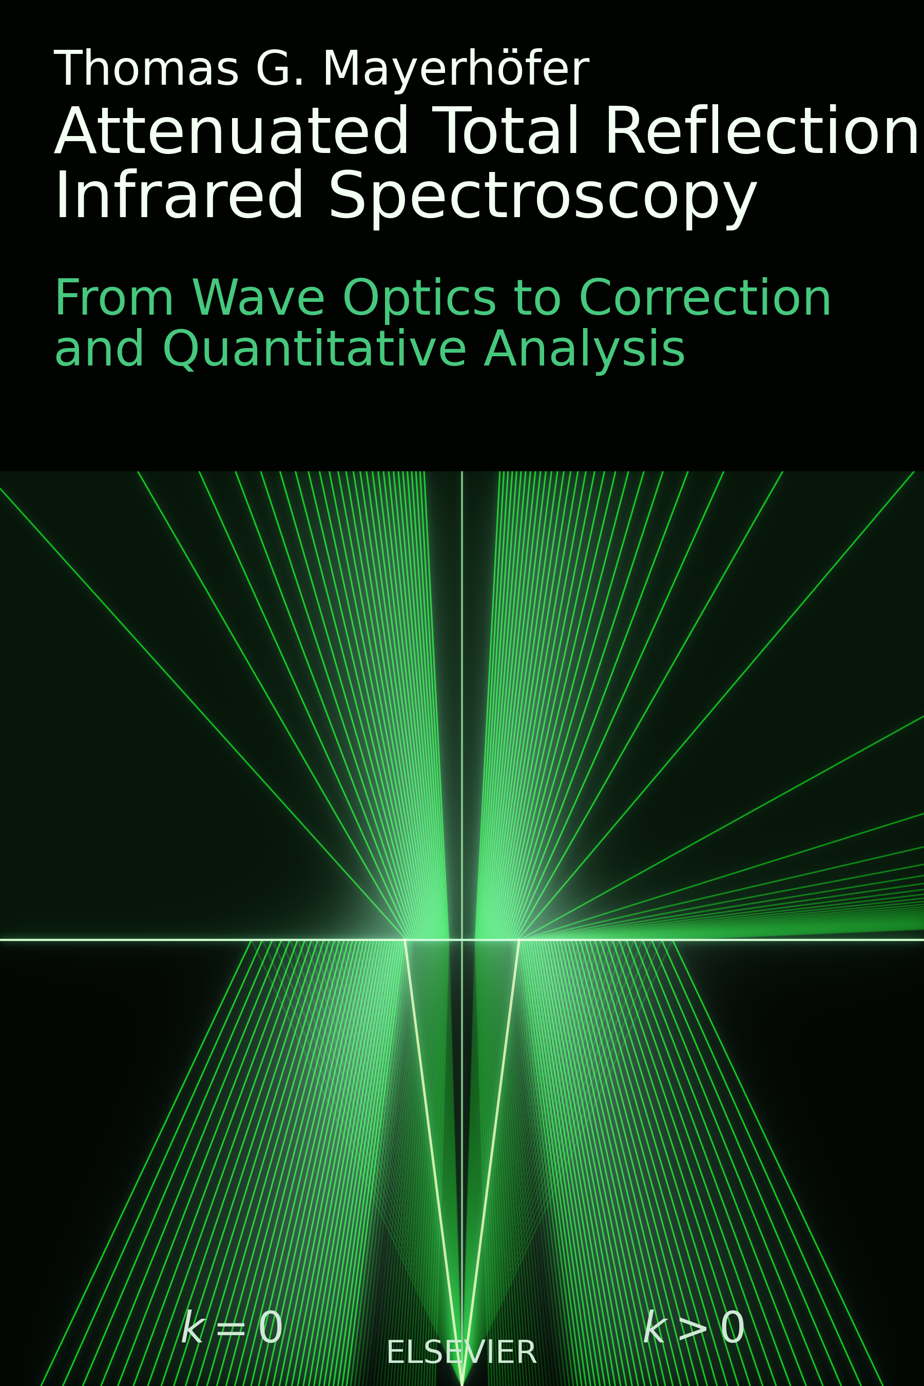

Thank you for your kind attention!
Acknowledgements
Dr. Susanne Pahlow
Dr. Oleksiy Ilchenko
Dr. Andrii Kutsyk
Dr. Alicja Dabrowska
Dr. Andreas Schwaighofer
Prof. Dr. Bernhard Lendl

