Slide 1



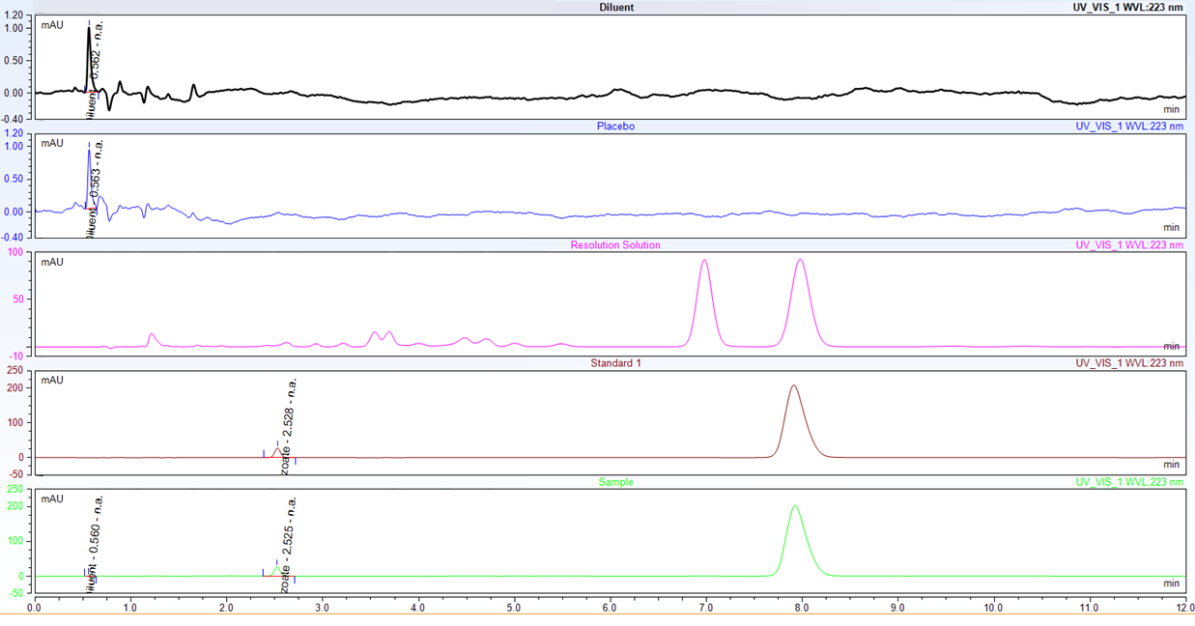
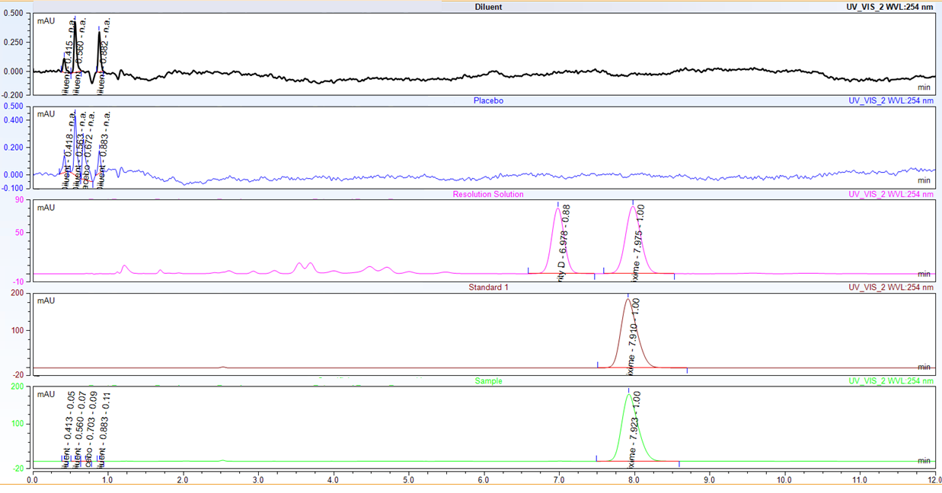
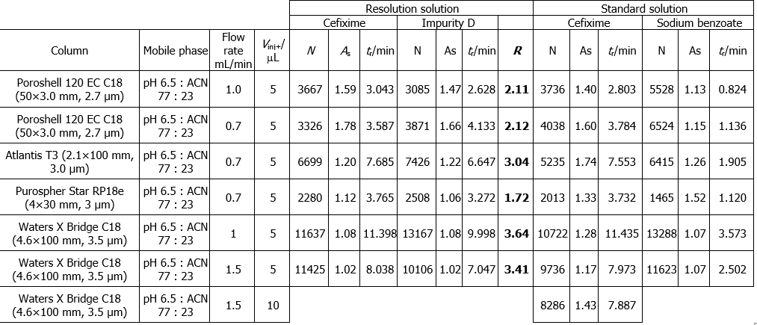
28th Congress of SCTM, 23-26 September, Ohrid, Macedonia
DEVELOPMENT AND OPTIMIZATION OF AN HPLC-UV-DAD METHOD FOR SIMULTANEOUS QUANTIFICATION OF CEFIXIME AND SODIUM BENZOTE IN ORAL SUSPENSION
Marijana Pejik^{1,2}, Marina Stefova², Stevce Petrovski¹, Maja Gjorgjeska¹, Sanja Kovacevska¹, Magdalena Atanasovski¹
e-mail: mpejic@alkaloid.com.mk
¹ Alkaloid AD Skopje, Skopje, Macedonia
² Institute of Chemistry, Faculty of Natural Sciences and Mathematics, Skopje, Macedonia
000
Introduction & Aim
Results & discussion
Antibiotics, especially cephalosporins, are widely used in modern medicine. Cefixime, a semisynthetic third-generation cephalosporin, is commonly formulated as an oral suspension containing sodium benzoate as a preservative. Current quantification procedures require separate analytical methods due to the different properties of the active ingredient and preservative. The aim of this study was development, optimization and validation of a simple, rapid, sensitive and specific HPLC method for simultaneous determination of cefixime and sodium benzoate in oral suspensions.
Specificity
Accuracy
 | Sodium benzoate (98-102 %) | Cefixime (98-102 %)
80 % | 101.22 | 99.62
100 % | 99.35 | 99.53
120 % | 101.13 | 100.56
Method development
Several HPLC and UHPLC columns were evaluated. While UHPLC provided faster analysis, HPLC showed better robustness for the oral suspension matrix. Mobile phase composition, flow rate, injection volume and detection wavelengths were optimized to achieve adequate separation and reliable quantification of sodium benzoate, cefixime and impurity D. The selected conditions provided good resolution and reproducible performance. (Table 1)
Linearity
 | R²>0.999
Sodium benzoate | 1.000
Cefixime | 1.000
Fig. 1. Chromatogram at 223 nm from diluent, placebo, resolution, standard and sample solution
Materials & methods
Table 1 Chromatographic parameters results (V_{inj} – injection volume, N – number of theoretical plates, As – asymmetry factor, R – resolution, t_{r} – retention time)
Precision
System | Nexera i Series
Column | Waters XBridge C18, 4.6 × 100 mm, 3.5 µm
Mobile phase | 77% TBAH buffer (31.6 mM, pH 6.5) / 23% ACN
Flow rate | 1.5 mL/min
Detection | 223 nm (Sodium benzoate) / 254 nm (Cefixime)
Temperature | 40 °C
Autosampler | 5 °C
Injection | 5 µL
 | System precision (%) RSD< 2.0
 | Ret. time | Area
Sodium benzoate | 0.2 | 0.6
Cefixime | 0.1 | 0.3
 | Method precision (%) RSD< 2.0
 | Ret. Time | Area | Amount
Sodium benzoate | 0.2 | 0.3 | 0.4
Cefixime | 0.1 | 0.3 | 0.5
Fig. 2. Chromatogram at 254 nm from diluent, placebo, resolution, standard and sample solution
Isocratic elution of both analytes achieved
in 12 minutes
Retention time of Cefixime: 7.8 minutes
Retention time of Sodium benzoate: 2.4 minutes
Robustness
Method robustness was demonstrated through intentional variations in acetonitrile content, buffer pH, flow rate, column lot, and column temperature.
Conclusion
The developed HPLC method is suitable for routine QC and regulatory applications. Simultaneous quantification of both analytes in a single run reduces analysis time, solvent consumption and laboratory costs.

