Slide 1

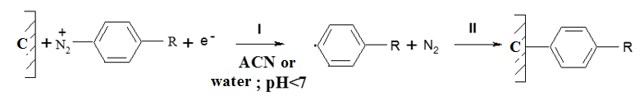




AEC-P28
28th Congress of SCTM, 23-26 September, Ohrid, Macedonia
ROLE OF THE SURFACE MODIFICATION OF COAL IN ENHANCING THE PROPERTIES OF REVERSE OSMOSIS MEMBRANES
Gentiana HASANI-BEKTESHI, Bashkim THAÇI*, Fetah PODVORICA, Arta DYLHASI
Deparment of Chemistry, University of Prishtina,10 000 Prishtinë, Republic of Kosovo
High-performance reverse osmosis membranes are expected to simultaneously exhibit high solute rejection, elevated water permeability, excellent chemical stability, and strong resistance to compaction, particularly in aqueous separation applications.¹ For several decades, aryl diazonium salts have been employed as reagents to modify a wide range of substrates, including carbons, metals, metal oxides (e.g., ZnO, Al₂O₃), nanomaterials, semiconductors, and polymer surfaces, with aryl moieties.
Coal surface modification in aqueous solution was performed as follows: the coal specimens were treated with boiling water under stirring conditions to remove all dissolved materials, i.e. inorganic part, color, etc. The residual coal after filtering was dried at 105ºC to constant weight.
The aryl groups strongly bonded in the coal particle surface had a significant impact on the rheology and morphology of the membranes, and these changes have influenced solute separation and solute solvent permeation rate.
The resulting membranes with enhanced hydrophilicity, look promising for improvement of impact resistance, stability and antifouling characteristics.

Slide 2
Introduction & Aim
High-performance reverse osmosis membranes are expected to simultaneously exhibit high solute rejection, elevated water permeability, excellent chemical stability, and strong resistance to compaction, particularly in aqueous separation applications.¹ For several decades, aryl diazonium salts have been employed as reagents to modify a wide range of substrates, including carbons, metals, metal oxides (e.g., ZnO, Al₂O₃), nanomaterials, semiconductors, and polymer surfaces, with aryl moieties.² The resulting grafted layers have diverse applications, including surface modification of membranes.³
This paper examines the role of aryldiazonium salt concentration in an aqueous acid medium in the chemical grafting of aryl moieties onto the coal surface, which is subsequently used for reverse osmosis (RO) membrane preparation. Coal particle surfaces were modified by chemical reduction of 4-nitrobenzene diazonium salt at different concentrations in an aqueous acid solution. Introducing aryl groups onto the coal surface, and thus into RO membranes, alters their characteristics, as shown by reverse osmosis parameters and SEM images. The resulting membranes showed the best results with coal particles modified with a middle concentration of aryldiazonium salt in aqueous medium with hypophosphoric acid. At an acceptable reverse osmosis salt rejection level (94.55 %) of NaCl-H₂O at a concentration of 0.4 g/dm³ as a reference system at 1.76 MPa, the flux was 42.6 L/hm².

Slide 3
Experimental
Coal surface modification in aqueous solution was performed as follows: the coal specimens were treated with boiling water under stirring conditions to remove all dissolved materials, i.e., inorganic parts, color, etc. The residual coal after filtering was dried at 105 °C to constant weight. Typically, 8 g of this coal was dispersed in 100 cm³ acetonitrile, and the same volume of aqueous solutions of (H₃PO₂, H₂SO₄, HCl, HNO₃, and H₃PO₄ of the same concentration 0.01M), and 5, 10, 15, 20, 50 mM of ⁺N₂C₆H₄NO₂BF₄^{-,} under stirring at a temperature < 5 °C for 5 h.
Film casting details
Table 1.Film casting details:
Concentration wt%
Casting solution Batches 317 K-1(I, II, III, IV, V)
___________________________________________
Cellulose acetate (E 398-3) 10
Modified Coal 15
Acetone 61,3
Magnesium perchlorate 1,45
Water 12,25
__________________________________________
Conditions of membrane preparation:
Temperature of casting solution: 24ºC
Temperature of casting atmosphere: 24ºC
Casting in ambient air: (RH-60%)
Solvent evaporation time: zero min.
Duration of film-setting in ice-cold water~0 ºC: 1hr.

Slide 4
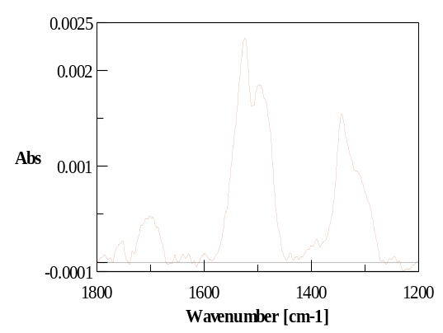
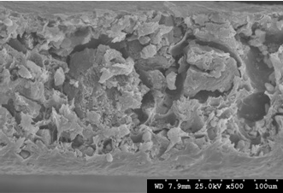
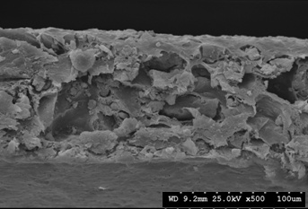

Results and discussions
 | Film type Batches | film no. | Film shrink. temp. ºC | A x 10⁻¹¹ gmol H₂O /cm² s Pa | D_{AM}/kδ 10⁻⁴ cm/s | f, solute sep. % | PR g/h | PWR g/h
(batch 317K-1, II) | H₃PO₂ 10mM DS | 1 | 88 | 3.96 | 1.19 | 89.55 | 60.86 | 61.26
 |  | 2 | 85 | 5.24 | 2.84 | 83.21 | 79.89 | 80.94
 | HCl 10mM DS | 1 | 88 | 2.74 | 0.54 | 93.40 | 40.93 | 42.34
 |  | 2 | 85 | 4.28 | 1.56 | 87.28 | 64.83 | 66.23
 | H₂SO₄ 10mM DS | 1 | 88 | 2.85 | 0.67 | 92.23 | 42.99 | 44.07
 |  | 2 | 85 | 3.79 | 1.52 | 86.71 | 57.67 | 58.62
 | HNO₃ 10mM DS | 1 | 88 | 2.99 | 0.69 | 92.28 | 45.27 | 46.32
 |  | 2 | 85 | 3.35 | 1.20 | 88.23 | 50.79 | 51.82
 | H₃PO₄ 10mM DS | 1 | 88 | 2.69 | 0.67 | 91.85 | 40.62 | 41.50
 |  | 2 | 85 | 3.67 | 1.53 | 86.39 | 55.79 | 56.72
(batch 317K-1, III) | H₃PO₂ 15mM DS | 1 | 88 | 3.75 | 1.01 | 90.78 | 57.48 | 57.92
 |  | 2 | 85 | 4.01 | 1.21 | 89.45 | 60.24 | 61.98
 | HCl 15mM DS | 1 | 88 | 2.71 | 0.68 | 91.90 | 41.25 | 41.89
 |  | 2 | 85 | 3.19 | 1.06 | 89.30 | 49.32 | 50.51
 | H₂SO₄ 15mM DS | 1 | 88 | 2.00 | 3.76 | 94.07 | 30.10 | 31.02
 |  | 2 | 85 | 3.27 | 7.76 | 91.88 | 48.89 | 50.63
 | HNO₃ 15mM DS | 1 | 88 | 2.52 | 0.54 | 93.08 | 38.33 | 38.98
 |  | 2 | 85 | 2.77 | 0.64 | 92.38 | 41.75 | 42.93
 | H₃PO₄ 15mM DS | 1 | 88 | 2.64 | 0.60 | 92.49 | 39.43 | 40.87
 |  | 2 | 85 | 3.78 | 1.85 | 84.38 | 57.81 | 58.43
(batch 317K-1, IV) | H₃PO₂ 20mM DS | 1 | 88 | 3.34 | 0.52 | 94.55 | 50.82 | 51.69
 |  | 2 | 85 | 3.76 | 0.88 | 91.82 | 57.14 | 58.06
 | HCl 20mM DS | 1 2 | 88 85 | 2.99 4.62 | 0.87 1.55 | 90.58 87.94 | 45.71 69.97 | 46.20 71.38
 | H₂SO₄ 20mM DS | 1 | 88 | 2.49 | 0.59 | 92.39 | 37.89 | 38.54
 |  | 2 | 85 | 2.82 | 0.73 | 91.55 | 42.93 | 43.65
 | HNO₃ 20mM DS | 1 | 88 | 3.05 | 0.87 | 90.38 | 45.29 | 47.09
 |  | 2 | 85 | 4.39 | 2.57 | 81.05 | 66.80 | 67.95
 | H₃PO₄ 20mM DS | 1 | 88 | 2.04 | 0.34 | 94.67 | 30.93 | 31.59
 |  | 2 | 85 | 3.85 | 1.49 | 87.03 | 58.59 | 59.60

Slide 5
Conclusions
Spontaneous grafting of aryl diazonium salts on coal surface particles can be achieved in aqueous acid and aprotic solutions at different concentrations of diazonium salt. Best results are obtained with DS concentrations in the range of 10 – 20 mM. This parameter is shown to be an important casting solution constituent for preparation of heterogeneous reverse osmosis membranes.
The aryl groups strongly bonded to the coal particle surface had a significant impact on the rheology and morphology of the membranes, and these changes have influenced solute separation and solute solvent permeation rate. RO membranes made of modified coal in an aqueous solution of hypophosphoric acid have superior characteristics; significant enhancement of flux compared with CA bare coal membranes.
The resulting membranes with enhanced hydrophilicity look promising for improvement of impact resistance, stability, and antifouling characteristics.

