Slide 1


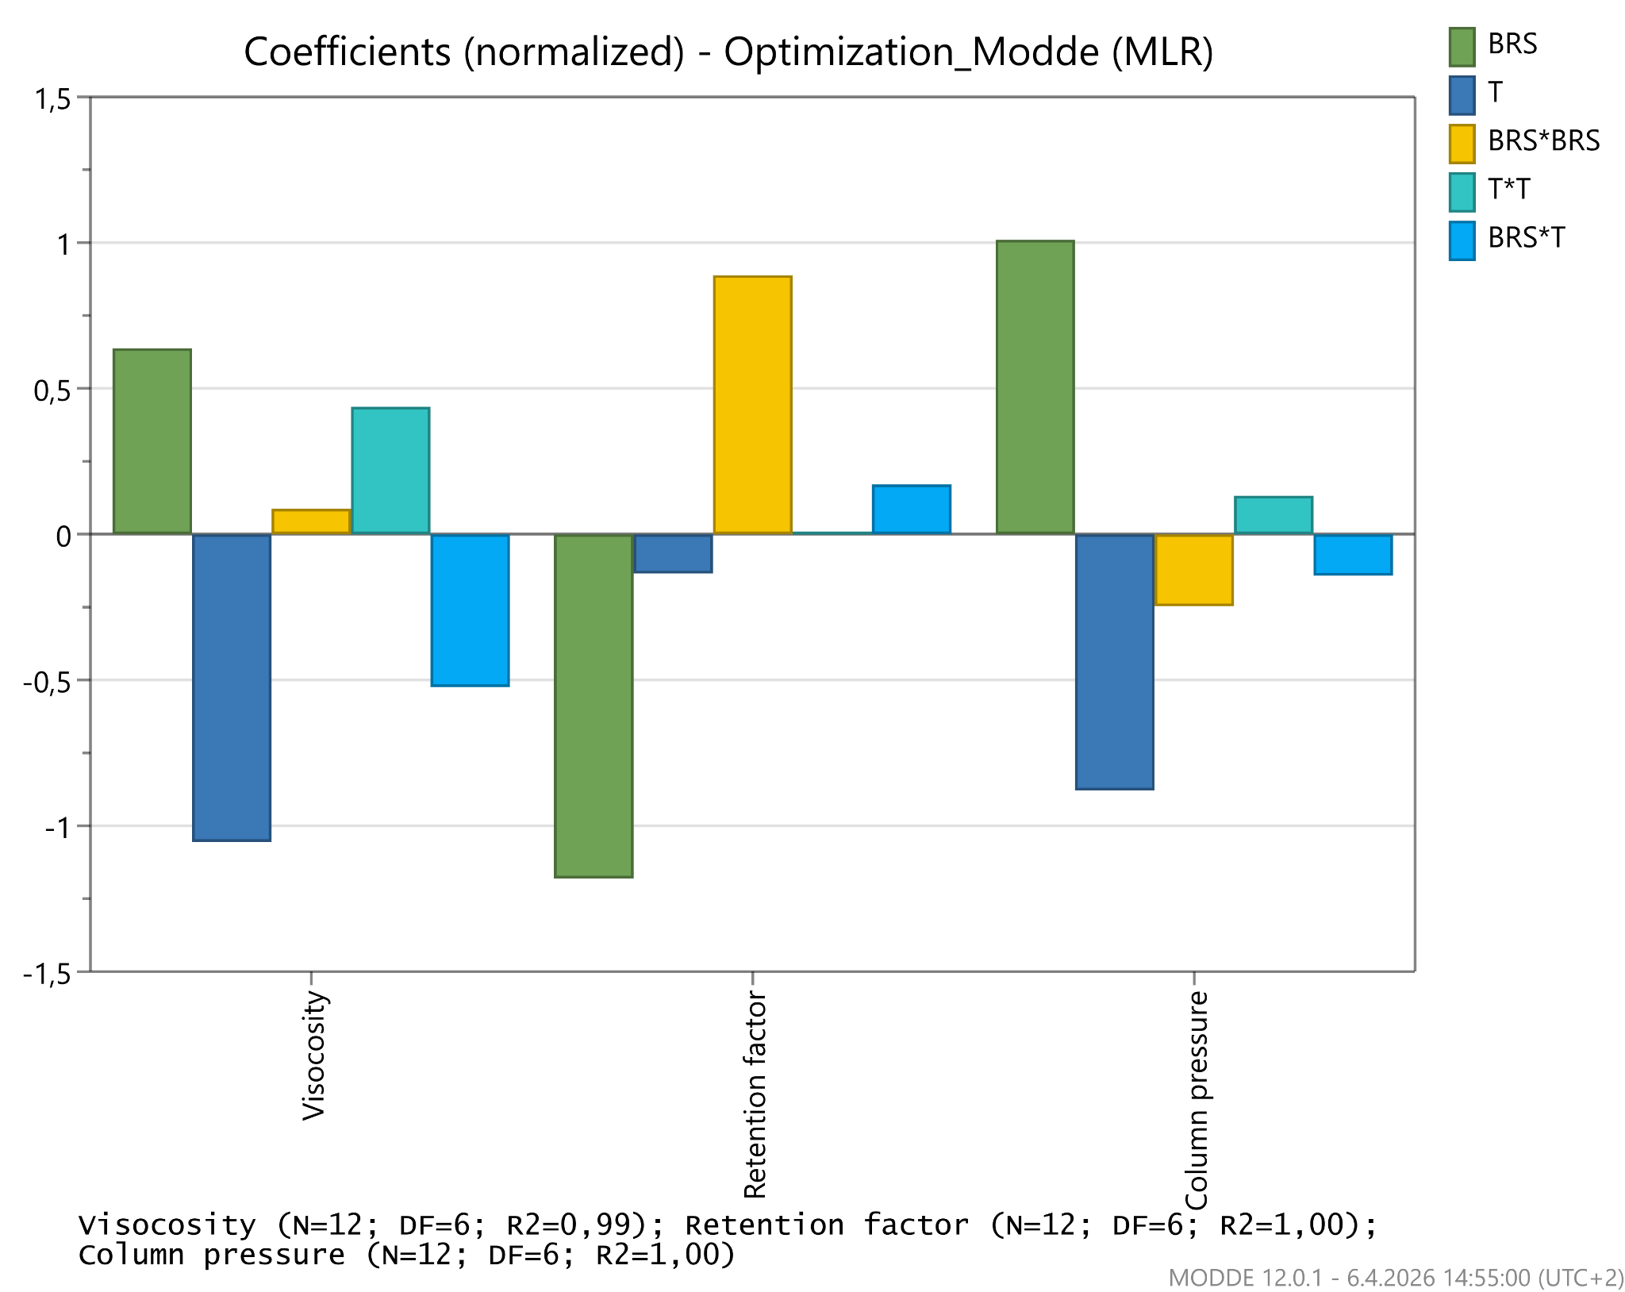
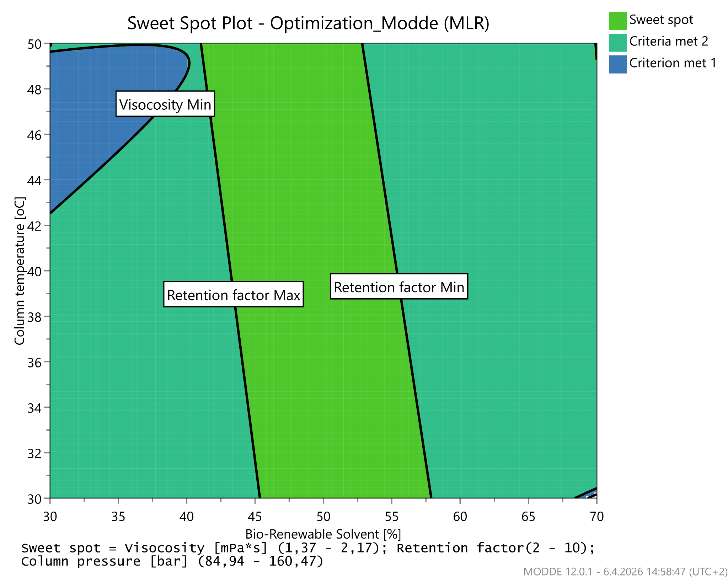
28th Congress of SCTM • 23-26 September 2026 • Ohrid, Macedonia
000
CHROMATOGRAPHIC PERFORMANCE EVALUATION OF A BIO-RENEWABLE SOLVENT USING DESIGN OF EXPERIMENTS
Aneta Lazarevska Kamcheva¹, Aleksandra Damjanoska¹˒², Stefan Radevski¹, Cveta Dolikjoska Trajkova¹, Natasha Anevska Stojanovska¹, Natalija Nakov²
¹ Manufacturing Technical Operations, Alkaloid AD Skopje, Republic of N. Macedonia, alazarevska@alkaloid.com.mk | ² Faculty of Pharmacy, Ss. Cyril and Methodius University in Skopje, Republic of N. Macedonia
INTRODUCTION & AIM
RESULTS & DISCUSSION
Green chromatography seeks to reduce solvent consumption, hazardous waste, and ecological impact. Bio-renewable solvents can provide a safer alternative to conventional organic eluents.
MODEL QUALITY
Excellent fit and predictive reliability for all responses
BALANCED OPERATING WINDOW
Model fit
Predictive reliability
BRS in mobile phase
≈45-55%
R² ≈ 0.99-1.00
Q² ≈ 0.997
Column temperature
≈38-42 °C
AIM
Evaluation of the chromatographic behavior of a selected lignocellulose-derived bio-renewable solvent (BRS).
OBSERVED RANGES
η
k′
P
VISCOSITY
PRESSURE
RETENTION, k′
1.37-2.17 mPa · s
84.9-160.5 bar
1.5-30.4
≈1.5 mPa·s
≈4.7
≈122 bar
EXPERIMENTAL
CCF 2² DESIGN • 12 EXPERIMENTS
COLUMN
LiChrospher® 100 RP18
125 × 4 mm, 5 µm
RETENTION MARKER
1% (v/v) toluene solution
2 FACTORS
BRS % (v/v)
Column temperature
3 RESPONSES
• Viscosity
• Retention factor k′
• Pressure
Software: MODDE® | Model: multiple linear regression
A Normalized model coefficients
B Sweet-spot operating region
CONCLUSION
These findings provide a rational basis for selecting sustainable chromatographic conditions, supporting safer and more environmentally responsible analytical practices.

