Slide 1
Synthesis of silver nanospirals
Rok Mravljak, Aleš Podgornik
Faculty for Chemistry and Chemical Technology, University of Ljubljana, Slovenia
28th SCTM, 23.9.- 26.9.2026, Ohrid

Slide 2
Outline
From silver nanoplates (AgNPt) to more complex nanostructures
Silver nanospiral properties
Silver nanospirals formation mechanism

Slide 3
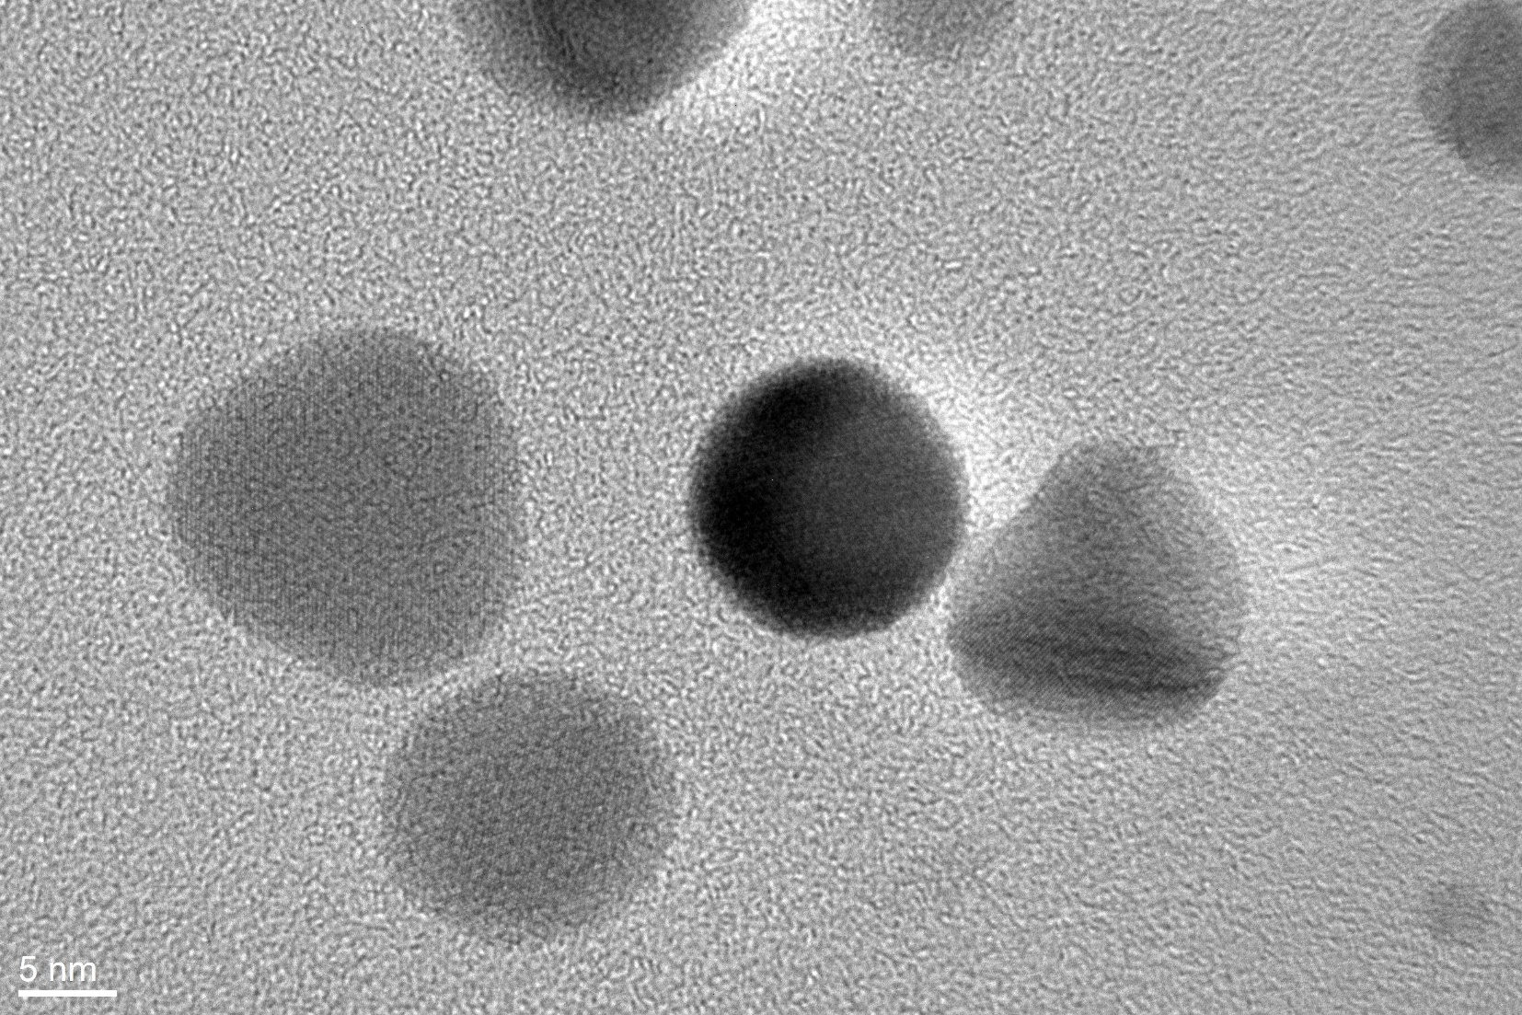
AgNP – seeds for AgNPt preparation
Mravljak & Podgornik, ACS Omega 8 (2023) 2760–2772

Slide 4
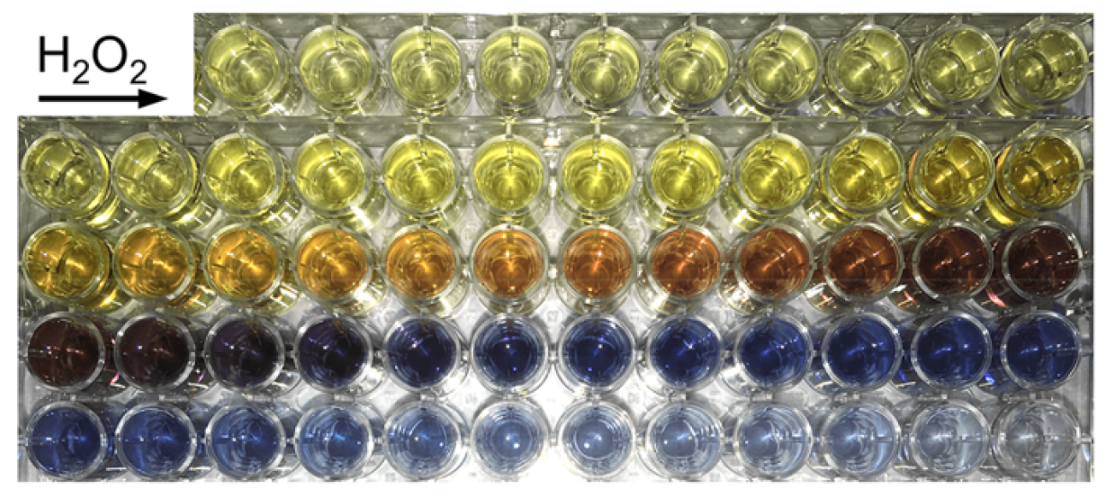
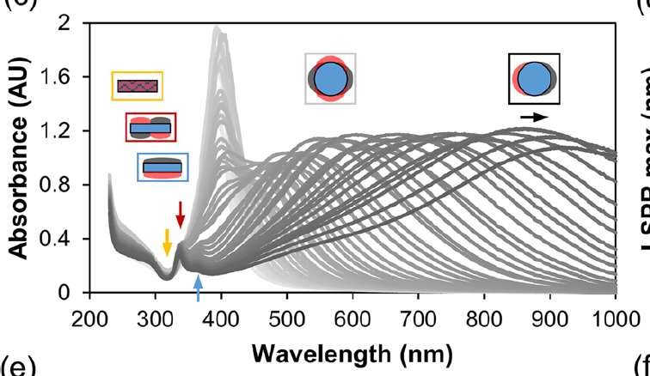
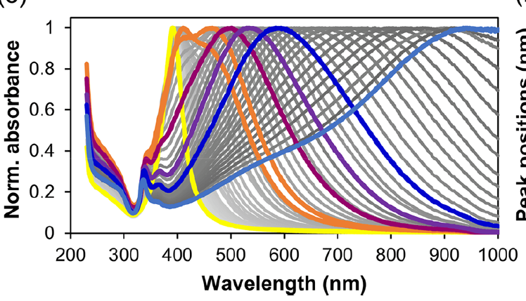
AgNPt – preparation and properties
Mravljak & Podgornik, ACS Omega 8 (2023) 2760–2772

Slide 5
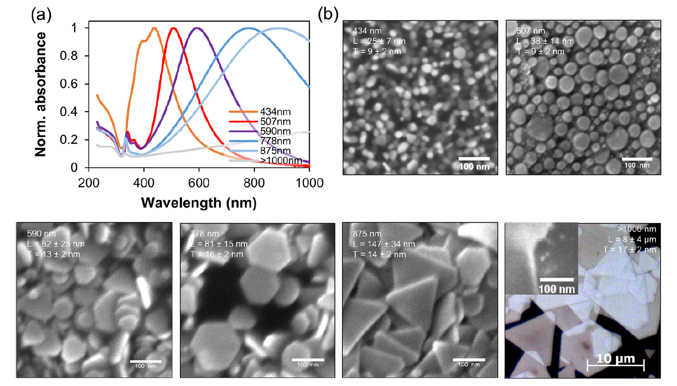
AgNPt – preparation and properties
Mravljak & Podgornik, ACS Omega 8 (2023) 2760–2772

Slide 6
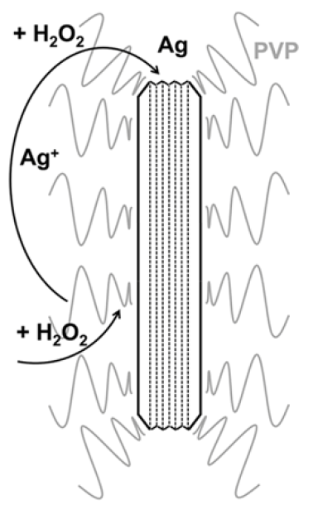
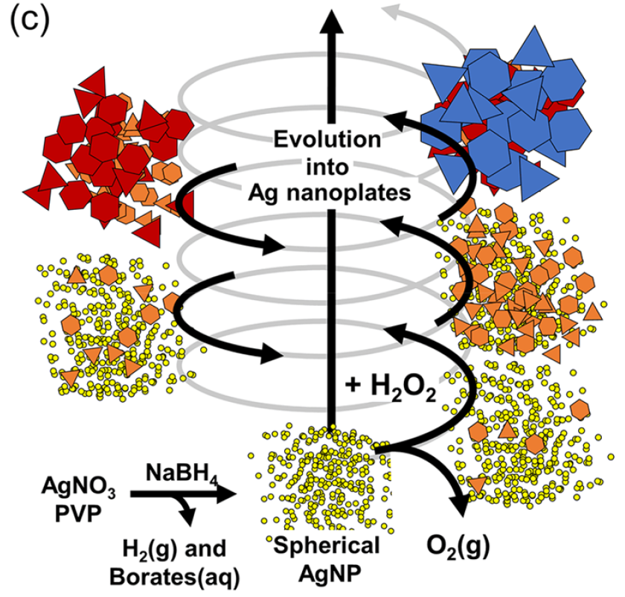
AgNPt – possible formation mechanism
What if some strong binding ligands are introduced before H₂O₂ addition?
Mravljak & Podgornik, ACS Omega 8 (2023) 2760–2772

Slide 7
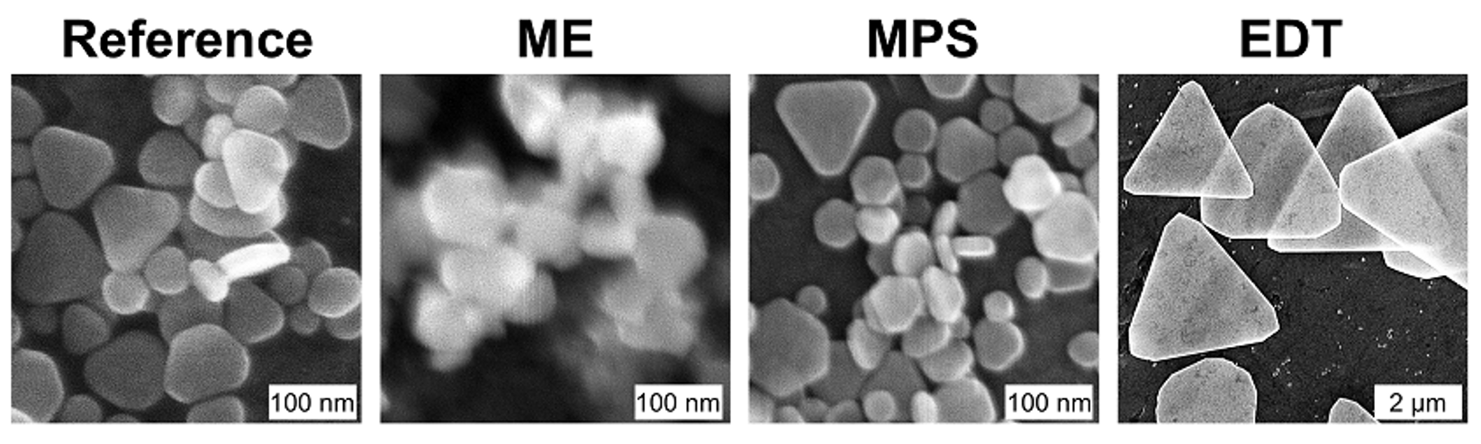
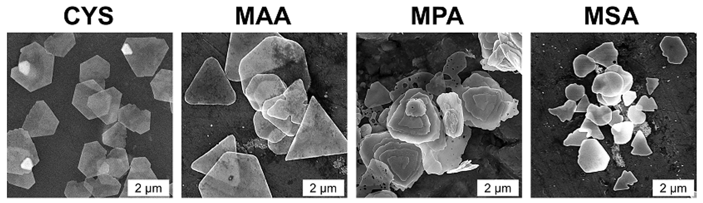
Effect of different ligands on silver nanoparticle morphology added before H₂O₂ addition
Mravljak et al., Comm. Chem. (2025) 8:292;
https://doi.org/10.1038/s42004-025-01684-y

Slide 8
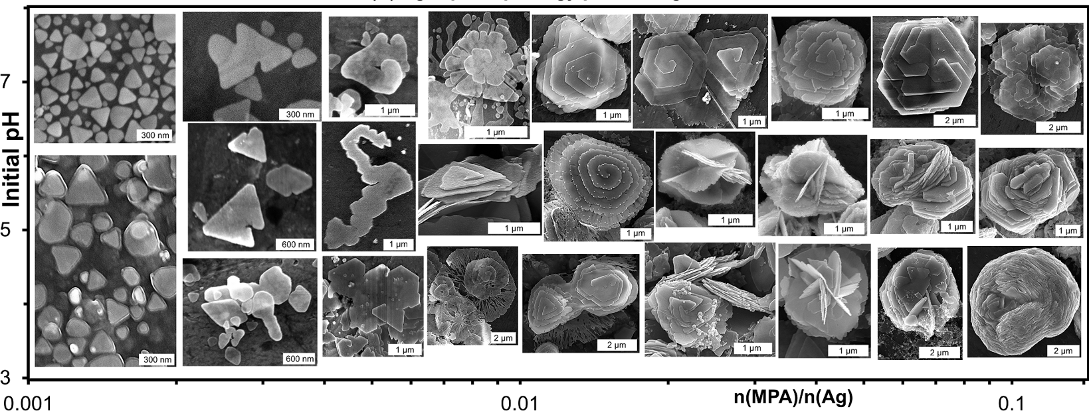
Effect of initial MPA concentration and pH value on silver nanoparticle morphology after H₂O₂ addition
Mravljak et al., Comm. Chem. (2025) 8:292; https://doi.org/10.1038/s42004-025-01684-y

Slide 9
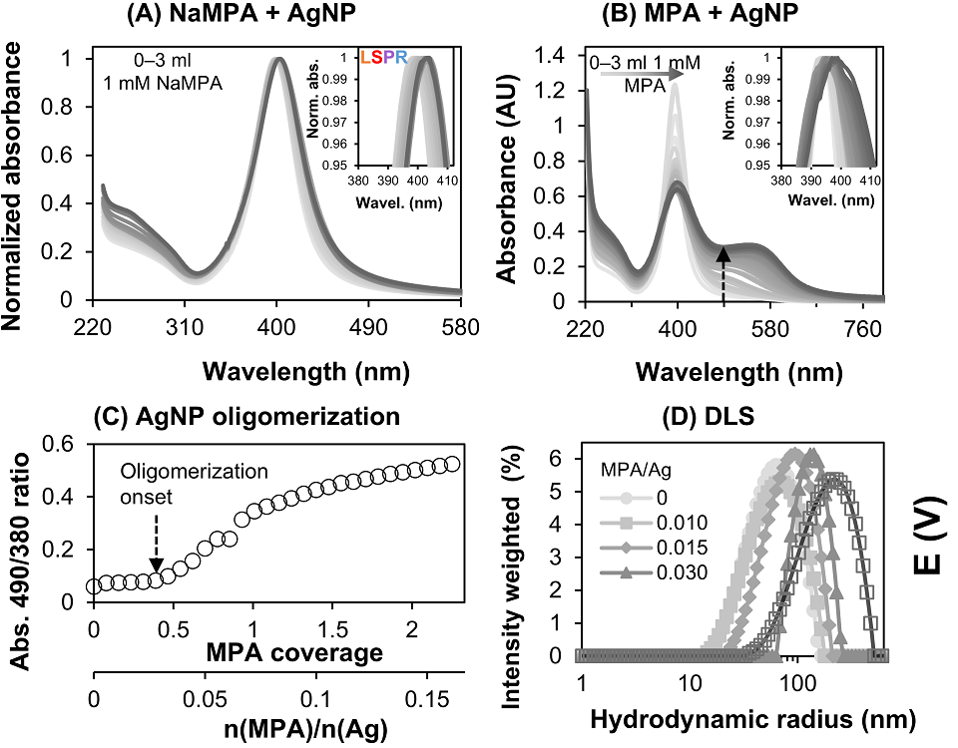
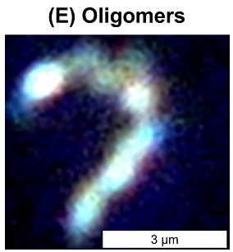
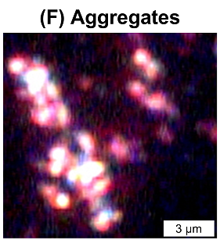
Effect of MPA addition on silver nanoparticle assembly
Mravljak et al., Comm. Chem. (2025) 8:292;
https://doi.org/10.1038/s42004-025-01684-y

Slide 10
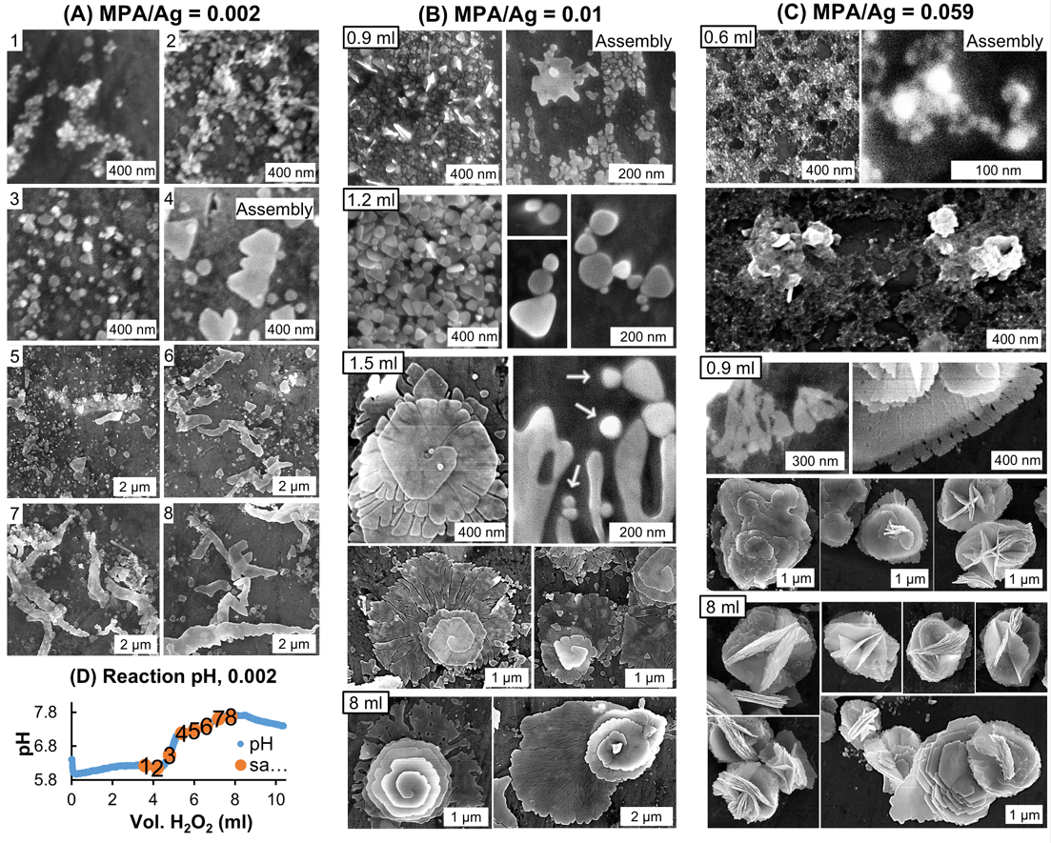
Effect of MPA concentration on silver nanoparticle morphology during consecutive H₂O₂ addition
Mravljak et al., Comm. Chem. (2025) 8:292;
https://doi.org/10.1038/s42004-025-01684-y

Slide 11
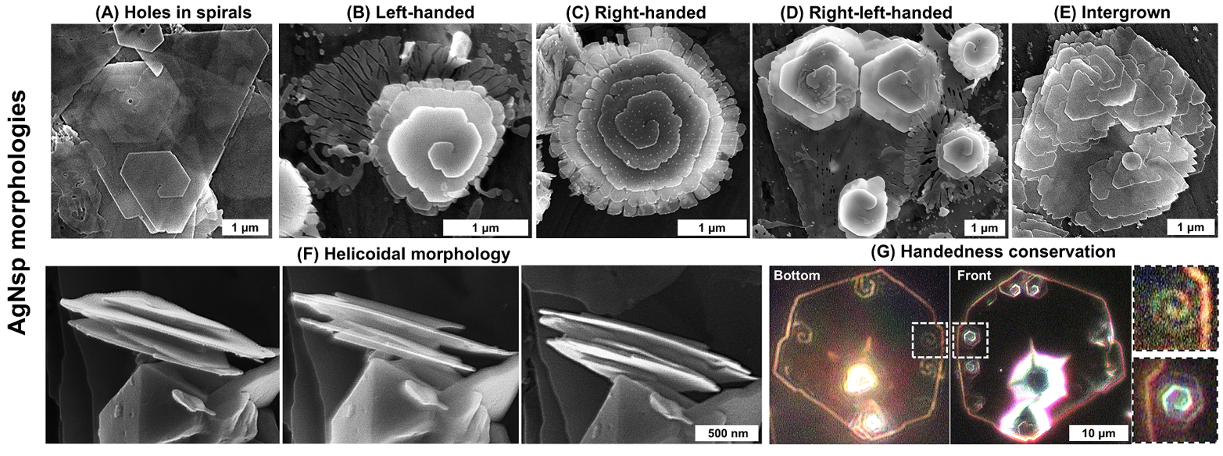
Silver nanospirals morphology
Mravljak et al., Comm. Chem. (2025) 8:292; https://doi.org/10.1038/s42004-025-01684-y
Notes:
Tukaj razmisleki glede možnega mehanizma – ne more biti klasična spiralna rast, kako razložiti dendritno rast?

Slide 12
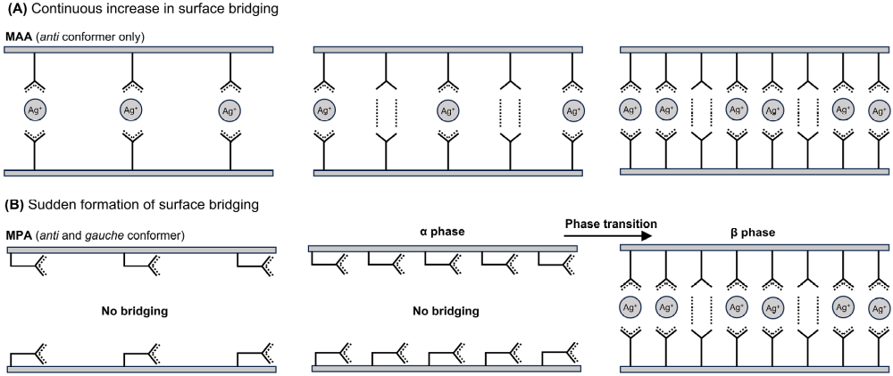
Why is MPA (mercaptopropionic acid) so special?
Contrary to other ligands (including MAA), MPA exhibits two different conformations when adsorbed, depending on its surface density.
This might explain observed morphology. But is this happening during this synthesis?
Mravljak et al., Comm. Chem. (2025) 8:292;
https://doi.org/10.1038/s42004-025-01684-y

Slide 13
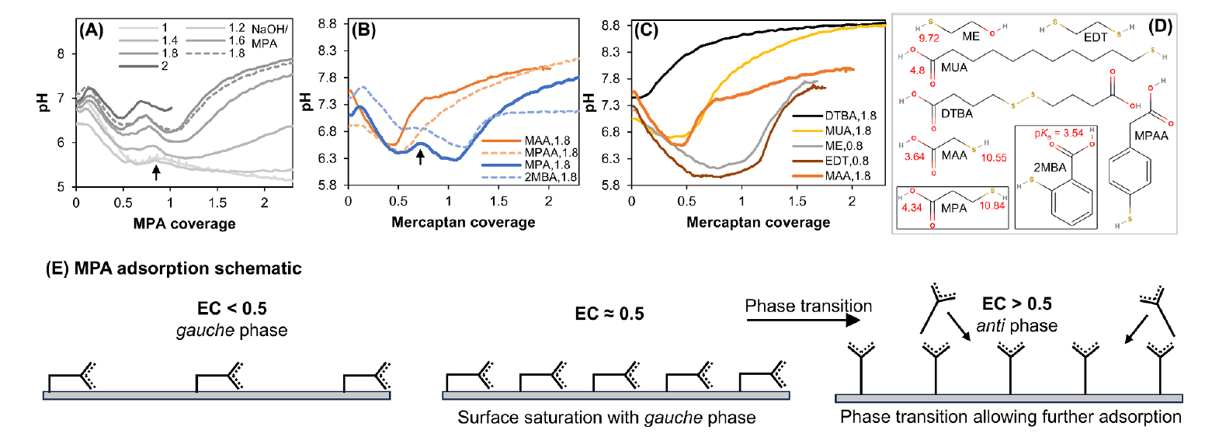
Why is MPA (mercaptopropionic acid) so special?
Mravljak et al., Comm. Chem. (2025) 8:292;
https://doi.org/10.1038/s42004-025-01684-y

Slide 14
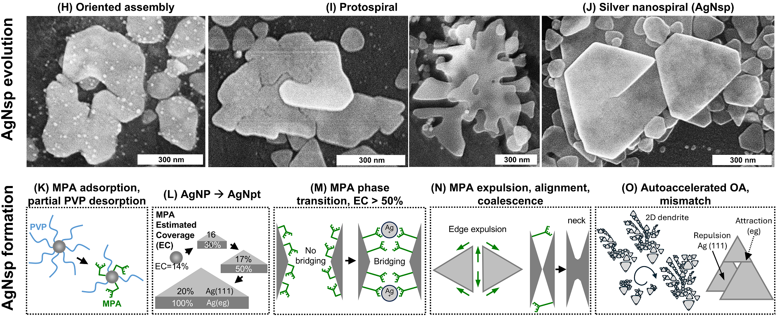
Possible silver nanospirals formation mechanism
Mravljak et al., Comm. Chem. (2025) 8:292;
https://doi.org/10.1038/s42004-025-01684-y

Slide 15
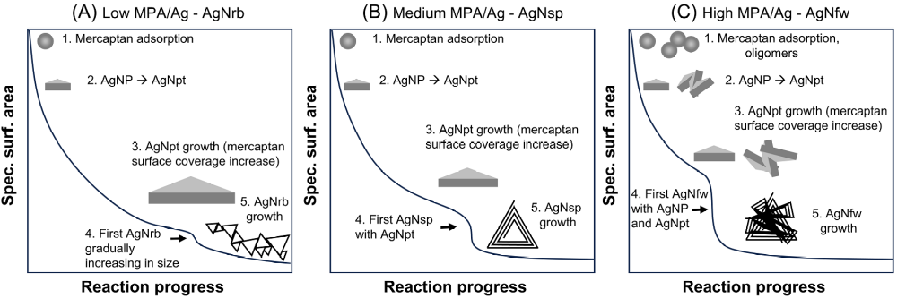
Possible silver nanospirals formation mechanism
What happens if synthesis is initiated by Ag ions and not AgNP?
Mravljak et al., Comm. Chem. (2025) 8:292;
https://doi.org/10.1038/s42004-025-01684-y

Slide 16

Possible silver nanospirals formation mechanism
Mravljak et al., Comm. Chem. (2025) 8:292;
https://doi.org/10.1038/s42004-025-01684-y

Slide 17
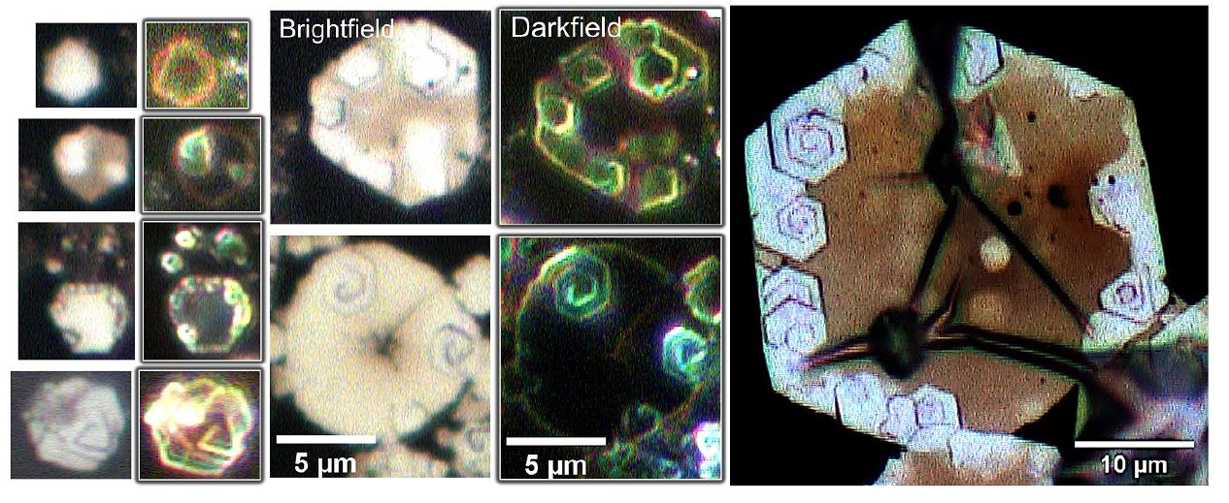
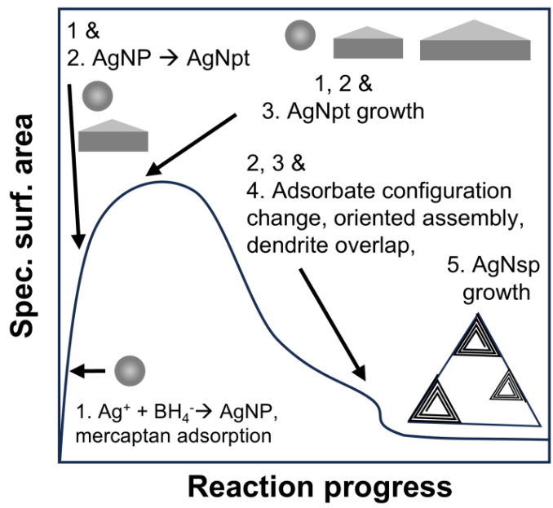
Possible silver nanospirals formation mechanism
Mravljak et al., Comm. Chem. (2025) 8:292;
https://doi.org/10.1038/s42004-025-01684-y

Slide 18
THANK YOU VERY MUCH FOR YOUR ATTENTION!

