Slide 1


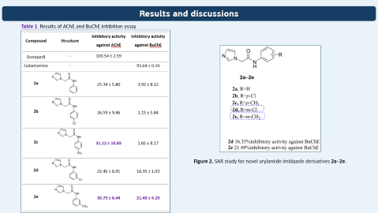
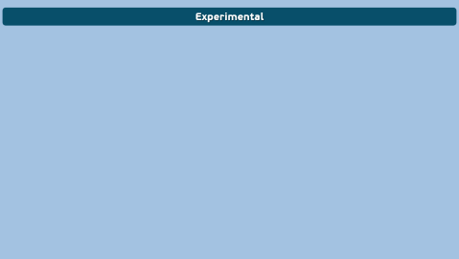
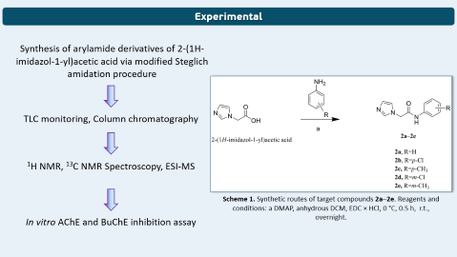


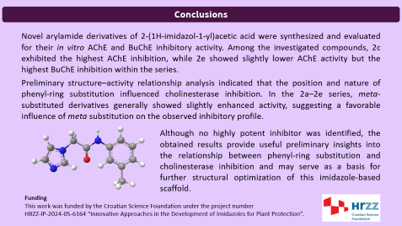
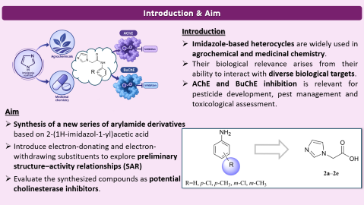

28th Congress of SCTM, 23-26 September, Ohrid, Macedonia
000
Synthesis and cholinesterase inhibitory evaluation of novel
aryl derivatives of 2-(1H-imidazol-1-yl)acetic acid
Martina Šrajer Gajdošik¹, Andrea Dandić¹, Marija Paurević¹, Domagoj Šubarić², Maja Karnaš Babić², Vesna Rastija²
¹ Department of Chemistry, Josip Juraj Strossmayer University of Osijek, Cara Hadrijana 8/A, 31000 Osijek, Croatia
² Faculty of Agrobiotechnical Sciences Osijek, Vladimira Preloga 1, 31000 Osijek, Croatia

Slide 2
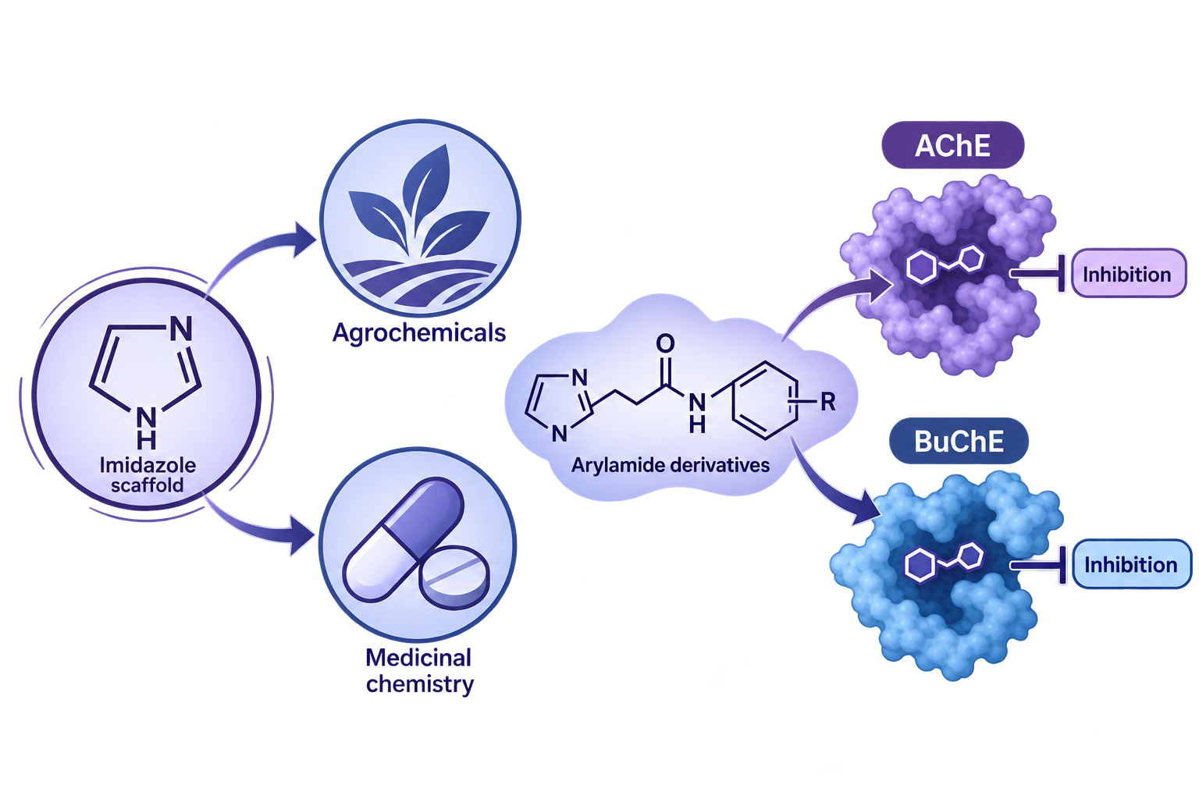
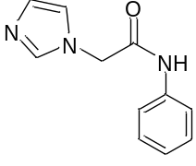
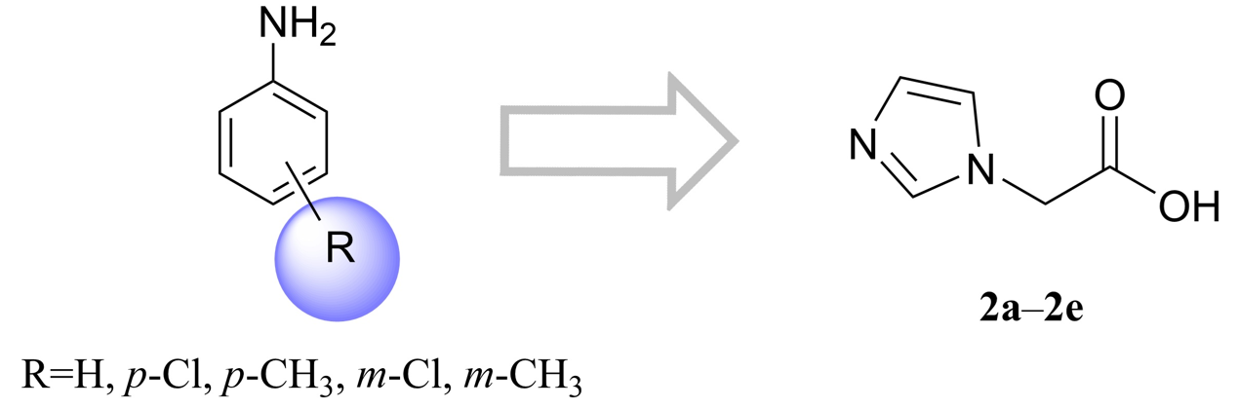
Introduction & Aim
Introduction
Imidazole-based heterocycles are widely used in agrochemical and medicinal chemistry.
Their biological relevance arises from their ability to interact with diverse biological targets.
AChE and BuChE inhibition is relevant for pesticide development, pest management and toxicological assessment.
R –
Aim
Synthesis of a new series of arylamide derivatives based on 2-(1H-imidazol-1-yl)acetic acid
Introduce electron-donating and electron-withdrawing substituents to explore preliminary structure–activity relationships (SAR)
Evaluate the synthesized compounds as potential cholinesterase inhibitors.

Slide 3
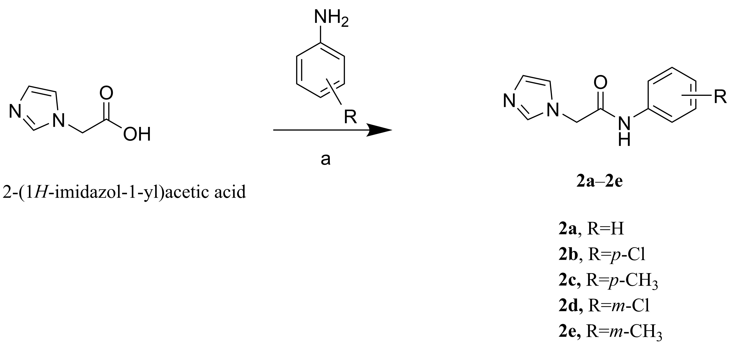
Experimental
Synthesis of arylamide derivatives of 2-(1H-imidazol-1-yl)acetic acid via modified Steglich amidation procedure
TLC monitoring, Column chromatography
¹H NMR, ¹³C NMR Spectroscopy, ESI-MS
Scheme 1. Synthetic routes of target compounds 2a–2e. Reagents and conditions: a DMAP, anhydrous DCM, EDC × HCl, 0 °C, 0.5 h, r.t., overnight.
In vitro AChE and BuChE inhibition assay

Slide 4
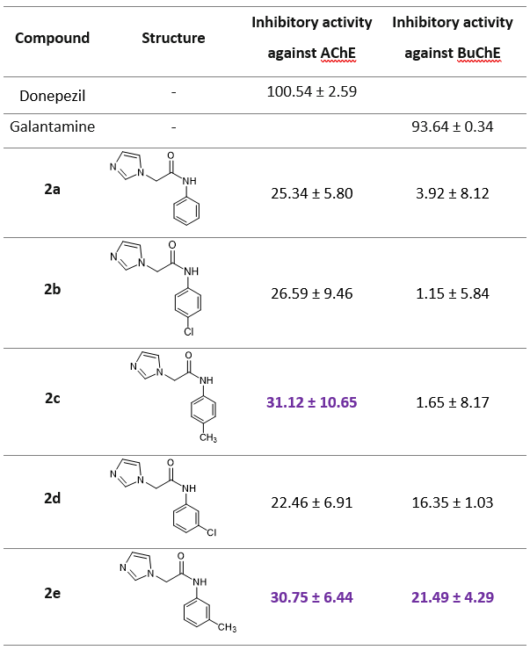
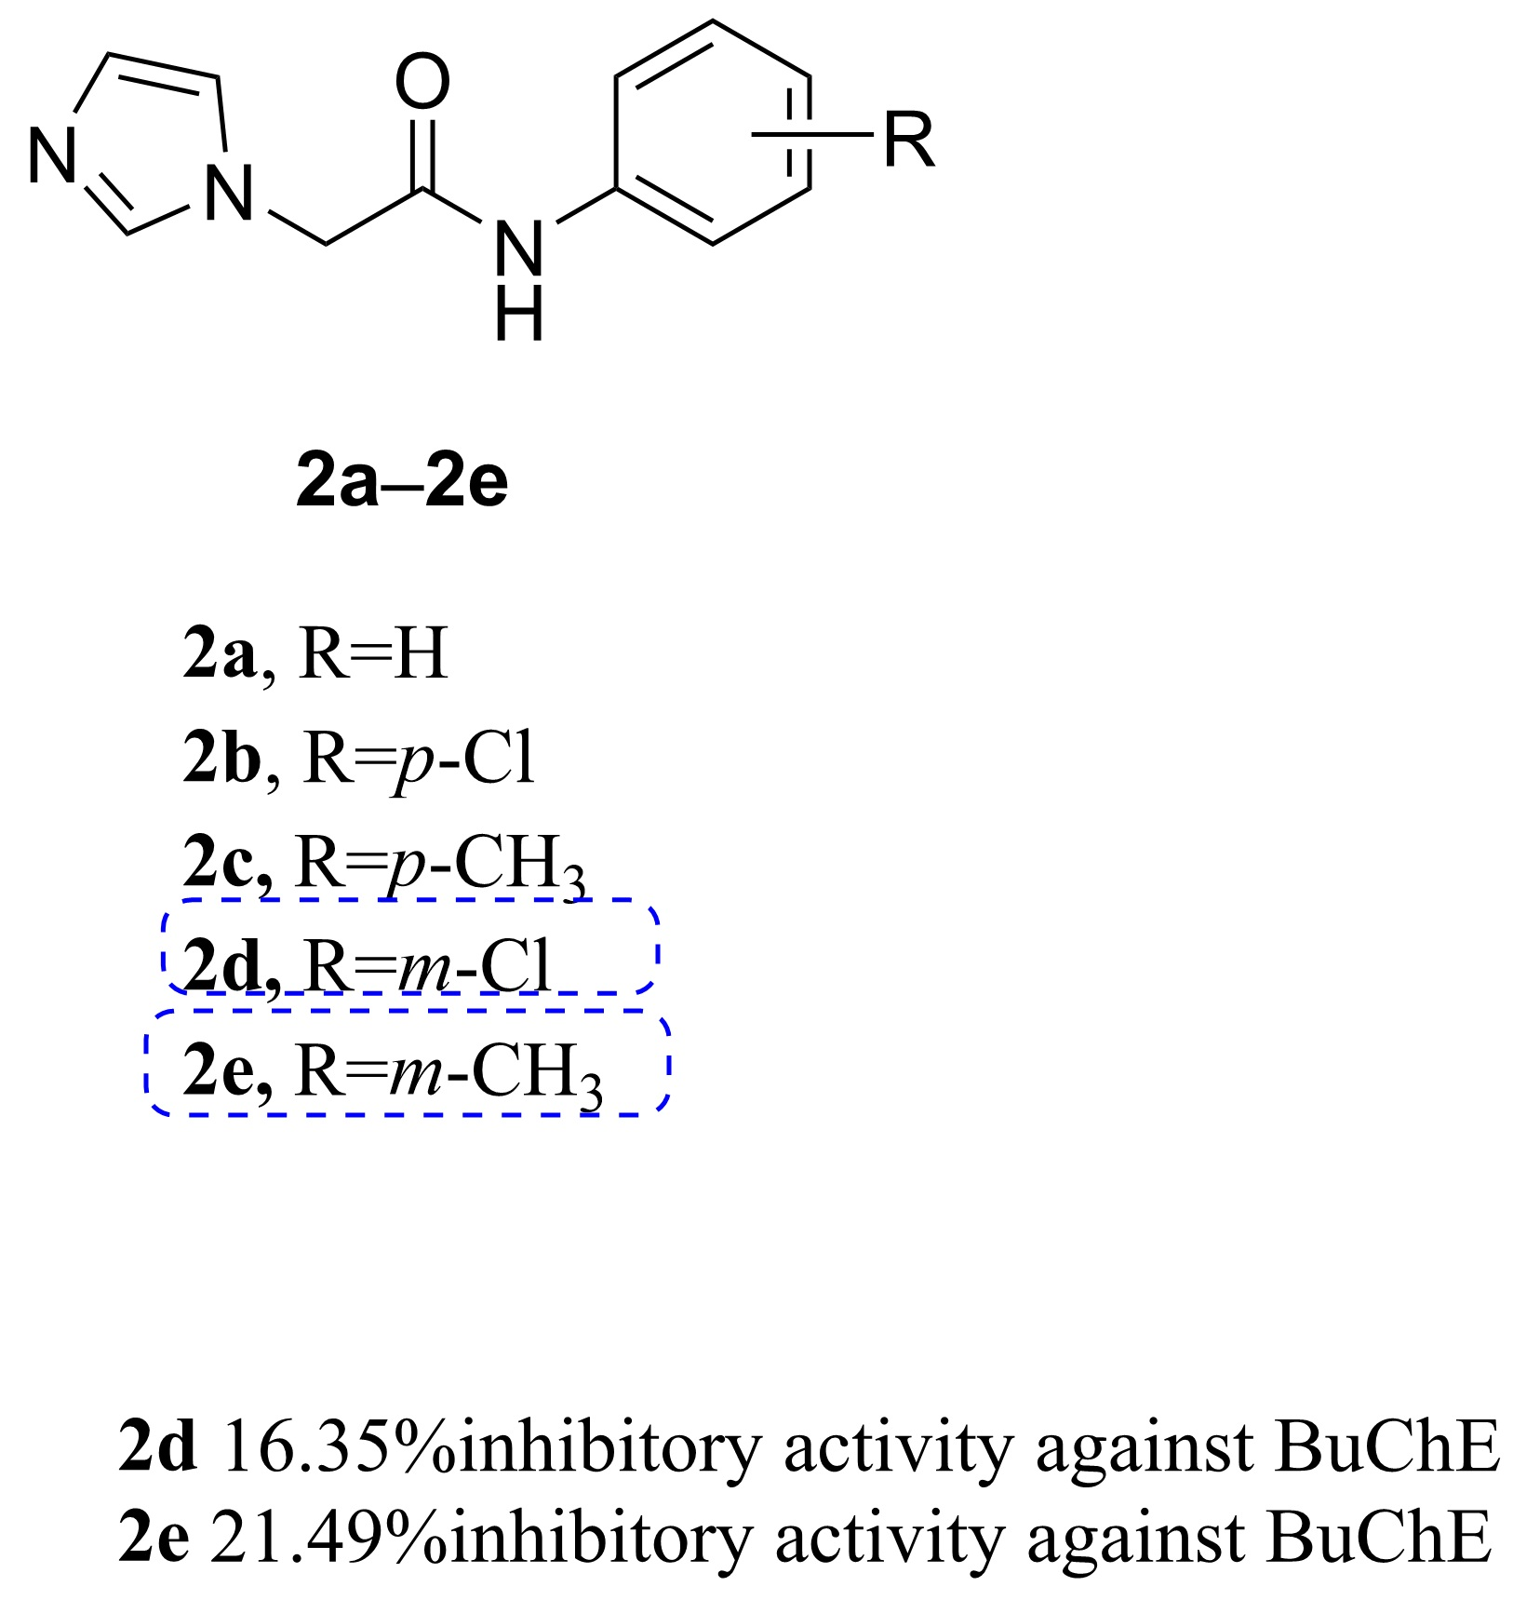
Results and discussions
Table 1. Results of AChE and BuChE inhibition assay
Figure 2. SAR study for novel arylamide imidazole derivatives 2a–2e.

Slide 5
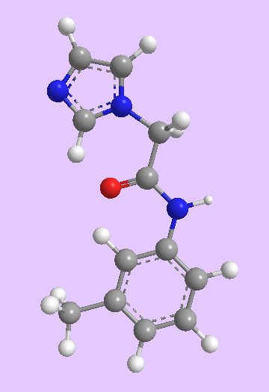

Conclusions
Novel arylamide derivatives of 2-(1H-imidazol-1-yl)acetic acid were synthesized and evaluated for their in vitro AChE and BuChE inhibitory activity. Among the investigated compounds, 2c exhibited the highest AChE inhibition, while 2e showed slightly lower AChE activity but the highest BuChE inhibition within the series.
Preliminary structure–activity relationship analysis indicated that the position and nature of phenyl-ring substitution influenced cholinesterase inhibition. In the 2a–2e series, meta-substituted derivatives generally showed slightly enhanced activity, suggesting a favorable influence of meta substitution on the observed inhibitory profile.
Although no highly potent inhibitor was identified, the obtained results provide useful preliminary insights into the relationship between phenyl-ring substitution and cholinesterase inhibition and may serve as a basis for further structural optimization of this imidazole-based scaffold.
Funding
This work was funded by the Croatian Science Foundation under the project number
HRZZ-IP-2024-05-6164 “Innovative Approaches in the Development of Imidazoles for Plant Protection”.

