Slide 1

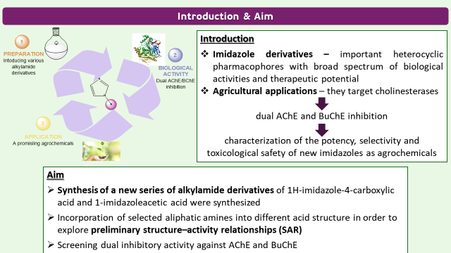
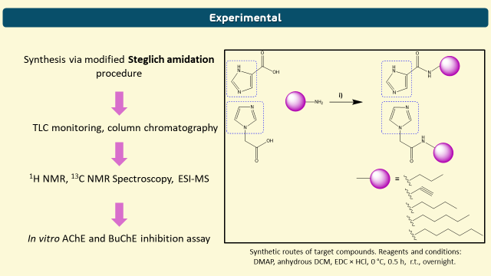
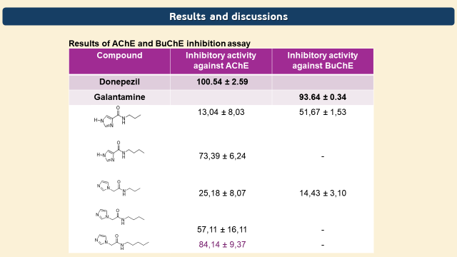
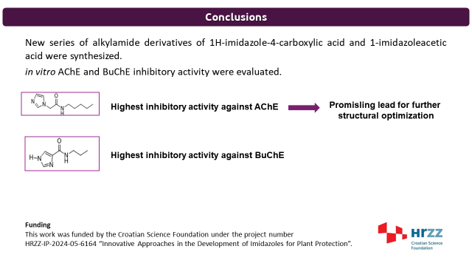
28th Congress of SCTM, 23-26 September, Ohrid, Macedonia
000
NOVEL ALKYL IMIDAZOLE-4-CARBOXYLIC ACID DERIVATIVES: SYNTHESIS AND EVALUATION OF CHOLINESTERASE INHIBITION
Marija Paurević¹, Andrea Dandić¹, Martina Šrajer Gajdošik¹, Domagoj Šubarić², Maja Karnaš Babić², Vesna Rastija²
¹ Department of Chemistry, Josip Juraj Strossmayer University of Osijek, Cara Hadrijana 8/A, 31000 Osijek, Croatia
² Faculty of Agrobiotechnical Sciences Osijek, Vladimira Preloga 1, 31000 Osijek, Croatia

Slide 2
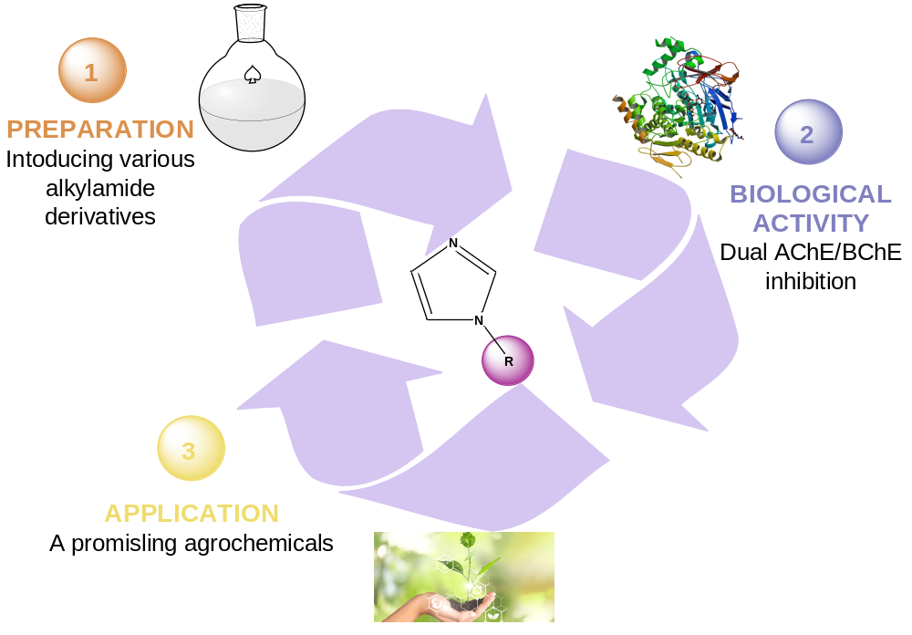
Introduction & Aim
Introduction
Imidazole derivatives – important heterocyclic pharmacophores with broad spectrum of biological activities and therapeutic potential
Agricultural applications – they target cholinesterases
dual AChE and BuChE inhibition
characterization of the potency, selectivity and toxicological safety of new imidazoles as agrochemicals
Aim
Synthesis of a new series of alkylamide derivatives of 1H-imidazole-4-carboxylic acid and 1-imidazoleacetic acid were synthesized
Incorporation of selected aliphatic amines into different acid structure in order to explore preliminary structure–activity relationships (SAR)
Screening dual inhibitory activity against AChE and BuChE

Slide 3
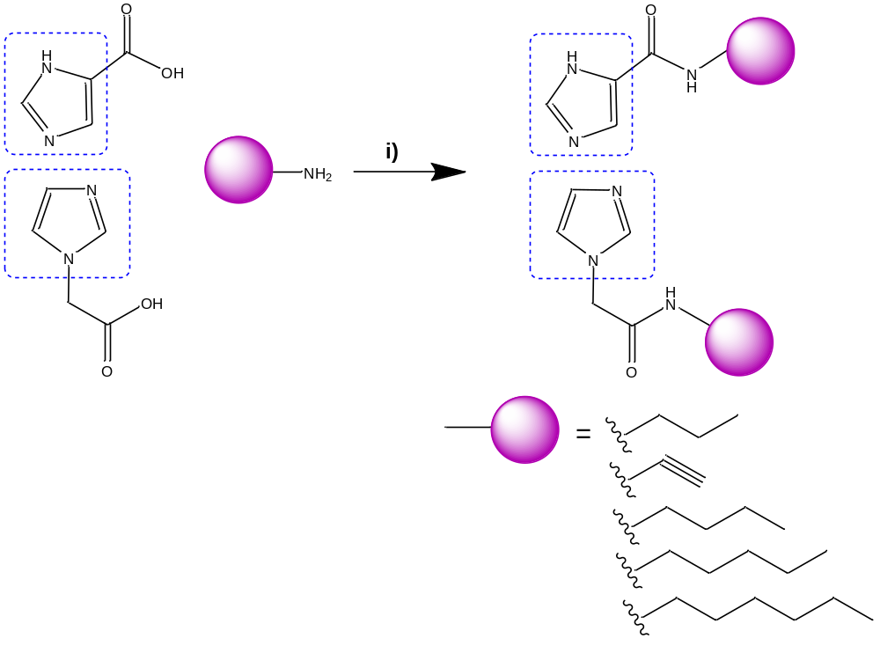
Experimental
Synthesis via modified Steglich amidation procedure
TLC monitoring, column chromatography
¹H NMR, ¹³C NMR Spectroscopy, ESI-MS
In vitro AChE and BuChE inhibition assay
Synthetic routes of target compounds. Reagents and conditions: DMAP, anhydrous DCM, EDC × HCl, 0 °C, 0.5 h, r.t., overnight.

Slide 4





Results and discussions
Results of AChE and BuChE inhibition assay
Compound | Inhibitory activity against AChE | Inhibitory activity against BuChE
Donepezil | 100.54 ± 2.59
Galantamine |  | 93.64 ± 0.34
 | 13,04 ± 8,03 | 51,67 ± 1,53
 | 73,39 ± 6,24 | -
 | 25,18 ± 8,07 | 14,43 ± 3,10
 | 57,11 ± 16,11 | -
 | 84,14 ± 9,37 | -

Slide 5

Conclusions
New series of alkylamide derivatives of 1H-imidazole-4-carboxylic acid and 1-imidazoleacetic acid were synthesized.
in vitro AChE and BuChE inhibitory activity were evaluated.
Highest inhibitory activity against AChE
Promisling lead for further
structural optimization
Highest inhibitory activity against BuChE
Funding
This work was funded by the Croatian Science Foundation under the project number
HRZZ-IP-2024-05-6164 “Innovative Approaches in the Development of Imidazoles for Plant Protection”.

