Slide 1
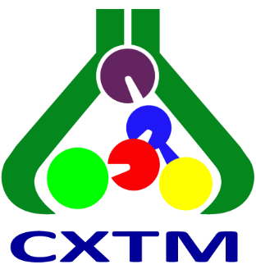
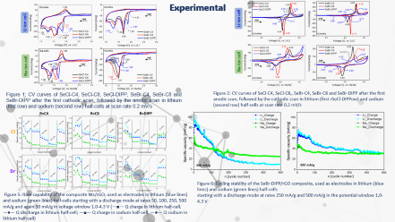
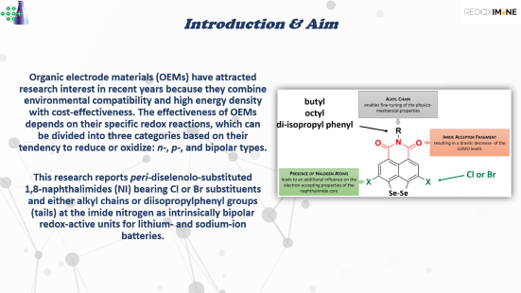
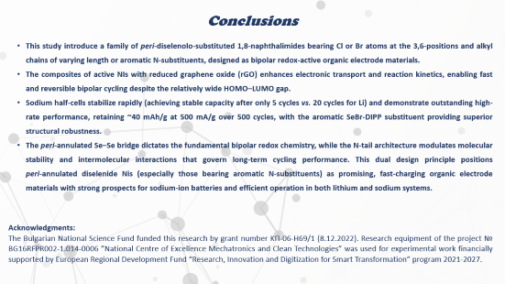
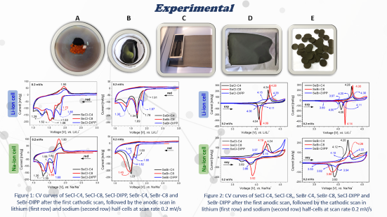

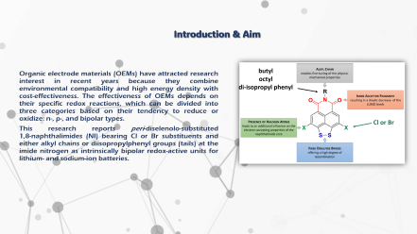
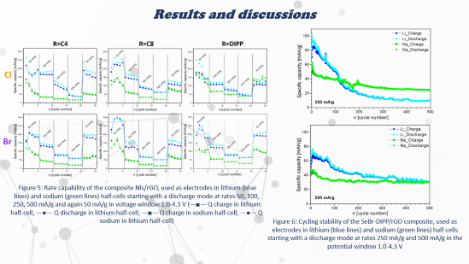

28th Congress of SCTM, 23-26 September, Ohrid, Macedonia
000
Li/Na competition in naphthalimide electrochemical matrix
V. Stoeva ¹ , D. Marinova ^{1,2 *}, L. Borislavov ^{1,2} and R. Stoyanova ^{1,2}
¹ Institute of General and Inorganic Chemistry, Bulgarian Academy of Sciences, 1113 Sofia, Bulgaria,*E-mail: manasieva@svr.igic.bas.bg
² National Centre of Excellence “Mechatronics and Clean Technologies”, 1113 Sofia, Bulgaria

Slide 2

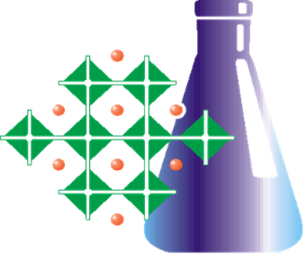

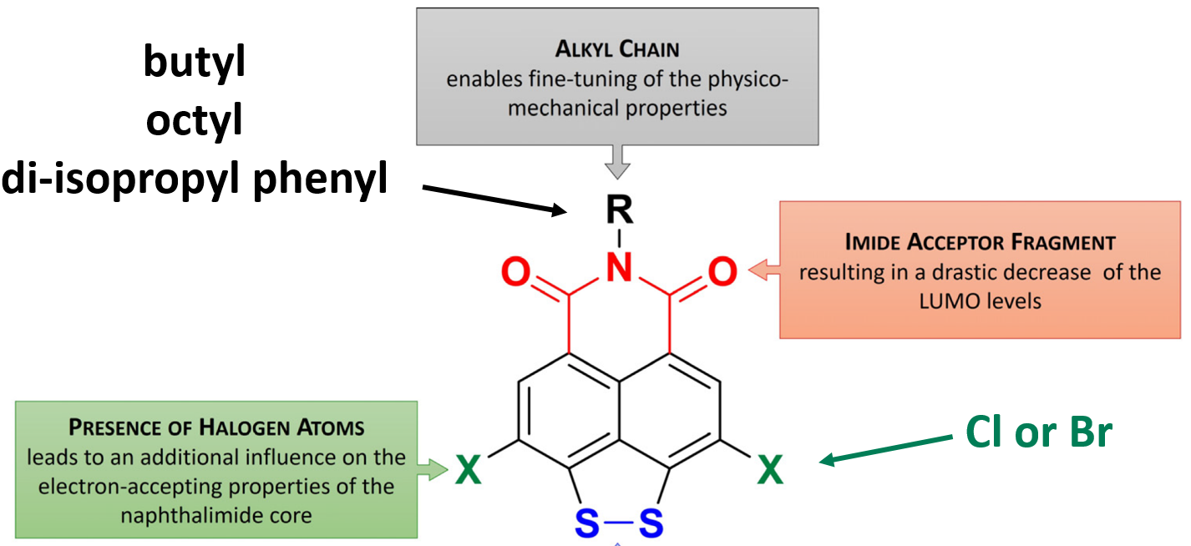
Introduction & Aim
Organic electrode materials (OEMs) have attracted research interest in recent years because they combine environmental compatibility and high energy density with cost-effectiveness. The effectiveness of OEMs depends on their specific redox reactions, which can be divided into three categories based on their tendency to reduce or oxidize: n-, p-, and bipolar types.
This research reports peri‑diselenolo‑substituted 1,8‑naphthalimides (NI) bearing Cl or Br substituents and either alkyl chains or diisopropylphenyl groups (tails) at the imide nitrogen as intrinsically bipolar redox‑active units for lithium‑ and sodium‑ion batteries.
Se-Se

Slide 3
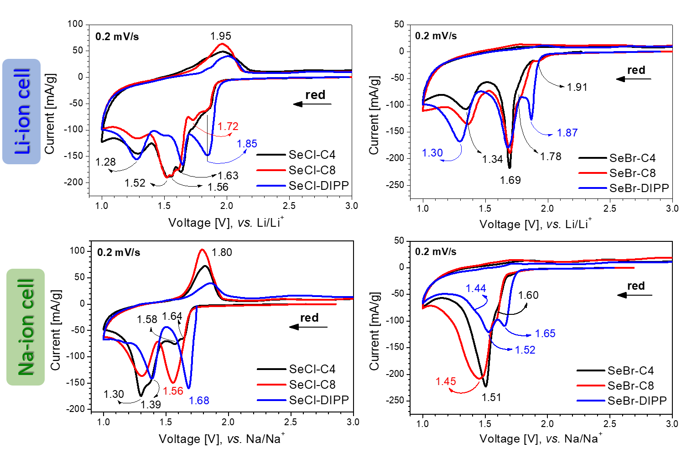
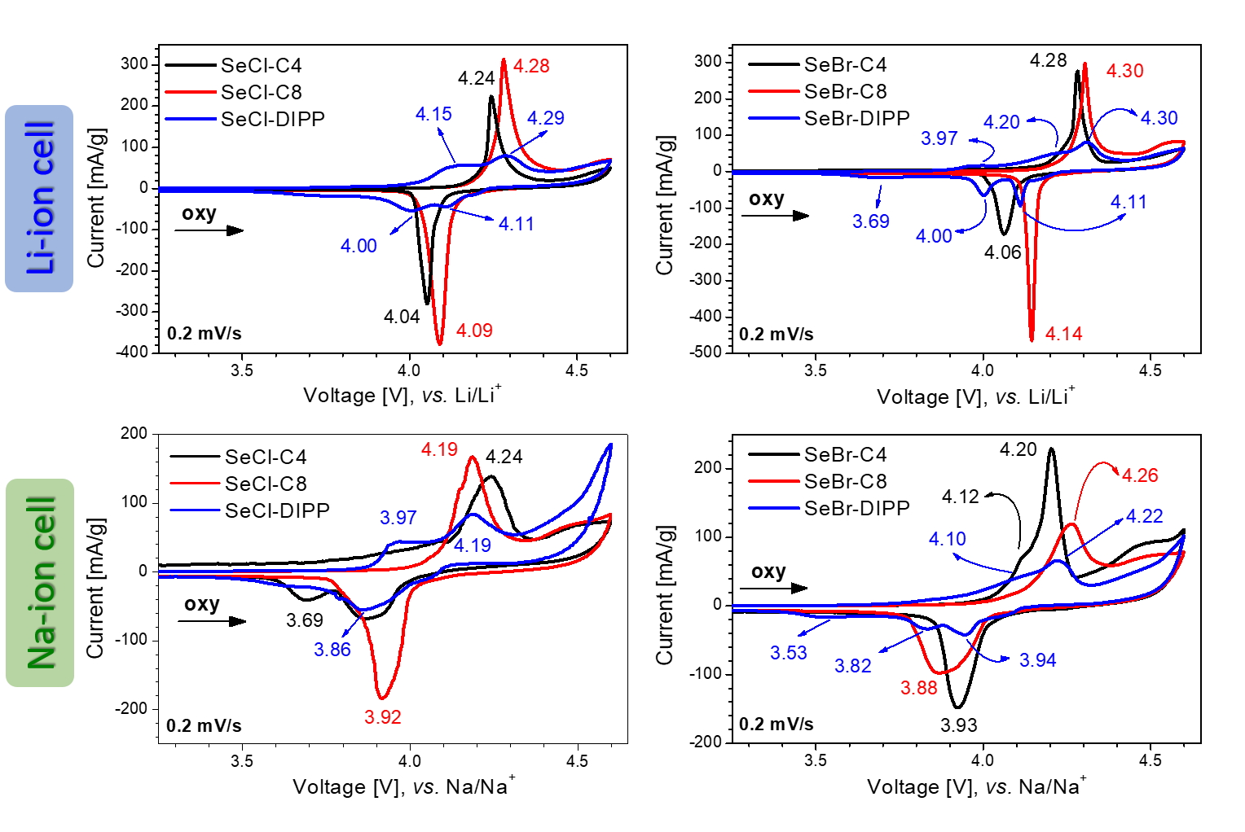
Experimental
Figure 1: CV curves of SeCl-C4, SeCl-C8, SeCl-DIPP, SeBr-C4, SeBr-C8 and SeBr-DIPP after the first cathodic scan, followed by the anodic scan in lithium (first row) and sodium (second row) half-cells at scan rate 0.2 mV/s
Figure 2: CV curves of SeCl-C4, SeCl-C8,, SeBr-C4, SeBr-C8, SeCl-DIPP and SeBr-DIPP after the first anodic scan, followed by the cathodic scan in lithium (first row) and sodium (second row) half-cells at scan rate 0.2 mV/s

Slide 4
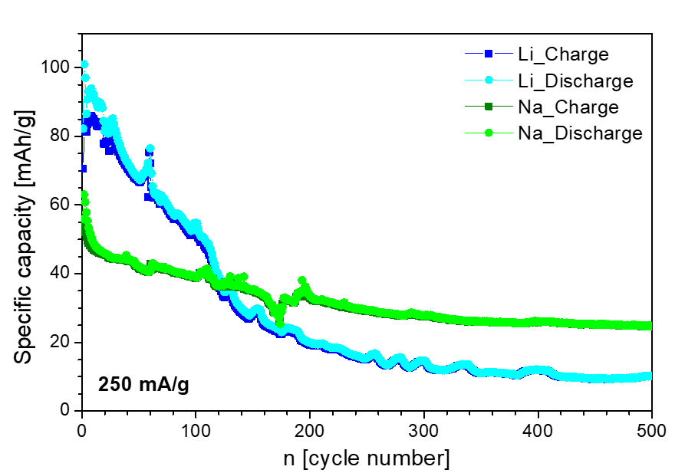
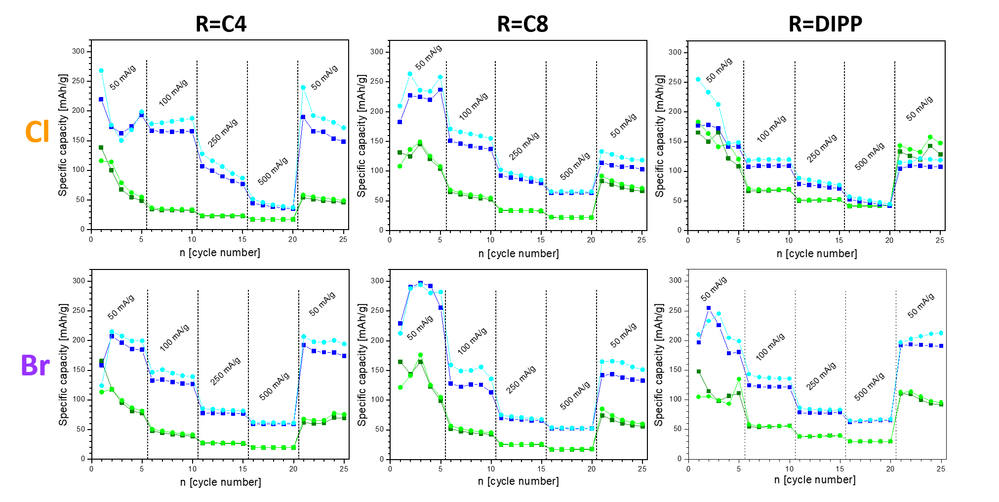
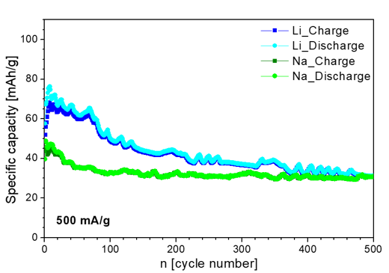
Results and discussions
Figure 5: Rate capability of the composite NIs/rGO, used as electrodes in lithium (blue lines) and sodium (green lines) half-cells starting with a discharge mode at rates 50, 100, 250, 500 mA/g and again 50 mA/g in voltage window 1.0-4.3 V (―■― Q charge in lithium half-cell, ―●― Q discharge in lithium half-cell; ―■― Q charge in sodium half-cell, ―●― Q sodium in lithium half-cell)
Figure 6: Cycling stability of the SeBr-DIPP/rGO composite, used as electrodes in lithium (blue lines) and sodium (green lines) half-cells starting with a discharge mode at rates 250 mA/g and 500 mA/g in the potential window 1.0-4.3 V

Slide 5
Conclusions
  This study introduce a family of peri‑diselenolo‑substituted 1,8‑naphthalimides bearing Cl or Br atoms at the 3,6‑positions and alkyl chains of varying length or aromatic N‑substituents, designed as bipolar redox‑active organic electrode materials.
  The composites of active NIs with reduced graphene oxide (rGO) enhances electronic transport and reaction kinetics, enabling fast and reversible bipolar cycling despite the relatively wide HOMO–LUMO gap.
  Sodium half-cells stabilize rapidly (achieving stable capacity after only 5 cycles vs. 20 cycles for Li) and demonstrate outstanding high-rate performance, retaining ~40 mAh/g at 500 mA/g over 500 cycles, with the aromatic SeBr-DIPP substituent providing superior structural robustness.
  The peri‑annulated Se–Se bridge dictates the fundamental bipolar redox chemistry, while the N‑tail architecture modulates molecular stability and intermolecular interactions that govern long‑term cycling performance. This dual design principle positions peri‑annulated diselenide Nis (especially those bearing aromatic N‑substituents) as promising, fast‑charging organic electrode materials with strong prospects for sodium‑ion batteries and efficient operation in both lithium and sodium systems.
Acknowledgments:
The Bulgarian National Science Fund funded this research by grant number KП-06-H69/1 (8.12.2022). Research equipment of the project № BG16RFPR002-1.014-0006 ”National Centre of Excellence Mechatronics and Clean Technologies” was used for experimental work financially supported by European Regional Development Fund “Research, Innovation and Digitization for Smart Transformation” program 2021-2027.

