Slide 1

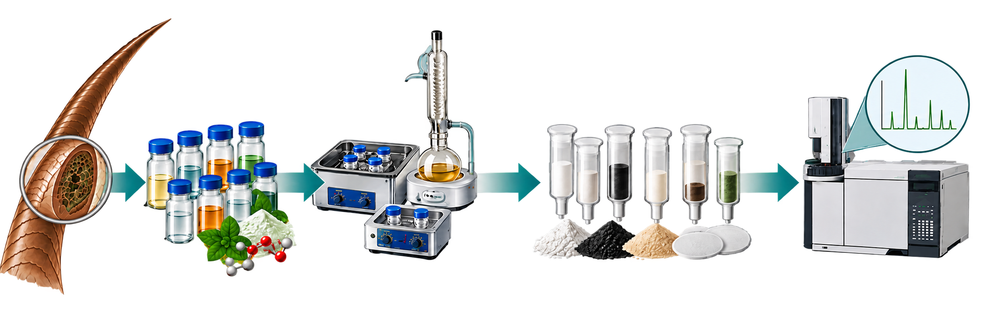
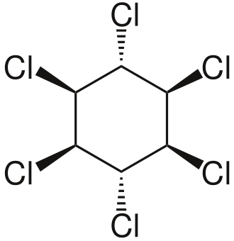
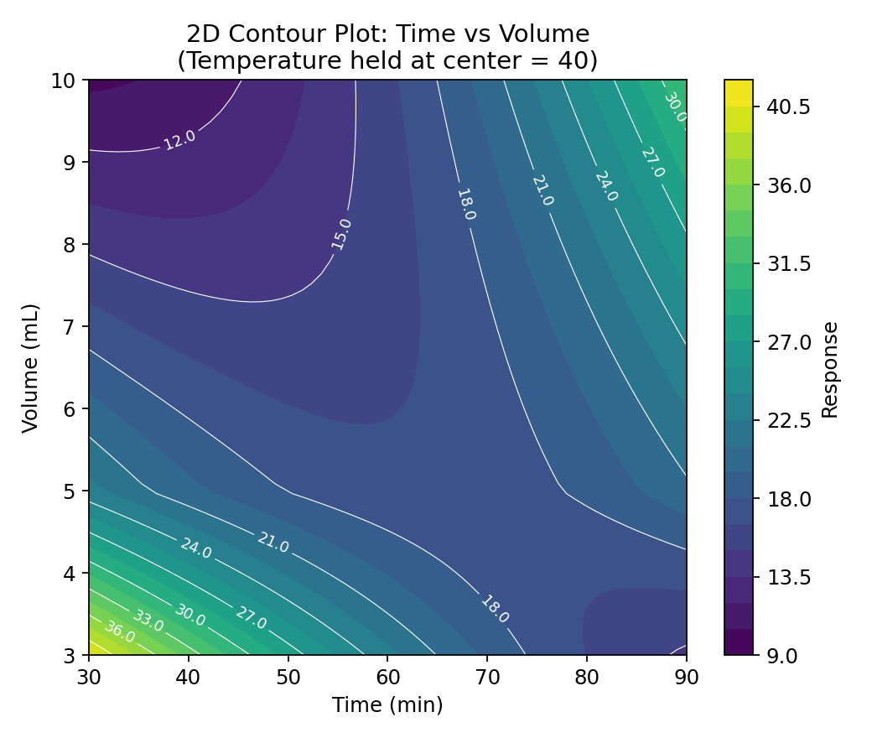
28th Congress of SCTM, 23-26 September, Ohrid, Macedonia
OPTIMIZATION OF DEEP EUTECTIC SOLVENT-BASED EXTRACTION OF PERSISTENT ORGANIC POLLUTANTS FROM HUMAN HAIR
AEC – P31
Sandra Shterjova, Marinela Cvetanoska, Marina Stefova, Jasmina Petreska Stanoeva
Institute of Chemistry, Faculty of Natural Sciences and Mathematics, Ss. Cyril and Methodius University in Skopje, Skopje, North Macedonia, email: sterjova21@gmail.com
Introduction & Aim
Human hair is a non-invasive matrix for long-term biomonitoring of persistent organochlorine pollutants. Their determination requires efficient extraction and clean-up due to the complex hair matrix. Deep eutectic solvents (DESs) are being explored as alternative extraction media to conventional organic solvents.
Aim: To establish efficient extraction and clean-up conditions for the determination of organochlorine pollutants in human hair.
Experimental
Results and discussion
Box–Behnken optimization
Solvent screening → Extraction optimization → Clean-up → GC–ECD
Conclusions
A significant Time × Volume interaction was observed (p = 0.028), indicating that the effect of extraction time depended on solvent volume.
DES was selected as an alternative extraction medium for further method development.
Extraction performance was influenced by the combined effects of extraction time and solvent volume.
Future work: method validation and application to human biomonitoring.
Acknowledgement
The authors gratefully acknowledge the financial support by the Macedonian Ecological Society for the project titled “Assessment of human exposure to persistent organic pollutants in Skopje using human hair biomonitoring”.

