Slide 1


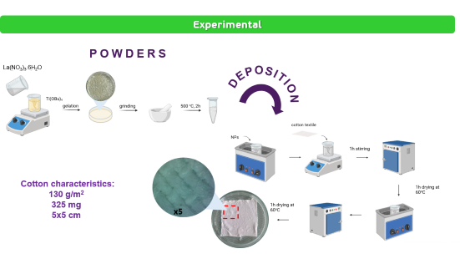
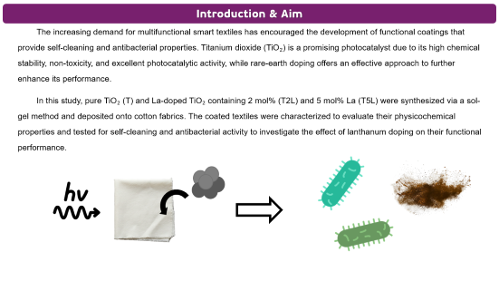
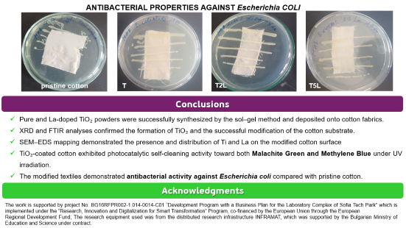
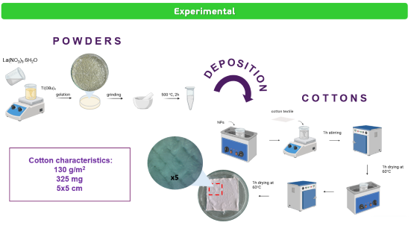
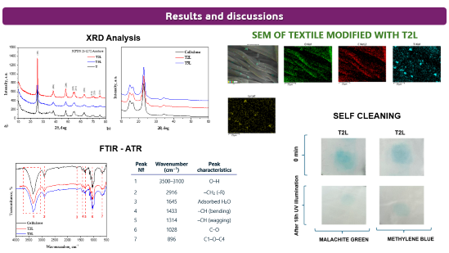
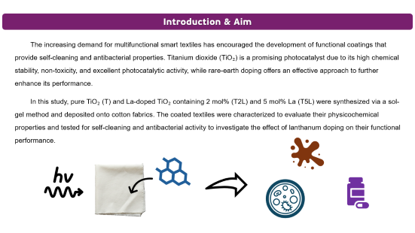
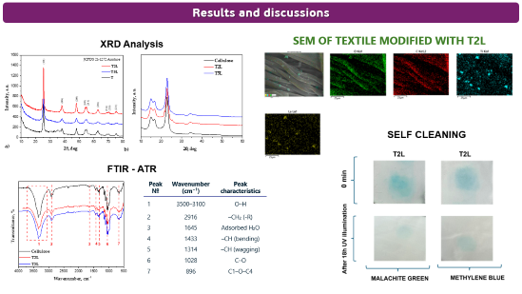
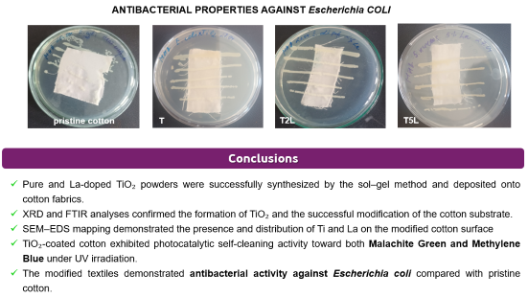
Multifunctional Cotton Textiles Modified with La-Doped TiO₂: Self-Cleaning and Antibacterial Performance
000
Stefani Petrova¹, Evelina Vasileva², Nina Danchova², Veselin Petrov², Albena Bachvarova-Nedelcheva¹
e-mail: stefany@svr.igic.bas.bg
¹ Institute of General and Inorganic Chemistry, Bulgarian Academy of Sciences, 1113 Sofia, Bulgaria; ² Faculty of Chemistry and Pharmacy, Sofia University
“St. Kliment Ohridski”, 1164 Sofia, Bulgaria
28th Congress of SCTM, 23-26 September, Ohrid, Macedonia

Slide 2

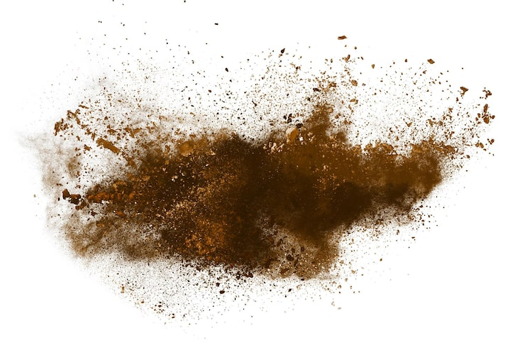
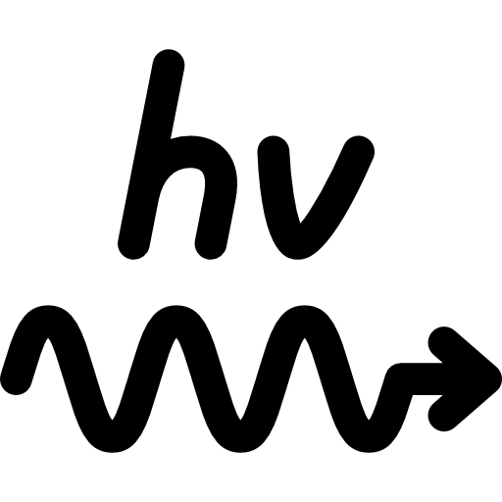
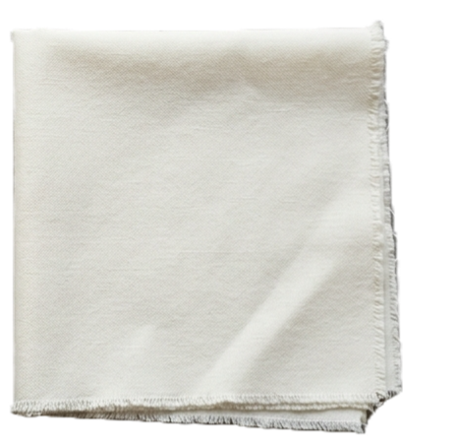
Introduction & Aim
The increasing demand for multifunctional smart textiles has encouraged the development of functional coatings that provide self-cleaning and antibacterial properties. Titanium dioxide (TiO₂) is a promising photocatalyst due to its high chemical stability, non-toxicity, and excellent photocatalytic activity, while rare-earth doping offers an effective approach to further enhance its performance.
In this study, pure TiO₂ (T) and La-doped TiO₂ containing 2 mol% (T2L) and 5 mol% La (T5L) were synthesized via a sol-gel method and deposited onto cotton fabrics. The coated textiles were characterized to evaluate their physicochemical properties and tested for self-cleaning and antibacterial activity to investigate the effect of lanthanum doping on their functional performance.

Slide 3
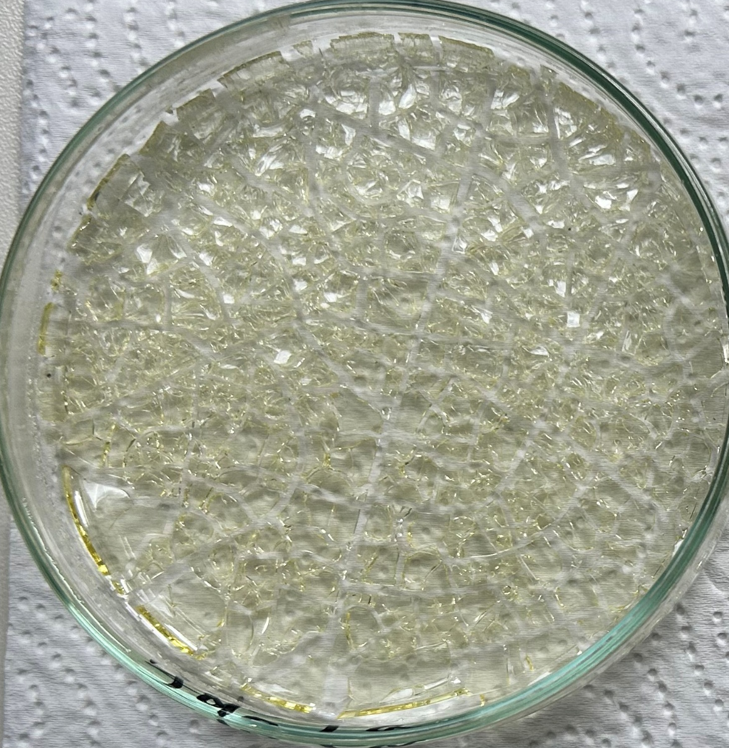
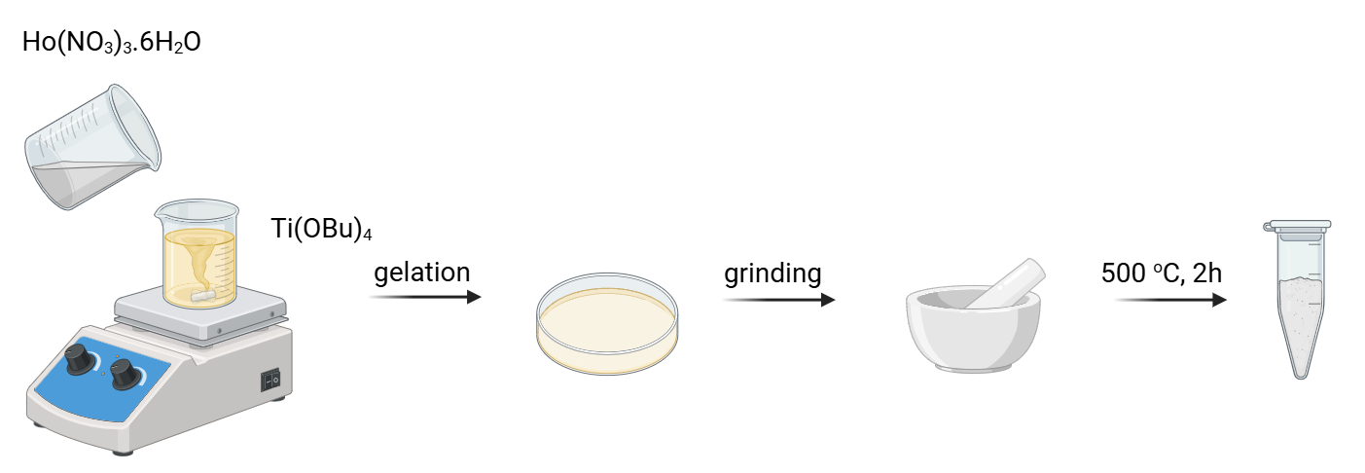
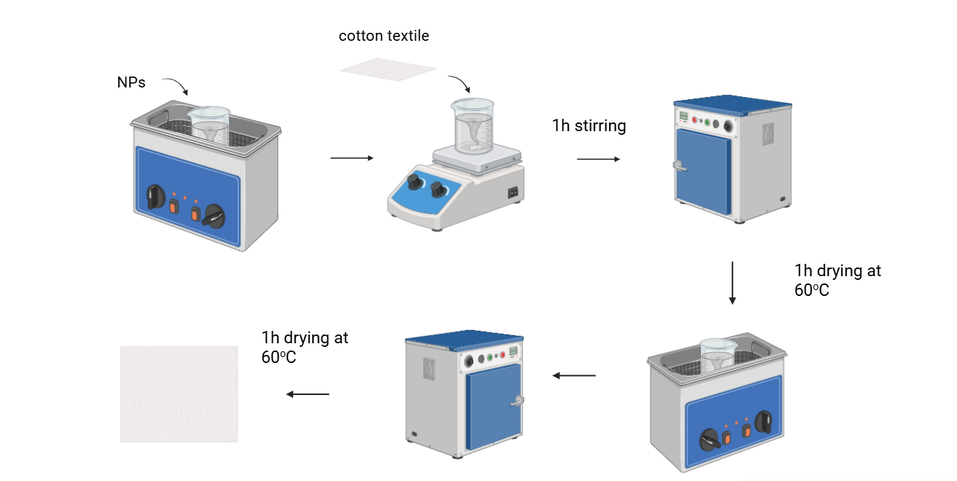
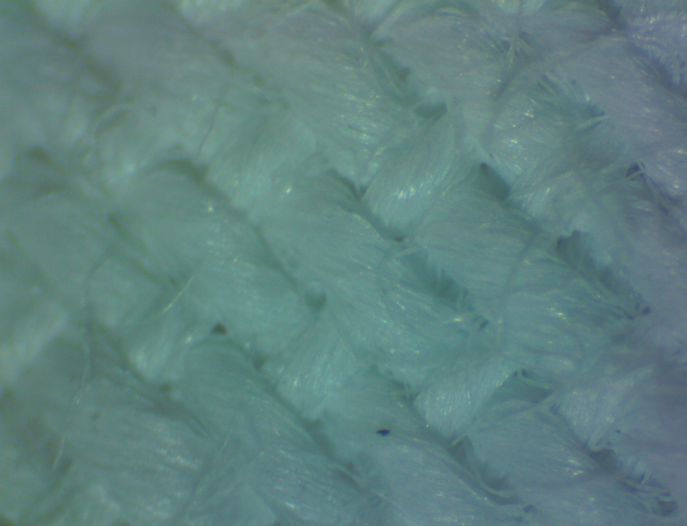
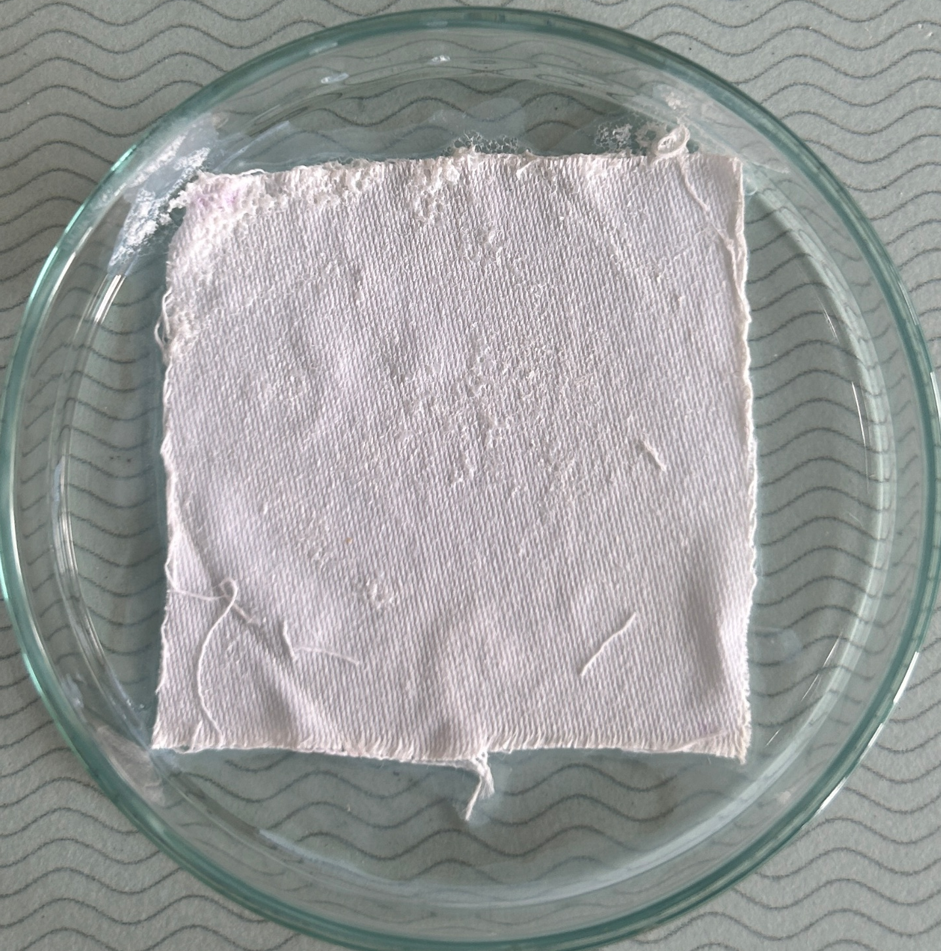
Experimental
POWDERS
La(NO₃)₃.6H₂O
DEPOSITION
COTTONS
Cotton characteristics:
130 g/m²
325 mg
5x5 cm
х5

Slide 4
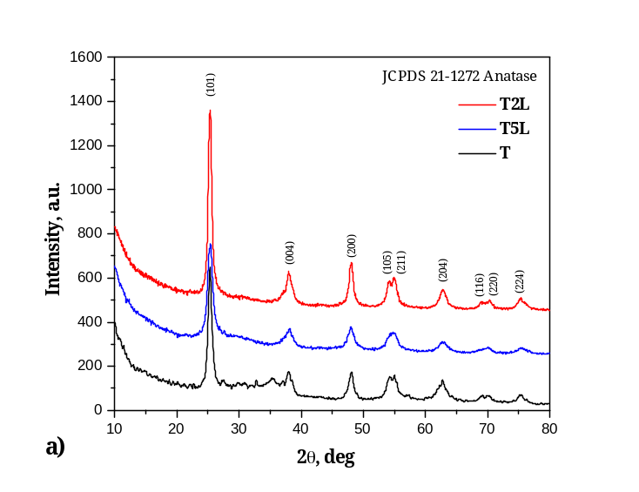
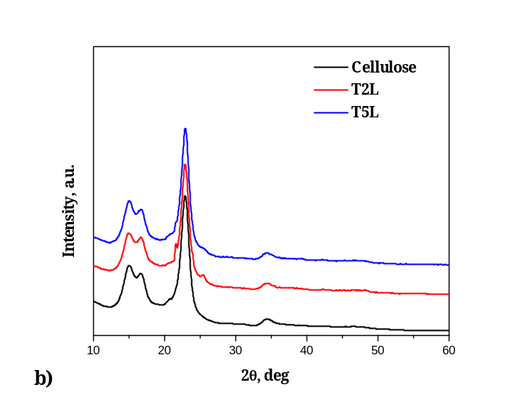
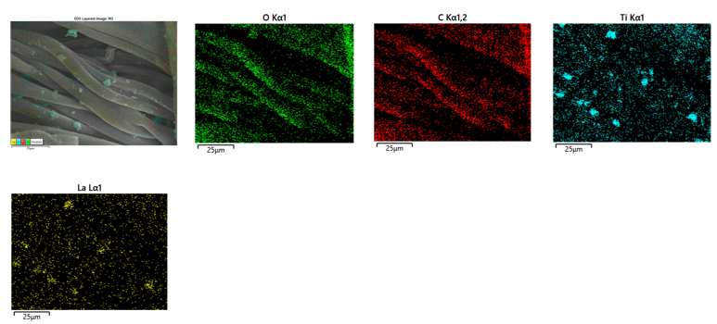
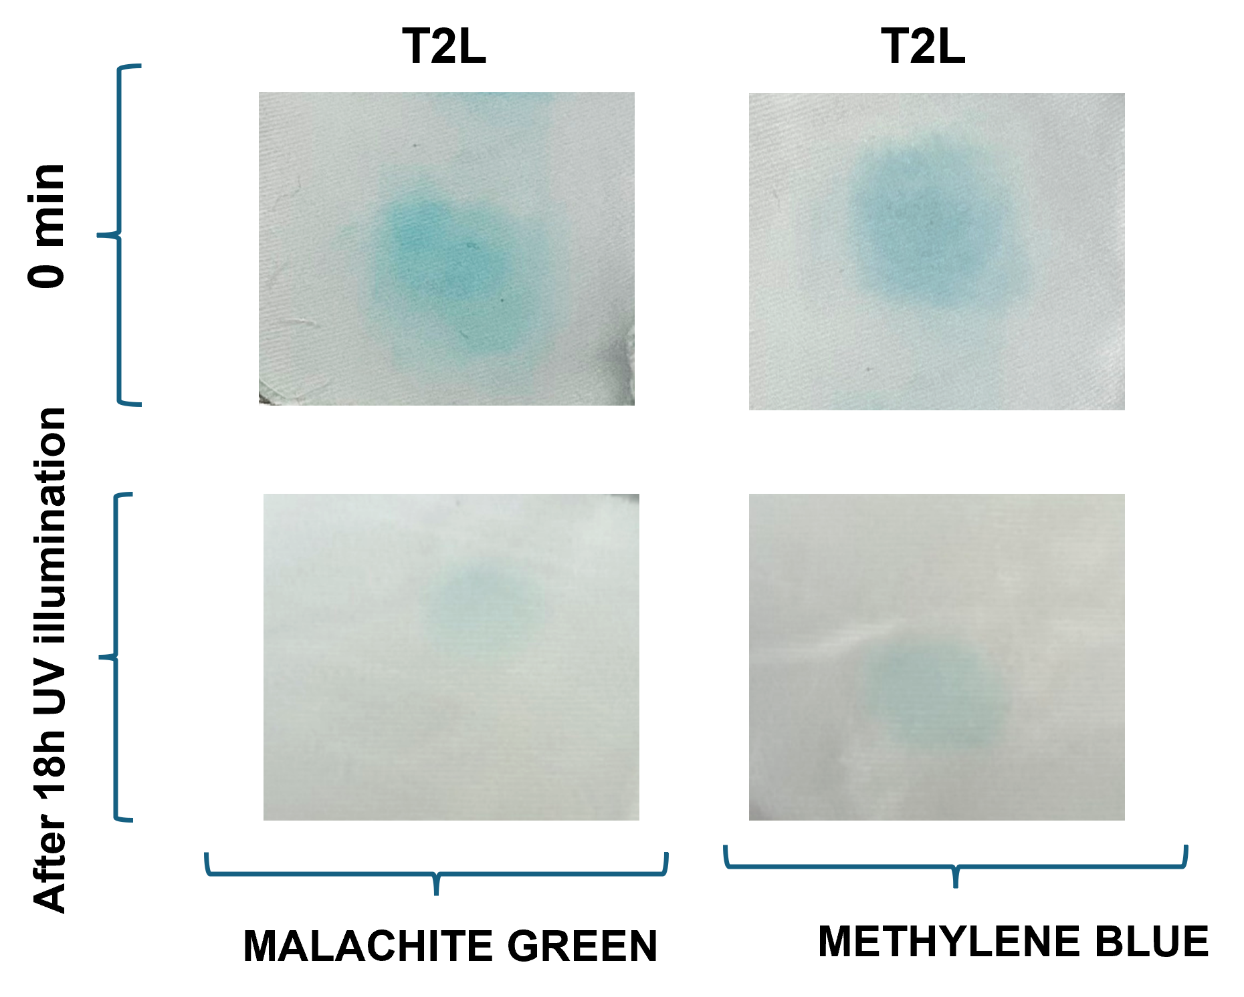
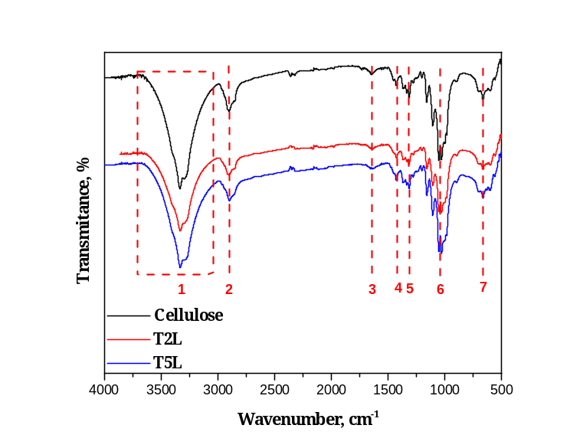
Results and discussions
SEM OF TEXTILE MODIFIED WITH T2L
XRD Analysis
SELF CLEANING
FTIR - ATR
Peak № | Wavenumber (cm⁻¹) | Peak characteristics
1 | 3500–3100 | O–H
2 | 2916 | –CH₂ (-R)
3 | 1645 | Adsorbed H₂O
4 | 1433 | –CH (bending)
5 | 1314 | –CH (wagging)
6 | 1028 | C–O
7 | 896 | C1–O–C4

Slide 5
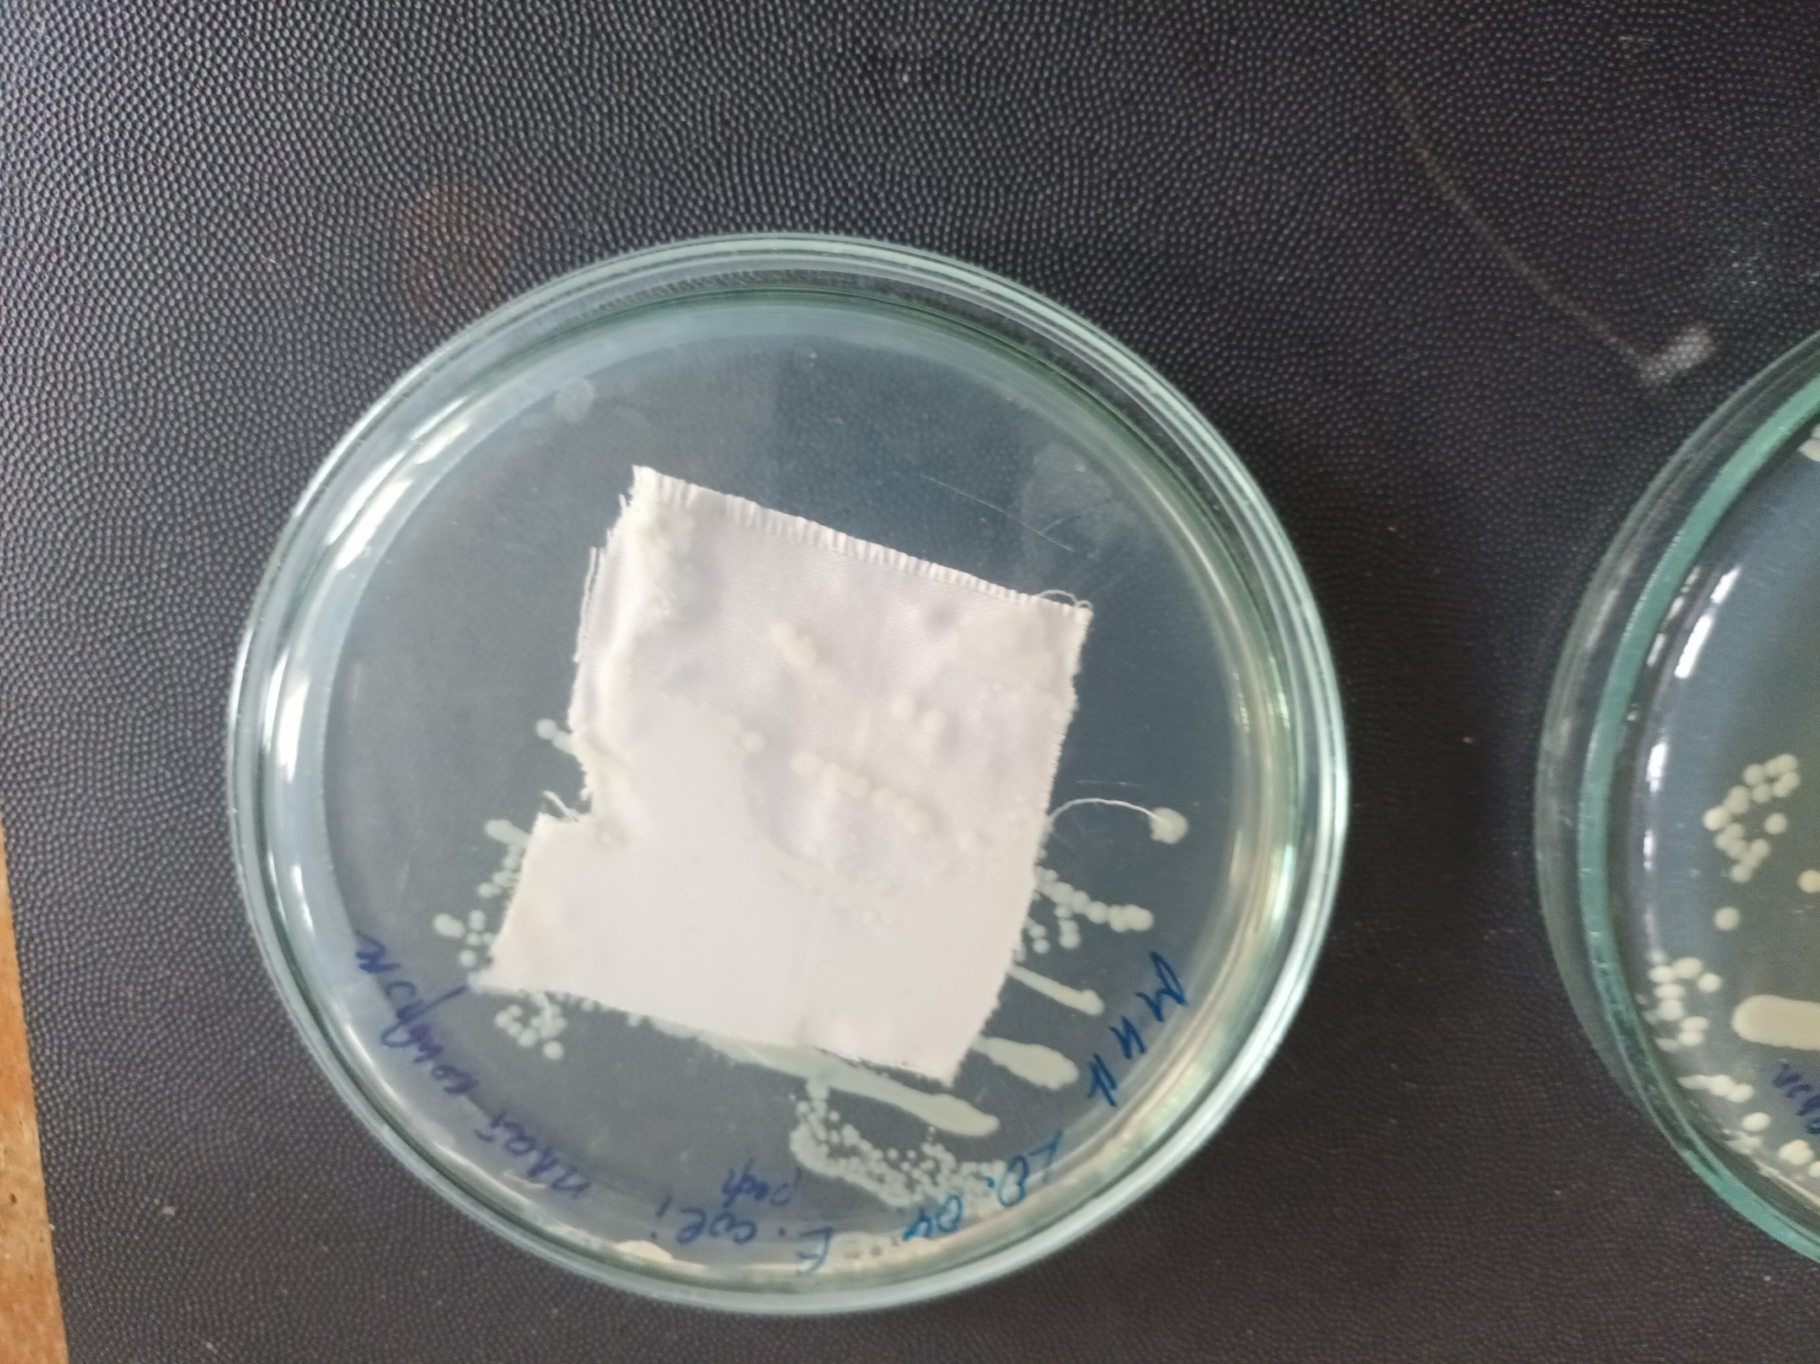
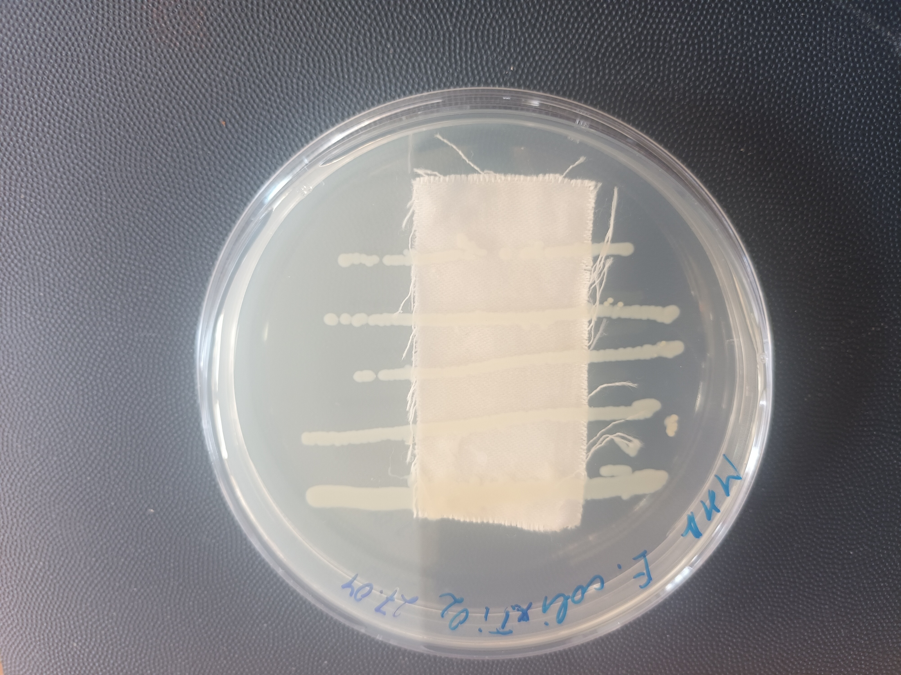
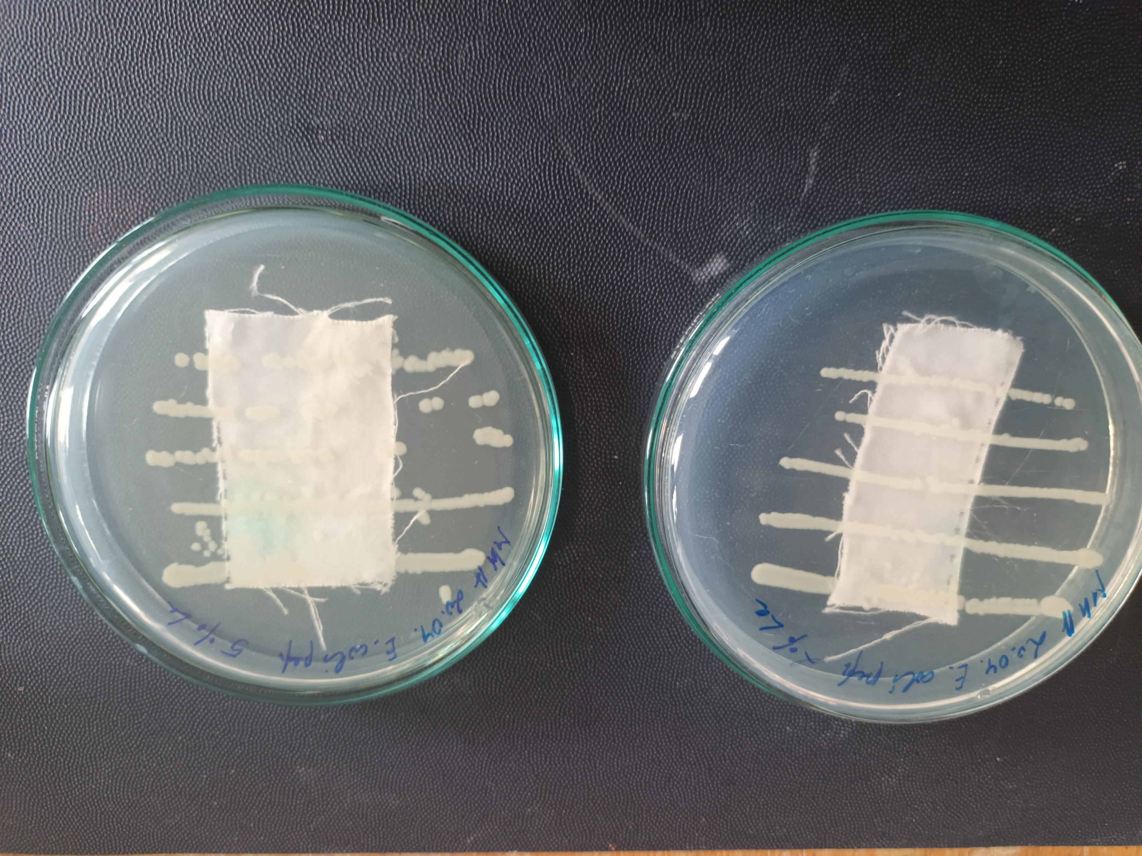
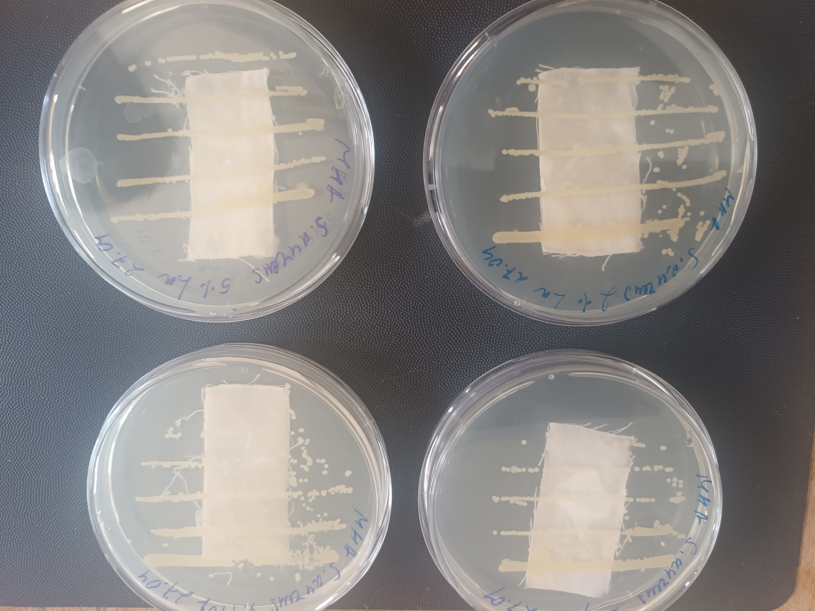
ANTIBACTERIAL PROPERTIES AGAINST Escherichia COLI
pristine cotton
T
T2L
T5L
Conclusions
Pure and La-doped TiO₂ powders were successfully synthesized by the sol–gel method and deposited onto cotton fabrics.
XRD and FTIR analyses confirmed the formation of TiO₂ and the successful modification of the cotton substrate.
SEM–EDS mapping demonstrated the presence and distribution of Ti and La on the modified cotton surface
TiO₂-coated cotton exhibited photocatalytic self-cleaning activity toward both Malachite Green and Methylene Blue under UV irradiation.
The modified textiles demonstrated antibacterial activity against Escherichia coli compared with pristine cotton.
Acknowledgments
The work is supported by project No. BG16RFPR002-1.014-0014-C01 “Development Program with a Business Plan for the Laboratory Complex of Sofia Tech Park” which is implemented under the “Research, Innovation and Digitalization for Smart Transformation” Program, co-financed by the European Union through the European
Regional Development Fund; The research equipment used was from the distributed research infrastructure INFRAMAT, which was supported by the Bulgarian Ministry of Education and Science under contract.

