Slide 1


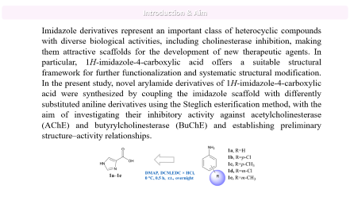
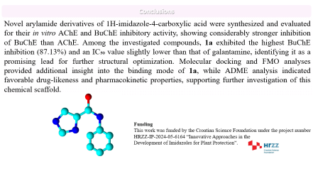
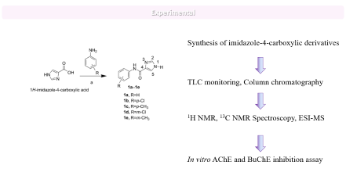


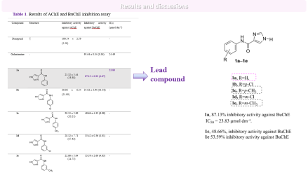

28th Congress of SCTM, 23-26 September, Ohrid, Macedonia
Design of novel aryl imidazole-4-carboxylic acid derivatives as potential cholinesterase inhibitors
Andrea Dandić¹, Marija Paurević¹, Martina Šrajer Gajdošik¹, Domagoj Šubarić², Maja Karnaš Babić², Vesna Rastija²
¹Department of Chemistry, Josip Juraj Strossmayer University of Osijek, Cara Hadrijana 8/A, 31000 Osijek, Croatia ² Faculty of Agrobiotechnical Sciences Osijek, Vladimira Preloga 1, 31000 Osijek, Croatia

Slide 2
Introduction & Aim
Imidazole derivatives represent an important class of heterocyclic compounds with diverse biological activities, including cholinesterase inhibition, making them attractive scaffolds for the development of new therapeutic agents. In particular, 1H-imidazole-4-carboxylic acid offers a suitable structural framework for further functionalization and systematic structural modification. In the present study, novel arylamide derivatives of 1H-imidazole-4-carboxylic acid were synthesized by coupling the imidazole scaffold with differently substituted aniline derivatives using the Steglich esterification method, with the aim of investigating their inhibitory activity against acetylcholinesterase (AChE) and butyrylcholinesterase (BuChE) and establishing preliminary structure–activity relationships.

Slide 3
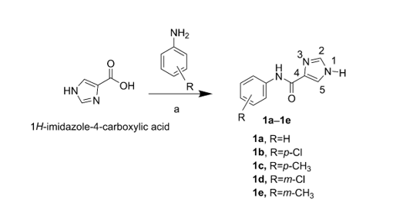
Experimental
Synthesis of imidazole-4-carboxylic derivatives
TLC monitoring, Column chromatography
¹H NMR, ¹³C NMR Spectroscopy, ESI-MS
In vitro AChE and BuChE inhibition assay

Slide 4
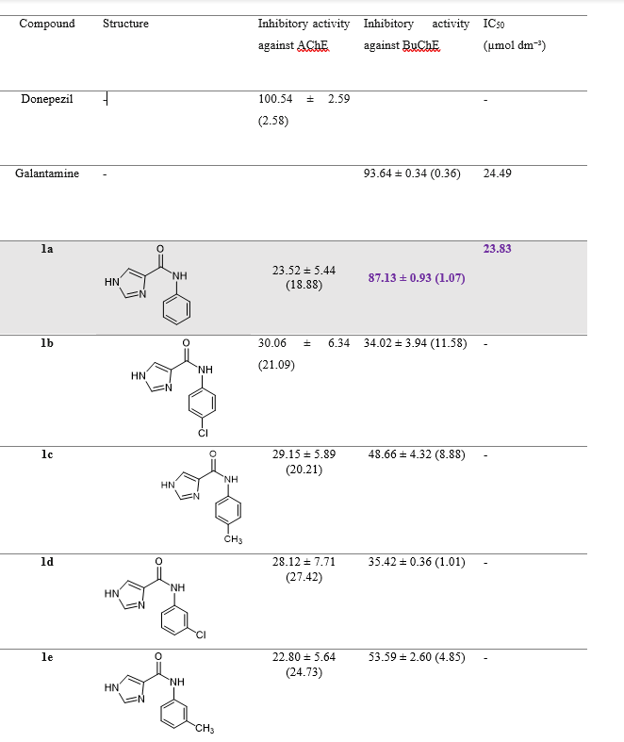
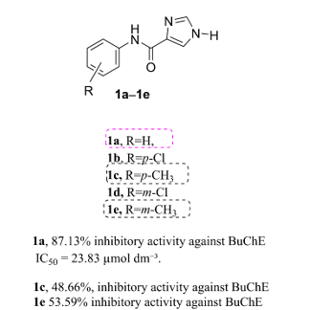
Results and discussions
Table 1. Results of AChE and BuChE inhibition assay
Lead
compound

Slide 5
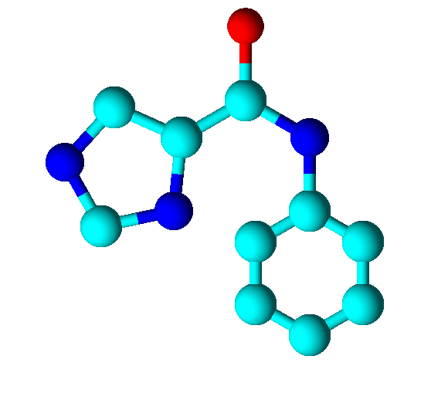

Conclusions
Novel arylamide derivatives of 1H-imidazole-4-carboxylic acid were synthesized and evaluated for their in vitro AChE and BuChE inhibitory activity, showing considerably stronger inhibition of BuChE than AChE. Among the investigated compounds, 1a exhibited the highest BuChE inhibition (87.13%) and an IC₅₀ value slightly lower than that of galantamine, identifying it as a promising lead for further structural optimization. Molecular docking and FMO analyses provided additional insight into the binding mode of 1a, while ADME analysis indicated favorable drug-likeness and pharmacokinetic properties, supporting further investigation of this chemical scaffold.
Funding
This work was funded by the Croatian Science Foundation under the project number
HRZZ-IP-2024-05-6164 “Innovative Approaches in the
Development of Imidazoles for Plant Protection”.

