Slide 1

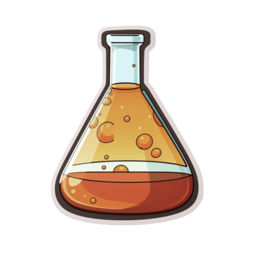





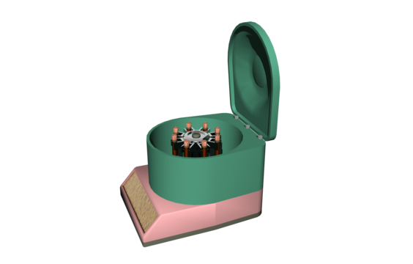



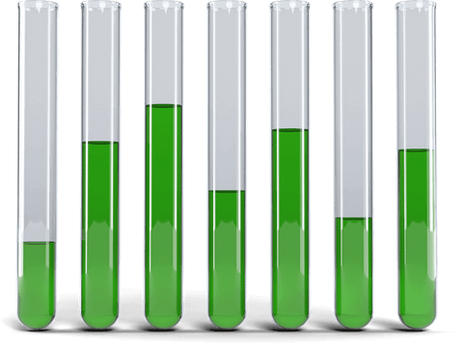
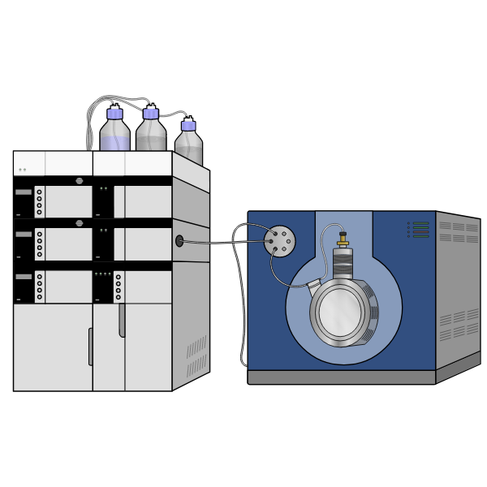

28th Congress of SCTM, 23-26 September, Ohrid, Macedonia
AEC – P4
COMPARISON OF DEEP EUTECTIC SOLVENTS FOR THE EXTRACTION OF POLYPHENOLIC COMPOUNDS FROM Salvia officinalis L.
Merva Ejupi, Marinela Cvetanoska, Marina Stefova, Jasmina Petreska Stanoeva
Institute of Chemistry, Faculty of Natural Sciences and Mathematics, Ss. Cyril and Methodius University in Skopje, Skopje, R. N. Macedonia
INTRODUCTION
METHODS
RESULTS
Polyphenolic compounds in Salvia exhibit antioxidant, anti-inflammatory and antimicrobial activities, highlighting their potential in food, pharmaceutical and cosmetic applications.
1
Sample preparation
31 identified compounds
Samples were homogenized and 50 mg was weighed.
HIGHEST EXTRACTION EFFICIENCY
2
DES preparation
ChT (1:2)
81,31 mg/g
Flavonoids
70 % MeOH
DES prepared at various molar ratios.
Phenolic acids
26.55 mg/g
Extraction
ChA (1:2)
0.36 mg/g
Procyanids
Terpenes
1.64 mg/g
3
50 mg + 1 mL DES; ultrasonic bath, 30 min.
ChT (1:2)
100.28 mg/g
NATURAL
COMPOUNDS
DES
SOLVENTS
SUSTAINABLE
EXTRACTION
Centrifugation
Total Polyphenolic Content
ChU (1:2)
49.17 mg/g
4
ChA (1:2)
38,60 mg/g
WHY DEEP EUTECTIC SOLVENTS?
15 min at 3600 rpm.
70% MeOH
44.84 mg/g
5
Filtration & dilution
Diluted with water and filtered
6
HPLC analysis
Polyphenolic-identified and quantified.
AIM
CONCLUSION
To evaluate and compare the extraction efficiency of NADES for polyphenolic compounds from Salvia officinalis L., using 70% methanol as a reference.
DES → Efficient extraction → ♻ Sustainable alternative

