Slide 1
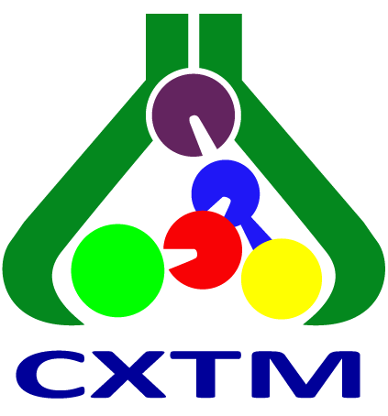
Influence of Moisture on the Molecular Structures of Pyrazole-Based Cadmium Halide Complexes
28th Congress of Chemists and Technologists of Macedonia
23-26 September, 2026, Metropol Lake Resort, Ohrid, Macedonia
Berta Barta Holló, Mirjana Radanović, Valentina Vukobrat, Kende Attila Béres, Zsolt Dürvanger, Vladimir Petruševski, László Kótai

Slide 2

Coordination compounds
Significance
Bioactivity
Model systems
CVD precursors
Photoluminescence – OLED application
Gas adsorption and storage

Slide 3
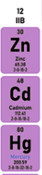
Pros and contras of d¹⁰ systems
d¹⁰ system:
They are not suitable for UV/Vis, magnetic, ESR studies
Good photophysical properties and oxidative stability
Specific properties of Cd(II):
soft-borderline Pearson acid character
flexible coordination geometry
and great variations in structural features of the complexes

Slide 4
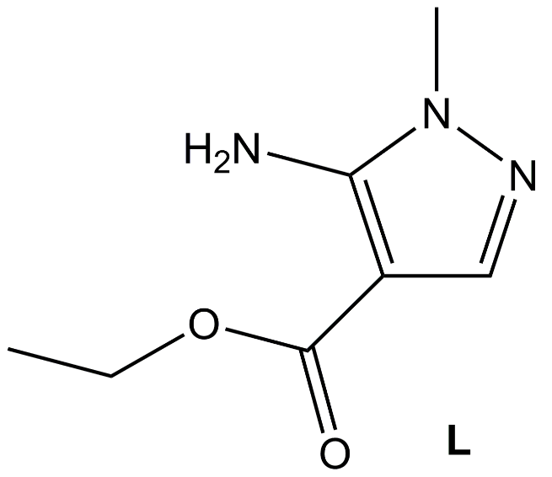
Complex formation
The photophysical properties can be tuned through ligand modification or structural engineering
Organic ligands with conjugated C=N bonds, e.g., pyrazole derivatives
The substituents can change the energy levels of the molecular orbitals and permit tuning of the optical band gap
Study the preparation and structural/spectroscopic cadmium halide complexes (CdX₂, X=Cl, Br, I) prepared in various solvents and compositions.
ethyl-5-amino-1-methyl-1H-pyrazole-4-carboxylate
ethyl-5-amino-1-methyl-1H-pyrazole-4-carboxylate

Slide 5
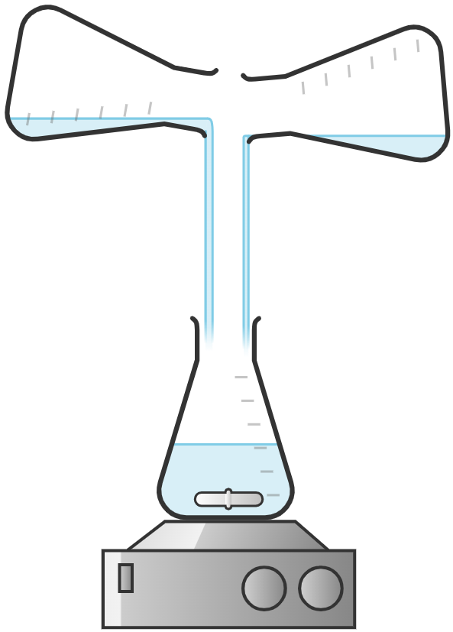
Synthesis – in general
Anhydrous CdX₂ + L in molar ratio 1:2 and 1:1
Different solvent mixtures
Two types of compounds – the Cd/L stoichiometry in the products does not depend strictly on the Cd/L molar ratio in the mother liquors
The effect of moisture

Slide 6
Chloride compounds
CdLCl₂ (1-Cl)
CdCl₂ + L CdL₂Cl₂ (2-Cl)
Solvent dependence
MeOH: 1-Cl
MeOH/MeCN: 2-Cl
MeOH/Me₂CO: 2-Cl at Cd:L=1:2 ratio,
2-Cl + 1-Cl-HYD at Cd:L =1:1 molar ratio
Formally, a hydrolysis-driven “quasi-disproportionation” takes place:
3CdLCl₂ +2H₂O → CdLCl₂·Cd(H₂O)Cl₂·H₂O + CdL₂Cl₂

Slide 7
Recrystallization
Polymeric compounds
from H₂O
1-Cl from MeOH
from MeOH, covered with an Et₂O layer: 1-Cl-HYD
1-Cl-HYD: CdLCl₂·Cd(H₂O)Cl₂·H₂O
2-Cl

Slide 8
What is the reason?
Humidity – 1-Cl transforms to 1-Cl-HYD, the liberated L will be in the solution
In MeOH, covered by Et₂O: 1-Cl-HYD crystallizes;
L and 2-Cl stay dissolved
In H₂O, H₂O/MeOH, MeOH/MeCN:
1-Cl gives CdCl₂ and 2-Cl,
CdCl₂ stays dissolved
In MeOH/Me₂CO: mixture 1-Cl-HYD + 2-Cl,
no crystallization
3CdLCl₂ +2H₂O → CdLCl₂·Cd(H₂O)Cl₂·H₂O + CdL₂Cl₂
2CdLCl₂ → CdL₂Cl₂ +CdCl₂
1-Cl
1-Cl-HYD
2-Cl
1-Cl
2-Cl

Slide 9
Bromide compounds
The compound of stoichiometry CdLBr₂ is 1-Br, its solvated form is 1-Br·MeOH
The compound of stoichiometry CdL₂Br₂ is 2-Br
1-Br·MeOH slowly loses MeOH
MeOH/MeCN
1-Br·MeOH
CdBr₂:L = 1:2
MeOH
2-Br
MeOH/MeCN
MeOH/Me₂CO
MeOH
CdBr₂:L = 1:1
1-Br·MeOH
MeOH/Me₂CO

Slide 10
Iodide compounds
CdI₂ with L gives a monomeric complex compound.
CdI₂:L = 1:2 2-I-HYD [CdL₂I₂H₂O]
CdI₂:L = 1:1 1-I (CdLI₂)
1-I + 2-I + 2-I-HYD
MeOH
MeOH/Me₂CO
Strong solvation and good solubility of CdI₂ in the coordinating MeCN
Solubility differences of 1-I and 2-I in MeOH/MeCN:
2 CdLI_{2(solid)} = CdL₂I_{2(solid)} + CdI_{2(solution)}
CdL₂I_{2(s)} + H₂O_{(vapor)} = [CdL₂I₂(H₂O)]_{(s)}
MeOH/MeCN

Slide 11
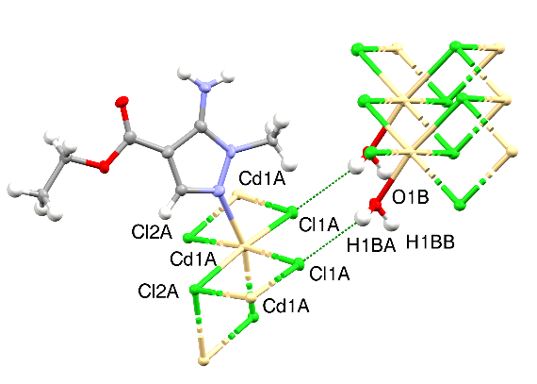
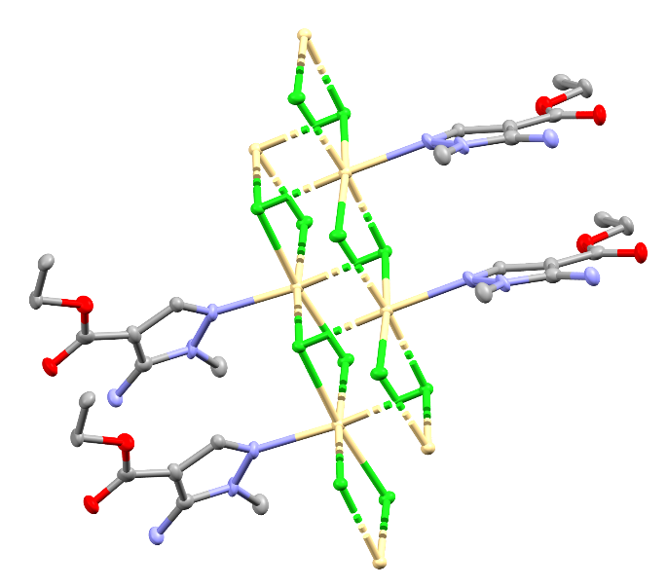
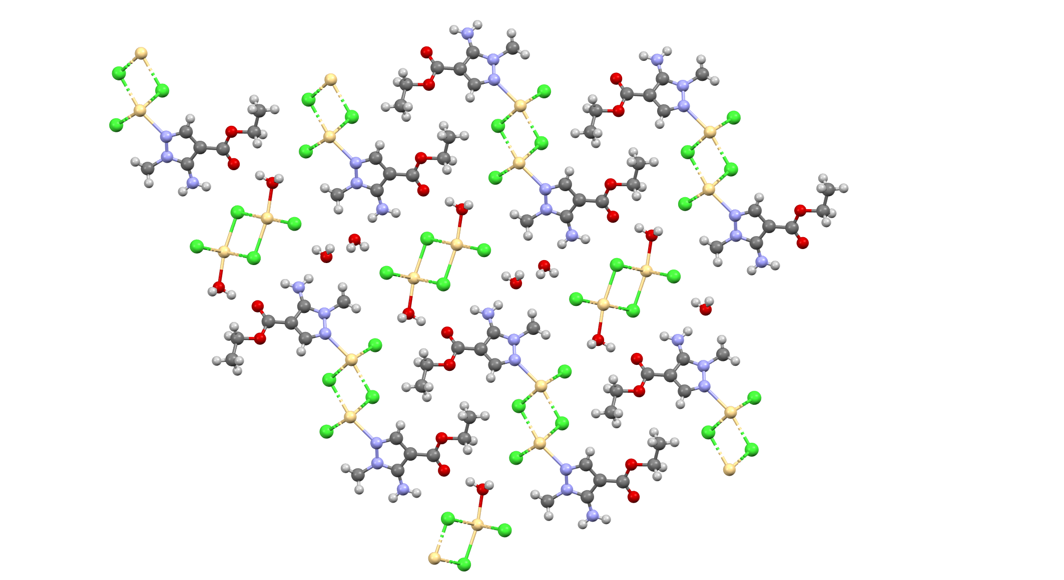
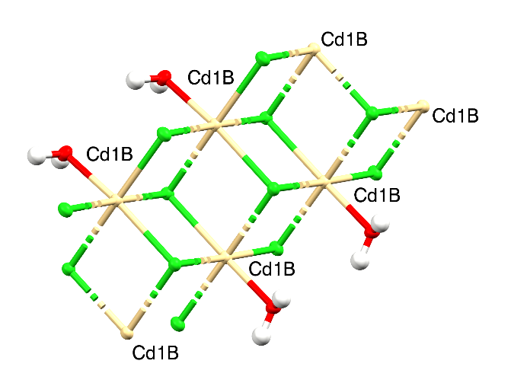
1-Cl-HYD (CdLCl₂·Cd(H₂O)Cl₂·H₂O)

Slide 12
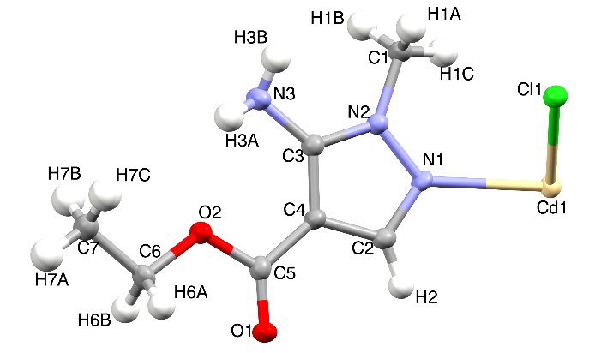
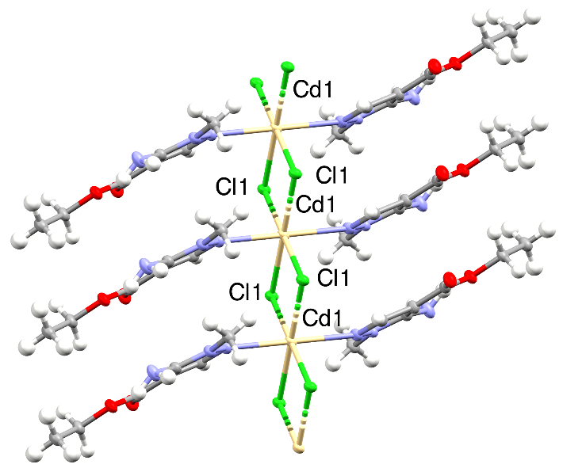
2-Cl

Slide 13
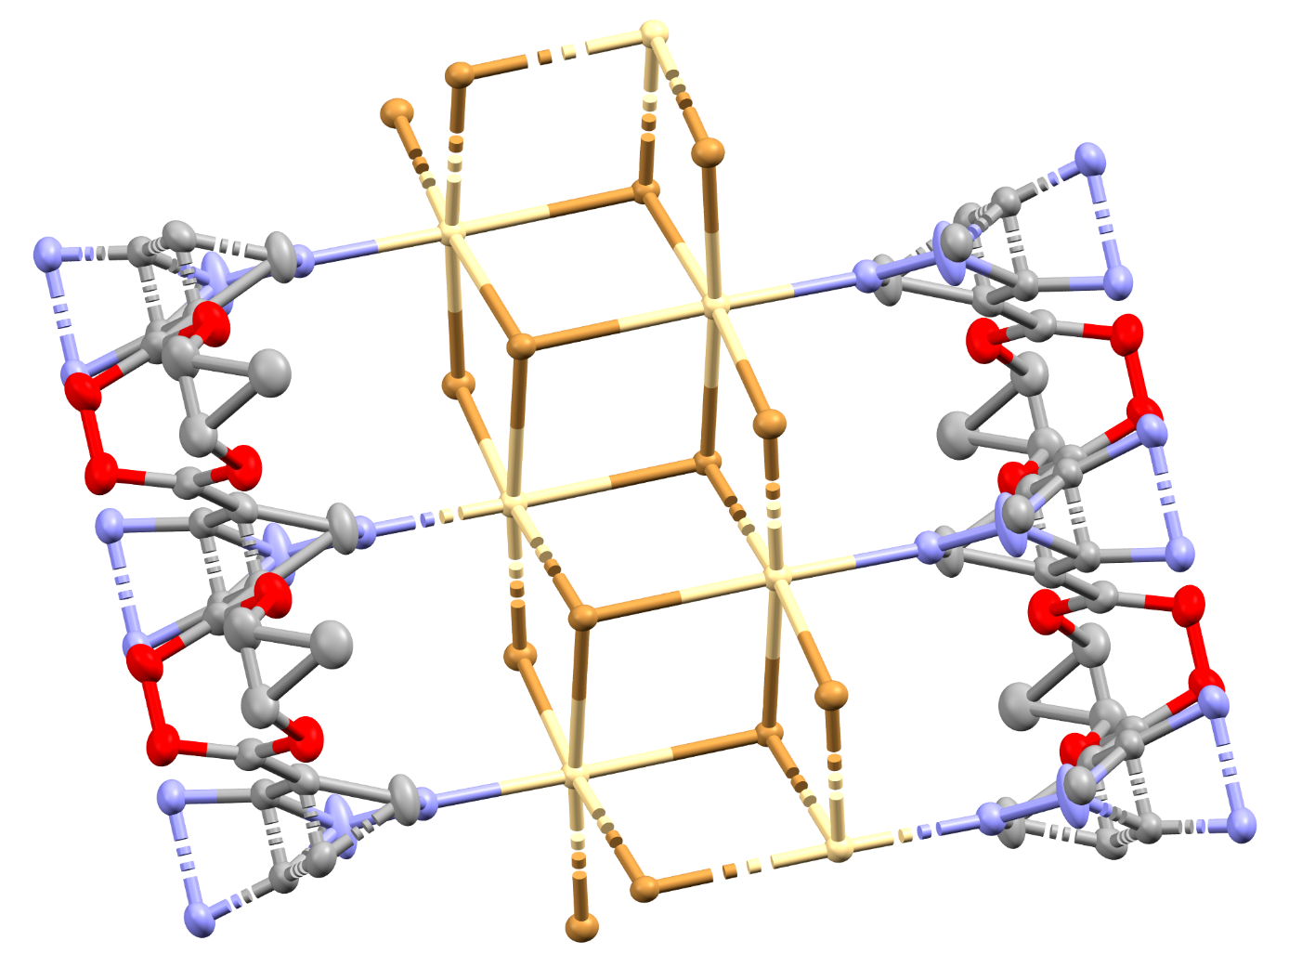
1-Br∙MeOH
1-Br·MeOH

Slide 14
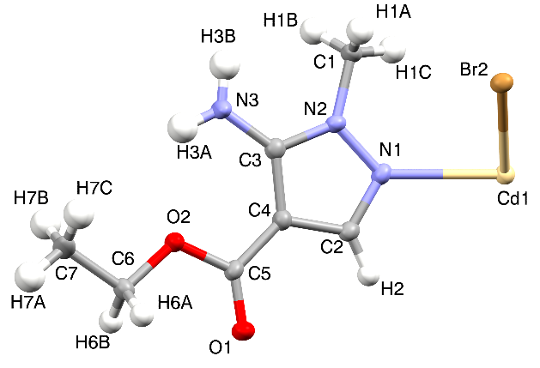
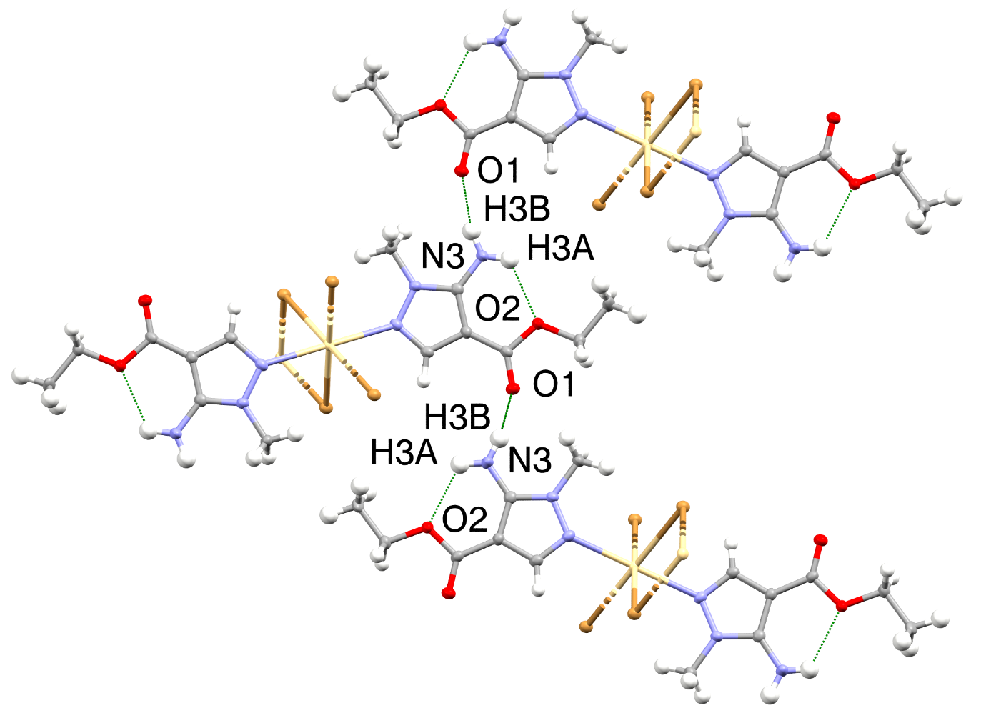
2-Br

Slide 15
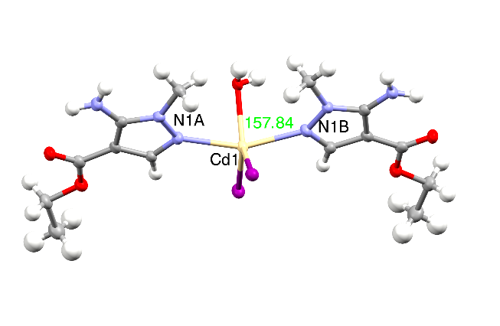
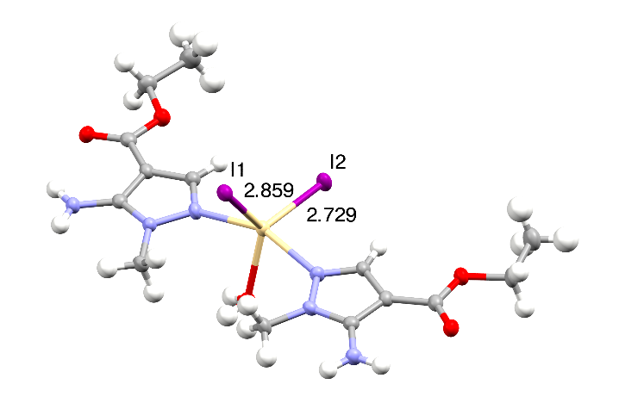
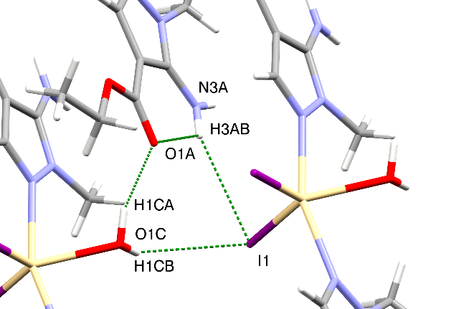
2-I-HYD [CdL₂I₂H₂O]

Slide 16
IR spectroscopy
Potential donor atoms:
endocyclic N
a slightly acidic exocyclic NH₂ group
a carboxylate
Cd(II): soft-borderline Pearson acid character → only the pyrazole basic N and the carboxylate O atoms are the expected donors.
Blue shift of ν(C=N), and the N-H and C-O stretching modes of exocyclic NH₂ and COOEt groups
ethyl-5-amino-1-methyl-1H-pyrazole-4-carboxylate

Slide 17
Mode | Ligand | Compound
 |  | 1-Cl | 1-Cl-HYD.H2O | 1-Br | 1-Br.MeOH | 1-I | 2-Cl | 2-Br | 2-I | 2-I-HYD
ν(O-H) |  |  | 3581 |  | 3407 3384 |  | - |  | - | 3411 3373
ν(N-H) | 3399 3281 3208 3161 | 3459 3371 3360 | 3483* 3461 3392 3336 3232* 3210 3164 | 3447 3445 3232 3139 | 3468 3343 3312 3234 | 3442 3411 3330 3315 3151 | 3470 3346 3234 3177 | 3470 3346 3234 3177 | 3437 3330 3315 3234 3166 | 3437 3329 3315 3215 3144
ν_{C=N/C=O} conjugate | 1680 | 1714 1690 | 1687 | 1694 | 1681 1666 | 1685 | 1705 1687 | 1705 1687 | 1692 | 1665
ν_{s}(NH2) | 1622 | 1628 | 1646 | 1620 | 1619 | 1613 | 1634 | 1635 | 1632 | 1637 1612

Slide 18
CdLX₂ Series
CdL₂X₂ Series
Wavenumbers (cm⁻¹)
Wavenumbers (cm⁻¹)

Slide 19
Far IR
Cd – X vibrations
260-200 cm⁻¹ Cd – Cl
200-160 cm⁻¹ Cd – Br
150-110 cm⁻¹ Cd – I
Wavenumbers (cm⁻¹)

Slide 20
The fluorescence properties
Lack of luminescence - there is no contribution from the ligand-to-metal charge transfer (LMCT)
All the studied samples demonstrate efficient fluorescence in the near-UV to blue spectral region with almost similar characteristics.
Electronic transitions belonging to the conjugated π system of the pyrazole ring ( π → π* )
The coordination of L to Cd(II) enhances emission intensity attributed to the ligand-centered transitions.
Sample | Peak position/nm | FWHM /nm | Intensity (a.u)
1-Cl | 407 | 109 | 20301
2-Cl | 392 | 69 | 44945
2-Br | 427 | 102 | 43988
2-I-HYD | 393 | 72 | 44600

Slide 21
Concluding remarks
Different coordination compounds were obtained depending on the solvents.
Traces of water from the solvents or adsorbed from the ambient environment significantly affected the complex formation mechanism.
The reaction of CdCl₂ with ethyl-5-amino-1-methyl-1H-pyrazole-4-carboxylate (L) is the most sensitive to both solvent nature and moisture presence.
CdCl₂ and CdBr₂ give coordination polymers with L.
2-Cl and 2-Br are isostructural.
In the IR spectra of the complexes, the characteristic vibrations of L are shifted toward higher wavenumbers.
All the studied samples demonstrate efficient fluorescence in the near-UV to blue spectral region with almost similar characteristics.
The solvent dependence of the fluorescence properties should be further investigated.

Slide 22
Thank you for your kind attention
We gratefully acknowledge the financial support of the Ministry of Science, Technological Development and Innovation of the Republic of Serbia (Grants No. 451-03-33/2026-03/200125 & 451-03-34/2026-03/200125)

