Slide 1



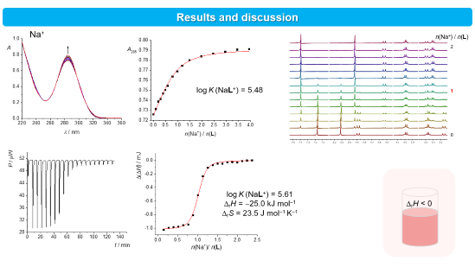
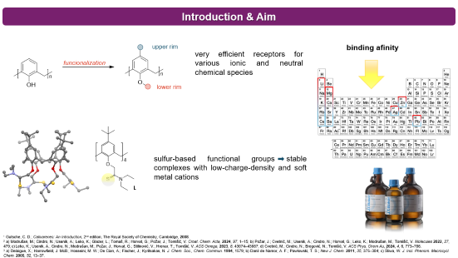
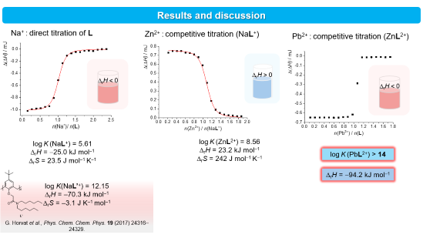
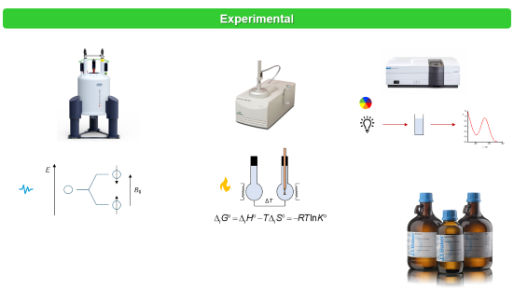
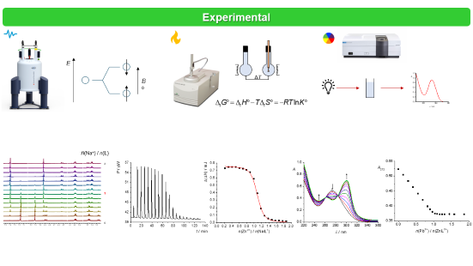
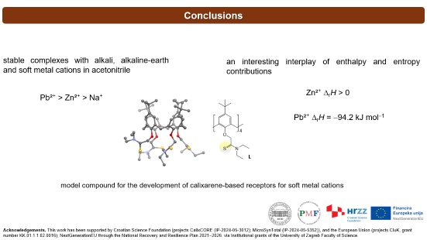
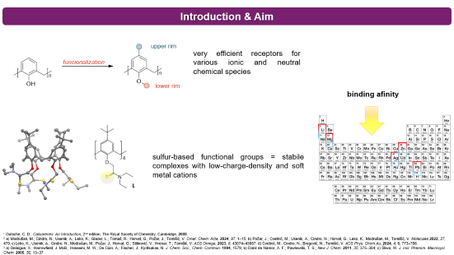
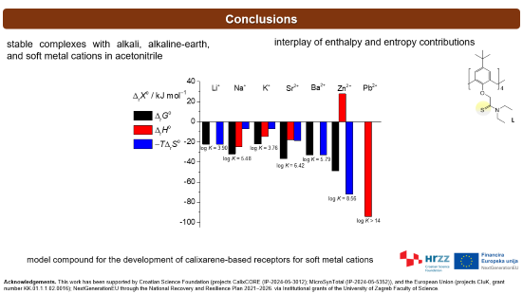
28th Congress of SCTM, 23-26 September, Ohrid, Macedonia
000
COMPLEXATION OF METAL CATIONS WITH THIOAMIDE CALIX[4]ARENE DERIVATIVE
K. Leko, B. Šijić, N. Cindro, A. Usenik, V. Stilinović, G. Talajić, V. Tomišić
University of Zagreb Faculty of Science, Department of Chemistry, Horvatovac 102A, 10000 Zagreb, Croatia
katarina.leko@chem.pmf.unizg.hr

Slide 2
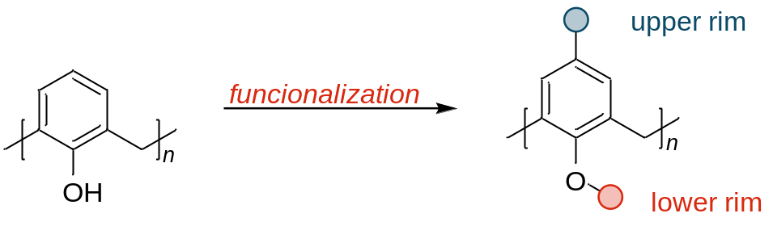
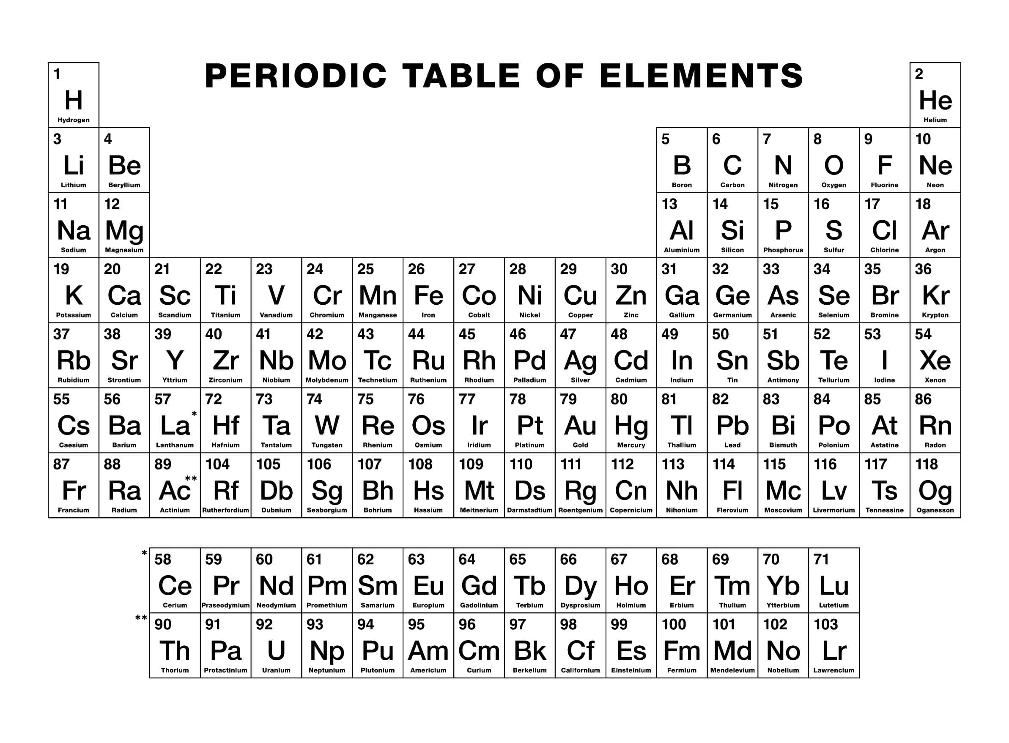
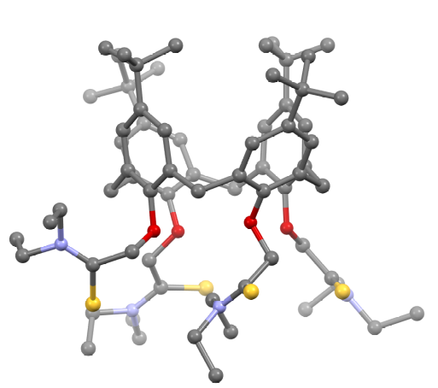
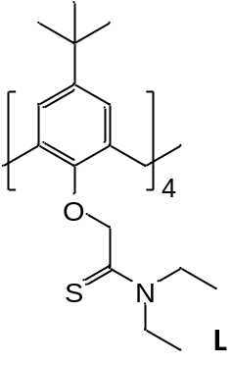
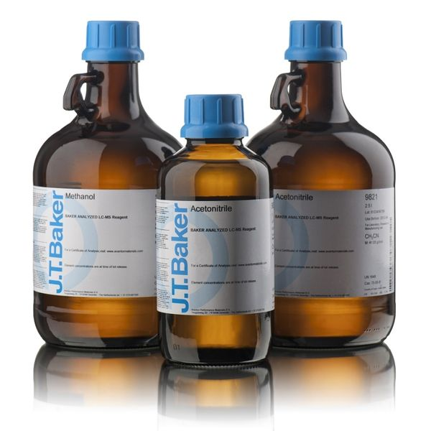
Introduction & Aim
binding afinity
very efficient receptors for various ionic and neutral chemical species
sulfur-based functional groups stable complexes with low-charge-density and soft metal cations
¹ Gutsche, C. D.; Calixarenes: An Introduction, 2nd edition, The Royal Society of Chemistry, Cambridge, 2008.
² a) Modrušan, M.; Cindro, N.; Usenik, A.; Leko, K.; Glazer, L.; Tomaš, R.; Horvat, G.; Požar, J.; Tomišić, V. Croat. Chem. Acta, 2024, 97, 1–15; b) Požar, J.; Cvetnić, M.; Usenik, A.; Cindro, N.; Horvat, G.; Leko, K.; Modrušan, M.; Tomišić, V. Molecules 2022, 27, 470; c) Leko, K.; Usenik, A.; Cindro, N.; Modrušan, M.; Požar, J.; Horvat, G.; Stilinović, V.; Hrenar, T.; Tomišić, V. ACS Omega, 2023, 8, 43074–43087; d) Cvetnić, M.; Cindro, N.; Bregović, N.; Tomišić, V. ACS Phys. Chem Au, 2024, 4, 6, 773–786.
³ a) Delaigue, X.; Harrowfield, J. McB.; Hosseini, M. W.; De Cian, A.; Fischer, J.; Kyritsakas, N. J. Chem. Soc., Chem. Commun. 1994, 1579; b) Danil de Namor, A. F.; Pawłowski, T. S.; New J. Chem. 2011, 35, 375–384; c) Śliwa, W. J. Incl. Phenom. Macrocycl. Chem. 2005, 52, 13–37.

Slide 3


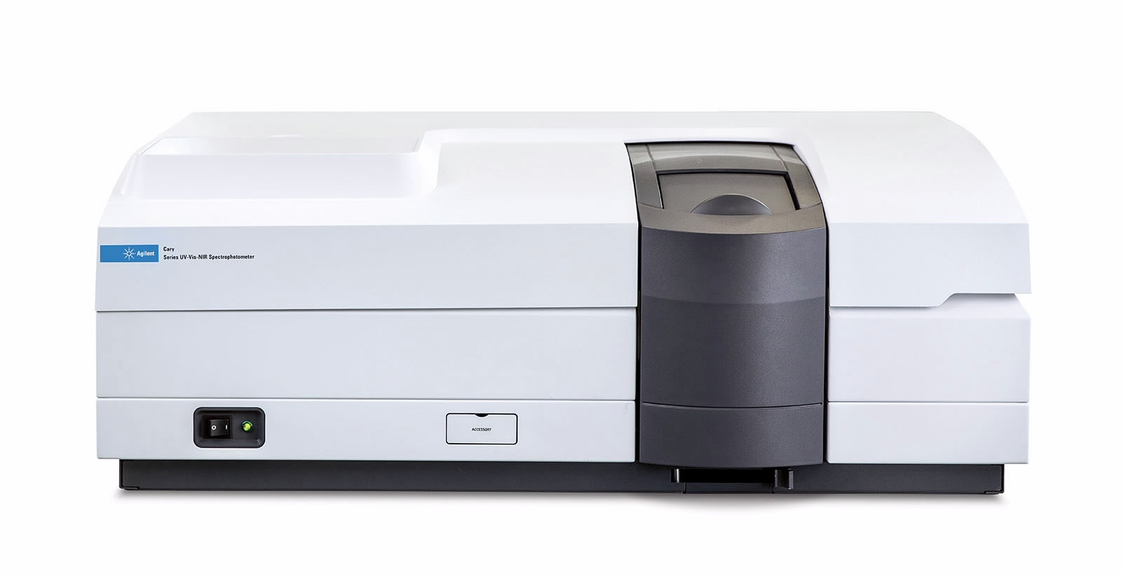
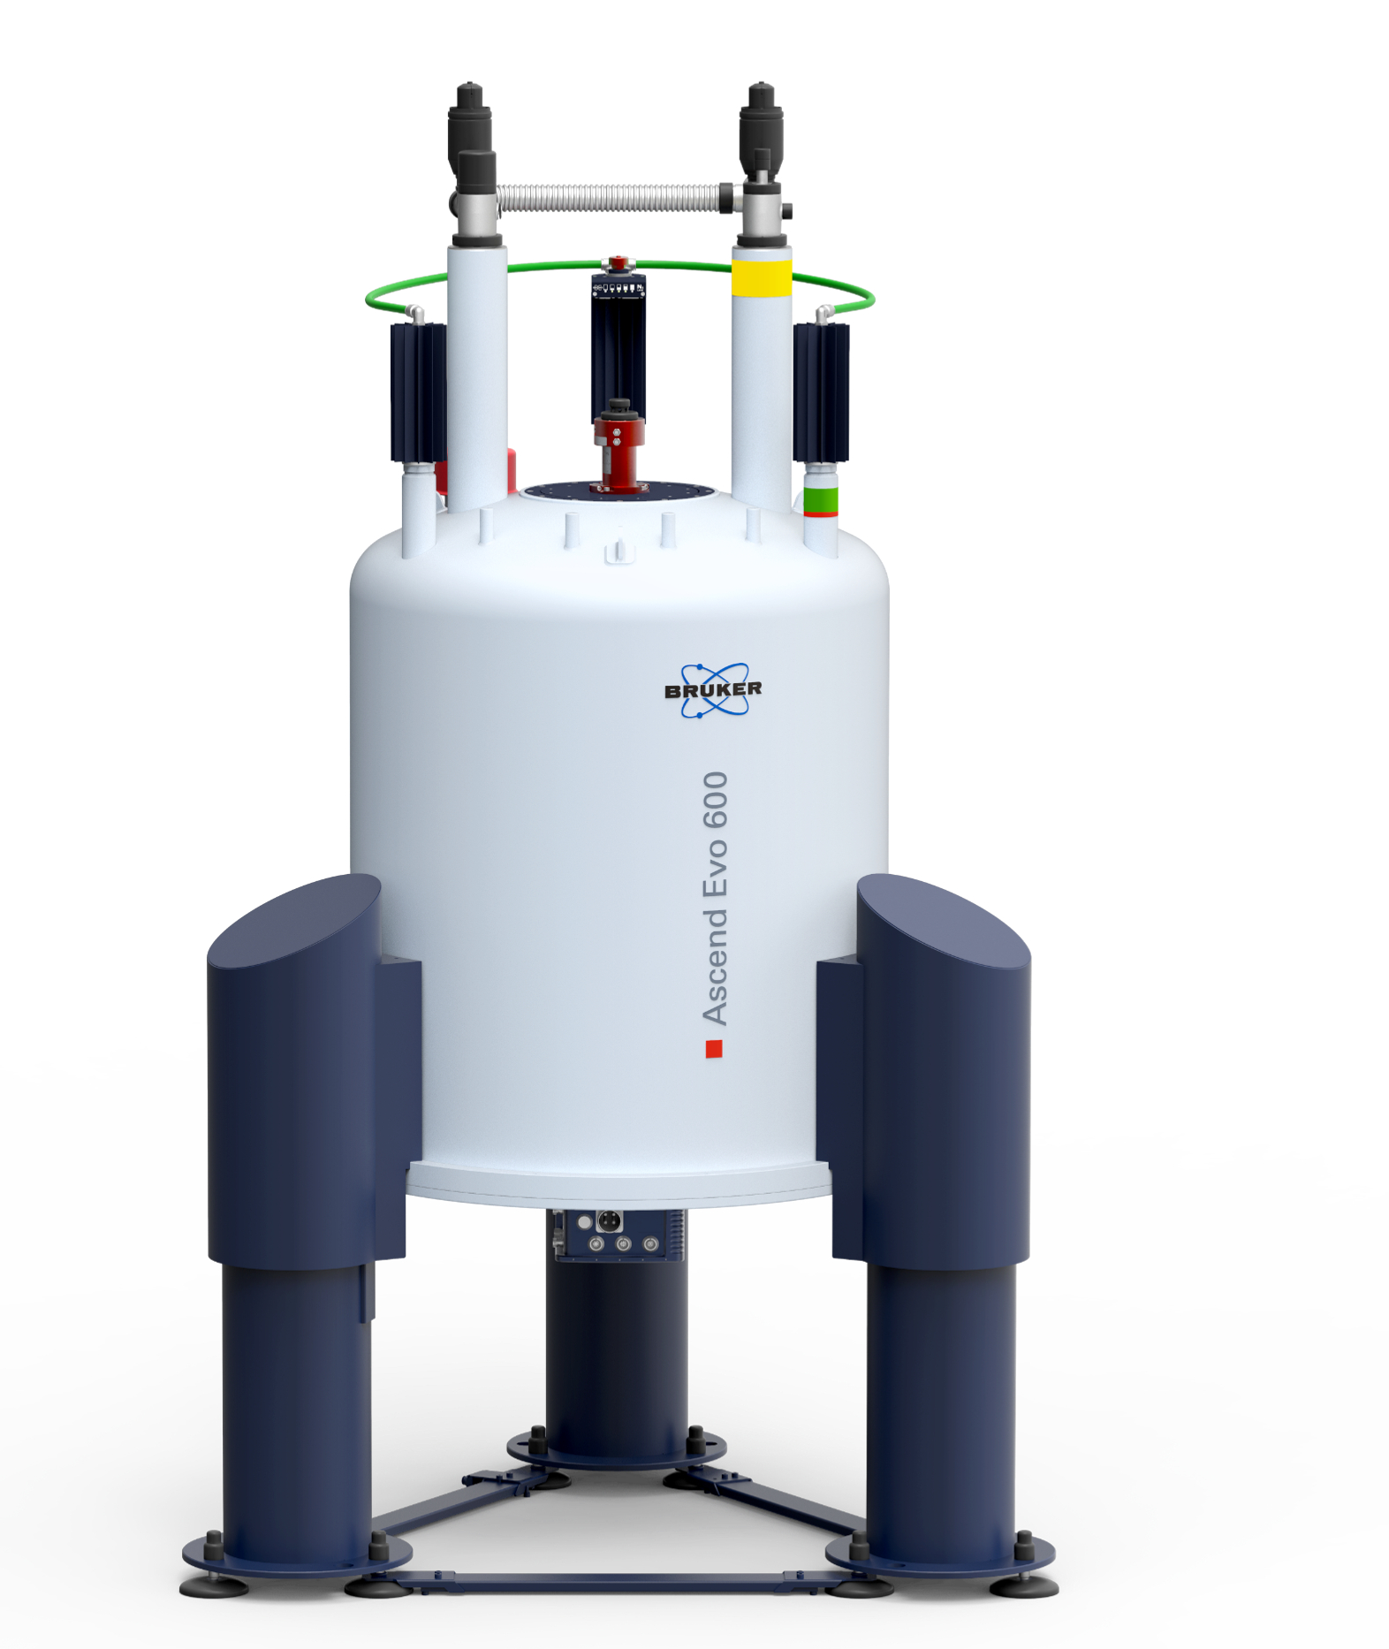

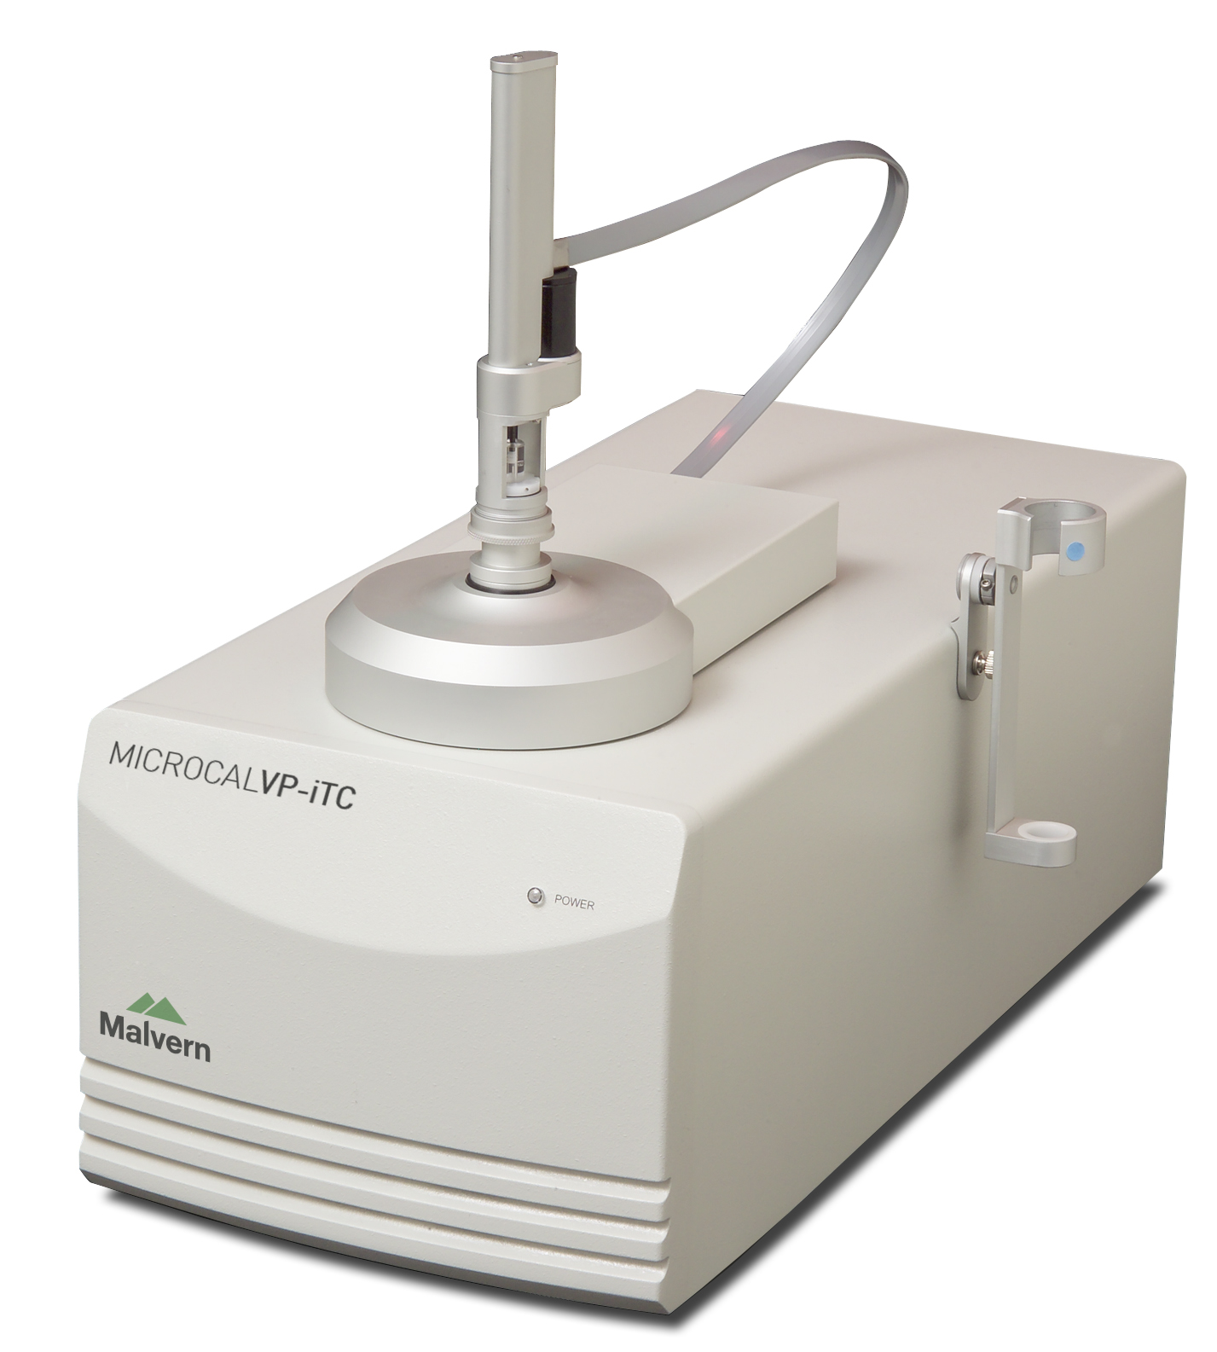
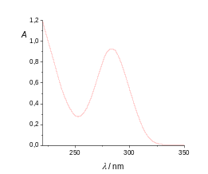


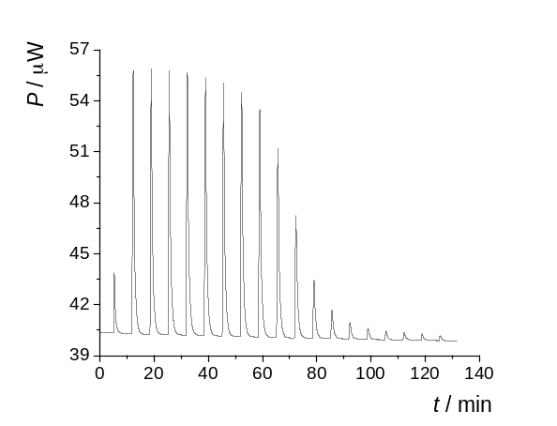
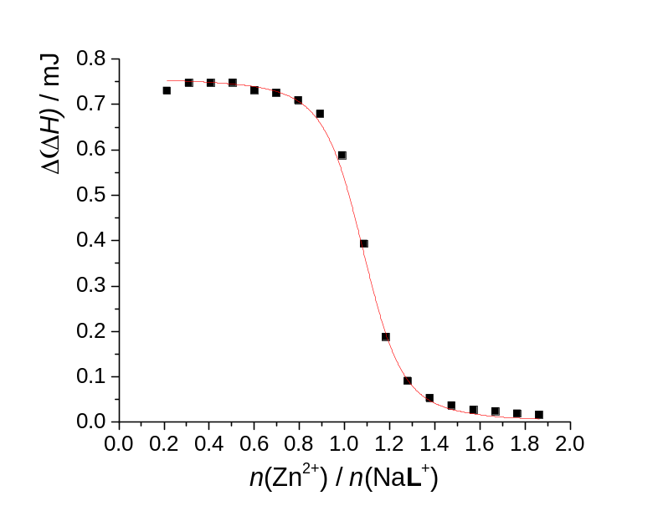
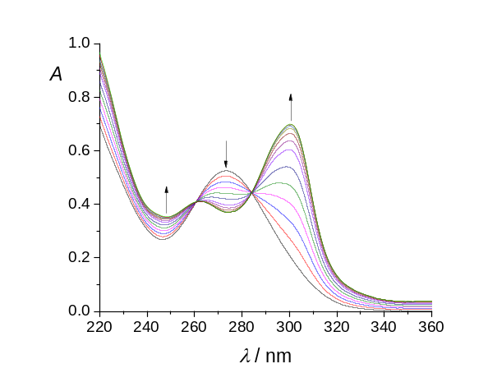
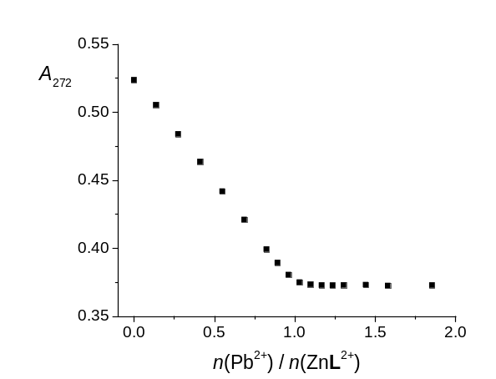
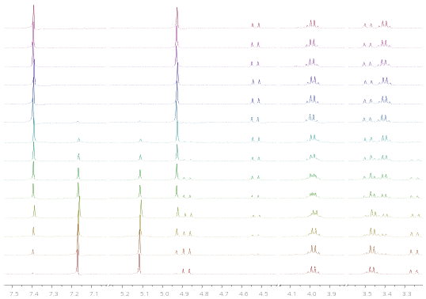
Experimental
E
B₀
ΔT
n(Na⁺) / n(L)
2
1
0

Slide 4
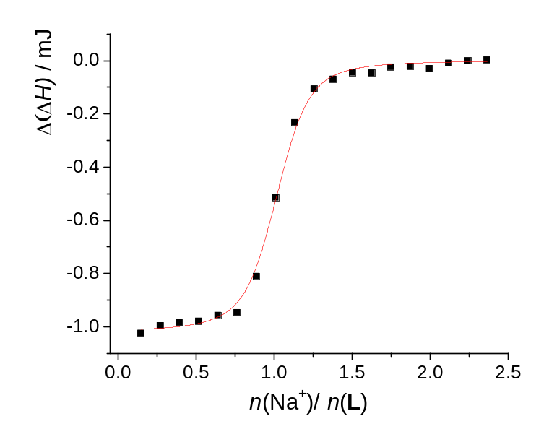
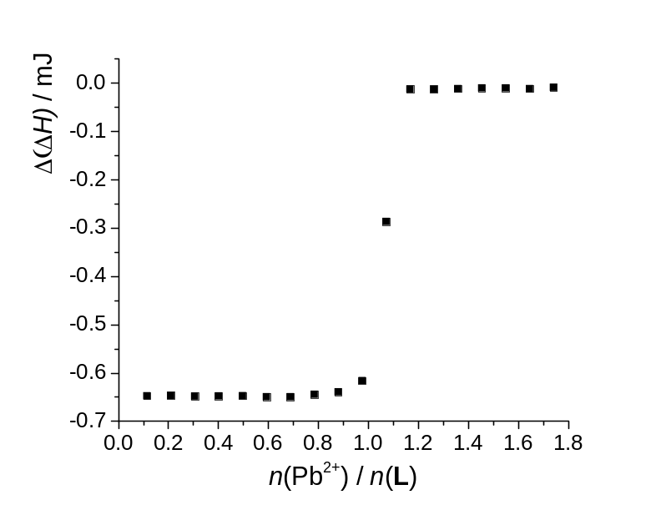
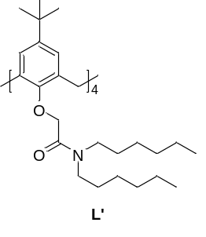
Results and discussion
Na⁺ : direct titration of L
Zn²⁺ : competitive titration (NaL⁺)
Pb²⁺ : competitive titration (ZnL²⁺)
Δ_{r}H > 0
Δ_{r}H < 0
Δ_{r}H < 0
log K (NaL⁺) = 5.61
Δ_{r}H = −25.0 kJ mol⁻¹
Δ_{r}S = 23.5 J mol⁻¹ K⁻¹
log K (ZnL²⁺) = 8.56
Δ_{r}H = 23.2 kJ mol⁻¹
Δ_{r}S = 242 J mol⁻¹ K⁻¹
log K (PbL²⁺) > 14
Δ_{r}H = −94.2 kJ mol⁻¹
log K(NaL’⁺) = 12.15
Δ_{r}H = –70.3 kJ mol^{–1}
Δ_{r}S = –3.1 J K^{–1} mol^{–1}
G. Horvat et al., Phys. Chem. Chem. Phys. 19 (2017) 24316–24329.

Slide 5
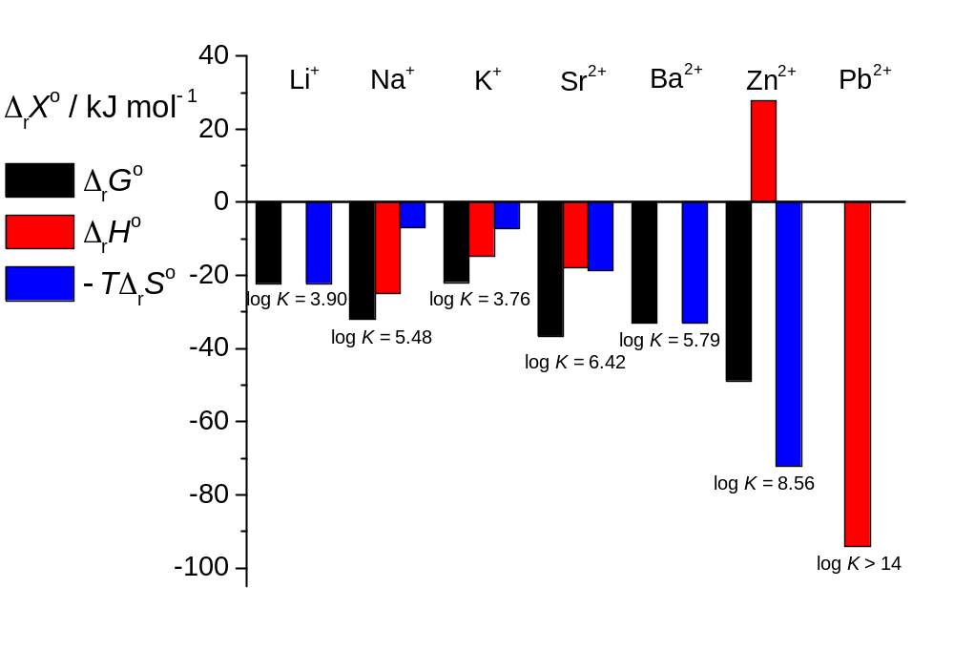


Conclusions
stable complexes with alkali, alkaline-earth, and soft metal cations in acetonitrile
interplay of enthalpy and entropy contributions
model compound for the development of calixarene-based receptors for soft metal cations
Acknowledgements. This work has been supported by Croatian Science Foundation (projects CalixCORE (IP-2024-05-3012); MicroSynTotal (IP-2024-05-5352)), and the European Union (projects CIuK, grant number KK.01.1.1.02.0016); NextGenerationEU through the National Recovery and Resilience Plan 2021−2026. via Institutional grants of the University of Zagreb Faculty of Science.

