Slide 1


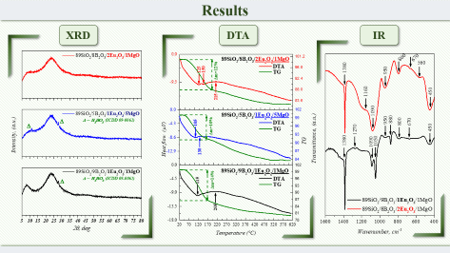
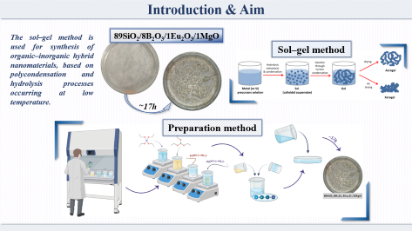
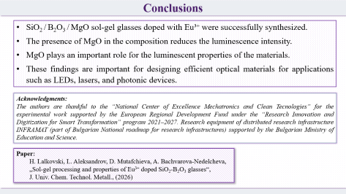
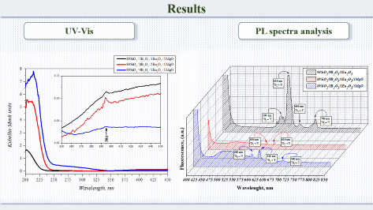
Effect of MgO on the luminescent properties of
SiO₂-B₂O₃-Eu₂O₃ sol-gel glasses
Hristo Lalkovski¹, Lyubomir Aleksandrov¹, Albena Bachvarova-Nedelcheva¹
¹ Institute of General and Inorganic Chemistry, Bulgarian Academy of Sciences, Sofia, Bulgaria,
lalkovski@svr.igic.bas.bg
000

Slide 2
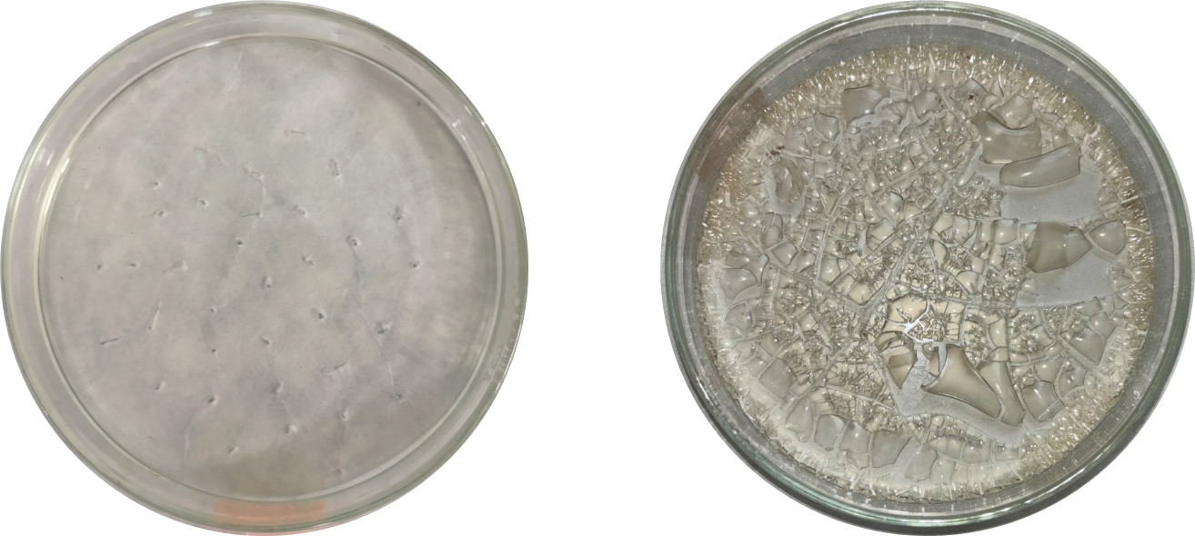
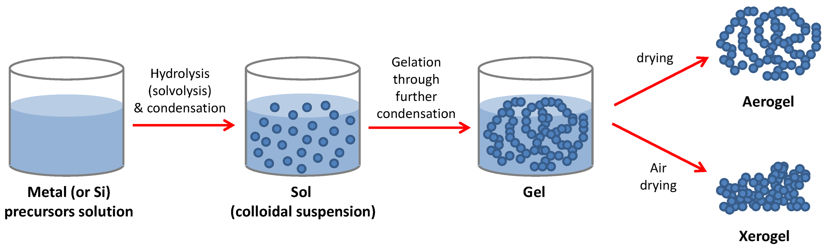
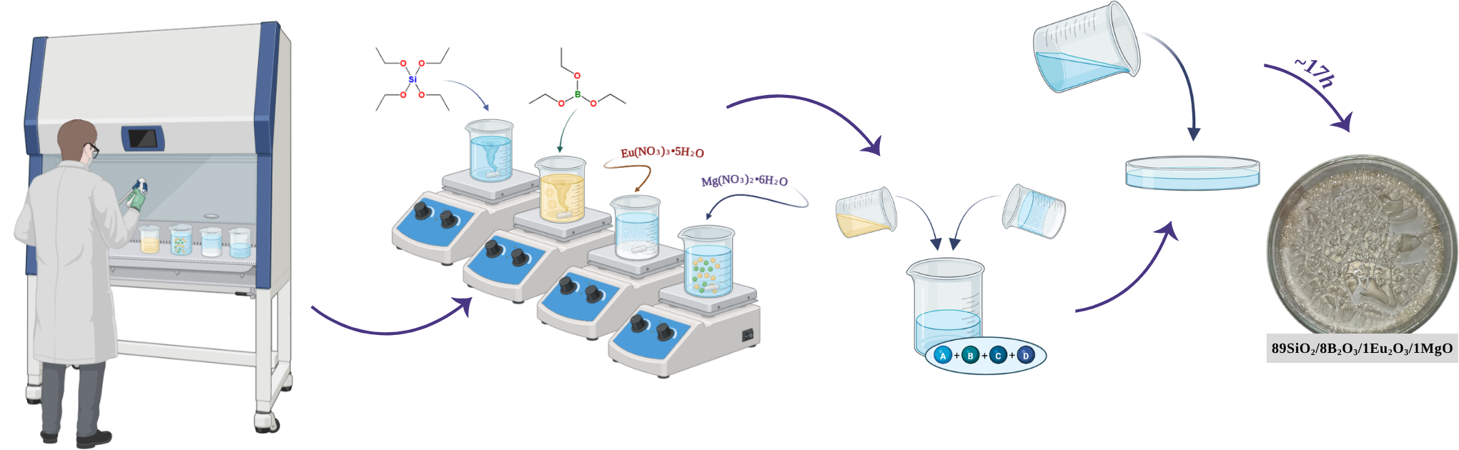
Introduction & Aim
The sol–gel method is used for synthesis of organic–inorganic hybrid nanomaterials, based on polycondensation and hydrolysis processes occurring at low temperature.
89SiO₂/8B₂O₃/1Eu₂O₃/1MgO
Sol–gel method
~17h
Preparation method

Slide 3
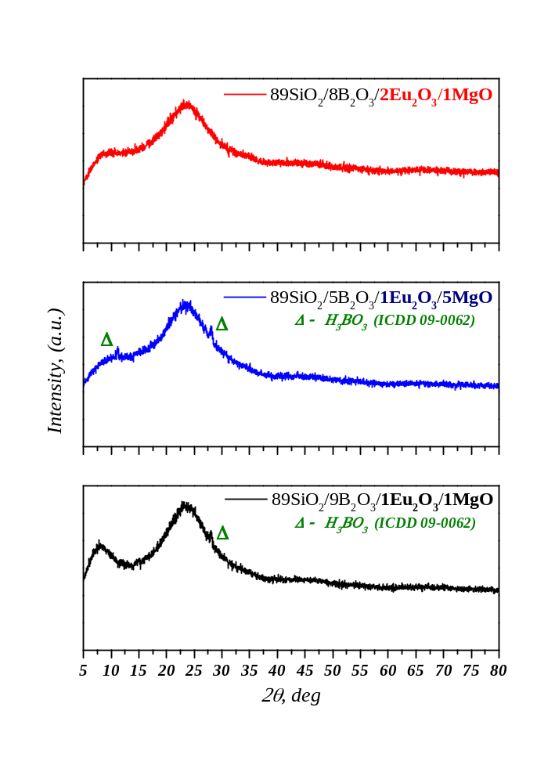
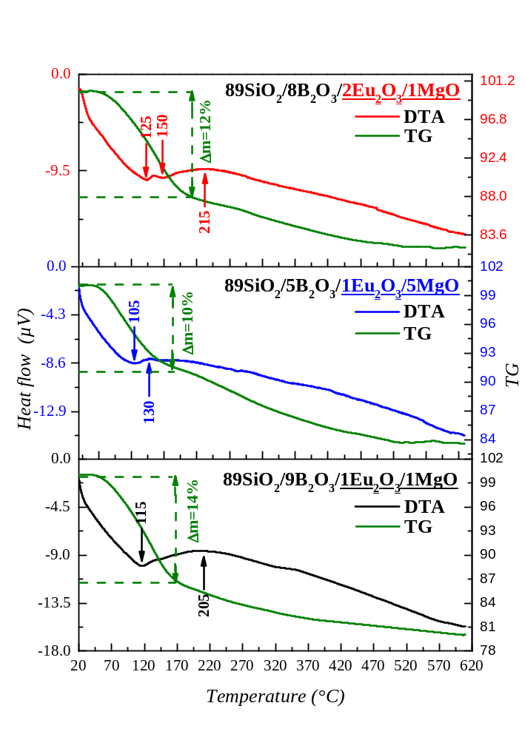
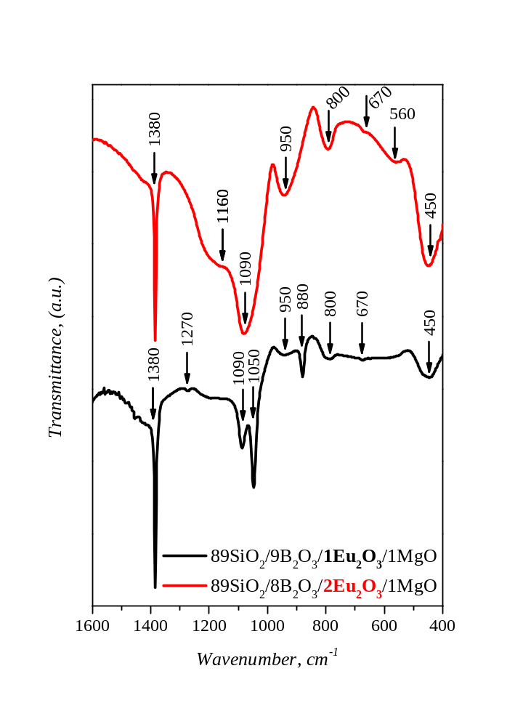
Results
XRD
DTA
IR

Slide 4
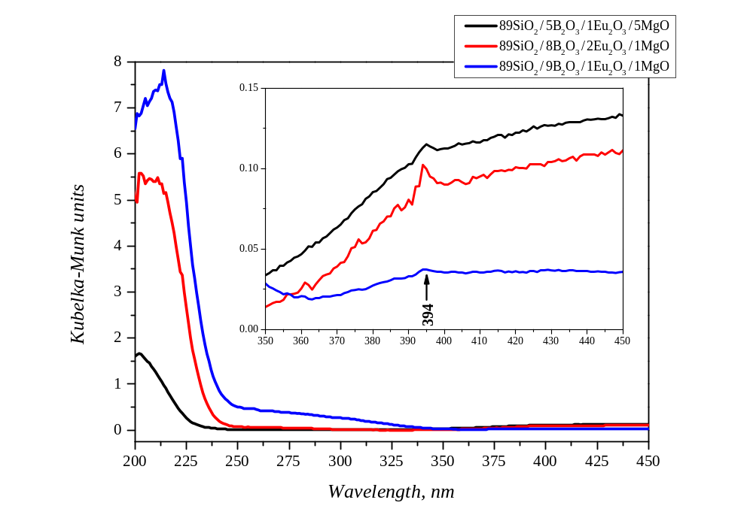
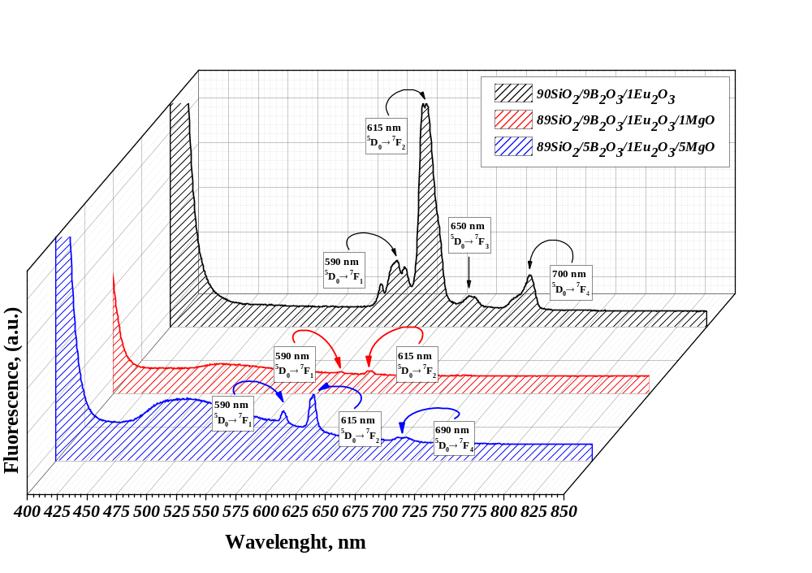
Results
UV-Vis
PL spectra analysis

Slide 5
Conclusions
SiO₂ / B₂O₃ / MgO sol-gel glasses doped with Eu³⁺ were successfully synthesized.
The presence of MgO in the composition reduces the luminescence intensity.
MgO plays an important role for the luminescent properties of the materials.
These findings are important for designing efficient optical materials for applications such as LEDs, lasers, and photonic devices.
Acknowledgments:
The authors are thankful to the “National Center of Excellence Mechatronics and Clean Tecnologies” for the experimental work supported by the European Regional Development Fund under the “Research Innovation and Digitization for Smart Transformation” program 2021–2027. Research equipment of distributed research infrastructure INFRAMAT (part of Bulgarian National roadmap for research infrastructures) supported by the Bulgarian Ministry of Education and Science.
Paper:
  H. Lalkovski, L. Aleksandrov, D. Mutafchieva, A. Bachvarova-Nedelcheva,
  „Sol-gel processing and properties of Eu³⁺ doped SiO₂-B₂O₃ glasses“,
  J. Univ. Chem. Technol. Metall., (2026)

