Slide 1

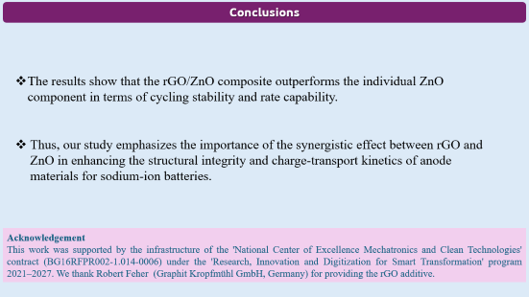
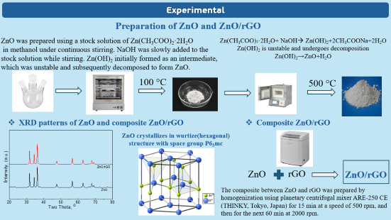
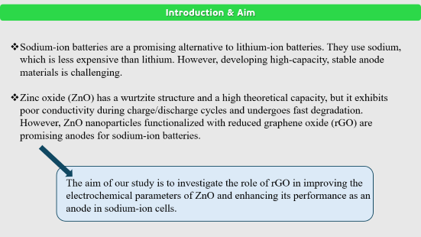
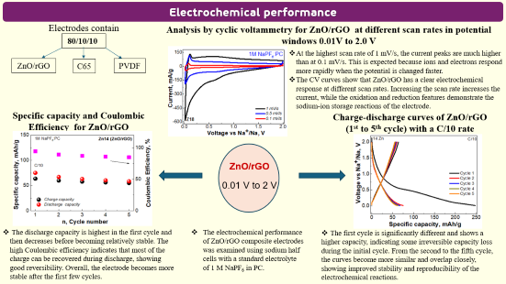
28th Congress of SCTM, 23-26 September, Ohrid, Macedonia
000
Composite of ZnO with reduced graphene oxide as anode for sodium-ion
Trajche Trajkov¹, Sonya Harizanova^{2,3}, Nina Kaneva¹, Radostina Stoyanova^{2,3}
¹St. Kliment Ohridski University, Faculty of Chemistry and Pharmacy, Sofia, Bulgaria, e-mail: trajce_trajkov11@hotmail.com, ²Institute of General and Inorganic Chemistry, Bulgarian Academy of Sciences, 1113 Sofia, Bulgaria, ³National Centre of Excellence “Mechatronics and Clean Technologies”, Sofia, Bulgaria

Slide 2
Introduction & Aim
Sodium-ion batteries are a promising alternative to lithium-ion batteries. They use sodium, which is less expensive than lithium. However, developing high-capacity, stable anode materials is challenging.
Zinc oxide (ZnO) has a wurtzite structure and a high theoretical capacity, but it exhibits poor conductivity during charge/discharge cycles and undergoes fast degradation. However, ZnO nanoparticles functionalized with reduced graphene oxide (rGO) are promising anodes for sodium-ion batteries.
The aim of our study is to investigate the role of rGO in improving the electrochemical parameters of ZnO and enhancing its performance as an anode in sodium-ion cells.

Slide 3
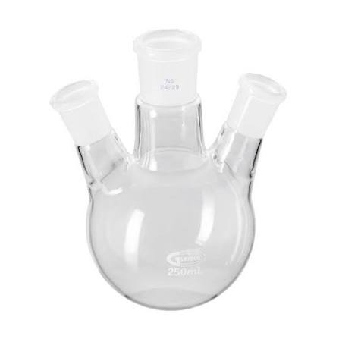
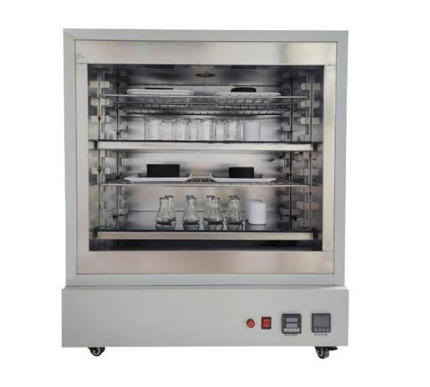
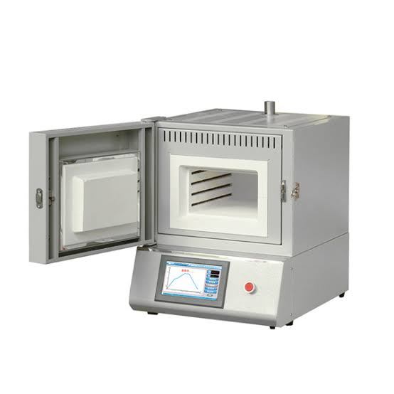
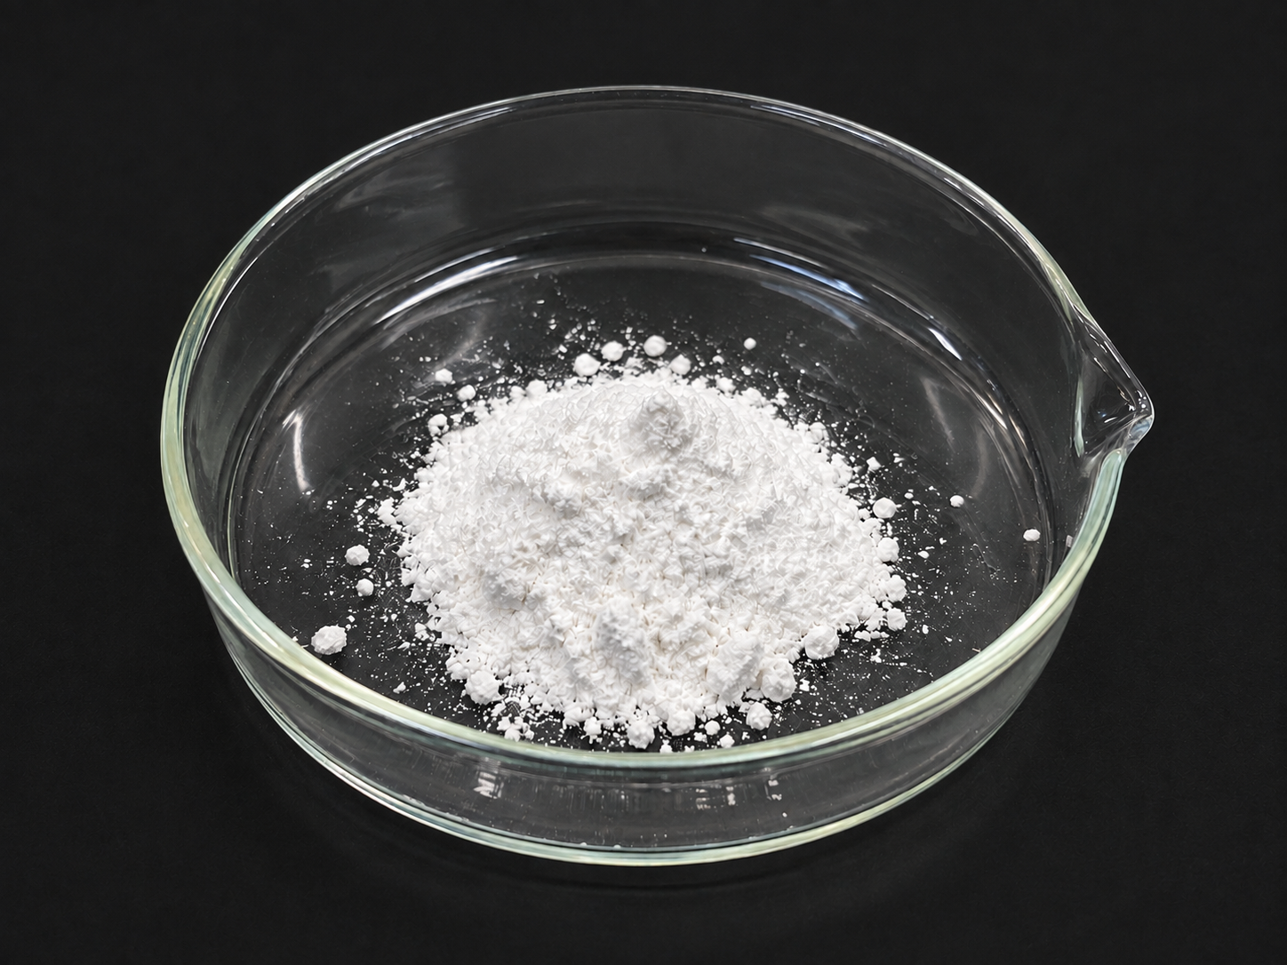
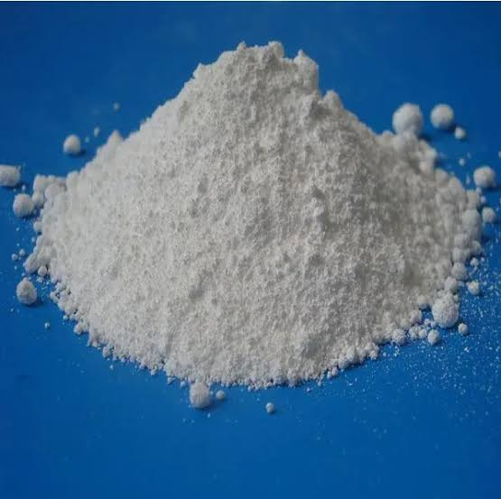
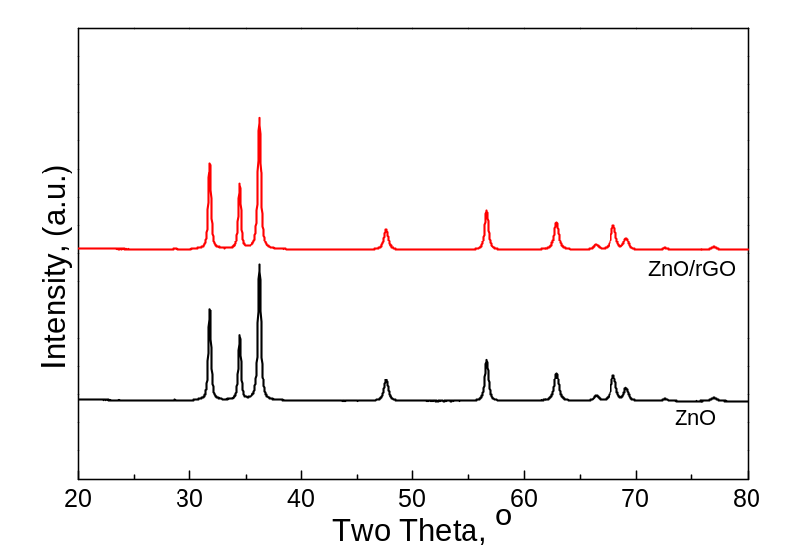
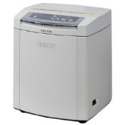
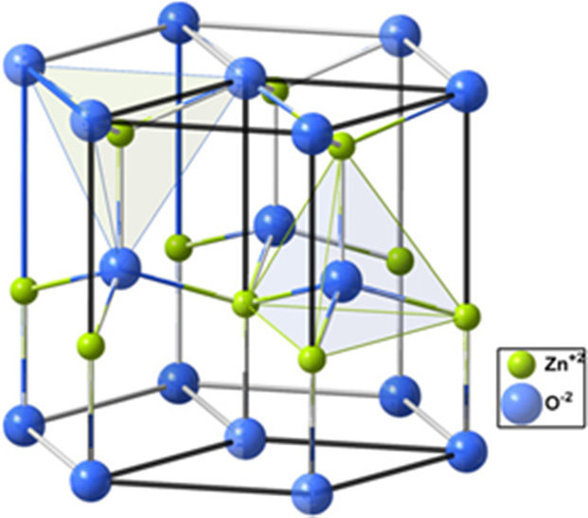
Experimental
Preparation of ZnO and ZnO/rGO
ZnO was prepared using a stock solution of Zn(CH₃COO)₂·2H₂O
in methanol under continuous stirring. NaOH was slowly added to the stock solution while stirring. Zn(OH)₂ initially formed as an intermediate, which was unstable and subsequently decomposed to form ZnO.
Zn(CH₃COO)₂·2H₂O+ NaOH→ Zn(OH)₂​+2CH₃​COONa+2H₂​O
Zn(OH)₂ is unstable and undergoes decomposition
Zn(OH)₂​→ZnO+H₂O
100 °C
500 °C
XRD patterns of ZnO and composite ZnO/rGO
Composite ZnO/rGO
ZnO crystallizes in wurtize(hexagonal) structure with space group P6₃mc
ZnO
rGO
ZnO/rGO
The composite between ZnO and rGO was prepared by homogenization using planetary centrifugal mixer ARE-250 CE (THINKY, Tokyo, Japan) for 15 min at a speed of 500 rpm, and then for the next 60 min at 2000 rpm.

Slide 4
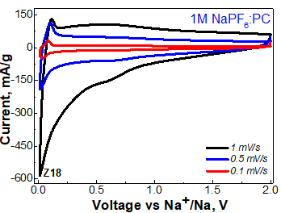
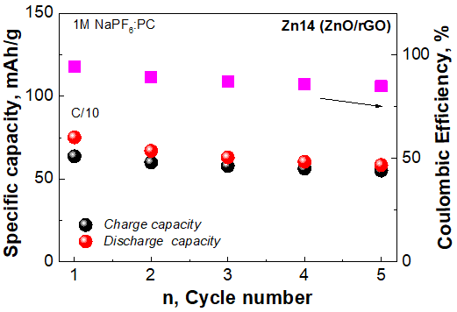
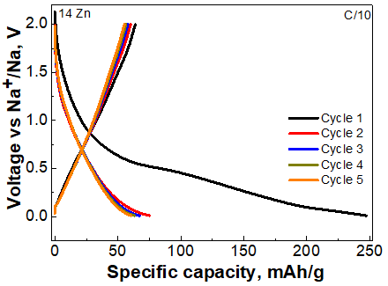
Electrochemical performance
Electrodes contain
Analysis by cyclic voltammetry for ZnO/rGO at different scan rates in potential windows 0.01V to 2.0 V
80/10/10
At the highest scan rate of 1 mV/s, the current peaks are much higher than at 0.1 mV/s. This is expected because ions and electrons respond more rapidly when the potential is changed faster.
The CV curves show that ZnO/rGO has a clear electrochemical response at different scan rates. Increasing the scan rate increases the current, while the oxidation and reduction features demonstrate the sodium-ion storage reactions of the electrode.
ZnO/rGO
C65
PVDF
Specific capacity and Coulombic
Efficiency for ZnO/rGO
Charge-discharge curves of ZnO/rGO
(1st to 5th cycle) with a C/10 rate
ZnO/rGO
0.01 V to 2 V
The discharge capacity is highest in the first cycle and then decreases before becoming relatively stable. The high Coulombic efficiency indicates that most of the charge can be recovered during discharge, showing good reversibility. Overall, the electrode becomes more stable after the first few cycles.
The electrochemical performance of ZnO/rGO composite electrodes was examined using sodium half cells with a standard electrolyte of 1 M NaPF₆ in PC.
The first cycle is significantly different and shows a
higher capacity, indicating some irreversible capacity loss during the initial cycle. From the second to the fifth cycle,
the curves become more similar and overlap closely,
showing improved stability and reproducibility of the electrochemical reactions.

Slide 5
Conclusions
The results show that the rGO/ZnO composite outperforms the individual ZnO component in terms of cycling stability and rate capability.
Thus, our study emphasizes the importance of the synergistic effect between rGO and ZnO in enhancing the structural integrity and charge-transport kinetics of anode materials for sodium-ion batteries.
Acknowledgement
This work was supported by the infrastructure of the 'National Center of Excellence Mechatronics and Clean Technologies' contract (BG16RFPR002-1.014-0006) under the 'Research, Innovation and Digitization for Smart Transformation' program 2021–2027. We thank Robert Feher (Graphit Kropfmühl GmbH, Germany) for providing the rGO additive.

