Slide 1





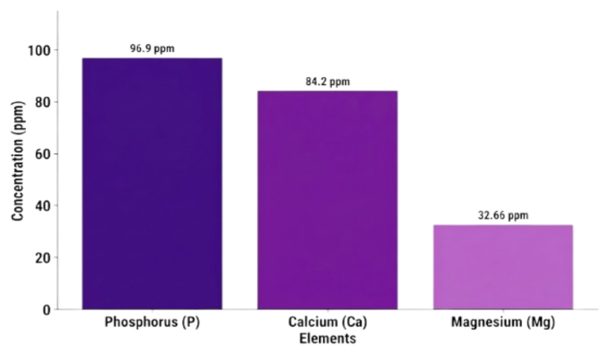

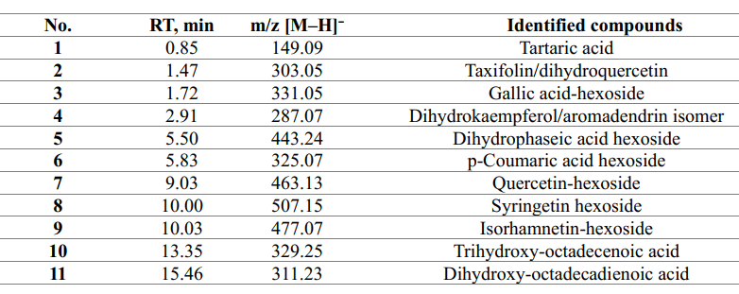

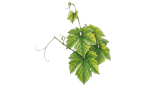
28th Congress of SCTM, 23-26 September, Ohrid, Macedonia
000
VALORISATION POTENTIAL OF PROKUPAC GRAPE POMACE: MINERAL PROFILE AND LC–MS-BASED CHARACTERISATION OF BIOACTIVE COMPOUNDS IN AQUEOUS EXTRACT
Nadja Ilic, Jana Cvetkovic, Sasa Savic, Jelena Zvezdanovic, Dragan Cvetkovic, Sanja Petrovic
¹ University of Nis, Faculty of Technology in Leskovac, Bulevar oslobodjenja 124, 16000 Leskovac, ² e-mail: nadjailic549@gmail.com
Introduction
Results and discussion
Grape pomace represents an important winery by-product with significant potential for valorization as a source of minerals and bioactive compounds. In this study, an aqueous extract of grape pomace was obtained from the autochthonous Serbian cultivar Prokupac.
Results of ICP-OES analysis
The plant material was prepared by drying the grape pomace and seeds in a drying oven at 40°C, followed by grinding in a mill. Subsequently, an aqueous extract of the plant material (1:20, w/v) was obtained at 50°C for 30 minutes using a magnetic stirrer. The extract was then centrifuged and filtered through 0.45 μm filters.
Experimental
Graph 1. Dominant mineral element profile in the extract
Graph 2. Microelement profile in the extract
Table 1. Results of LC-MS grape pomace
Conclusions
The obtained results indicate that aqueous extraction can be an effective and environmentally acceptable approach for recovering mineral constituents and polar bioactive compounds from Prokupac grape pomace.
Acknowledgement: The authors wish to express their gratitude to the Republic of Serbia, Ministry of Science, Technological Development and Innovation, for supporting this work through the Program for Financing Scientific Research Projects (Ref. No. 451-03-34/2026-03/200133).

