Slide 1

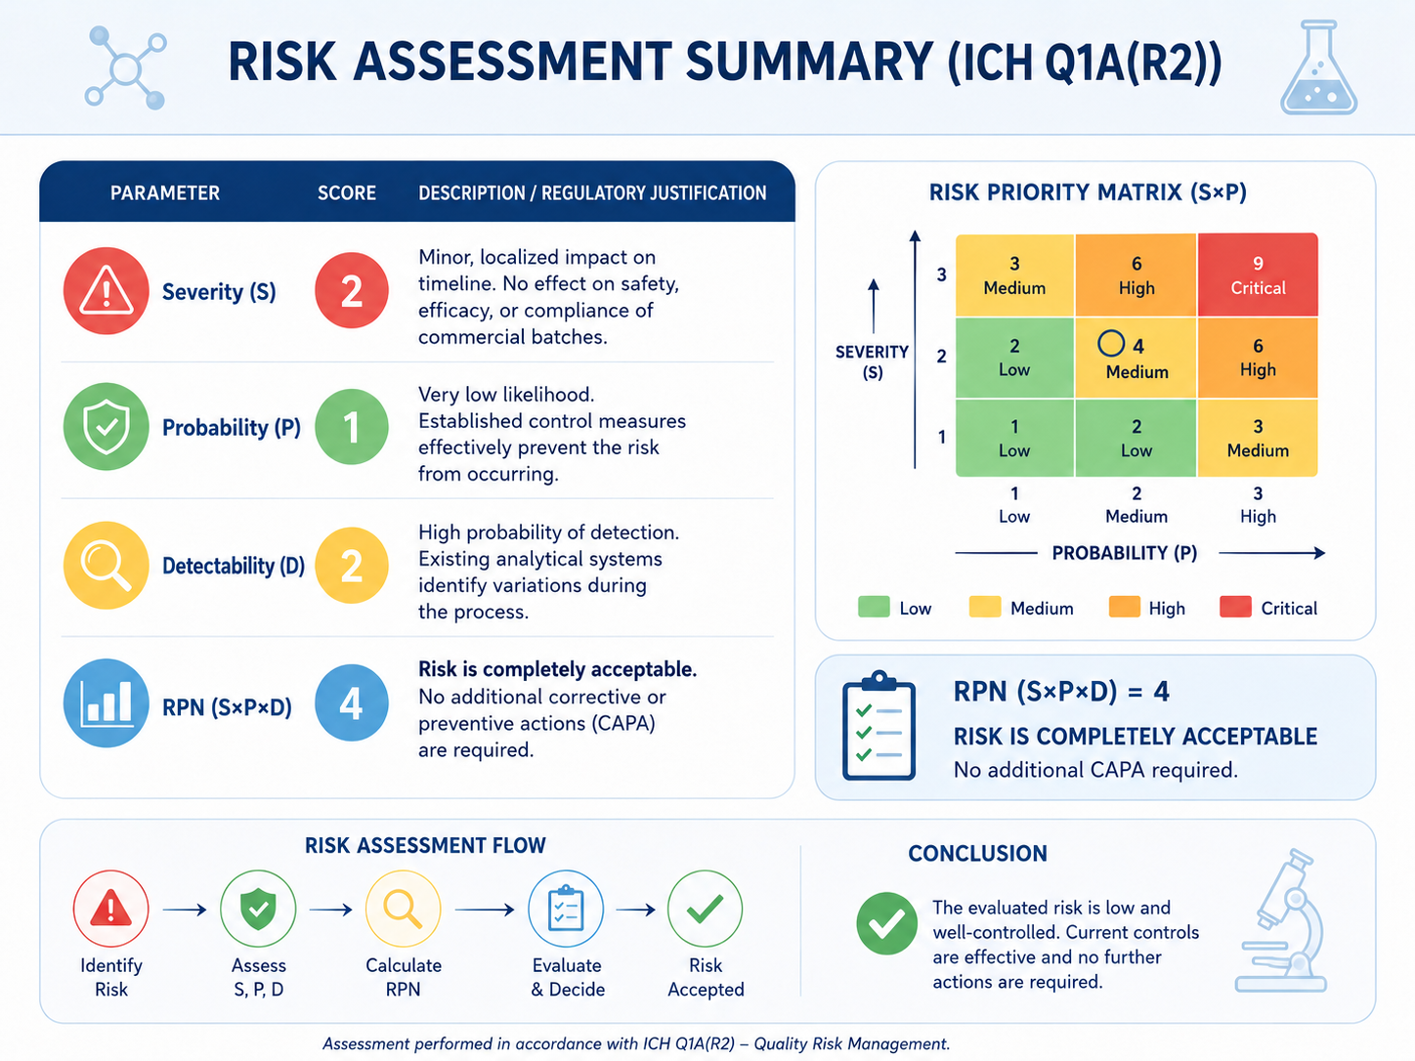
28th Congress of SCTM, Ohrid, North Macedonia, 23-26 September 2026
Elena Stankovska¹, Dragana Kafedžiska¹ Marina Mandžukovska¹, Elena Cvetanovska Šarkovska¹, Vasilka Dubrova Koceva¹ estankovska@alkaloid.com.mk
¹ Quality Control Pharmaceuticals, ALKALOID AD Skopje, Blvd. A. Makedonski 12, 1000 Skopje, Republic of Macedonia
Risk Assessment for reducing the number of ongoing stability studies in order to improve process efficiency and reduce chemical and pharmaceutical waste
Introduction
Materials
Stability studies are essential to ensure the quality, safety, and efficacy of pharmaceutical products throughout their shelf life. They also provide data to support product or process modifications.
The primary rationale for conducting this risk analysis arises from the limited capacity of the stability chambers, as well as the need to optimize and enhance the efficiency of stability studies for commercial batches within the Quality Control framework.
This study aims to evaluate the risk associated with reducing the number of batches included in the ongoing stability program, as well as the testing frequency reduction. Extensive historical data demonstrate that the stability profiles of the evaluated products are well established and consistent over time. Based on this evidence, it is proposed that monitoring one batch per year is sufficient to ensure continued product quality and compliance with regulatory requirements. The evaluation of stability data, including the application of appropriate statistical tools, enables the justified implementation of reduced testing frequency.
The FMEA (Failure Mode Effects Analysis) method was used to perform this risk assessment.
FMEA provides an organized, critical analysis of potential failure modes of the system being defined and identifies associated causes. It uses occurrence and detection probabilities in conjunction with severity criteria to develop a risk priority number (RPN) for ranking corrective action considerations.
Risk scoring criteria were predefined according to internal procedures and aligned with ICH Q9 principles.
RPN has been calculated on the basis of multiplication of the following indicators: severity, detection and probability.
Conclusion
Based on the product knowledge, established stability profiles, consistent trend analysis, regulatory guidelines, logistical considerations and consistent manufacturing process, a risk assessment for reducing the number of commercial batches placed for monitoring stability to one batch annually and reduced testing frequency for products with well-established historical stability data is considered to present a low level of risk. This approach ensures compliance with ICH guidelines, maintenance product quality and safety and optimizes stability testing resources. This change will not compromise the integrity of stability monitoring program but will enhance operational efficiency and sustainability.
Results and Disscusion
The optimization of the process for monitoring stability studies of commercial batches, through the reduction of the number of batches and testing frequency, leads to the identification of a risk related to compromising the representativeness of ongoing stability studies.The following risk control measures have been established:
Justification for reducing the number of batches included in stability studies, taking into account the following aspects: established stability profiles, trend analysis and consistency, regulatory requirements, logistical and environmental considerations, manufacturing consistency, and the purpose of stability studies
Continuous annual evaluation of stability results, including the use of appropriate statistical tools, and trend monitoring for all productsThe reduction of testing frequency is defined, for each product individually, in the annual plan for testing frequency reduction
Based on the established measures and the application of the FMEA method for risk assessment, the risk has been determined to be low.
Justification for reducing the number of batches included in stability studies, taking into account the following aspects: established stability profiles, trend analysis and consistency, regulatory requirements, logistical and environmental considerations, manufacturing consistency, and the purpose of stability studies
Based on the evaluation of stability data, an appropriate justification for reduced testing frequency is developed for each product individually.
The reduction of testing frequency is defined, for each product individually, in the annual plan for testing frequency reduction
Severity (S)
What it represents: How severe the consequences would be for product quality or the patient if the risk occurs.
The value is 2 (minor severity). The justification states that there is a minor, localized impact on the stability documentation or testing timeline, but it does not affect the safety, efficacy, or regulatory compliance of the commercial batches. The product still remains fully within the approved specifications outlined in the ICH Q1A(R2) and EudraLex guidelines.
Probability (P)
What it represents: What is the likelihood or chance that this specific failure or problem will occur.
The value is 1 (very low probability). The justification states that "the risk does not occur" thanks to the already established control measures.
Detectability (D)
What it represents: Impact can be expected / damage quickly disappears without causing irreversible or long-term effect.
The value is 2 (high probability of detection), because the existing system allows the risk to be detected during the process itself.
Risk Priority Number (RPN)
Calculation: It is calculated by multiplying the three values:(RPN=S*P*D=2*1*2)
Since the RPN value is exceptionally low, the risk is considered completely acceptable. Therefore, no additional measures are required to reduce it.
International Council for Harmonization of Technical Requirements for Pharmaceuticals for Human Use; ICH guideline Q1A(R2): Stability Testing of new Drug Substances and Products; 2003.
International Council for Harmonization of Technical Requirements for Pharmaceuticals for Human Use; ICH guideline Q9(R1): Quality risk management, 2023.
World Health Organization (WHO); WHO Technical report series, No. 1010, 2018, Annex 10: Stability testing of active pharmaceutical ingridients and finished pharmaceutical products; 2018
References

