Slide 1


28th Congress of SCTM, 23-26 September, Ohrid, Macedonia
75
MONITORING THE ORGANIC MATTER CONTENT IN
BOTTOM SEDIMENT SEGMENTS ALONG THE STRUGA SHORELINE OF LAKE OHRID
Elena Arsoska¹, Tajana Kostadinova², Andrijana Chankulovska Tenovska², Slobodan Bogoevski²
¹Vardar Dolomit DOOEL, Skopje, North Macedonia,
²Faculty of Technology and Metallurgy, Ss. Cyril and Methodius University in Skopje, North Macedonia
e-mail: earsoska@yahoo.com

Slide 2
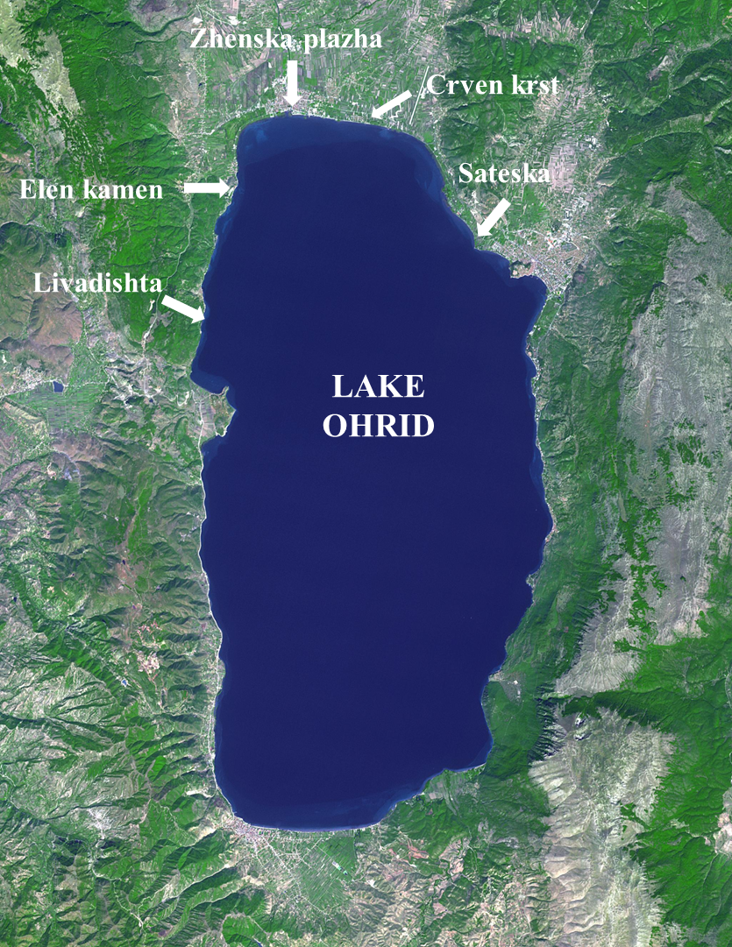
Introduction & Aim
The littoral sediments of lake ecosystems represent an important natural archive in which both organic and inorganic substances originating from natural processes and anthropogenic activities accumulate over time. Organic matter in sediments plays a fundamental role in biogeochemical processes by influencing carbon cycling, the binding and mobility of heavy metals, nutrient dynamics, and the overall quality of the aquatic environment.
Lake Ohrid, recognized as one of the oldest and most biologically significant lakes in Europe, possesses exceptional ecological and scientific value. Its unique hydrological and ecological balance is highly sensitive to both natural and anthropogenic pressures, particularly within the littoral zone, where urban development, tourism, and tributary inflows exert considerable influence on the ecosystem. Consequently, lake sediments provide valuable records of the long-term accumulation of organic matter and serve as important indicators for assessing the sources and extent of organic pollution.
Determining the organic matter content, together with sediment moisture content, provides valuable insight into the mechanisms controlling the accumulation, distribution, and potential sources of organic matter. Furthermore, this approach helps identify the predominant medium in which organic matter is retained, whether dissolved or associated with the water phase, or adsorbed onto mineral particles within the sediment. Such information is essential for understanding the transport, deposition, and transformation of organic compounds in lacustrine environments.
The main objective of this study was to determine the content and spatial distribution of organic matter in the littoral sediments of the Struga coastal zone of Lake Ohrid and to identify the potential natural and anthropogenic sources contributing to its accumulation.
Fig. 1 Geographic map of Lake Ohrid with measuring points

Slide 3
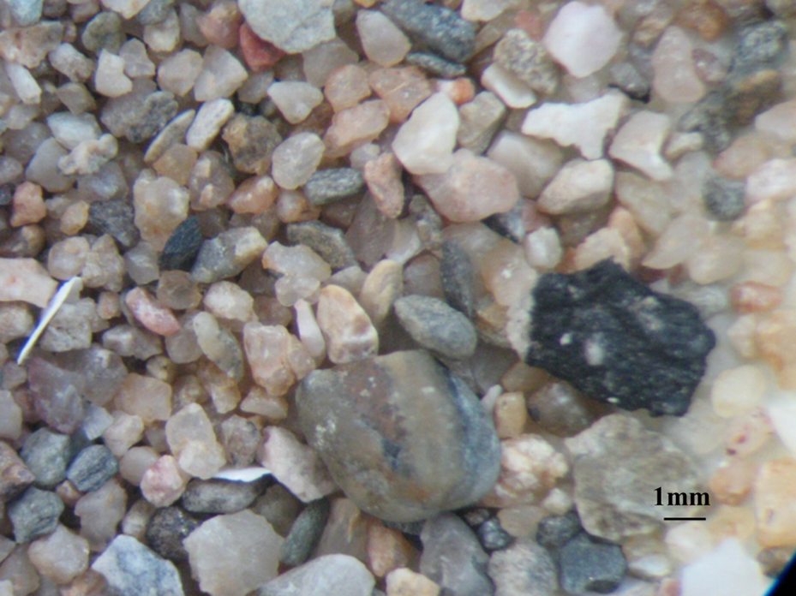
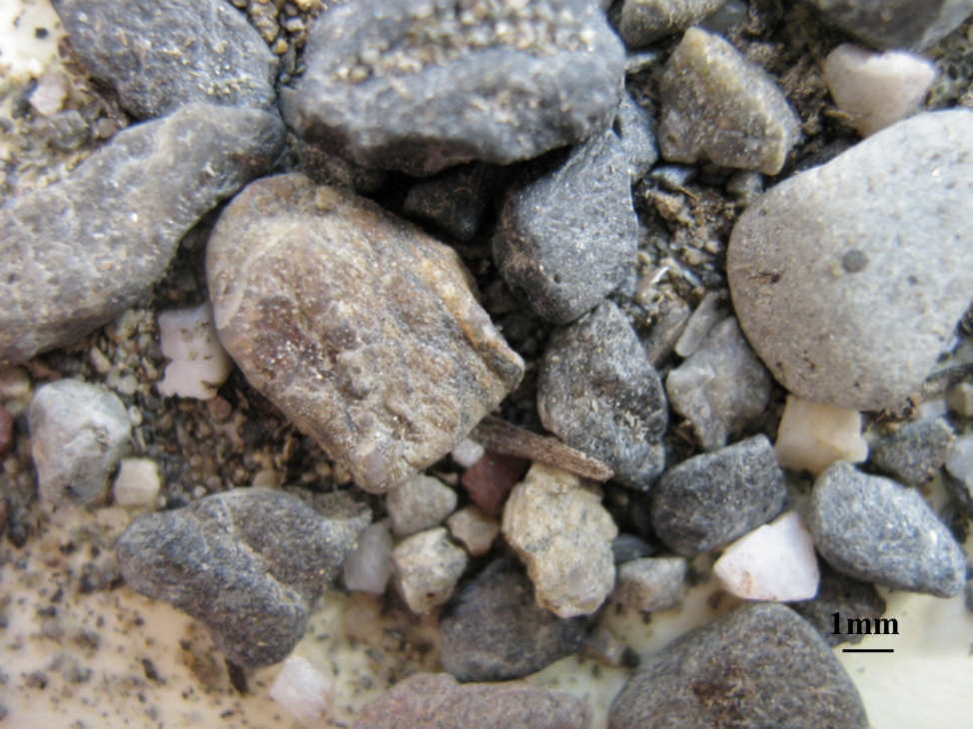
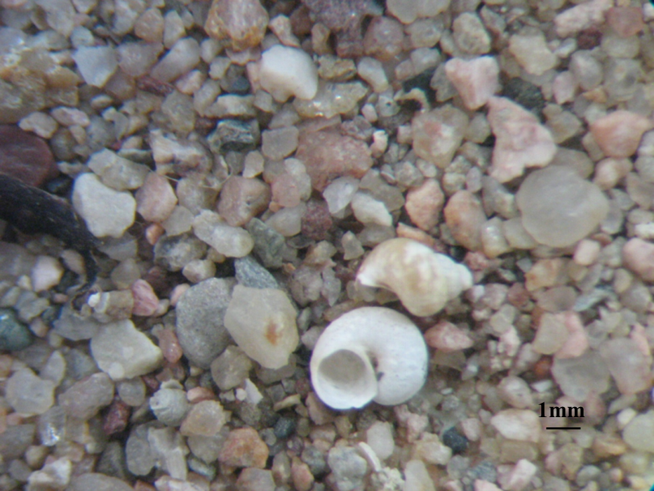
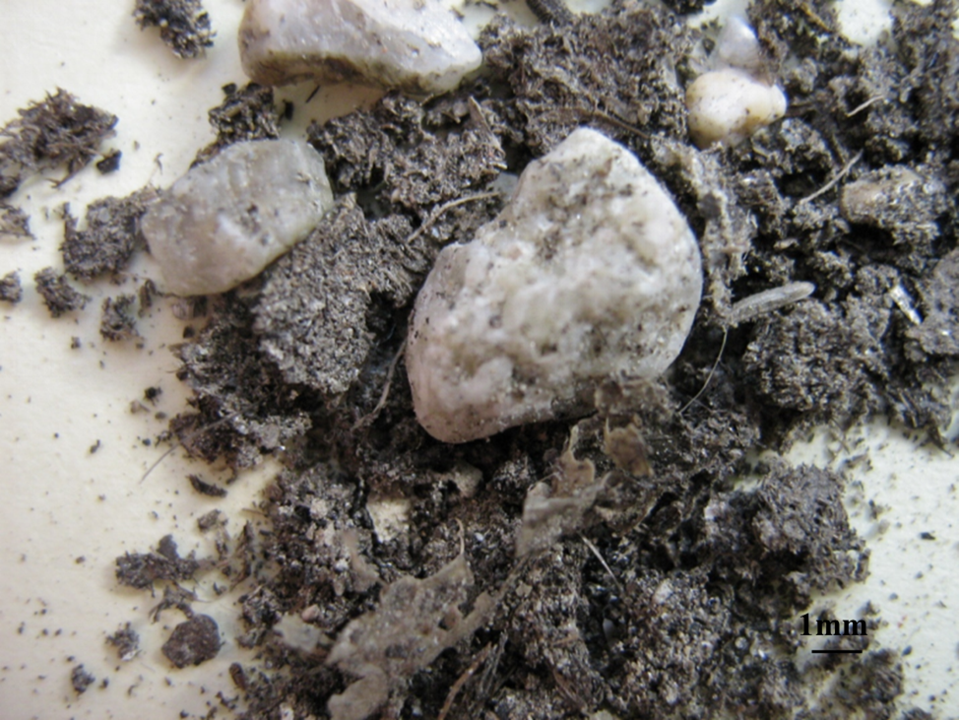
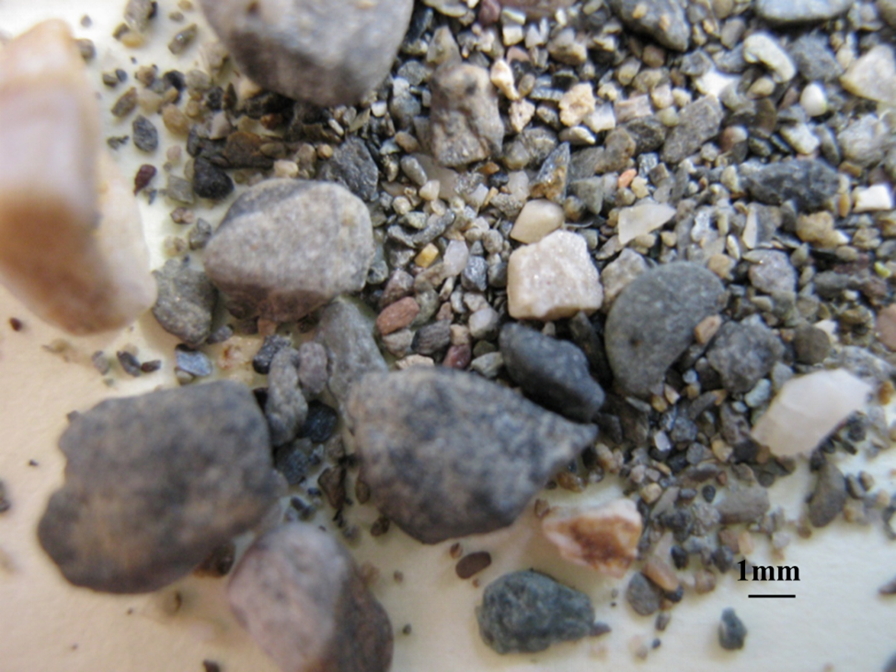
Experimental
Five sampling sites along the shoreline of Lake Ohrid, namely Elen Kamen, Zhenska Plazha, Livadishta, Crven Krst, and Sateska, were selected for this investigation to represent different environmental and anthropogenic conditions within the study area. At each sampling site, sediment samples were collected from five predefined sampling points positioned at distances of 5, 10, 15, 20, and 25 m from the shoreline. This sampling design enabled the assessment of spatial variations in sediment characteristics with increasing distance from the lake shore.
The moisture content of each sample was determined using the standard gravimetric method. Approximately representative portions of sediment were dried in a laboratory oven at 105 °C until a constant mass was achieved, and the moisture content was calculated from the difference between the initial and final sample weights. The organic matter content of the sediment was determined using the loss-on-ignition (LOI) method. The oven-dried samples were heated in a muffle furnace at 600 °C for an appropriate period to ensure complete combustion of the organic fraction. The percentage of organic matter was then calculated gravimetrically from the mass loss occurring during ignition. To characterize the coarse sediment fraction, each sample was subjected to sieve analysis, and the material retained on the 1 mm sieve was separated for further examination. This fraction was analysed using optical microscopy to identify the predominant particle types and anthropogenic debris present within the sediments. The microscopic observations provided valuable information on the composition and morphology of the retained material, including mineral grains, shell fragments, plant remains, and potential plastic or other anthropogenic particles.
Figures 2–6 present representative microscopic images of the sediment fraction retained on the 1 mm sieve for each of the five investigated sampling sites. These images illustrate the morphological characteristics and compositional differences of the coarse sediment material, providing a visual comparison of the sediment constituents among the selected locations.
Fig. 2. Microscopic image – Elen Kamen
Fig. 3. Microscopic image –Zhenska plazha
Fig. 4. Microscopic image – Livadishta
Fig. 5. Microscopic image – Crven krst
Fig. 6. Microscopic image – Sateska

Slide 4
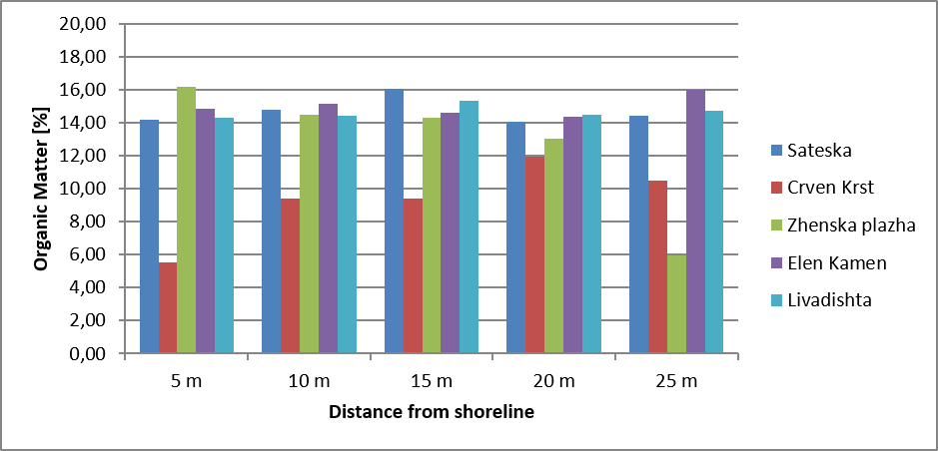
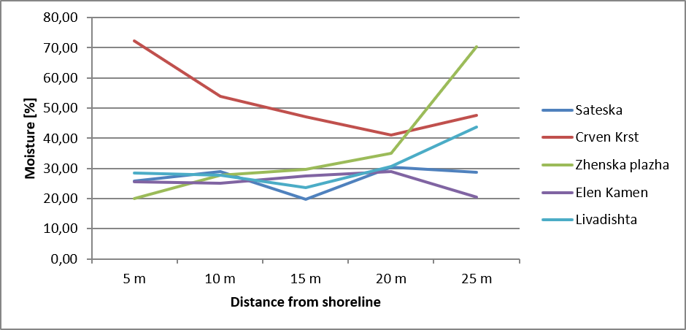
Results and discussions
The observed moisture patterns are closely linked to sediment grain size. The high moisture values at Crven Krst point to fine-grained substrates that retain more water, whereas coarser, sandy shoreline sediments retain less. Sateska's stability reflects steady fluvial (river-driven) deposition, while the abrupt shift at Zhenska plazha (25 m) suggests an anthropogenic influence on the lakebed. Taken together, the profiles reveal a clear transition from high-energy, wave-washed sandy environments near the shore to low-energy, depositional environments further out.
Key findings:
Crven Krst exhibits the highest moisture content near the shoreline (5 m) and consistently elevated values throughout the profile, indicating water-rich, fine-grained sediments.
Zhenska plazha shows a marked increase in moisture at 25 m, accompanied by a pronounced decline in organic matter at the same point.
Elen Kamen and Livadishta maintain relatively stable organic matter values across all sampling distances.
Sateska displays consistently stable organic matter content, reflecting continuous sediment input from the river-influenced zone.

Slide 5
Conclusions
The results from the Sateska River sampling site indicate a relatively homogeneous distribution of organic matter with increasing distance from the shoreline. In contrast, data from the Crven Krst site show a gradual increase in organic matter content as the distance from the shoreline increases. At the Zhenska Plaza site, the opposite trend was observed, with organic matter content decreasing with increasing distance from the shore.
The Elen Kamen and Livadishta sites exhibited a relatively uniform distribution of organic matter across the sampling transects. Overall, the elevated organic matter content recorded at the Sateska River site suggests a dominant anthropogenic influence, with the river acting as a major source of organic matter originating from contamination within its catchment.
At the Crven Krst and Zhenska Plaza sites, the results indicate the combined effects of natural biogenic production and anthropogenic inputs. Similarly, the relatively high organic matter content at Elen Kamen and Livadishta can be attributed to the interaction of natural and human-induced factors, including extensive reed-bed zones that support rich biological communities, together with uncontrolled anthropogenic activities.
Although organic matter is predominantly associated with the liquid phase of the sediment samples, the remaining fraction is strongly influenced by the mineralogical composition of the sediment and by deposited solid organic material of natural origin. This interpretation is supported by microscopic observations of the material retained on a 1 mm sieve during sample preparation.

