Slide 1

28th Congress of SCTM, 23-26 September, Ohrid, Macedonia
76
EVALUATING HEAT TRANSFER DISTRIBUTION IN SOIL PROFILES
Elena Arsoska¹, Andrijana Chankulovska Tenovska², Tajana Kostadinova², Slobodan Bogoevski²
¹Vardar Dolomit DOOEL, Skopje, North Macedonia, e-mail: earsoska@yahoo.com , ²Faculty of Technology and Metallurgy,
Ss. Cyril and Methodius University in Skopje, North Macedonia

Slide 2
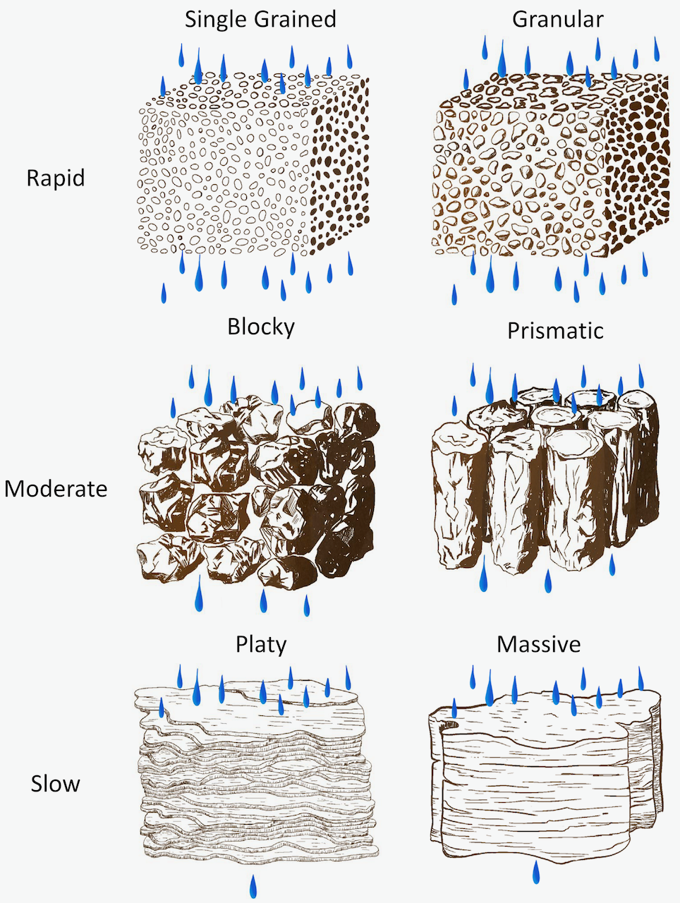
Introduction & Aim
Heat transfer in soils is a fundamental physical process that governs numerous environmental, agricultural, and engineering applications, including soil temperature dynamics, plant root development, geothermal energy utilization, underground heat storage, and the transport of water and dissolved substances. The thermal behavior of soil is controlled by the interaction of its solid, liquid, and gaseous phases, whose proportions continuously change under different environmental conditions. Consequently, soil represents a heterogeneous porous medium in which heat transfer is influenced by several interrelated physical and mineralogical properties.
Among the factors controlling soil thermal behavior, moisture content is considered one of the most influential parameters because water possesses a significantly higher specific heat capacity than both mineral particles and air. Furthermore, the evaporation and condensation of pore water during heating involve latent heat exchange, substantially affecting heat storage and heat transport within the soil profile. Soil porosity, bulk density, particle arrangement, and degree of compaction further modify the thermal conductivity and heat capacity of soils by altering the contact area between mineral grains and the distribution of pore water and air.
The mineralogical composition of soil also contributes to its thermal response, as different minerals exhibit distinct thermal properties. Common soil-forming minerals such as quartz, calcite, albite, muscovite, clinochlore, and gypsum possess different specific heat capacities and thermal conductivities, thereby influencing the overall distribution and transfer of thermal energy. Understanding the individual and combined effects of these minerals is essential for accurately describing heat transport in natural soil systems.
Fig. 1 Water movement as affected by type
(shape) of aggregates

Slide 3
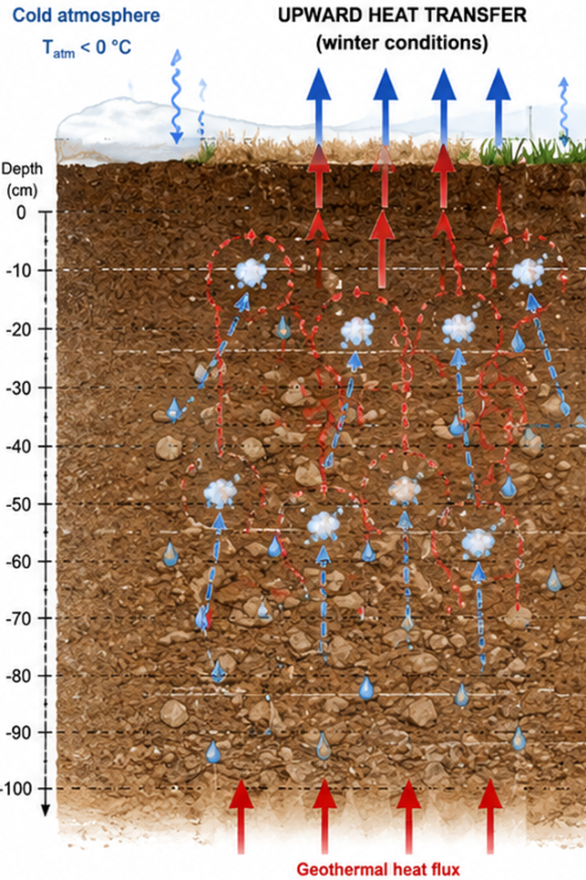
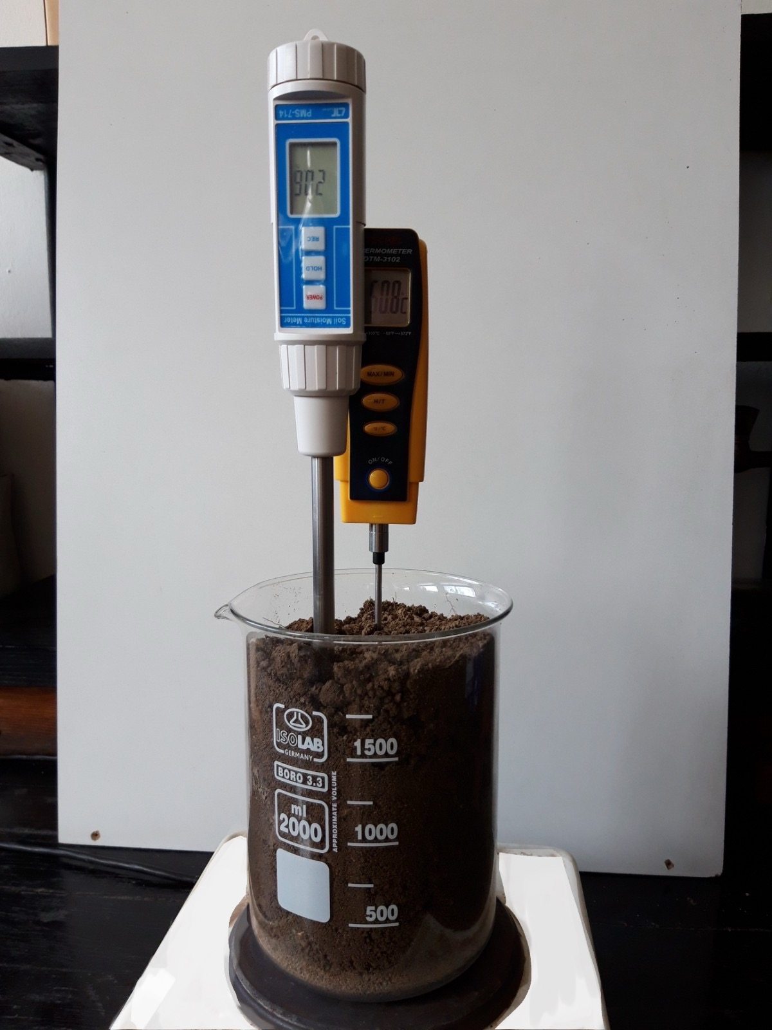
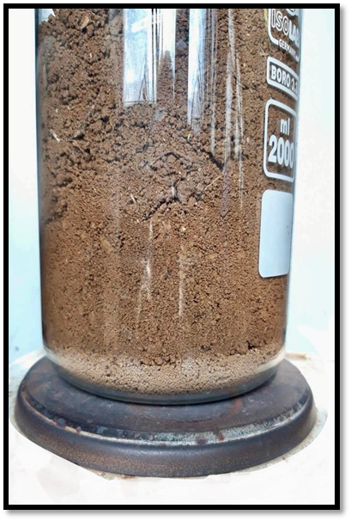
Experimental
Heat transfer is shown on figure 2 and 3.
The experiment was realized with a contact heating surface with a constant temperature of 180 ˚C. The position of the measuring point was set at 8 cm above the heating surface.
The experimental measurements were conducted on soil samples under three different moisture conditions, namely dry soil, soil with a moisture content of 10%, and soil with a moisture content of 15%, while two porosity levels (45% and 50%) were considered.
Fig. 2 Measurement of soil temperature and moisture during heat transfer
Fig. 3 Initial stage of the drying process
Fig. 4 Heat transfer within the soil profile

Slide 4
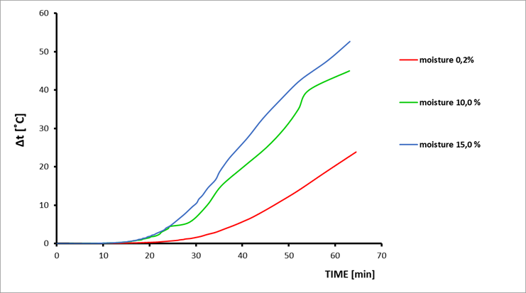
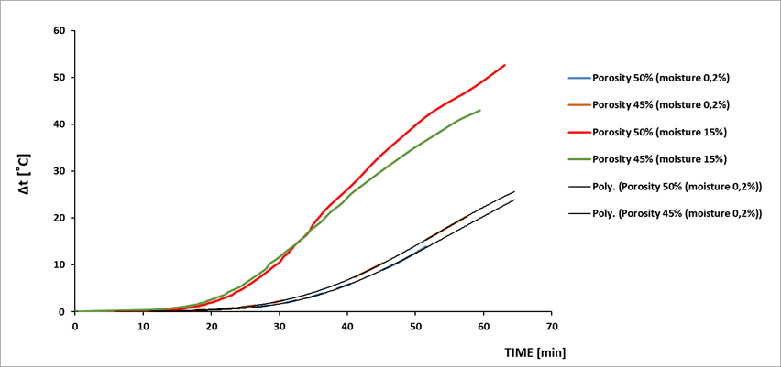
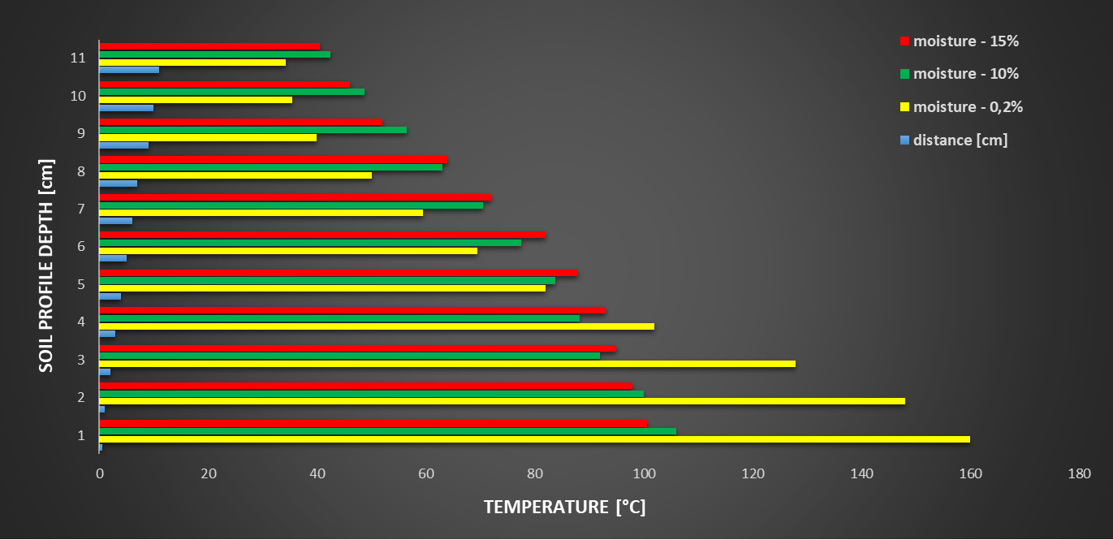
Results and discussions
The rate (intensity) of heat transfer is higher in the soil sample with 50% porosity compared to the sample with the lower porosity of 45%. This behavior is directly associated with changes in the packing index, which lead to a reduction in pore and capillary dimensions and their closer spatial arrangement. As a consequence, the resistance of the porous medium increases, thereby impeding the movement of water vapor and, consequently, reducing the transfer of the heat it carries.
The moisture present in the samples becomes the dominant medium for heat transfer, not only because of its high heat capacity but also due to phase transformation, namely the conversion of liquid water into water vapor under appropriate thermal conditions. As the moisture content further increases (15%), this effect becomes even more pronounced.
Furthermore, the shape of the curves reveals certain fluctuations in the moist samples compared with the more uniform behavior observed in the dry sample. This phenomenon can be attributed to the increased complexity of the soil system resulting from the presence of a third phase, namely moisture. Following its transition into the gaseous phase (water vapor), moisture diffuses through the porous and capillary network of the soil with varying intensity and through different transport mechanisms. During this process, the vapor transfers heat to mineral particles at lower temperatures, where it subsequently condenses. This phase change alters both the mechanism and the rate of heat transfer within the soil matrix.
The moisture front essentially acts as the carrier and transport medium of thermal energy, forming the thermal wave front through different heat transfer mechanisms depending on the temperature conditions prevailing within each layer of the soil profile.

Slide 5
Conclusions
The present study demonstrates that heat transfer within soils under controlled non-adiabatic conditions is governed by the combined influence of moisture content, porosity, mineralogical composition, and soil structure. Among these factors, soil moisture was identified as the dominant parameter controlling thermal behavior owing to its high heat capacity and its ability to undergo phase transitions. The evaporation, migration, and subsequent condensation of pore water significantly enhanced heat transport by facilitating the transfer of latent heat throughout the soil profile. As soil moisture increased, particularly at 15%, these processes became more pronounced, resulting in greater heat transfer intensity and more complex temperature distributions.
Increased compaction (lower porosity) reduced pore and capillary dimensions, thereby increasing flow resistance and limiting vapor-assisted heat transport.
The observed temperature profiles confirm that the moisture front acts as the principal carrier of thermal energy, generating a thermal wave that propagates through the soil by a combination of conductive and phase-change mechanisms. This process varies with local temperature conditions and highlights the importance of coupled heat and moisture transport in determining soil thermal behavior. The mineralogical composition of the investigated soils provides the structural framework for these processes and contributes to the overall thermal response through the specific thermal properties of the dominant mineral constituents.
Consequently, the adopted experimental methodology provides a reliable approach for investigating thermal energy distribution in heterogeneous porous media.
Overall, the findings improve the understanding of heat transfer mechanisms in natural soils and demonstrate that realistic prediction of soil thermal behavior requires simultaneous consideration of moisture dynamics, phase transformations, pore structure, and mineralogical composition. These results provide a valuable experimental basis for the development and validation of advanced heat transfer models and have practical significance for agricultural management, environmental monitoring, geothermal energy applications, underground thermal energy storage, and other engineering systems involving soil temperature prediction.

