Slide 1



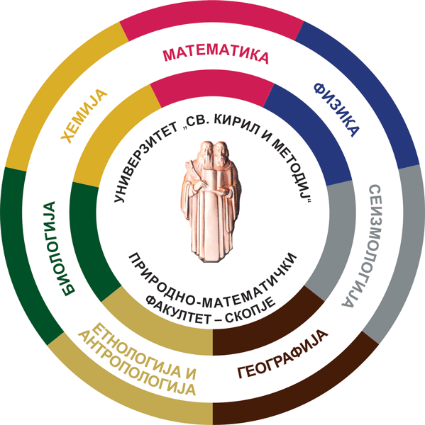
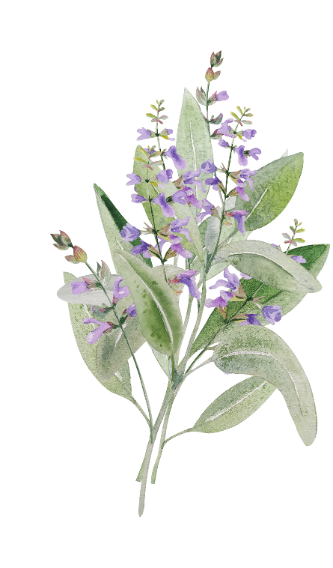
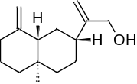



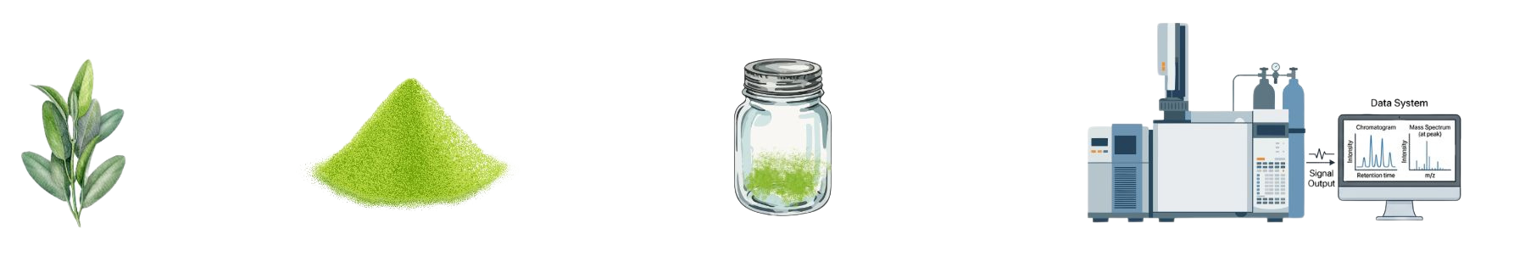
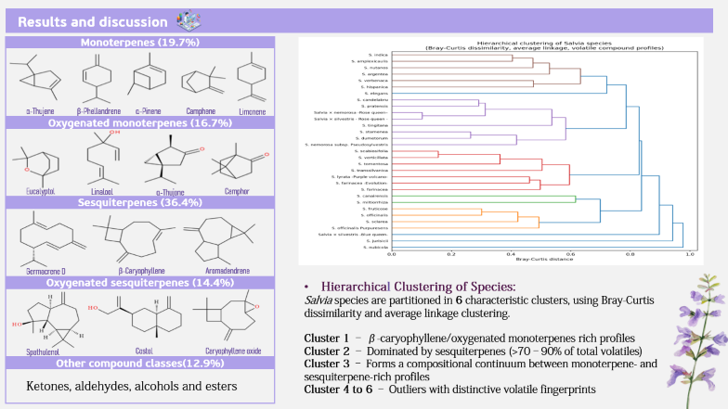
28th Congress of SCTM, 23-26 September, Ohrid, Macedonia
AEC-P5
VOLATILE COMPOUND DIVERSITY IN Salvia SPECIES REVEALED BY HS–GC–MS ANALYSIS
Anastasija Hadzismileva, Gjorgina Leseva, Marinela Cvetanoska, Pece Sherovski, Marina Stefova, Jasmina Petreska Stanoeva
Institute of Chemistry, Faculty of Natural Sciences and Mathematics, Ss. Cyril and Methodius University in Skopje, Skopje, North Macedonia
e-mail: anastasijahadzismileva23@gmail.com
Introduction & Aim
Salvia species are well known for their aromatic properties, which arise from a diverse mixture of volatile compounds. Apart from being the major constituents of Salvia essential oils, they contribute significantly to their biological activity. The present study aimed to characterize, compare and analyze the correlations between the volatile profiles of 33 different Salvia species using HS-GC-MS method.
Experimental
Results and discussion
HS-GC-MS
analysis
Plant collection
Plant powder
Conclusions
The analyzed Salvia species exhibited highly diverse and complex volatile profiles, characterized by a predominance of terpenoid compounds.
The observed variability across these volatile profiles highlights their efficacy for chemotaxonomic differentiation of the genus Salvia.
Acknowledgment
This work has been supported by Macedonian Ecological Society for the financial support of the project titled ”Integrated Strategy for Taxonomic Discrimination of Salvia Species Based on Chemical and Genetic Markers”.

Slide 2
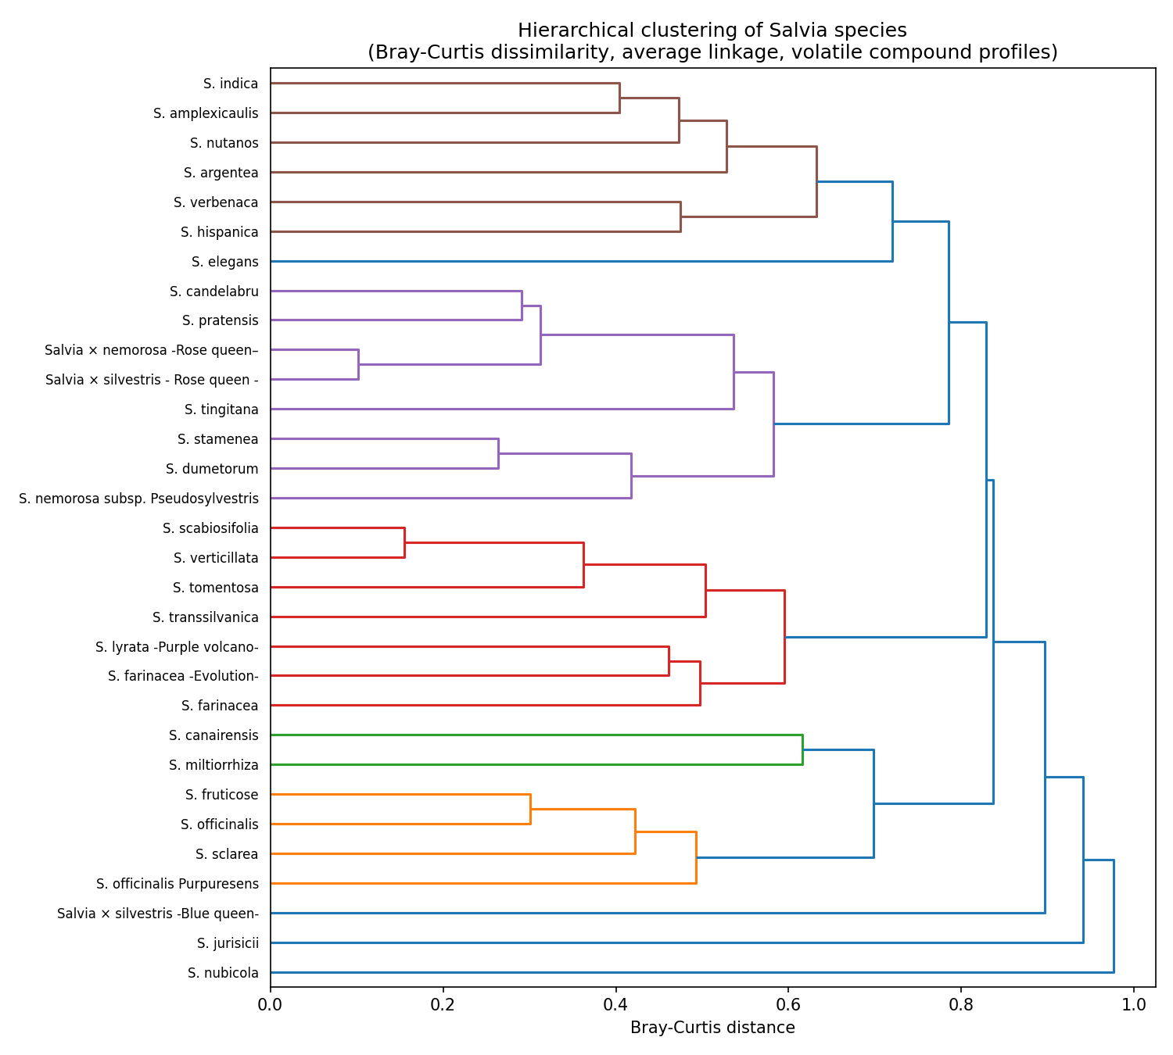
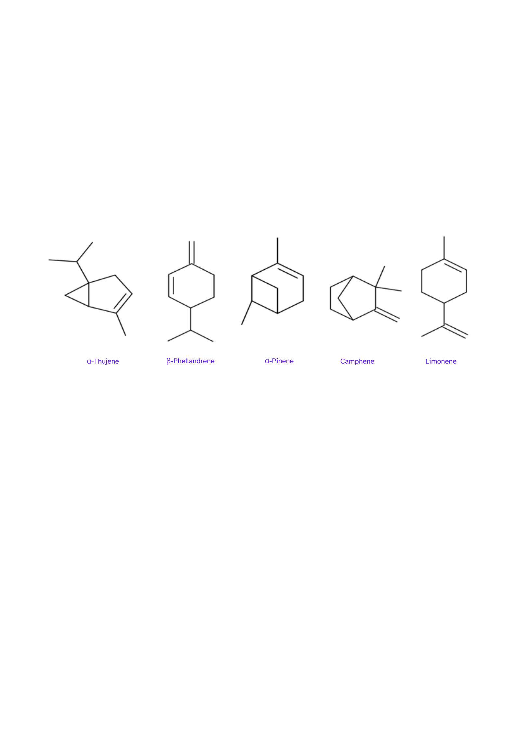
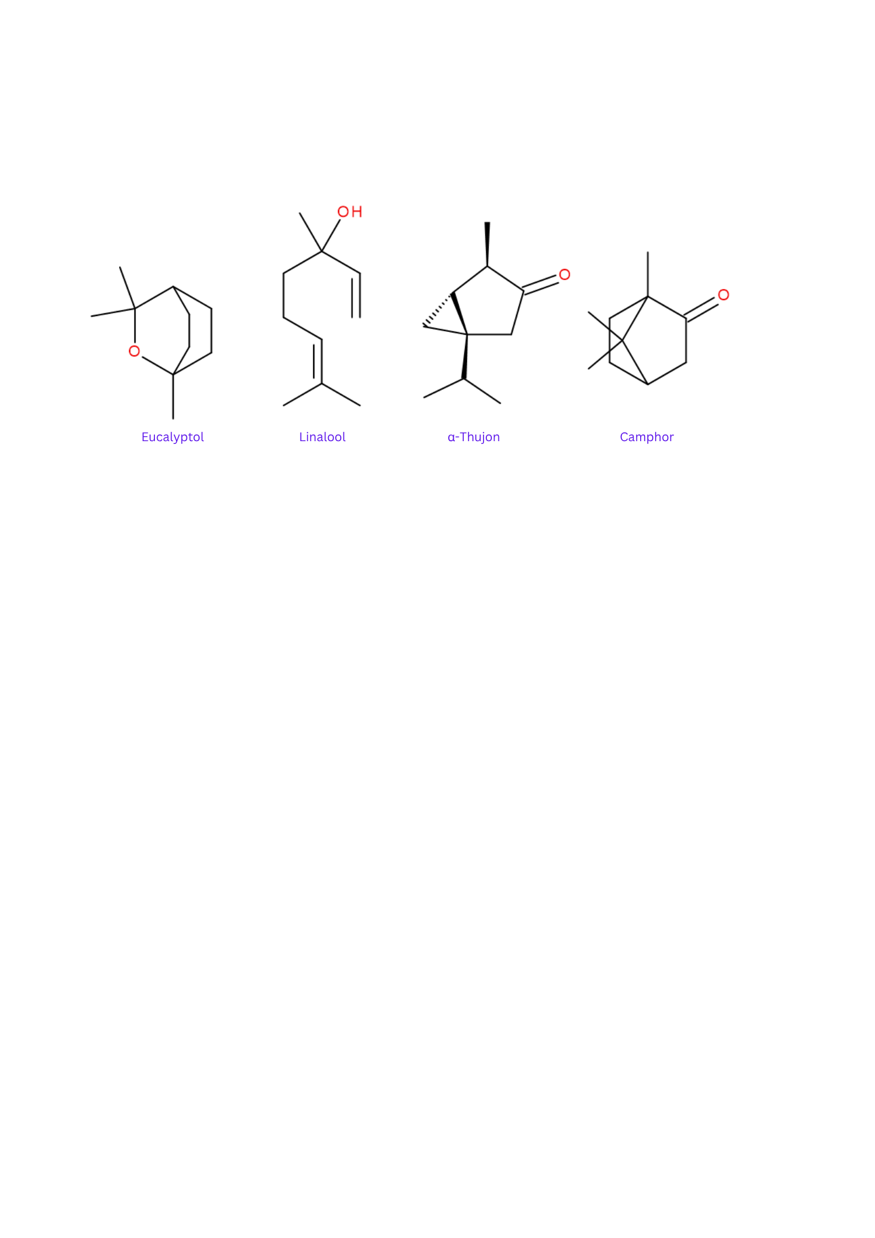
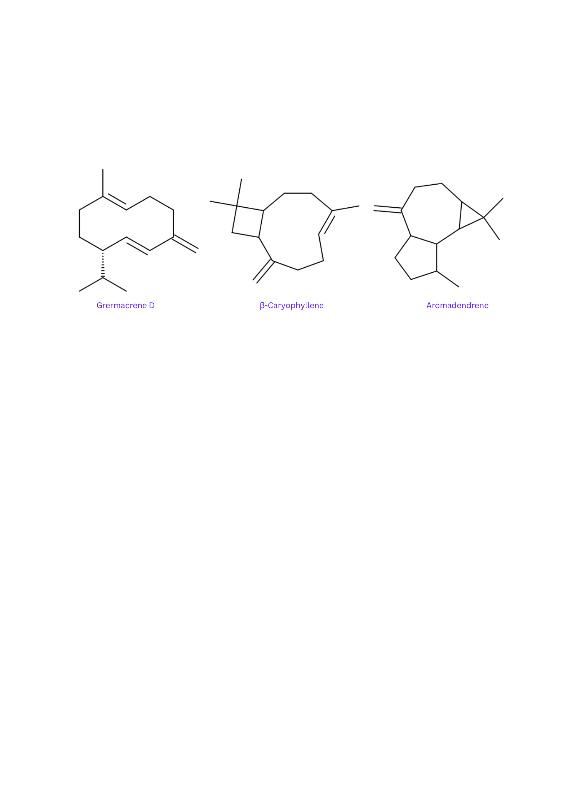
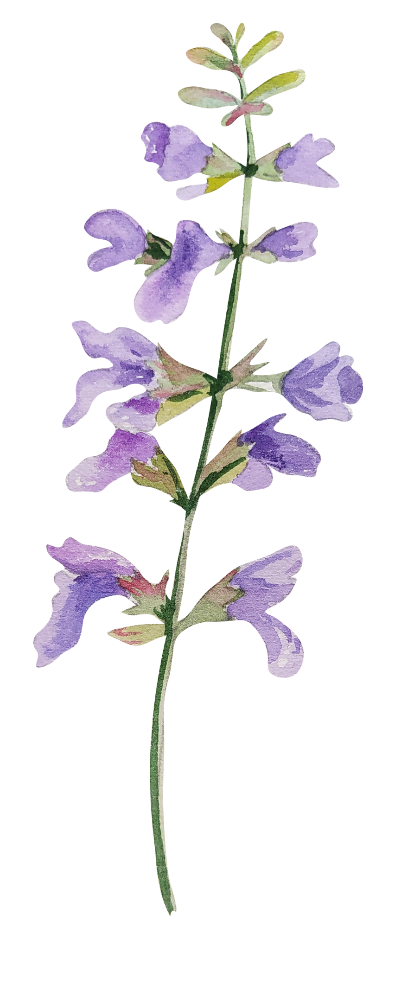
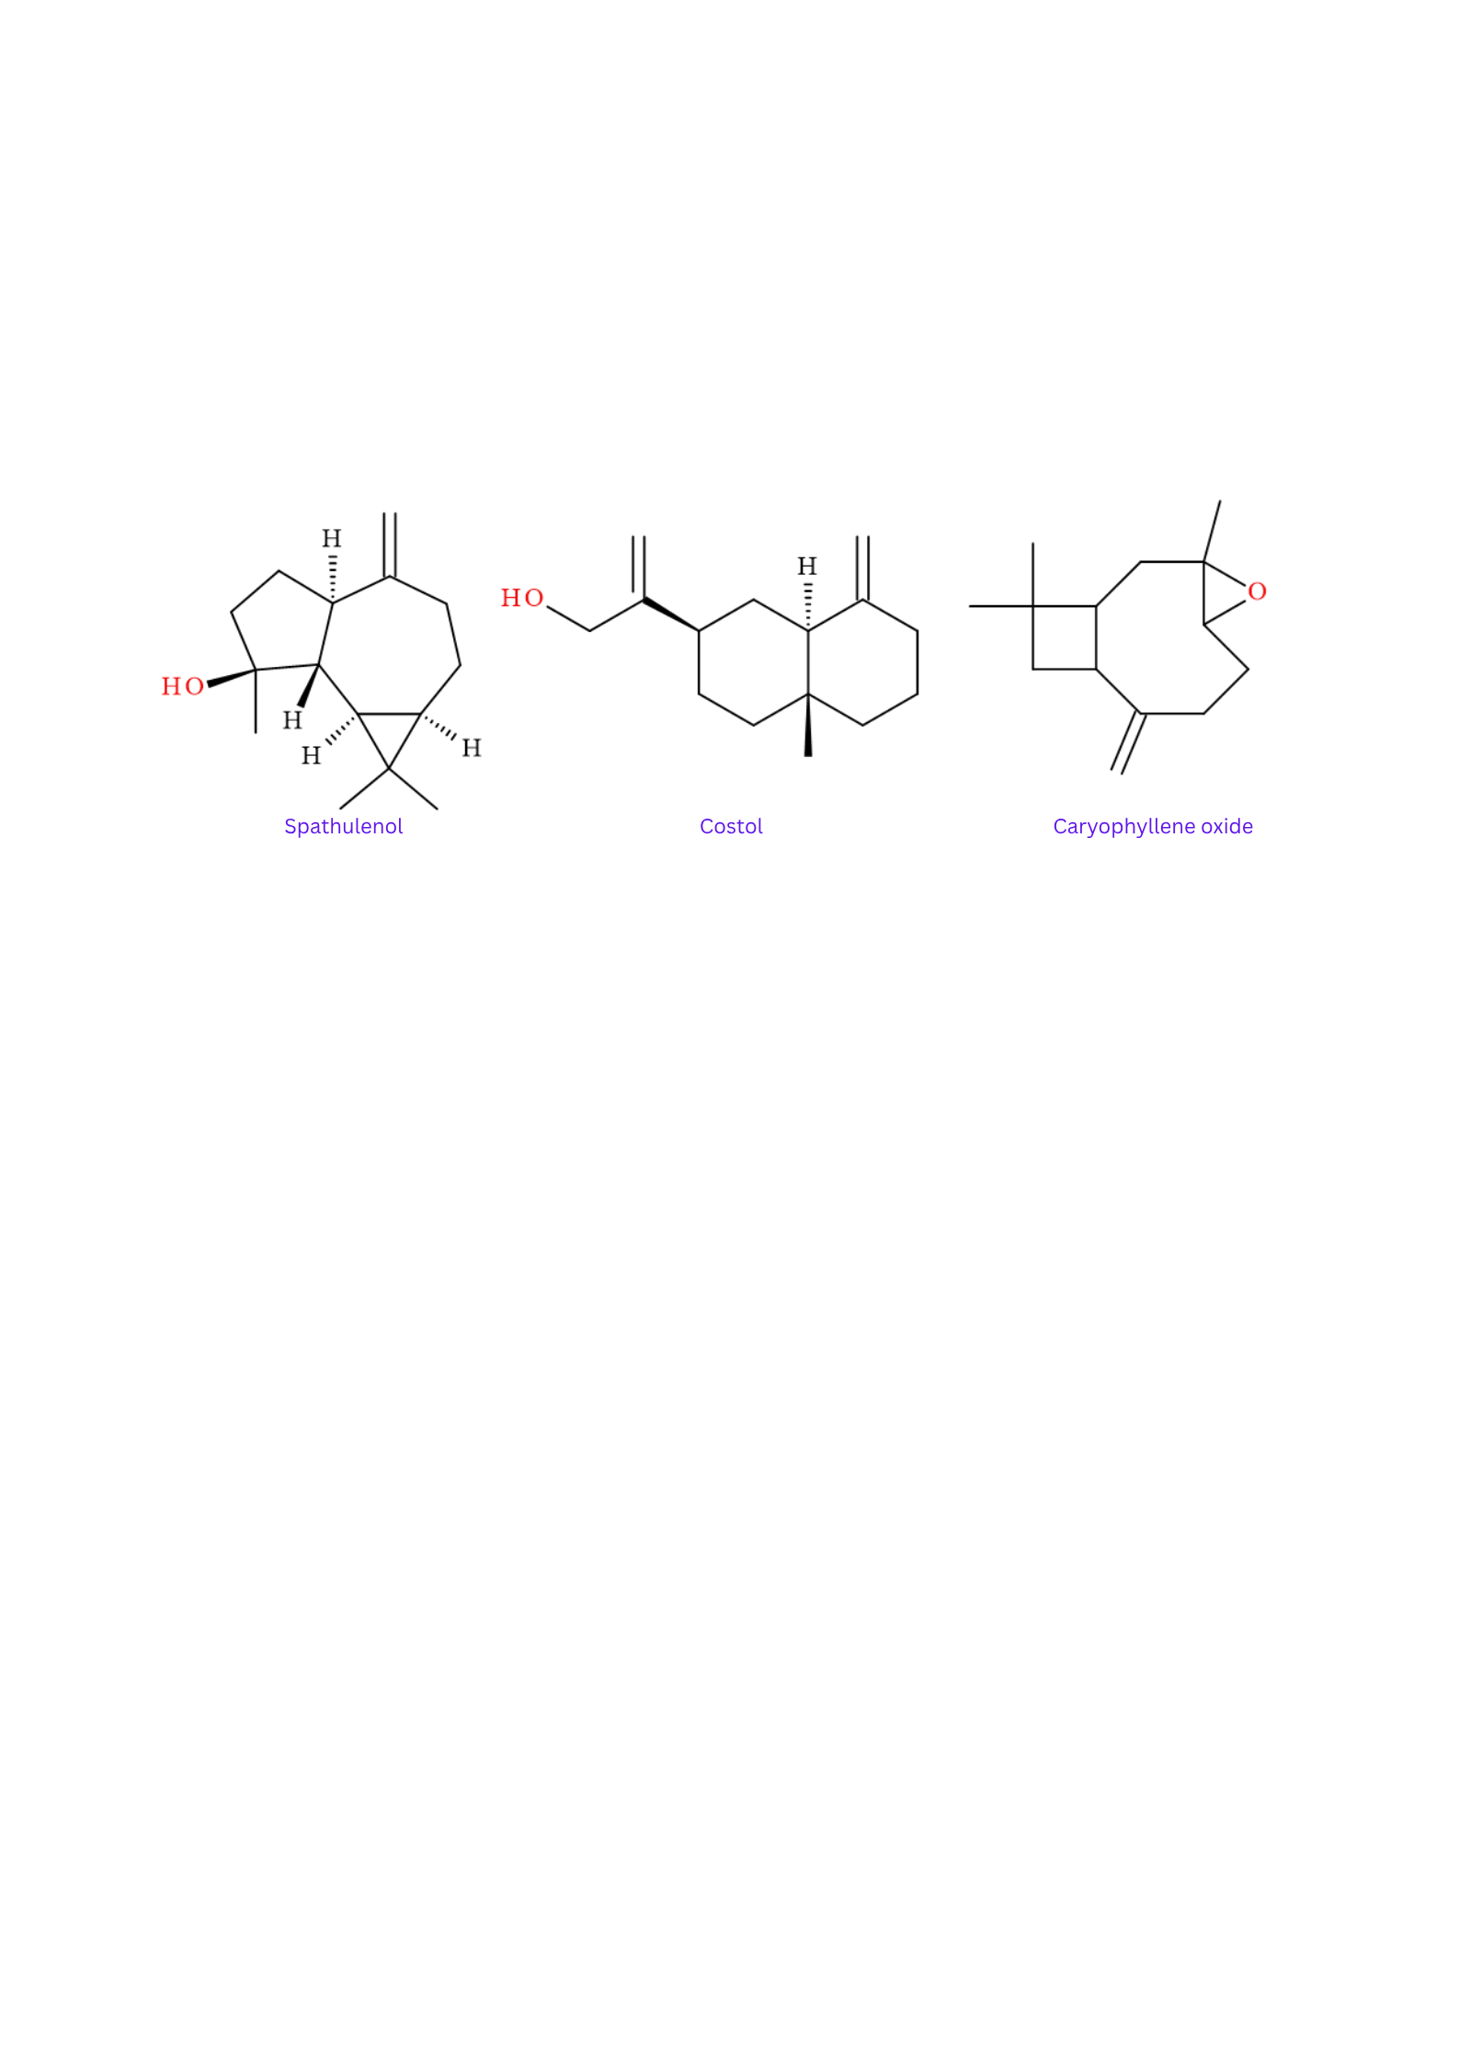
Results and discussion
Monoterpenes (19.7%)
α-Thujene
β-Phellandrene
α-Pinene
Camphene
Limonene
Oxygenated monoterpenes (16.7%)
Eucalyptol
Linalool
α-Thujone
Camphor
Sesquiterpenes (36.4%)
Germacrene D
β-Caryophyllene
Aromadendrene
Oxygenated sesquiterpenes (14.4%)
Hierarchical Clustering of Species:
Salvia species are partitioned in 6 characteristic clusters, using Bray-Curtis dissimilarity and average linkage clustering.
Cluster 1 – β-caryophyllene/oxygenated monoterpenes rich profiles
Cluster 2 – Dominated by sesquiterpenes (>70–90% of total volatiles)
Cluster 3 – Forms a compositional continuum between monoterpene- and sesquiterpene-rich profiles
Cluster 4 to 6 – Outliers with distinctive volatile fingerprints
Spathulenol
Costol
Caryophyllene oxide
Other compound classes(12.9%)
Ketones, aldehydes, alcohols and esters

