Slide 1

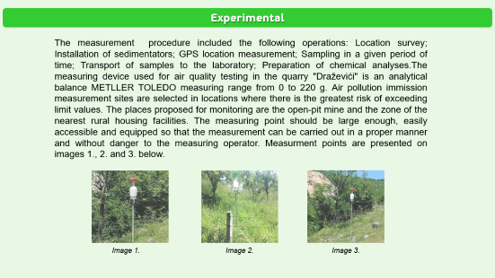
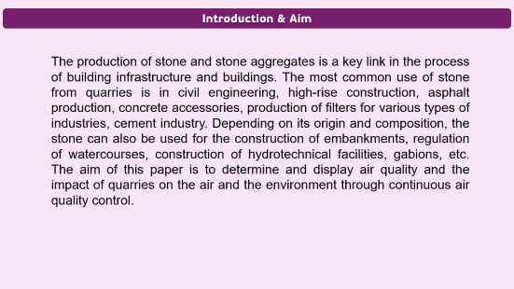
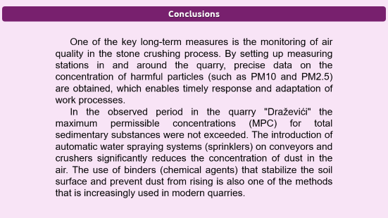


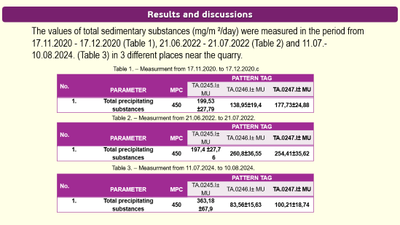

28th Congress of SCTM, 23-26 September, Ohrid, Macedonia
000
MONITORING OF THE QUALITY OF AIR IN STONE-BREAKER
Snežana Aksentijević¹ , Ljiljana Trumbulović²
¹ Western Serbia Academy of Applied Studies, Užice ,Serbia, sneza.aksentijevic@gmail.com, ² Western Serbia Academy of Applied Studies, Užice, Serbia

Slide 2
Introduction & Aim
The production of stone and stone aggregates is a key link in the process of building infrastructure and buildings. The most common use of stone from quarries is in civil engineering, high-rise construction, asphalt production, concrete accessories, production of filters for various types of industries, cement industry. Depending on its origin and composition, the stone can also be used for the construction of embankments, regulation of watercourses, construction of hydrotechnical facilities, gabions, etc. The aim of this paper is to determine and display air quality and the impact of quarries on the air and the environment through continuous air quality control.

Slide 3
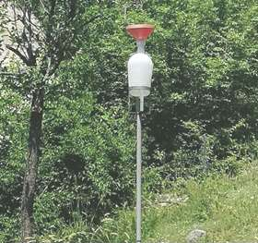
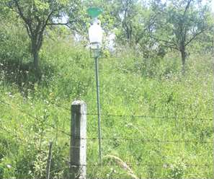
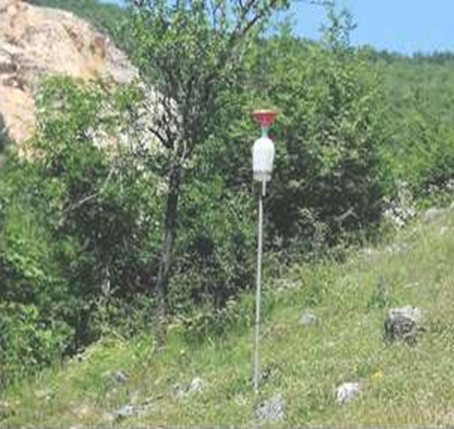
Experimental
The measurement procedure included the following operations: Location survey; Installation of sedimentators; GPS location measurement; Sampling in a given period of time; Transport of samples to the laboratory; Preparation of chemical analyses.The measuring device used for air quality testing in the quarry "Draževići" is an analytical balance METLLER TOLEDO measuring range from 0 to 220 g. Air pollution immission measurement sites are selected in locations where there is the greatest risk of exceeding limit values. The places proposed for monitoring are the open-pit mine and the zone of the nearest rural housing facilities. The measuring point should be large enough, easily accessible and equipped so that the measurement can be carried out in a proper manner and without danger to the measuring operator. Measurment points are presented on images 1., 2. and 3. below.
Image 1.
Image 2.
Image 3.

Slide 4
Results and discussions
The values of total sedimentary substances (mg/m ²/day) were measured in the period from 17.11.2020 - 17.12.2020 (Table 1), 21.06.2022 - 21.07.2022 (Table 2) and 11.07.-10.08.2024. (Table 3) in 3 different places near the quarry.
Table 1. – Measurment from 17.11.2020. to 17.12.2020.с
No. | PARAMETER | MPC | PATTERN TAG
 |  |  | TA.0245.I± MU | TA.0246.I± MU | TA.0247.I± MU
1. | Total precipitating substances | 450 | 199,53 ±27,79 | 138,95±19,4 | 177,73±24,88
Table 2. – Measurment from 21.06.2022. to 21.07.2022.
No. | PARAMETER | MPC | PATTERN TAG
 |  |  | TA.0245.I± MU | TA.0246.I± MU | TA.0247.I± MU
1. | Total precipitating substances | 450 | 197,4 ±27,7 6 | 260,8±36,55 | 254,41±35,62
Table 3. – Measurment from 11.07.2024. to 10.08.2024.
No. | PARAMETER | MPC | PATTERN TAG
 |  |  | TA.0245.I± MU | TA.0246.I± MU | TA.0247.I± MU
1. | Total precipitating substances | 450 | 363,18 ±67,9 | 83,56±15,63 | 100,21±18,74

Slide 5
Conclusions
One of the key long-term measures is the monitoring of air quality in the stone crushing process. By setting up measuring stations in and around the quarry, precise data on the concentration of harmful particles (such as PM10 and PM2.5) are obtained, which enables timely response and adaptation of work processes.
In the observed period in the quarry "Draževići" the maximum permissible concentrations (MPC) for total sedimentary substances were not exceeded. The introduction of automatic water spraying systems (sprinklers) on conveyors and crushers significantly reduces the concentration of dust in the air. The use of binders (chemical agents) that stabilize the soil surface and prevent dust from rising is also one of the methods that is increasingly used in modern quarries.

