Slide 1

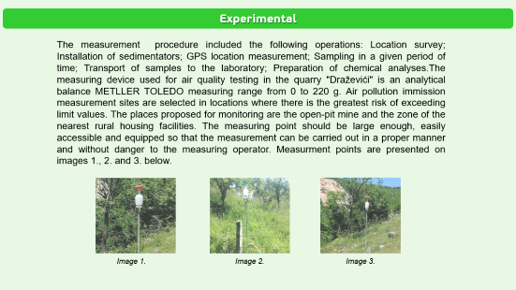
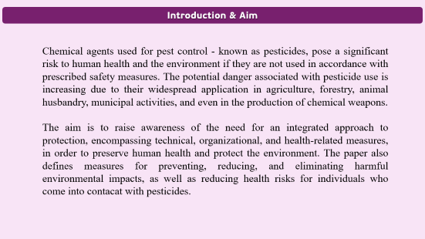
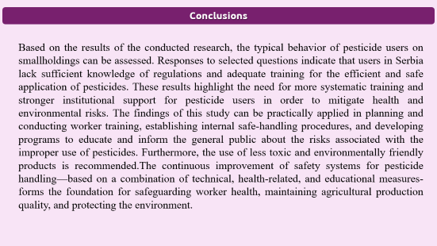
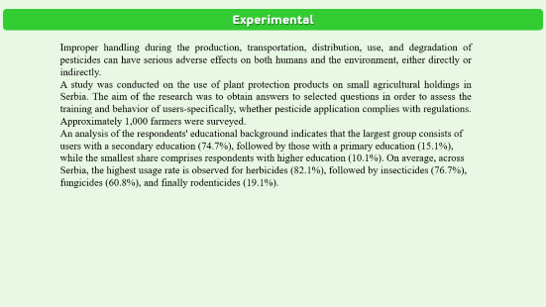


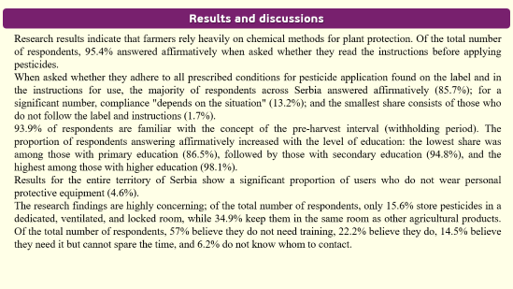

AEC-P35
28th Congress of SCTM, 23-26 September, Ohrid, Macedonia
SUSTAINABLE USE OF PESTICIDES FOR THE PURPOSE OF ENVIRONMENTAL PROTECTION AND EMPLOYEE SAFETY
Ljiljana Trumbulović¹, SnežanaAksentijević²
¹Western Serbia Academy of Applied Studies, Užice ,Serbia, ljiljanatrumbulovic@gmail.com, ² Western Serbia Academy of Applied Studies, Užice, Serbia

Slide 2
Introduction & Aim
Chemical agents used for pest control - known as pesticides, pose a significant risk to human health and the environment if they are not used in accordance with prescribed safety measures. The potential danger associated with pesticide use is increasing due to their widespread application in agriculture, forestry, animal husbandry, municipal activities, and even in the production of chemical weapons.
The aim is to raise awareness of the need for an integrated approach to protection, encompassing technical, organizational, and health-related measures, in order to preserve human health and protect the environment. The paper also defines measures for preventing, reducing, and eliminating harmful environmental impacts, as well as reducing health risks for individuals who come into contacat with pesticides.

Slide 3
Experimental
Improper handling during the production, transportation, distribution, use, and degradation of pesticides can have serious adverse effects on both humans and the environment, either directly or indirectly.
A study was conducted on the use of plant protection products on small agricultural holdings in Serbia. The aim of the research was to obtain answers to selected questions in order to assess the training and behavior of users-specifically, whether pesticide application complies with regulations. Approximately 1,000 farmers were surveyed.
An analysis of the respondents' educational background indicates that the largest group consists of users with a secondary education (74.7%), followed by those with a primary education (15.1%), while the smallest share comprises respondents with higher education (10.1%). On average, across Serbia, the highest usage rate is observed for herbicides (82.1%), followed by insecticides (76.7%), fungicides (60.8%), and finally rodenticides (19.1%).

Slide 4
Results and discussions
Research results indicate that farmers rely heavily on chemical methods for plant protection. Of the total number of respondents, 95.4% answered affirmatively when asked whether they read the instructions before applying pesticides.
When asked whether they adhere to all prescribed conditions for pesticide application found on the label and in the instructions for use, the majority of respondents across Serbia answered affirmatively (85.7%); for a significant number, compliance "depends on the situation" (13.2%); and the smallest share consists of those who do not follow the label and instructions (1.7%).
93.9% of respondents are familiar with the concept of the pre-harvest interval (withholding period). The proportion of respondents answering affirmatively increased with the level of education: the lowest share was among those with primary education (86.5%), followed by those with secondary education (94.8%), and the highest among those with higher education (98.1%).
Results for the entire territory of Serbia show a significant proportion of users who do not wear personal protective equipment (4.6%).
The research findings are highly concerning; of the total number of respondents, only 15.6% store pesticides in a dedicated, ventilated, and locked room, while 34.9% keep them in the same room as other agricultural products. Of the total number of respondents, 57% believe they do not need training, 22.2% believe they do, 14.5% believe they need it but cannot spare the time, and 6.2% do not know whom to contact.

Slide 5
Conclusions
Based on the results of the conducted research, the typical behavior of pesticide users on smallholdings can be assessed. Responses to selected questions indicate that users in Serbia lack sufficient knowledge of regulations and adequate training for the efficient and safe application of pesticides. These results highlight the need for more systematic training and stronger institutional support for pesticide users in order to mitigate health and environmental risks. The findings of this study can be practically applied in planning and conducting worker training, establishing internal safe-handling procedures, and developing programs to educate and inform the general public about the risks associated with the improper use of pesticides. Furthermore, the use of less toxic and environmentally friendly products is recommended.The continuous improvement of safety systems for pesticide handling—based on a combination of technical, health-related, and educational measures-forms the foundation for safeguarding worker health, maintaining agricultural production quality, and protecting the environment.

