Slide 1



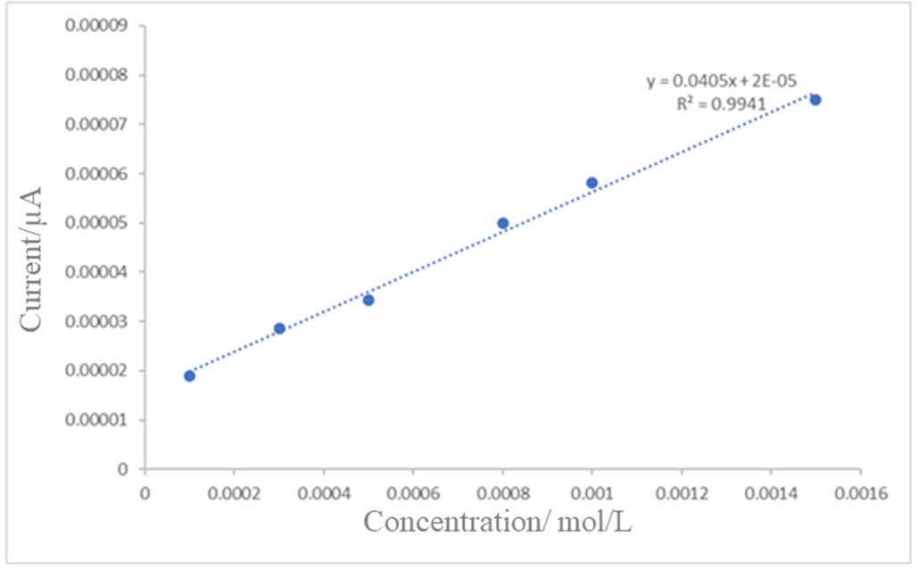
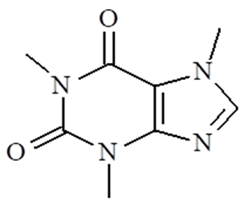
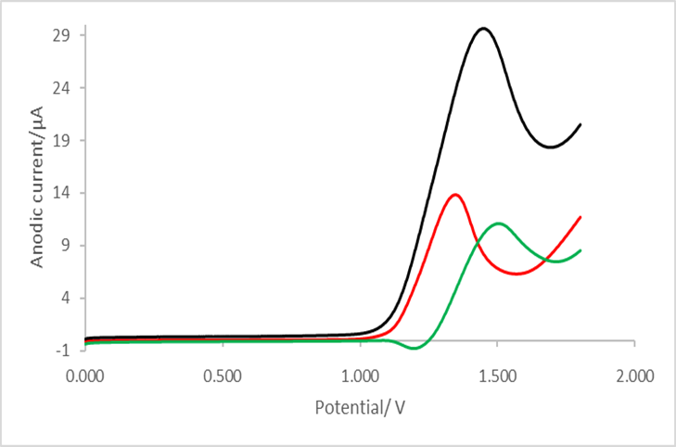
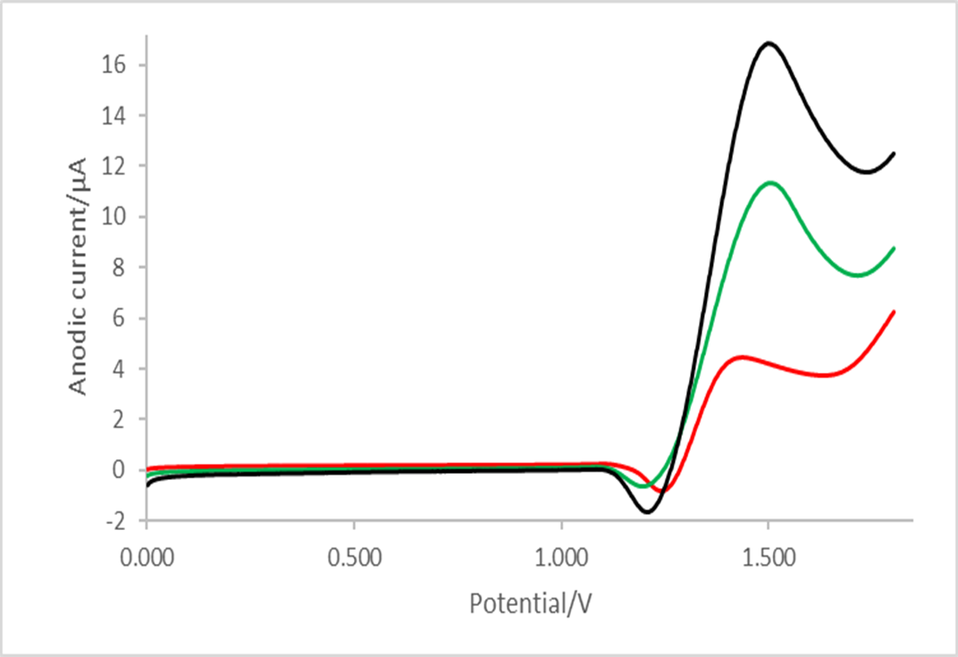
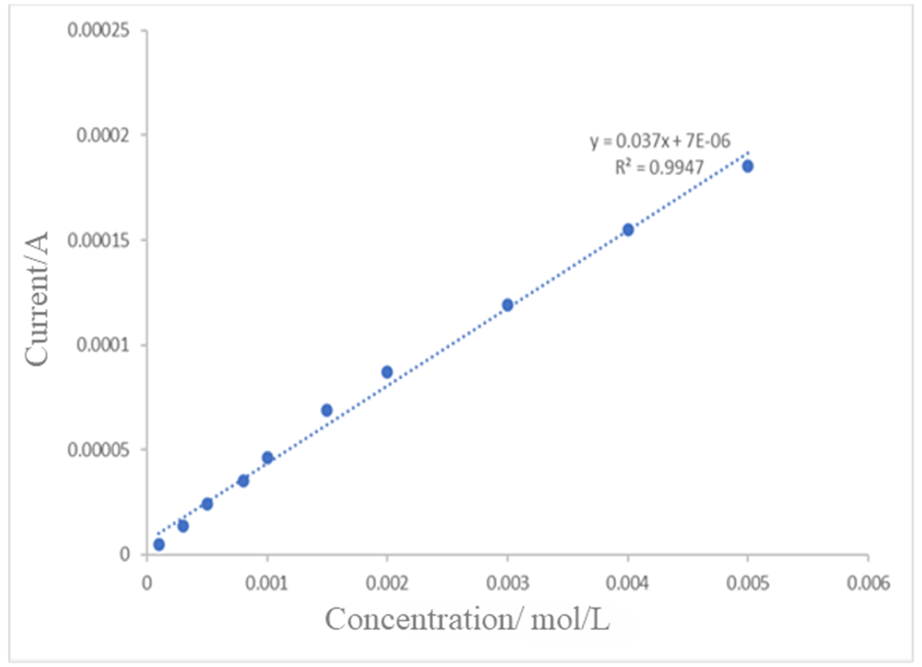
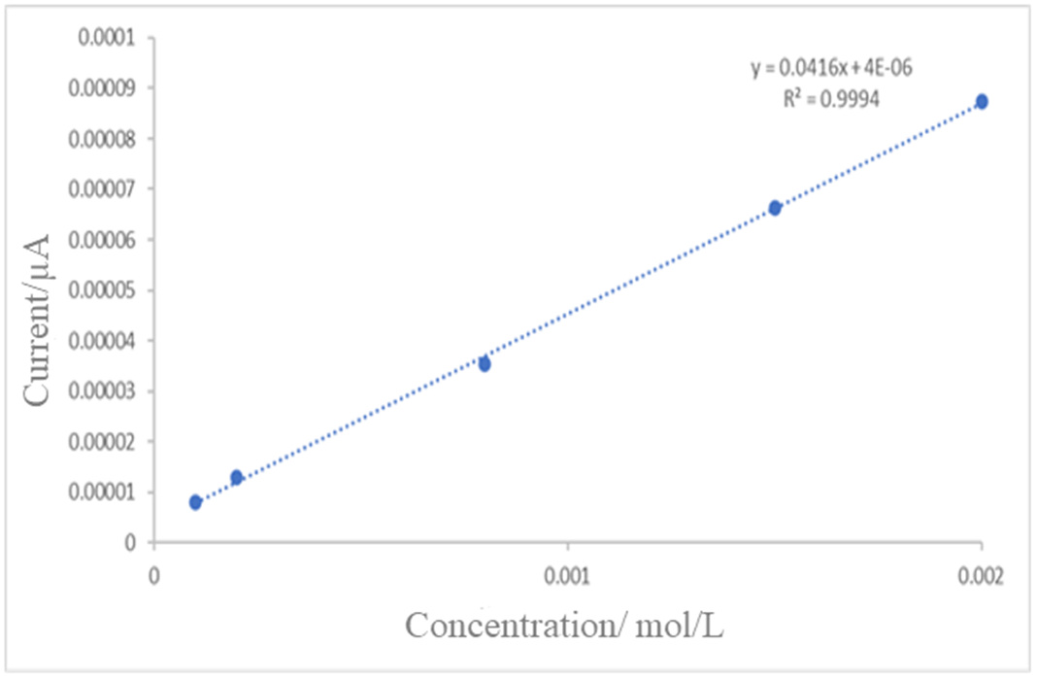
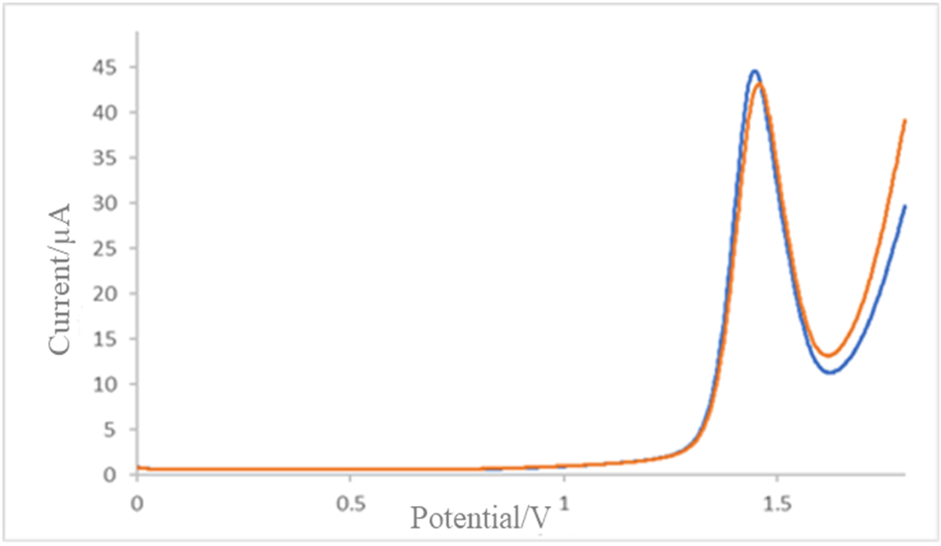
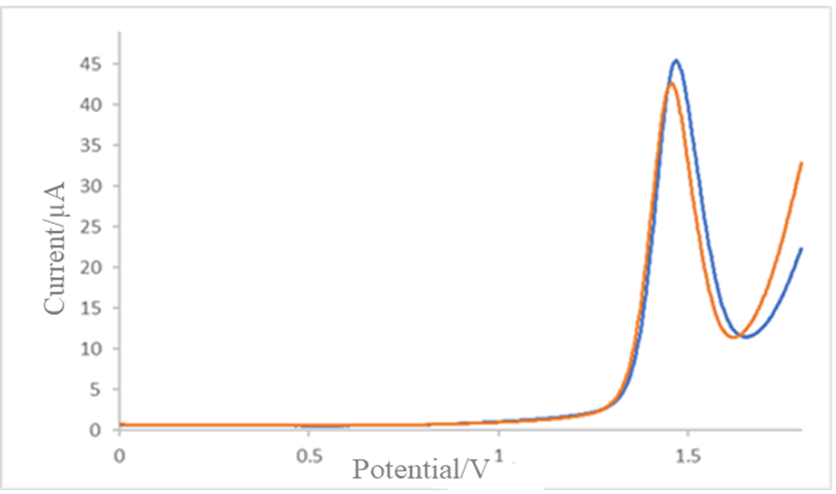
28th Congress of SCTM, 23-26 September, Ohrid, Macedonia
Voltammetric study of caffeine: mechanism and analytical application
000
Monika Organdjieva^{1,2}, Valentin Mircheski² , Bisera Janeska-Trajkovska¹, Nenad Dimitrovski¹, Mena Ivanoska Zdravkovska¹, Gjorgji Petrushevski¹
, e-mail: morgandjieva@alkaloid.com.mk
¹ Alkaloid AD Skopje, Skopje, Macedonia
² Institute of Chemistry, Faculty of Natural Sciences and Mathematics, Skopje, Macedonia
Sample preparation – black tea
Sample analysis – black tea
Caffeine is a purine alkaloid belonging to the xanthine family, chemically known as 1,3,7-trimethylxanthine. It is widely recognized for its stimulant and mild diuretic effects. Electrochemical methods are increasingly used for caffeine determination due to their high sensitivity and selectivity, rapid response, good reproducibility, and low-cost instrumentation.
Introduction & Aim
5 mL of previously prepared black tea (one tea filter bag in 250 mL hot water) was transferred into a volumetric flask. The sample was diluted to a final volume of 10 mL with 0.2 mol/L acetate buffer.
A higher initial buffer concentration was used because the tea infusion had been prepared with water.
After dilution, the final acetate buffer concentration was 0.1 mol/L.
This procedure ensured uniform and optimal conditions for analysis.
The caffeine content in black tea was determined using the calibration equation (y = 0.0405x + 2 × 10⁻⁵). After correction for dilution, the caffeine concentration was calculated to be 7.8 × 10⁻⁴ mol/L. The corresponding caffeine content was 37.99 mg per 250 mL of tea infusion, equivalent to 1.90% (w/w) in the analyzed 2 g tea filter bag.
The obtained results are consistent with literature data for caffeine content in black tea.
Procedure
Aqueous solution and non-aqueous solution on room temperature
Electrolytes: acetate buffer solution: c = 0.1 mol/L; pH = 4.1 and 0.1M TBAP in ACN
Concentration of caffeine: 1.0 × 10⁻³ mol/L.
Reference electrode: Ag/AgCl (c(KCl) = 3 mol/L) and Ag/Ag+ (0.1M TBAP, 0.1M KNO₃ in ACN).
Counter electrode: graphite rod.
Working electrode: Boron-doped diamond electrode (BDD).
Electrochemical techniques: square-wave voltammetry (SWV).
Figure 5. Dependence of anodic current on caffeine concentration during the sample evaluation of the proposed method
Figure 1. Structural formula of caffeine
Voltammograms recorded in 0.1 M TBAP/ACN for investigation of mechanism
Results & discussion
(A)
(B)
In a non-aqueous medium, the best results are obtained for investigation of mechanism, although the system is difficult to maintain due to the specific conditions required. Nevertheless, we obtained recordings in which the reduction peak is clearly visible. This peak appears after the second redox couple, indicating another coupled chemical reaction and ultimately supporting an ECEC mechanism.
Calibration curve & linearity
Accuracy
A linear relationship between anodic current and caffeine concentration was observed over the investigated concentration range.
Method accuracy was evaluated using a standard solution containing 9 × 10⁻⁴ mol/L caffeine (1.74 mg/10 mL) and the standard addition method. The determined concentration was 8.8 × 10⁻⁴ mol/L (1.71 mg), corresponding to a recovery of 98.29%. These results confirm the high accuracy and reliability of the proposed method.
Figure 6. Typical SWV voltammograms for caffeine showing forward (A) and backward (B) components. Esw = 50 mV and ∆E = 1 mV f = 100 Hz (black), f = 50 Hz (green), f = 10 Hz (red).
Proposed oxidation mechanism
Figure 2. Dependence of anodic current on caffeine concentration during the linearity evaluation of the proposed method.
Figure 3. Dependence of anodic current on caffeine concentration during the accuracy evaluation of the proposed method
Sensitivity and precision
Figure 7. The oxidation reaction of caffeine. The structure of caffeine is shown as compound 1. 8-Oxycaffeine and its diol analogue are labeled as compounds 2 and 3, respectively.
(A)
(B)
Precision of the method was evaluated through two types of experiments:
Repeatability (intra-day precision) was assessed by performing consecutive measurements of the same solution on the same day, with the electrode being cleaned between measurements.
Intermediate precision (inter-day precision) was evaluated by measuring a solution of the same concentration on the following day to assess the day-to-day reproducibility of the method.
Conclusion
The BDD electrode provided the best response for caffeine determination. The SWV method showed high accuracy (98.29% recovery), and black tea analysis revealed 1.90% (w/w) caffeine, confirming a rapid, sensitive, and cost-effective method.
Figure 4. Typical voltammograms of caffeine obtained from consecutive measurements performed (a) on the same day and (b) on the following day. The caffeine concentration was 1.0 × 10⁻³ mol/L.

