Slide 1

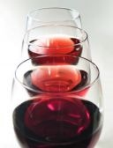
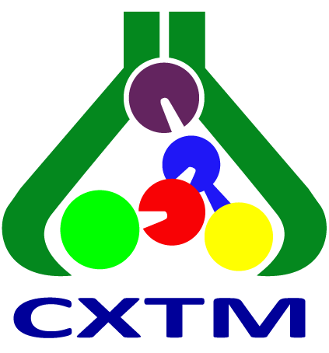
28th Congress of Chemists and Technologists of Macedonia
23-26 September, 2026, Metropol Lake Resort, Ohrid, Macedonia
LC-ESI-MS/MS DETERMINATION OF POLYPHENOLS IN KRATOŠIJA WINE
VIOLETA IVANOVA-PETROPULOS¹
¹Goce Delcev University, Faculty of Agriculture, Stip, Republic of N. Macedonia
Elena Bogeva¹, Aleksandra Sentkowska², Magdalena Biesaga³, Ewa Pobozy³
²Heavy Ion Laboratory, University of Warsaw, Warsaw, Poland
³Faculty of Chemistry, University of Warsaw, Warsaw, Poland

Slide 2
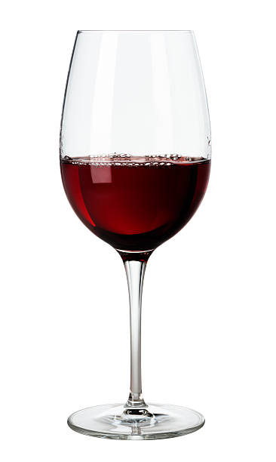
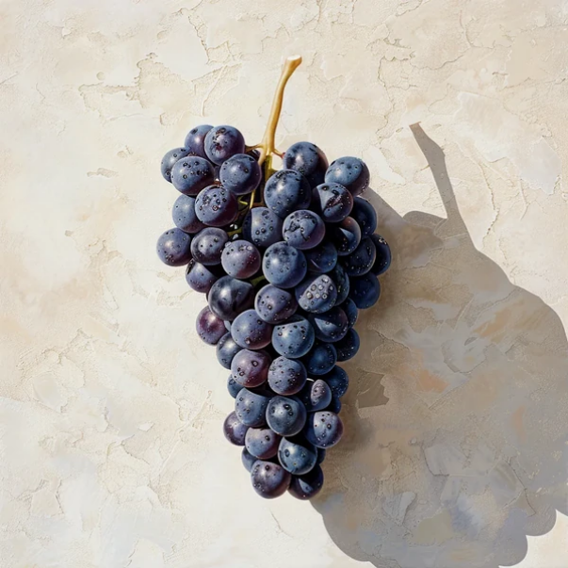
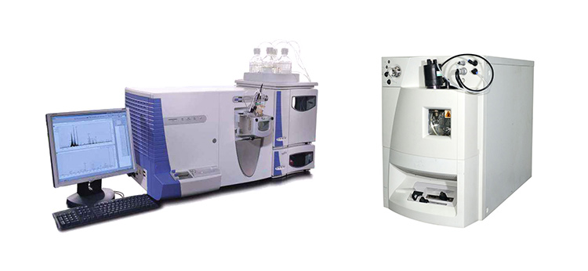
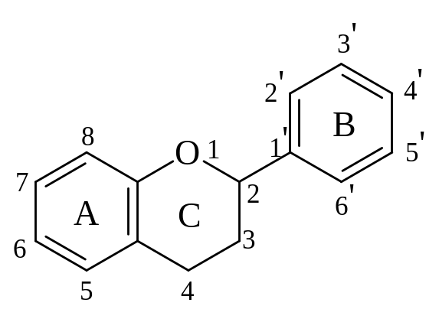
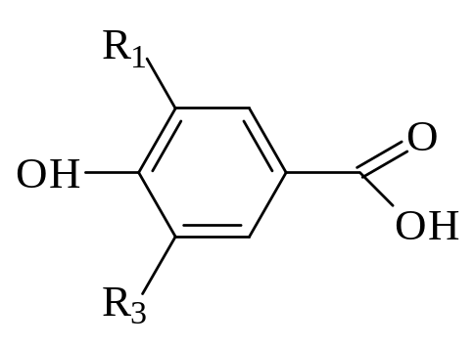
PRESENTATION OVERVIEW
Phenolic compounds in red wine
Liquid Chromatography
Macedonian viticulture and winemaking
Kratošija – important Balkan variety
Results for flavonoids and non-flafonoids in
Kratošija wine

Slide 3
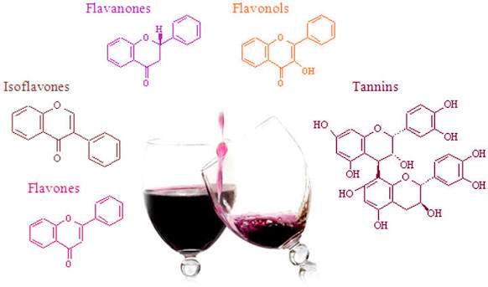
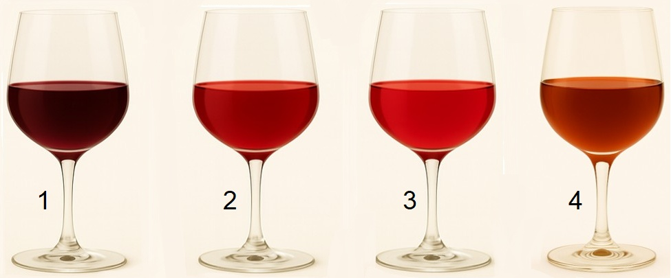
Phenolic compounds in red wine
Very important components in wine and grapes responsible for the quality of wine,
Determine the color, taste, astringency and bitterness of the wine.
They are responsible for the differences between red and white wines, especially the color and taste of reds.
These substances are present in different parts of the grapes and are extracted during vinification.
Beneficial effects on health: antioxidant, antimicrobial, anticancer ...

Slide 4
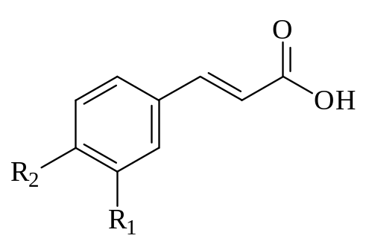
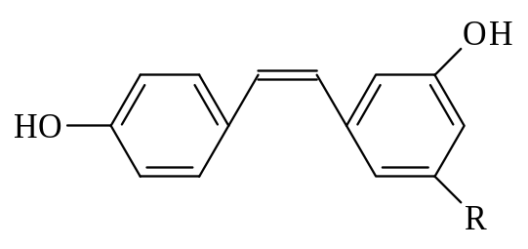
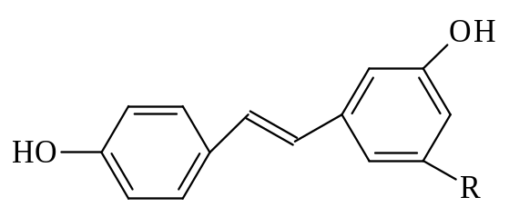
Phenolic composition of wine
NON-FLAVONOIDS
Phenolic acids
Hydroxybenzoic acids | R₁ | R₂
Gallic acid | OH | OH
Protocatechuic acid | OH | H
Stilbens
Hydroxycinnamic acids | R₁ | R₂
Cinnamic acid | H | H
p-Coumaric acid | H | OH
Caffeic acid | OH | OH
Ferulic acid | OH | OCH₃
cis-
Resveratrol
trans-

Slide 5
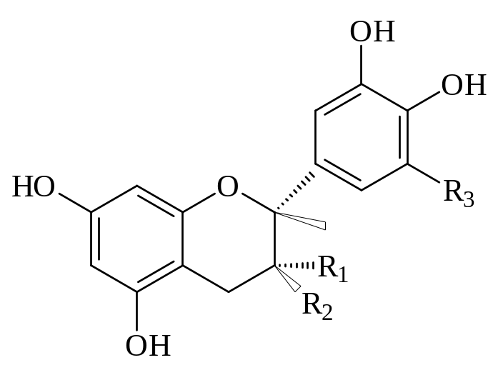
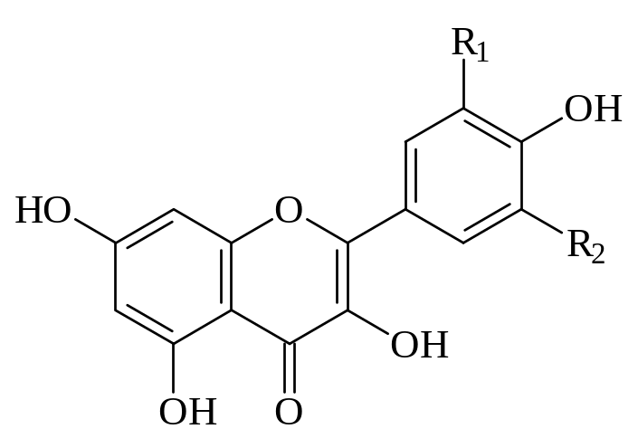
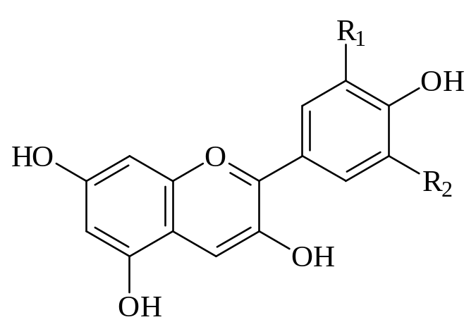
Flavonoids
Flavan-3-ols
Flavan-3-ols | R₁ | R₂ | R₃
(+)-Catechin | H | OH | H
(–)-Epicatechin | OH | H | H
(–)-Gallocatehin | H | OH | OH
(–)-Epigallocatechin | OH | H | OH
(–)-Epicatechin gallate | OGalloyl | H | H
Flavonols
Flavonols | R₁ | R₂
Myricetin | OH | OH
Quercetin | OH | H
Laricitrin | OCH₃ | OH
Kaempferol | H | H
Syringetin | OCH₃ | OCH₃
  Anthocyanidins
Anthocyanidins | R₁ | R₂
Delphinidin | OH | OH
Cyanidin | OH | H
Petunidin | OCH₃ | OH
Peonidin | OCH₃ | H
Malvidin | OCH₃ | OCH₃
5

Slide 6
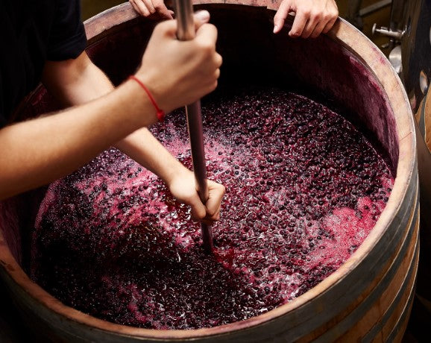
Laboratory Methods for Measuring Phenolic Compounds in Red Wine
Spectroscopic
Chromatographic

Slide 7
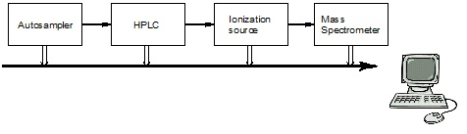
HPLC- ESI-Q TRAP-MS/MS
High-performance liquid chromatography (HPLC) is a very powerful separation method used to identify and/or quantify one or several components in a mixture simultaneously.
- used in food science, environmental science, pharmaceutical industry, biological and chemical research, etc.
Mass spectrometry (MS) is a detection technique by measuring mass-to-charge ratio of ionic species.
- a sample is injected in the instrument and then evaporated.
- species in the sample are charged by certain ionized methods, such as electron ionization (EI), electrospray ionization (ESI), chemical ionization (CI), matrix-assisted laser desorption/ionization (MALDI).
- the ionic species will be analyzed depending on their mass-to-charge ratio (m/z) in the analyzer, such as quadrupole, time-of-flight (TOF), ion trap and fourier transform ion cyclotron resonance.
Liquid chromatography coupled with tandem mass spectrometry (LC-MS/MS) has the advantages of high sensitivity, good selectivity, high throughput, good reproducibility, and wide coverage of metabolites.
In targeted metabolomics, a triple quad mass spectrometer can be used with high sensitivity, good reproducibility, and a wide linear dynamic range in MRM mode.
7

Slide 8
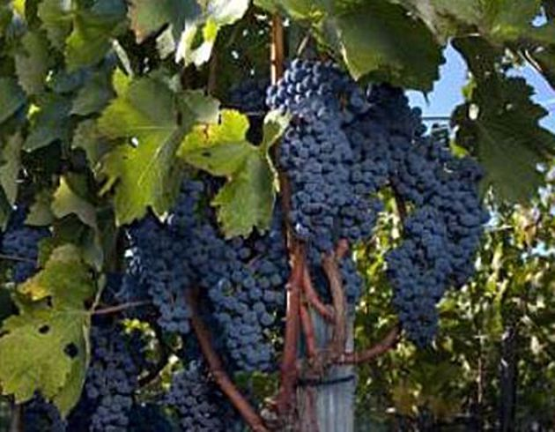
Macedonian viticulture and winemaking
Grape and wine production in Republic of N. Macedonia has a very long tradition.
Viticulture and winemaking are one of the key agricultural-related economic activities in the Macedonia. With its terroir, climate, soil, terrain and tradition, the country has all the conditions for the production of high-quality wine.

Slide 9
Macedonian viticulture and winemaking
Wine grape varieties account for about: 85% (60 % red and 40 % white)
Table grape varieties account for about: 15%.
Total area under wine and table grapes
Total area under vineyards and age structure
Total area under wine grapes and most
abundant varieties

Slide 10
Macedonian viticulture and winemaking
Capacity of wineries | Number of wineries | % of total number of wineries | Total wine capacity (hl) | % of total wine capacity
from 151.000 hl to 500.000 hl | 4 | 2.45 | 896.000 | 51.83
from 51.000 hl to 150.000 hl | 5 | 3.07 | 408.930 | 23.65
from 11.000 hl to 50.000 hl | 12 | 7.36 | 359.400 | 20.79
from 1.000 hl to 10.000 hl | 19 | 11.66 | 47.450 | 2.74
~ 500 hl | 123 | 75.46 | 16.975 | 0.98
TOTAL | 163 |  | 1.728.755
Capacity of wineries
Wine export in quantity (million liters)
Wine export in value (million euros)
Wine export by year (2012-2022) in quantity and value

Slide 11
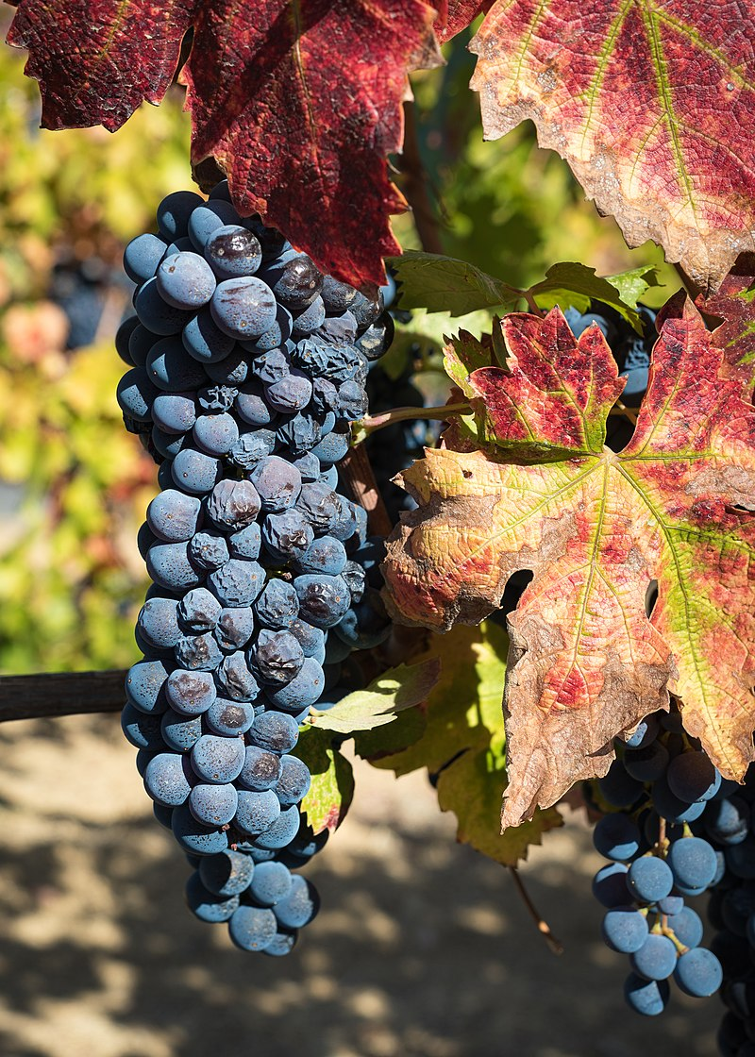
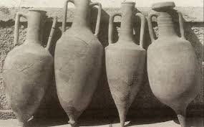
Kratošija – important Balkan variety
Kratošija is considered as an old ancient variety, grown at the Macedonian vineyards in the period when wine was produced in amphora.
In the period of Yugoslavia, Kratošija was replaced with Vranec variety.
Nowadays, Kratošija is found mainly in combination with Vranec vines and at small locations alone, mainly in the Tikveš wine region.
Expansion of the vine areas is expecting in the coming years.
ORIGIN of Kratošija
In some publications, Kratošija is considered as autochthonous Montenegrin variety (Pajović Šćepanović et al. 2019a; 2019b; 2024)
The results of DNA analyses obtained by Calò et al. (2008) showed that Kratošija is a synonym of Zinfandel (USA), Primitivo (Italy) and Crljenak Kaštelanski (Croatia).
Moreover, previous investigations of Maletić et al. (2004) indicated that Zinfandel has a Croatian origin because of its microsatellite allelas typical for the Croatian gene pool.
Consequently, more additional genetic investigations are necessary to be done.
Therefore, it would be the best if Kratošija is considered as a Balkan variety.

Slide 12
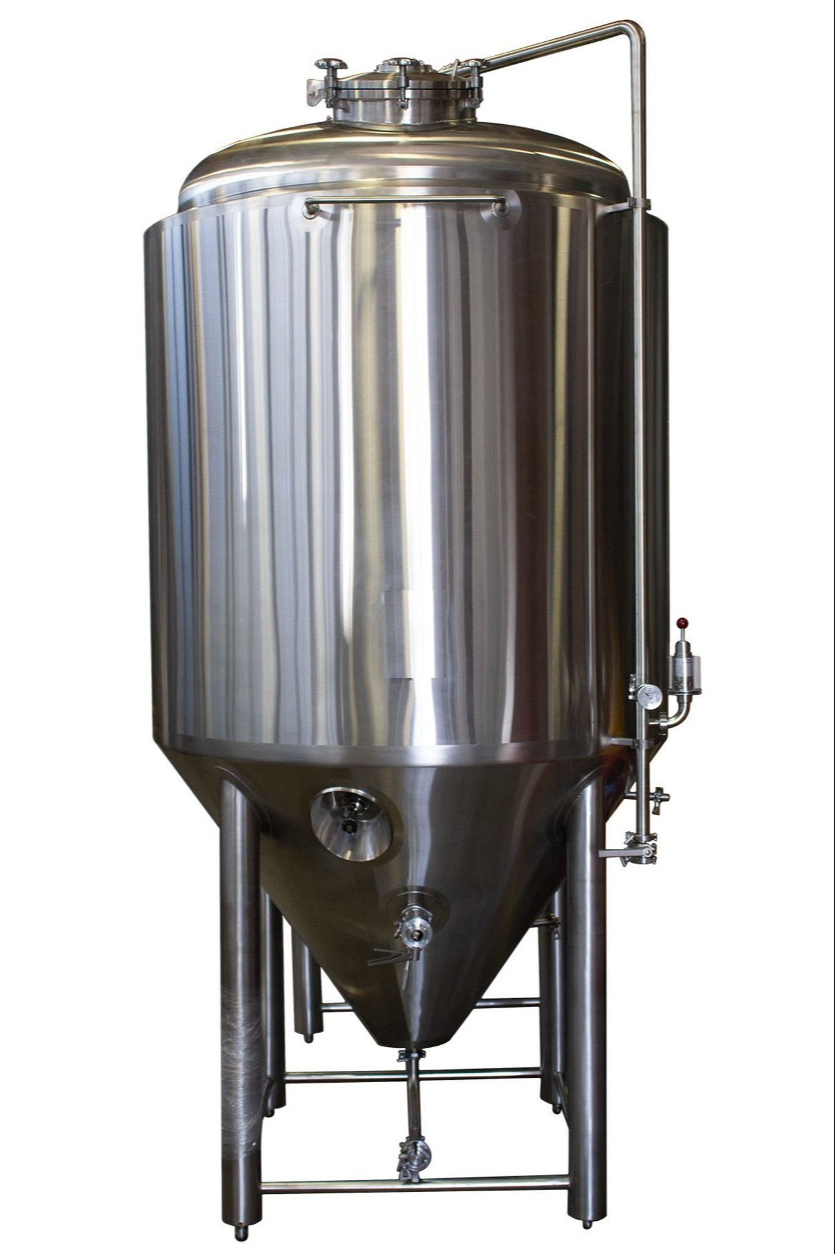
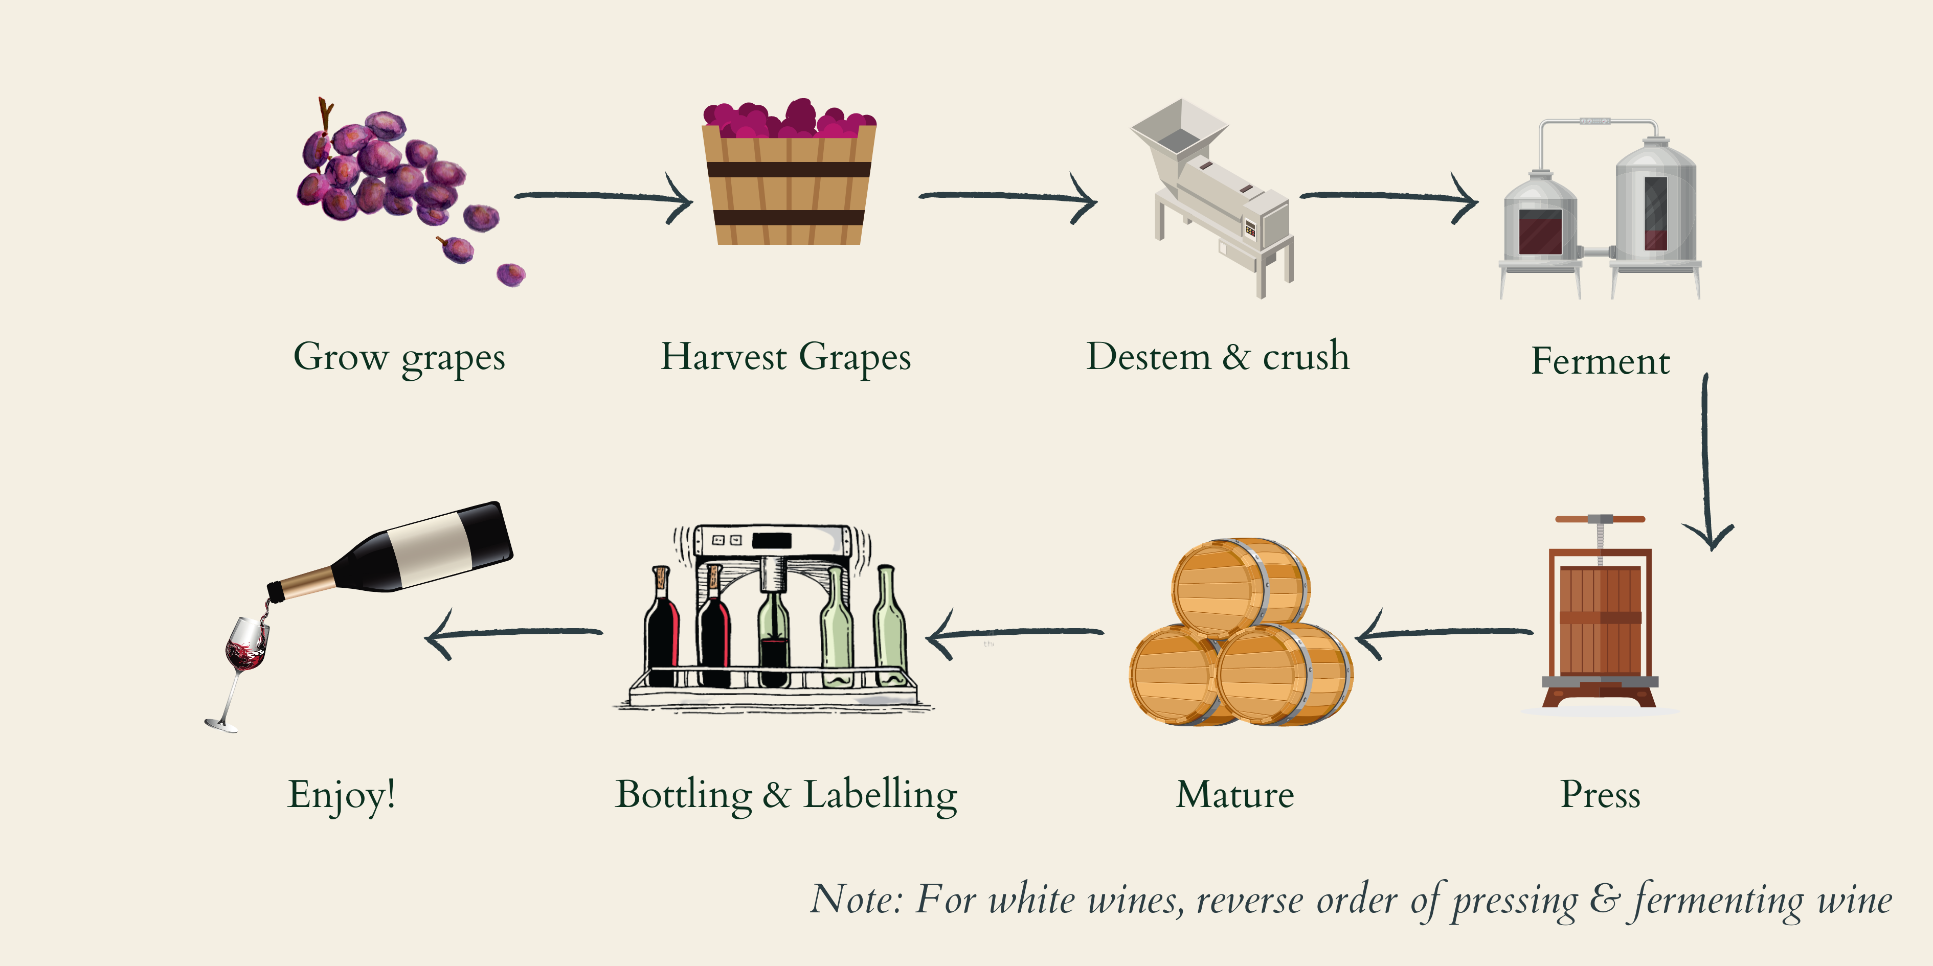
Winemaking
Kratošija grapes, harvest at 260 °Brix
Kratošija 1 with yeast: ZymafloreTM Xpure (Laffort, Bordeaux, France)
Added:
Potassium metabisulfite, K₂S₂O₅
Enzyme Lafaze HE GRAND CRU
Yeast recommended for wines with high aromatic purity, freshness, expression of black fruit notes and great smoothness on mouthfeel.
I
Kratošija 2 with yeast: Lalvin ICV D80 (Lallemand, Blagnac, France)
Yeast brings high foremouth volume, big mid-palate mouthfeel and intense fine grain tannin to reds. It is one of the best strains for contributing big tannin volume and is characterized by ripe fruit, smoke and a licorice finish.
II
21 day alcoholic fermentation (18-20 °C)
Punching down:
Two times a day - 14 days
Once a day – 7 days
12

Slide 13
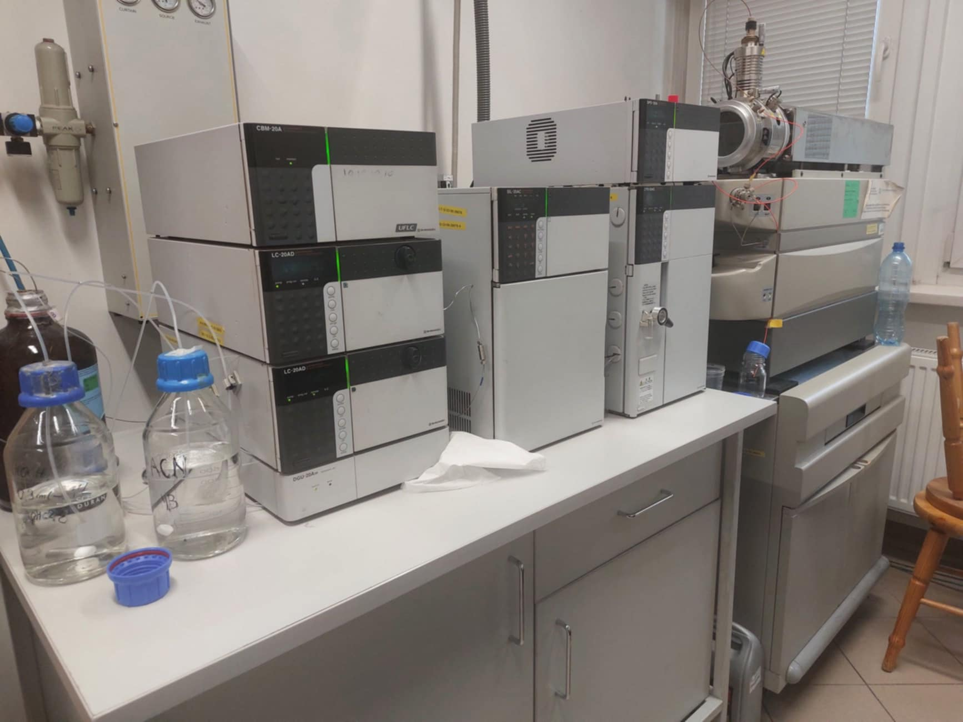
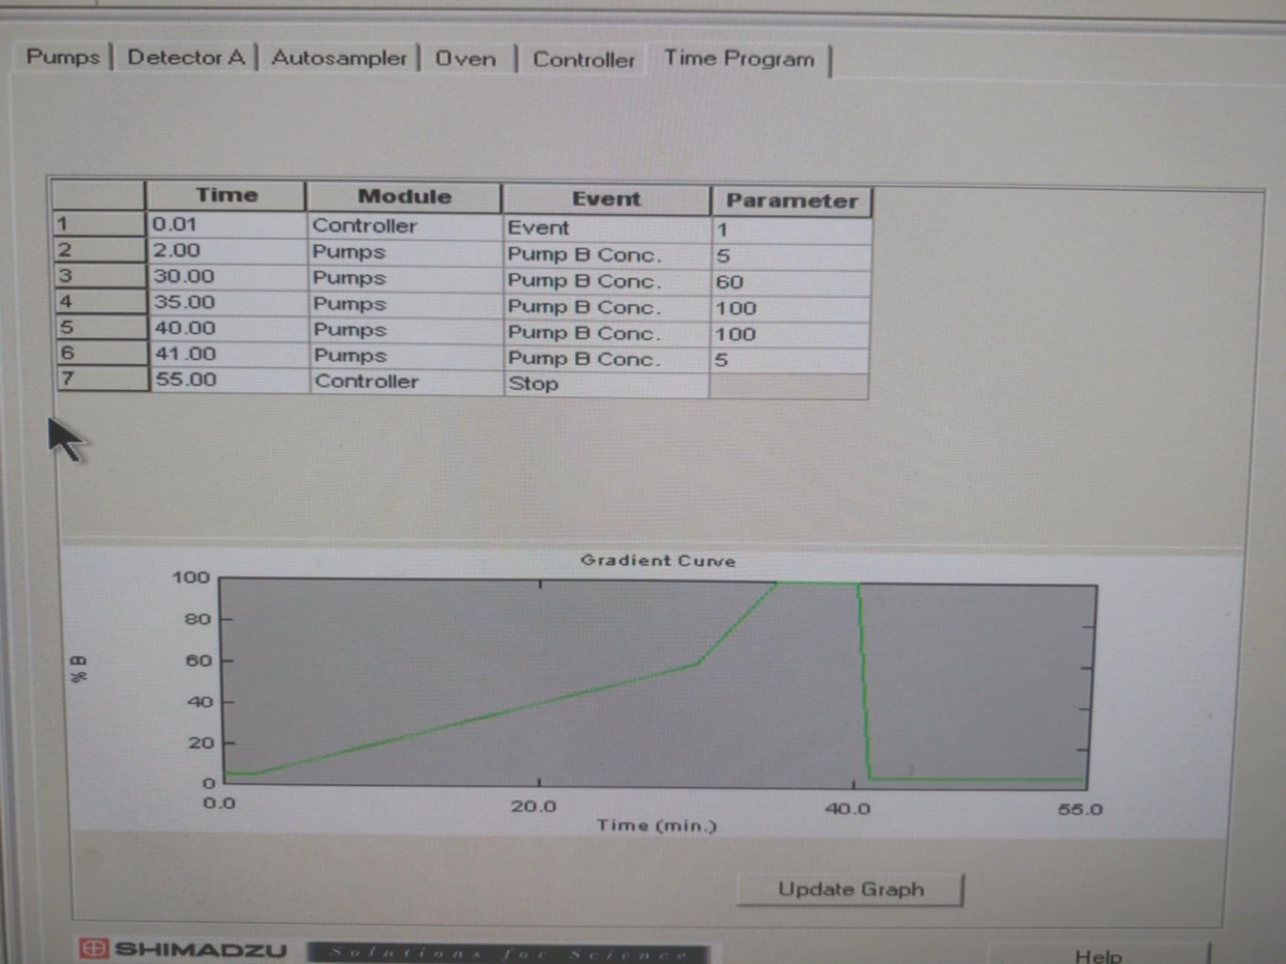
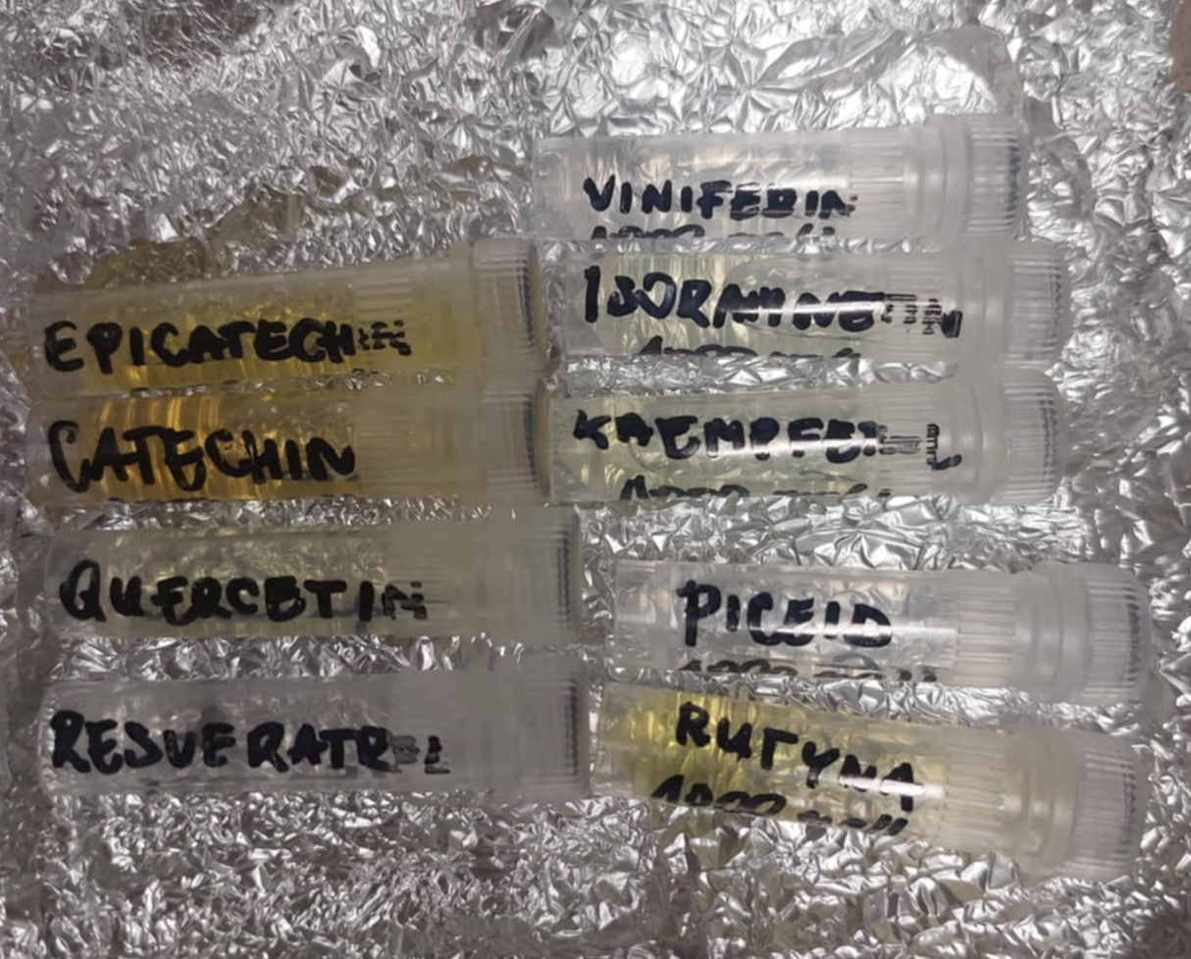
HPLC-ESI-MS/MS analysis of flavonoids and
non-flavonoids
LC 20 Shimadzu, ESI-MS 3200
Negative/positive mode, ESI
Sample volume: 10 mL injection
Column: Luna, 3 µm C18 (100x2mm) (Phenomenex)
Eluent A: HCOOH pH 2.8, eluent B: ACN
Time program for gradient elution:
0-2 min 5% ACN
30min 60 % ACN
35 min 100% ACN
40 min 100% ACN
41 min 5% ACN
55 stop
Standards
Biesaga M, Pyrzynska K (2009) J Chromatogr A 1216(38): 6620-6626

Slide 14
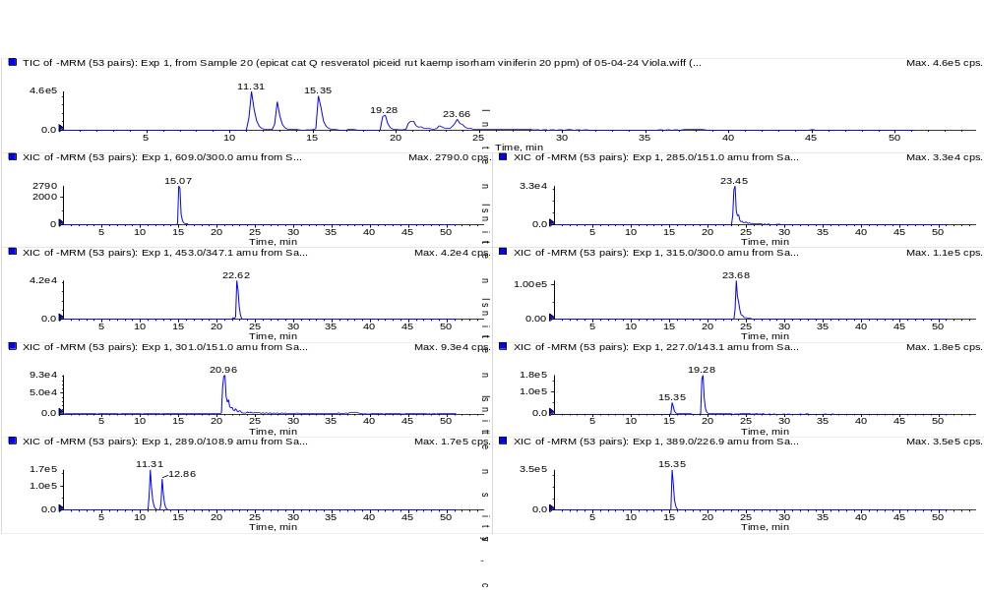
Characterization of standards
Standards (20 ppm)
Resveratrol
Piceid
Catechin
Epicatechin
Quercetin
Viniferin
Isoramnetin
Kaempferol
Rutin
All standards were analyzed separately in full scan in positive [M+H]⁺ and negative [M-H]⁻ ionization modes to detect the precursor ions characteristic of each compound, observing maximum sensitivity in the negative ion mode.

Slide 15
Total ion chromatogram (TIC) in SRM mode of two wine samples
SRM (single reaction monitoring mode) is a mode of tandem mass spectrometry used to detect and quantify specific compounds with high sensitivity.
Involves selecting a specific precursor ion (Q1), fragmenting it, and monitoring one specific product ion (Q3).
This Q1/Q3 par is called transition, and it is characteristic from the analyte.
Even some flavonoids have same fragmentation ions, there is no problem in differentiating between them since they have characteristic SRM pair.

Slide 16
Extracted ion chromatogram (EIC) of phenolic acids in Kratošija wines in SRM mode
 | Phenolic acids | Q1 | Q3 | t_{R}/min
1 | Gallic acid | 169 | 125 | 4.28
2 | 3,4 DHBA | 153 | 109 | 8.02
3 | Chlorogenic acid | 353 | 191 | 9.48
4 | Dihydroferulic acid | 195 | 136 | 11.27
5 | Vanillic | 167 | 152 | 12.15
6 | Caffeic | 179 | 135 | 12.41
7 | Syringic | 197 | 182 | 12.54
8 | p-Coumaric | 163 | 119 | 14.86
9 | Ferulic | 193 | 134 | 15.66
10 | p-HBA | 137 | 93 | 18.4
EIC of phenolic acids
Ivanova-Petropulos et al. (2025) Food Analytical Methods, 18, 2882-2892

Slide 17
Extracted ion chromatogram (EIC) of stilbenes and flavan-3-ols in Kratosija wines in SRM mode
EIC of stilbenes
EIC of flavan-3-ols

Slide 18
Extracted ion chromatogram (EIC) of flavonols, flavones, flavanone, and flavanonol
 | Flavonols | Q1 | Q3 | t_{R}/min
1 | Quercetin | 447 | 301 | 16.85
2 | Myricetin | 317 | 151 | 18.48
3 | Syringetin | 345 | 315 | 23.22
 | Flavones | Q1 | Q3 | t_{R}/min
1 | Chrysin | 255 | 153 | ?
2 | Luteolin | 285 | 133 | 20.82
 | Flavanones | Q1 | Q3 | tR/min
1 | Naringenin | 271 | 151 | 22.75
 | Flavanonols | Q1 | Q3 | tR/min
1 | Taxifolin | 303 | 125 | 16.06
Ivanova-Petropulos et al. (2025) Food Analytical Methods, 18, 2882-2892

Slide 19
Quantification of non-flavonoids
Kratošija 1 with yeast: ZymafloreTM Xpure (Laffort, Bordeaux, France)
Kratošija 2 with yeast: Lalvin ICV D80 (Lallemand, Blagnac, France)
Higher content of nonflavnoids (phenolic acids and stilbenes) in Kratošija 1 (wine fermented with ZymafloreTM XPure yeast) can be attributed to a higher extraction of these compounds during the alcoholic fermentation
Interaction with the yeast cell walls during the fermentation, followed by adsorption of nonflavonoids, which decreased their amount in Kratošija 2 (wine fermented with Lalvin ICV DB80 yeast).

Slide 20
Quantification of flavonoids
Crysinm, luteolin, taxifolin and naringenin
- detected for the first time in Macedonian red wines.
- possess anti-oxidant, anti-inflammatory and anti-cancer properties.
Taxifolin is effective for cardiovascular and cancer diseases, inflammation, Alzheimer, diabetes, allergic reaction.

Slide 21
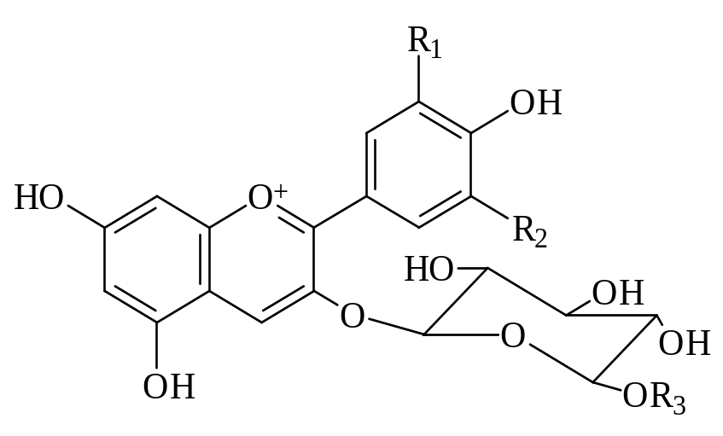
HPLC-ESI-TQMS analysis of anthocyanins and pyranoanthocyanins
LC 20 Shimadzu, ESI-TQMS 8030
Negative/positive mode, ESI-TQMS
Sample volume: 5 mL injection
Column: Kinetex C18 column
(100 x 2.1 mm, 2.6 µm)
Eluent A: HCOOH pH 2.8, eluent B: ACN
Time program for gradient elution:
0-3 min 10% ACN
4-10 min 20 % ACN
10-15 min 25% ACN
15-31 min 90% ACN
32-50 min10% ACN
Anthocyanins | R₁ | R₂
Dp-3-glc | OH | OH
Cy-3-glc | OH | H
Pt-3-glc | OCH₃ | OH
Pn-3-glc | OCH₃ | H
My-3-glc | OCH₃ | OCH₃

Slide 22
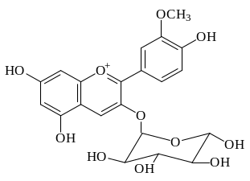
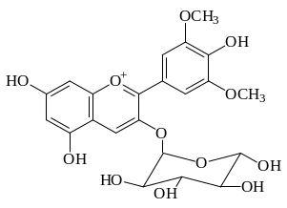
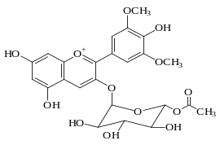
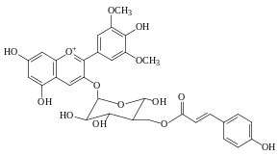
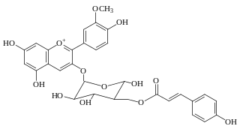
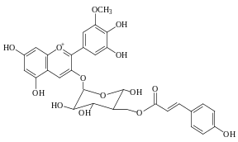
MS identification of anthocyanins
6
x10
301
7
331
M ⁺ = 463
Peonidin-3-glucoside
x10
M ⁺ = 493
Malvidin-3-glucoside
8
3
Anthocyanins | t_{r} (min) | MS (m/z) M⁺ | MS/MS (m/z)
Monoglucosides
Dp-3-glc | 5.1 | 465 | 303
Cy-3-glc | 6.0 | 449 | 287
Pt-3-glc | 6.9 | 479 | 317
Pn-3-glc | 7.4 | 463 | 301
My-3-glc | 8.3 | 493 | 331
Acetylglucosides
Dp-3-acetylglc | 11.4 | 507 | 303
Pt-3-acetylglc | 13.6 | 521 | 317
Pn-3-acetylglc | 16.2 | 505 | 301
Mv-3-acetylglc | 18.1 | 535 | 331
p-Coumaroylglucosides
Dp-3-p-coumglc | 13.6 | 611 | 303
Cy-3-p-coumglc | 17.3 | 595 | 287
Pt-3- p-coumglc | 20.3 | 625 | 317
6
Intensity
Intensity
2
4
2
1
0
100
200
300
400
500
600
700
m/z
0
100
200
300
400
500
600
700
m/z
7
7
x10
331
x10
331
M ⁺ = 535
Malvidin-3-acetylglucoside
1.25
M ⁺ = 639
Malvidin-3-coumaroylglucoside
1.5
1.00
1.0
0.75
Intensity
Intensity
0.50
0.5
0.25
0.0
100
200
300
400
500
600
700
m/z
0.00
100
200
300
400
500
600
700
m/z
6
6
M ⁺ = 625
Petunidin-3-p-coumaroylglucoside
x10
287
x10
317
1.5
M ⁺ = 595
Cyanidin-3-p-coumaroylglucoside
2.5
Intensity
Intensity
1.0
2.0
1.5
0.5
1.0
0.5
0.0
100
200
300
400
500
600
700
m/z
0.0
100
200
300
400
500
600
700
m/z

Slide 23
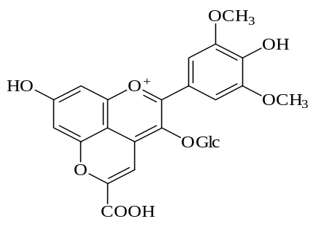
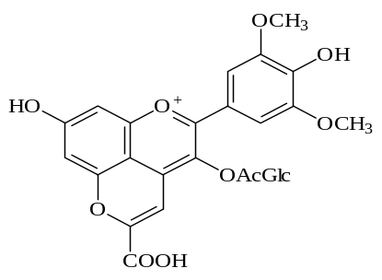
MS identification of pyranoanthocyanins
399
Pyranoanthocyanins | t_{r} (min) | MS (m/z) M⁺ | MS/MS (m/z)
Vitisin-A | 15.2 | 561 | 399
Ac-vitisin-A | 17.7 | 603 | 399
p-Cm--vitisin-A | 19.1 | 707 | 399
Vitisin-B | 16.2 | 517 | 355
Ac-vitisin-B | 20.2 | 559 | 355
p-Cm-vitisin-B | 21.7 | 663 | 355
10-carboxy-pyranoPn-3-glc |  | 531 | 369
10-catechin-pyranoMv-3-glc |  | 805 | 643, 491
10-epicatechin-pyranoMv-3-glc |  | 805 | 643,491
10-DHP-pymv-3-glc-(pinotin A) | 28.0 | 625 | 463
10-DHP-pymv-3-acglc | 30.4 | 667 | 463
10-DHP-pymv-3-cmglc | N.D. | N.D. | N.D.
10-MHP-pymv-3-glc | 31.8 | 609 | 447
10-MHP-pymv-3-acglc | 32.4 | 651 | 447
10-MHP-pymv-3-cmglc | 35.2 | 755 | 447
3400000
3200000
M ⁺ = 561
Vitisin A
3000000
2800000
2600000
2400000
2200000
2000000
1800000
Intensity
1600000
1400000
1200000
1000000
800000
600000
400000
200000
561
723
805
0
200
300
400
500
600
700
800
900
1000
1100
399
m/z
500000
M ⁺ = 603
Acetylvitisin A
450000
400000
350000
Intensity
300000
250000
200000
150000
100000
50000
0
200
338
400
557
600
747
800
929
1000
1200
m/z
23
23

Slide 24
Semi-quantification of anthocyanins

Slide 25
Semi-quantification of pyranoanthocyanins
25

Slide 26
CONCLUSION
HPLC coupled to tandem mass spectroscopy (MS/MS) operated in electrospray ionization (ESI) and quadrupole linear ion trap (Q TRAP) negative/positive mode is sensitive technique for determination of non-flavonoids and flavonoids, as well as small amounts of compounds.
1.
Complex polyphenolic profile of Kratošija wine
Gallic acid was the dominant phenolic acid, followed by caffeic acid.
Flavan-3-ols procyanidins B1 and B3 dominated in wines.
Anthocyanins monoglucosedes dominated in wine.
2.
Flavones chrysin and luteolin, flavanone naringenin, flavanonol taxifolin and stilbenoid viniferin were reported for the first time in Macedonian red wine.
Influence of yeast was noticed. Wine fermented with Xpure yeast (Kratošija 1) presented higher content of almost all groups of compounds, except for flavan-ols which were higher in wine fermented with D80 yeast (Kratošija 2).
3.

Slide 27
ACKNOWLEDGEMENT
CEEPUS Network
TEACHING AND LEARNING BIOANALYSIS

Slide 28
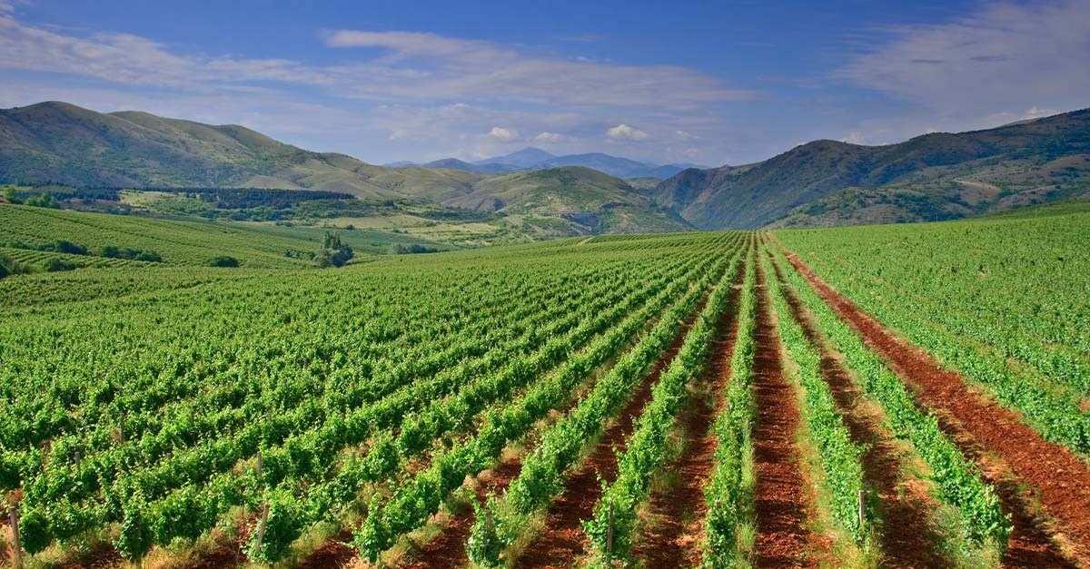
Thank you for your kind attention

