Slide 1

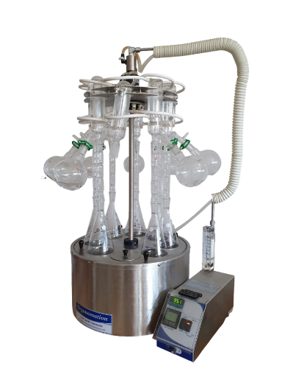
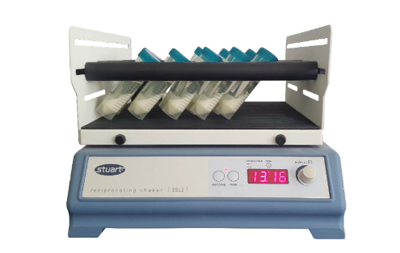
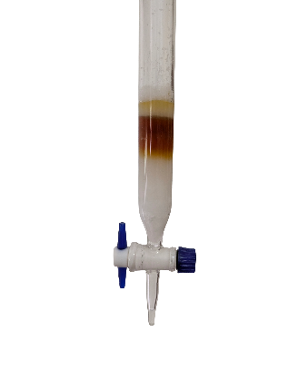
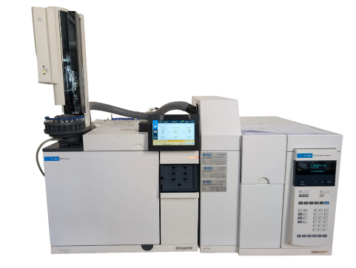
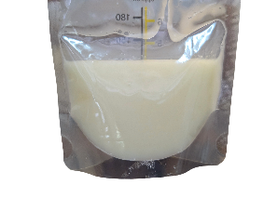
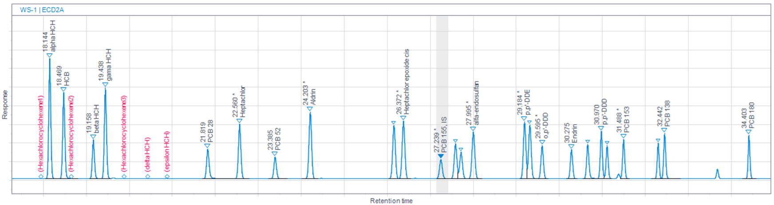
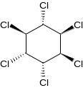
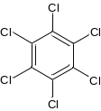
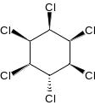
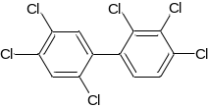
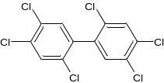
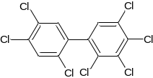
28th Congress of SCTM, 23-26 September, Ohrid, Macedonia
000
HUMAN BIOMONITORING OF ORGANOCHLORINE PESTICIDES AND POLYCHLORINATED BIPHENYLS IN BREAST MILK: OPTIMIZATION OF ANALYTICAL PROCEDURES AND TRACE-LEVEL DETERMINATION
Stefan Kirovski, Marina Stefova, Jasmina Petreska Stanoeva
Institute of Chemistry, Faculty of Natural Sciences and Mathematics, Ss. Cyril & Methodius University in Skopje, Skopje, Macedonia
Introduction & Aim
Human biomonitoring provides an important tool for evaluating internal exposure to persistent organic pollutants (POPs). Organochlorine pesticides (OCPs) and polychlorinated biphenyls (PCBs) are persistent, bioaccumulative contaminants that may be transferred through breastfeeding. This study focused on the optimization of an analytical procedure for their determination in breast milk and its application to samples from breastfeeding mothers in North Macedonia.
Experimental
Results and discussion
Accuracy
Recovery/% = 54.9 -121.0
for most of the analytes
Instrumental precision
RSD/% = 0.39 – 9.51
for most of the analytes
Milk sample
Extraction
Destructive clean-up
Concentration
Analysis
Fig. 1 Chromatogram of the working standard solution (WS), showing the order and retention times (t_{R}) of the peaks of the different analytes and the internal standard (IS PCB-155).
Linearity in matrix
R² = 0.9960 – 0.9977
Тhe determination of OCPs and PCBs was performed using gas chromatography coupled with an electron capture detector (GC–ECD).
For chromatographic separation - HP-5 column (30 m × 0.25 mm × 0.25 μm)
Mobile phase - Nitrogen (N₂), with a gas flow rate of 0.5 mL/min.
Injection volume - 2 μL with a splitless, pulsed injection mode (injector temperature - 210 °C).
Temperature - programmed
Detector temperature - 350 °C
α-HCH
HCB
γ-HCH
PCB 138
PCB 153
PCB 180
Conclusions
The concentrations of OCPs and PCBs were determined in 30 human milk samples. The preliminary results indicated considerable variation in the occurrence and concentrations of individual POPs among the analyzed samples. Several compounds, including α-HCH, HCB and γ-HCH, were detected in all analyzed samples, while PCB 138, PCB 153 and PCB 180 were also detected in a high proportion of samples. Other target compounds were detected less frequently or were not detected in the analyzed samples.
The preliminary findings demonstrate the presence of multiple OCPs and PCBs in breast milk samples from North Macedonia. The results will be quantitatively evaluated, and further statistical analysis will assess correlation between POPs concentrations and demographic, dietary, lifestyle, and potential exposure-related factors.

