Slide 1


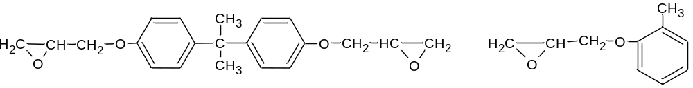
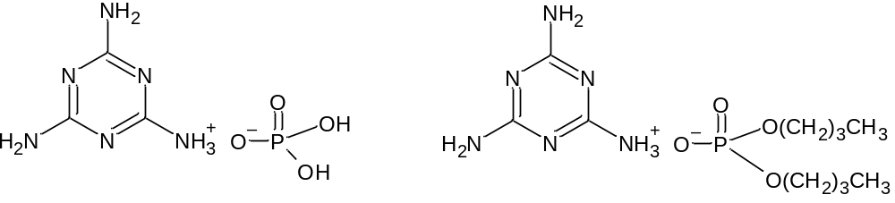
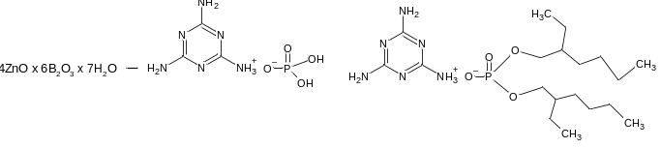
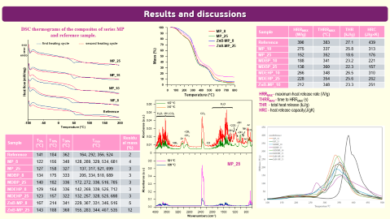


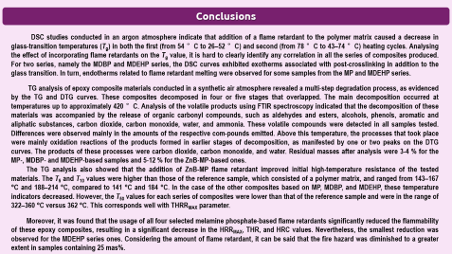
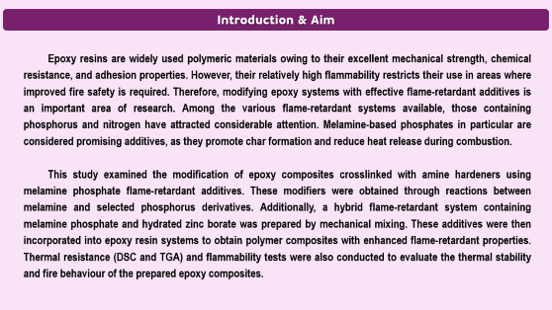
28th Congress of SCTM, 23-26 September, Ohrid, Macedonia
000
Thermal and Fire Properties of Epoxy Composites
with Melamine-Based Flame Retardants
Beata Podkościelna, Magdalena Rogulska, Bogdan Tarasiuk
Department of Polymer Chemistry, Institute of Chemical Sciences, Maria Curie-Skłodowska University in Lublin, Poland beata.podkoscielna@mail.umcs.pl
16 systems of composites were obtained, differing in type (MP, MDBP, MDEHP, and ZnB-MP) and content (8, 10, 15, and 25 mas%) of flame retardant. A sample without an added flame retardant was also prepared and used as a reference sample.
Epidian® 601 (Epx601) epoxy resin
MP MDBP
ZnB-MP MDEHP

Slide 2
Introduction & Aim
Epoxy resins are widely used polymeric materials owing to their excellent mechanical strength, chemical resistance, and adhesion properties. However, their relatively high flammability restricts their use in areas where improved fire safety is required. Therefore, modifying epoxy systems with effective flame-retardant additives is an important area of research. Among the various flame-retardant systems available, those containing phosphorus and nitrogen have attracted considerable attention. Melamine-based phosphates in particular are considered promising additives, as they promote char formation and reduce heat release during combustion.
This study examined the modification of epoxy composites crosslinked with amine hardeners using melamine phosphate flame-retardant additives. These modifiers were obtained through reactions between melamine and selected phosphorus derivatives. Additionally, a hybrid flame-retardant system containing melamine phosphate and hydrated zinc borate was prepared by mechanical mixing. These additives were then incorporated into epoxy resin systems to obtain polymer composites with enhanced flame-retardant properties. Thermal resistance (DSC and TGA) and flammability tests were also conducted to evaluate the thermal stability and fire behaviour of the prepared epoxy composites.

Slide 3
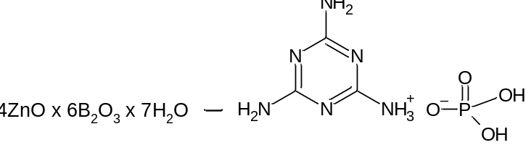
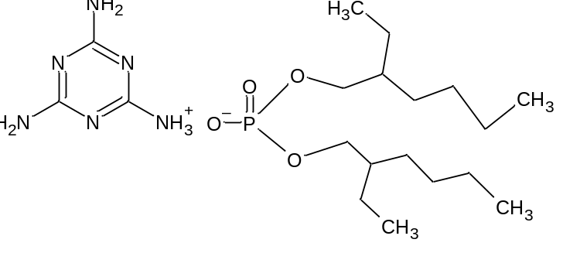
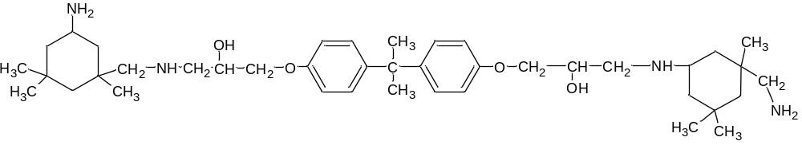
Experimental
Chemical structures of the used epoxy resin, flame retardants and hardener
Composite preparation
16 systems of composites were obtained, differing in type (MP, MDBP, MDEHP, and ZnB-MP) and content (8, 10, 15, and 25 mas%) of flame retardant. A sample without an added flame retardant was also prepared and used as a reference sample.
Epoxy resin (12 g), plasticizer (tris(1-chloropropan-2-yl) phosphate) (1 g), and flame retardant (from ~1.65 g to 6.33 g) were added to a glass vessel and mixed. After mixing to ensure proper homogenization, the vessel was transferred to a heating chamber (50°C), and IDA hardener (6 g) was added. The vessel contents were then gently stirred and returned to the heating chamber (50°C) for 10 minutes. The prepared composition was then poured onto 100x80 mm glass plates with Teflon spacers and allowed to cure at 25°C for 24 h, followed by 4 h at 80 °C in a heating chamber.
Epidian® 601 (Epx601) epoxy resin
melamine phosphate (MP) melamine dibutyl phosphate (MDBP)
a mixture of hydrated zinc borate – melamine phosphate with a 1:1 mass ratio (ZnB-MP)
melamine di(2-ethylhexyl)phosphate (MDEHP)
IDA

Slide 4
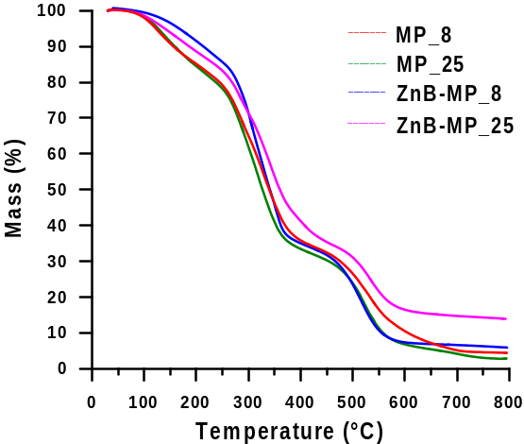
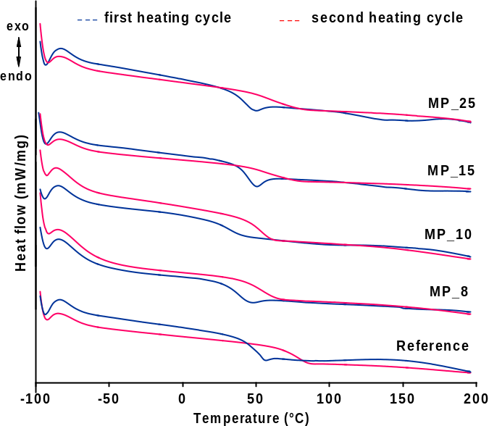
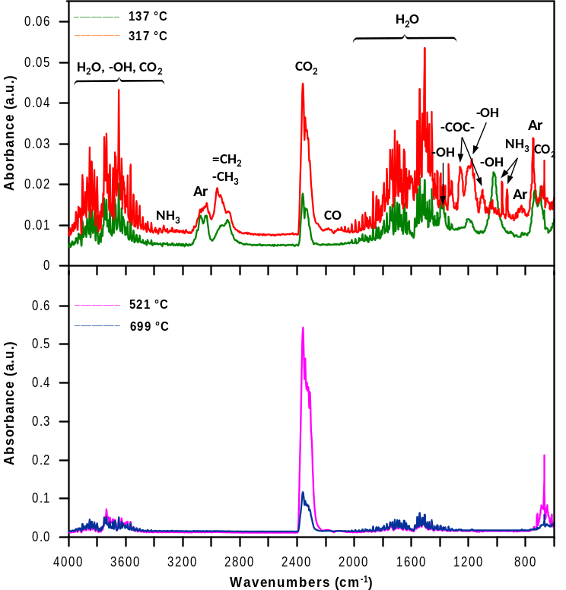
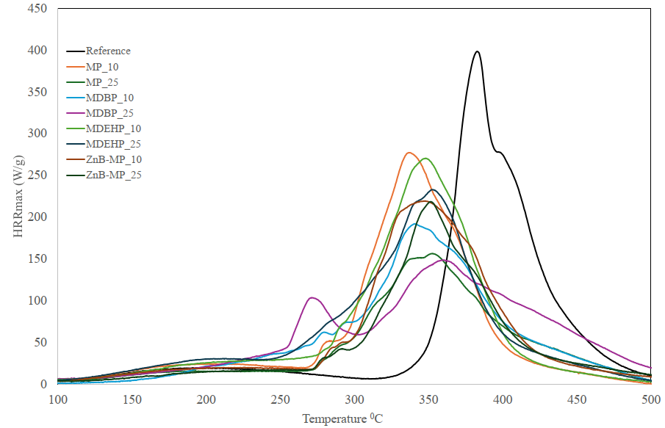
Results and discussions
DSC thermograms of the composites of series MP
and reference sample.
Sample | HRR_{MAX} (W/g) | THRR_{MAX} (°C) | THR (kJ/g) | HRC (J/g×K)
Reference | 390 | 383 | 27.1 | 439
MP_10 | 275 | 337 | 25.8 | 313
MP_25 | 152 | 352 | 18.6 | 176
MDBP_10 | 188 | 341 | 23.2 | 221
MDBP_25 | 138 | 360 | 22.3 | 157
MDEHP_10 | 266 | 348 | 26.5 | 310
MDEHP_25 | 228 | 354 | 25.6 | 262
ZnB-MP_10 | 212 | 348 | 23.3 | 251
HRR_{MAX} - maximum heat release rate (W/g)
THRR_{MAX} - time to HRR_{MAX} (s)
THR - total heat release (kJ/g)
HRC - heat release capacity(J/gK)
Sample | T_{5%} (°C) | T_{10%} (°C) | T_{50%} (°C) | T_{max} (°C) | Residual mass (%)
Reference | 141 | 184 | 362 | 164, 292, 356, 524 | 2
MP_8 | 122 | 156 | 340 | 128, 289, 329, 534, 681 | 4
MP_25 | 127 | 158 | 327 | 137, 317, 521, 699 | 3
MDBP_8 | 134 | 175 | 333 | 205, 334, 518, 689 | 3
MDBP_25 | 140 | 182 | 336 | 172, 272, 336, 516, 705 | 3
MDEHP_8 | 129 | 164 | 336 | 142, 269, 339, 526, 712 | 3
MDEHP_25 | 123 | 157 | 322 | 132, 257, 328, 525, 698 | 3
ZnB-MP_8 | 167 | 214 | 341 | 229, 307, 331, 346, 516 | 5
ZnB-MP_25 | 143 | 188 | 360 | 155, 283, 344, 407, 535 | 12
MP_25

Slide 5
Conclusions
DSC studies conducted in an argon atmosphere indicate that addition of a flame retardant to the polymer matrix caused a decrease in glass-transition temperatures (T_{g}) in both the first (from 54 °C to 26–52 °C) and second (from 78 °C to 43–74 °C) heating cycles. Analysing the effect of incorporating flame retardants on the T_{g} value, it is hard to clearly identify any correlation in all the series of composites produced. For two series, namely the MDBP and MDEHP series, the DSC curves exhibited exotherms associated with post-crosslinking in addition to the glass transition. In turn, endotherms related to flame retardant melting were observed for some samples from the MP and MDEHP series.
TG analysis of epoxy composite materials conducted in a synthetic air atmosphere revealed a multi-step degradation process, as evidenced by the TG and DTG curves. These composites decomposed in four or five stages that overlapped. The main decomposition occurred at temperatures up to approximately 420 °C. Analysis of the volatile products using FTIR spectroscopy indicated that the decomposition of these materials was accompanied by the release of organic carbonyl compounds, such as aldehydes and esters, alcohols, phenols, aromatic and aliphatic substances, carbon dioxide, carbon monoxide, water, and ammonia. These volatile compounds were detected in all samples tested. Differences were observed mainly in the amounts of the respective com-pounds emitted. Above this temperature, the processes that took place were mainly oxidation reactions of the products formed in earlier stages of decomposition, as manifested by one or two peaks on the DTG curves. The products of these processes were carbon dioxide, carbon monoxide, and water. Residual masses after analysis were 3-4 % for the MP-, MDBP- and MDEHP-based samples and 5-12 % for the ZnB-MP-based ones.
The TG analysis also showed that the addition of ZnB-MP flame retardant improved initial high-temperature resistance of the tested materials. The T₅ and T₁₀ values were higher than those of the reference sample, which consisted of a polymer matrix, and ranged from 143–167 °C and 188–214 °C, compared to 141 °C and 184 °C. In the case of the other composites based on MP, MDBP, and MDEHP, these temperature indicators decreased. However, the T₅₀ values for each series of composites were lower than that of the reference sample and were in the range of 322–360 °C versus 362 °C. This corresponds well with THRR_{MAX} parameter.
Moreover, it was found that the usage of all four selected melamine phosphate-based flame retardants significantly reduced the flammability of these epoxy composites, resulting in a significant decrease in the HRR_{MAX}, THR, and HRC values. Nevertheless, the smallest reduction was observed for the MDEHP series ones. Considering the amount of flame retardant, it can be said that the fire hazard was diminished to a greater extent in samples containing 25 mas%.

