Slide 1

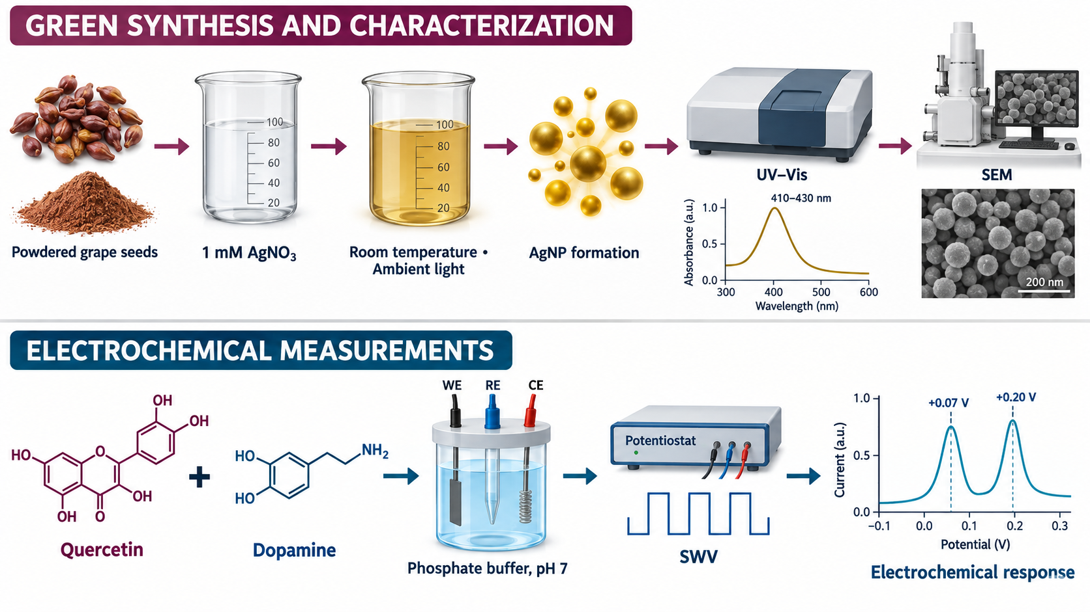
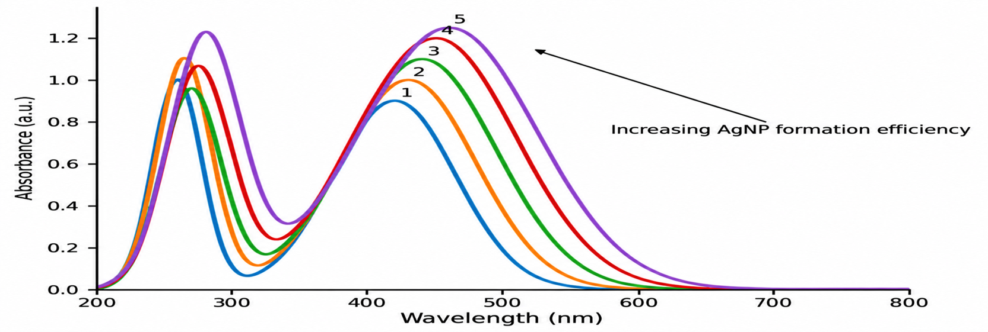
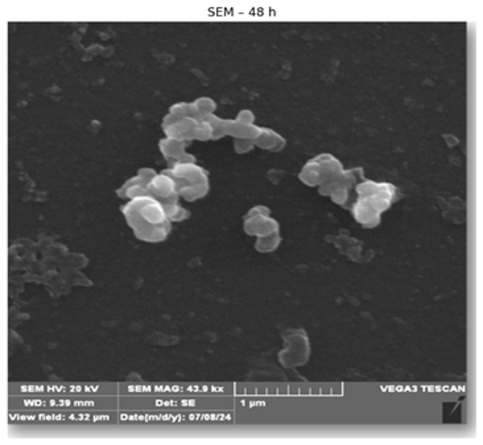
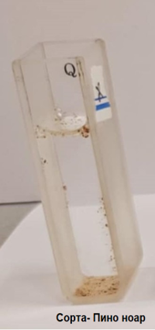
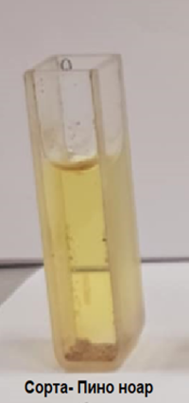
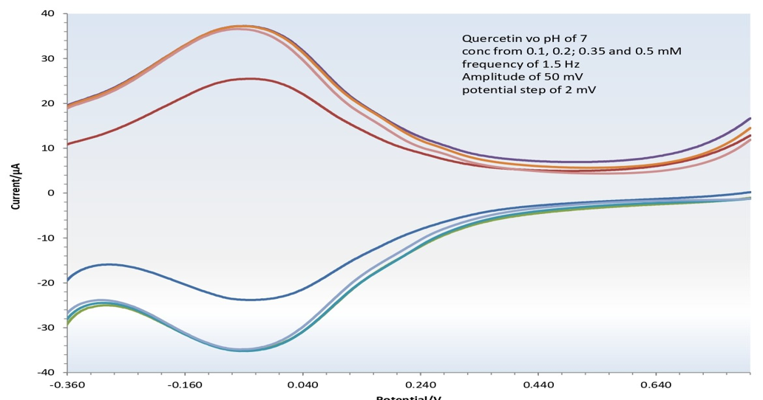
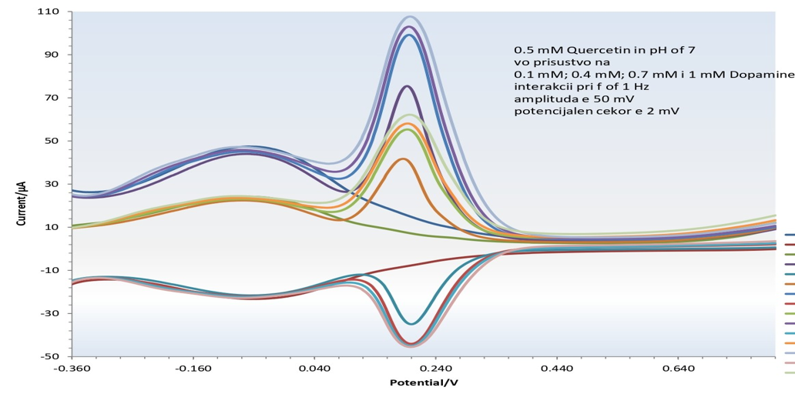








Redox Chemistry of Polyphenols- Green Synthesis of Silver Nanoparticles and Electrochemical Interactions of Quercetin with Dopamine
28th Congress of SCTM, 23-26 September, Ohrid, Macedonia
P19
Sanja Lazarova¹, Viktorija Cackova¹, Pavlinka Kokoskarova¹, Milkica Janeva¹
¹Faculty of Medical Sciences, Goce Delcev University, Stip, North Macedonia
Polyphenols are natural redox-active compounds capable of reducing metal ions and interacting with biologically relevant electroactive molecules.
This study investigates grape-seed polyphenols as reducing and stabilizing agents in the green synthesis of silver nanoparticles, as well as the electrochemical behavior of quercetin and its interactions with dopamine using square-wave voltammetry.
Grape-seed polyphenols enabled the simple and environmentally friendly synthesis of predominantly spherical silver nanoparticles, confirmed by UV–VIS spectroscopy and SEM analysis. Quercetin exhibited a characteristic quasi-reversible redox response and weak interactions with dopamine, while maintaining sufficient peak separation for their individual electrochemical identification.
The appearance of the characteristic LSPR band at 410–430 nm confirmed AgNP formation. SEM analysis revealed predominantly spherical particles with diameters of approximately 20–50 nm
Quercetin exhibited a quasi-reversible redox response at approximately +70 mV, while dopamine showed a distinct signal near +0.20 V. Their signals remained sufficiently separated, although small changes in peak current and shape indicated weak electrochemical interactions
Acknowledgements
The authors gratefully acknowledge Prof. Dr. Rubin Gulaboski for his valuable scientific guidance, expert advice, and continuous support throughout this research

Slide 2
Introduction & Aim

Slide 3
Experimental

Slide 4
Results and discussions

Slide 5
Conclusions

