Slide 1

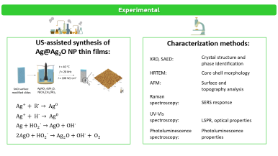
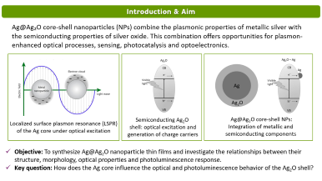
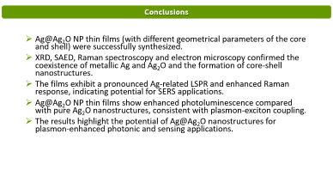
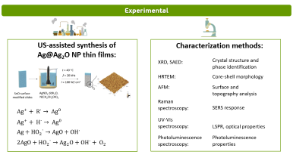
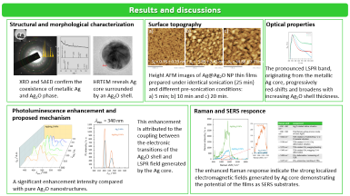
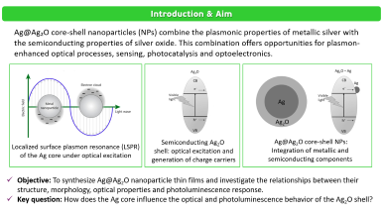
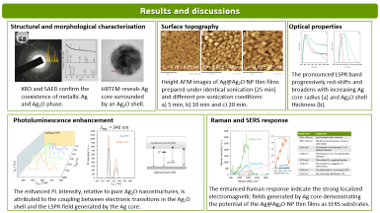
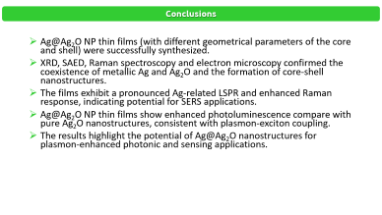
28th Congress of SCTM, 23-26 September, Ohrid, Macedonia
000
STRUCTURE-PROPERTY RELATIONSHIP AND
PLASMON-ENHANCED PHOTOLUMINESCENCE IN
Ag@Ag₂O CORE-SHELL NANOPARTICLE THIN FILMS
Meri Sokolovska¹, Rola Moussa², Ljupcho Pejov¹, Vlado Lazarov², Biljana Pejova¹
¹Institute of Chemistry, Faculty of Natural Sciences and Mathematics,
SS Cyril and Methodius University, Skopje, Macedonia
²School of Physics Engineering and Technology, University of York, York, YO10 5DD, UK

Slide 2
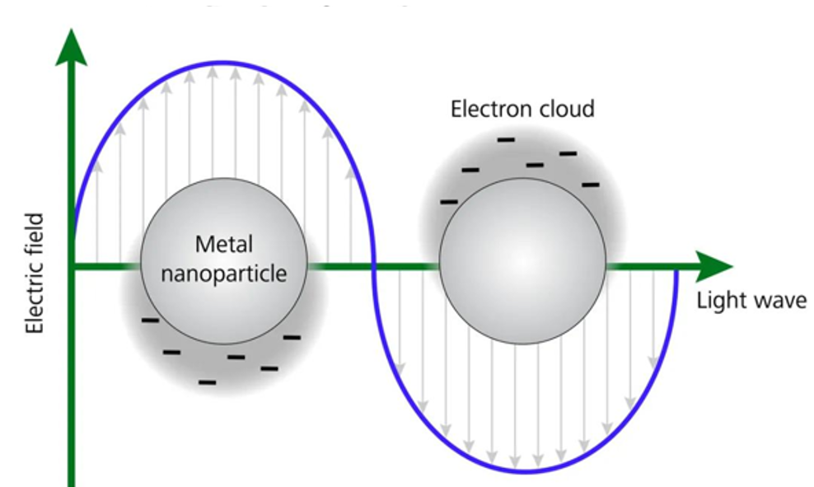
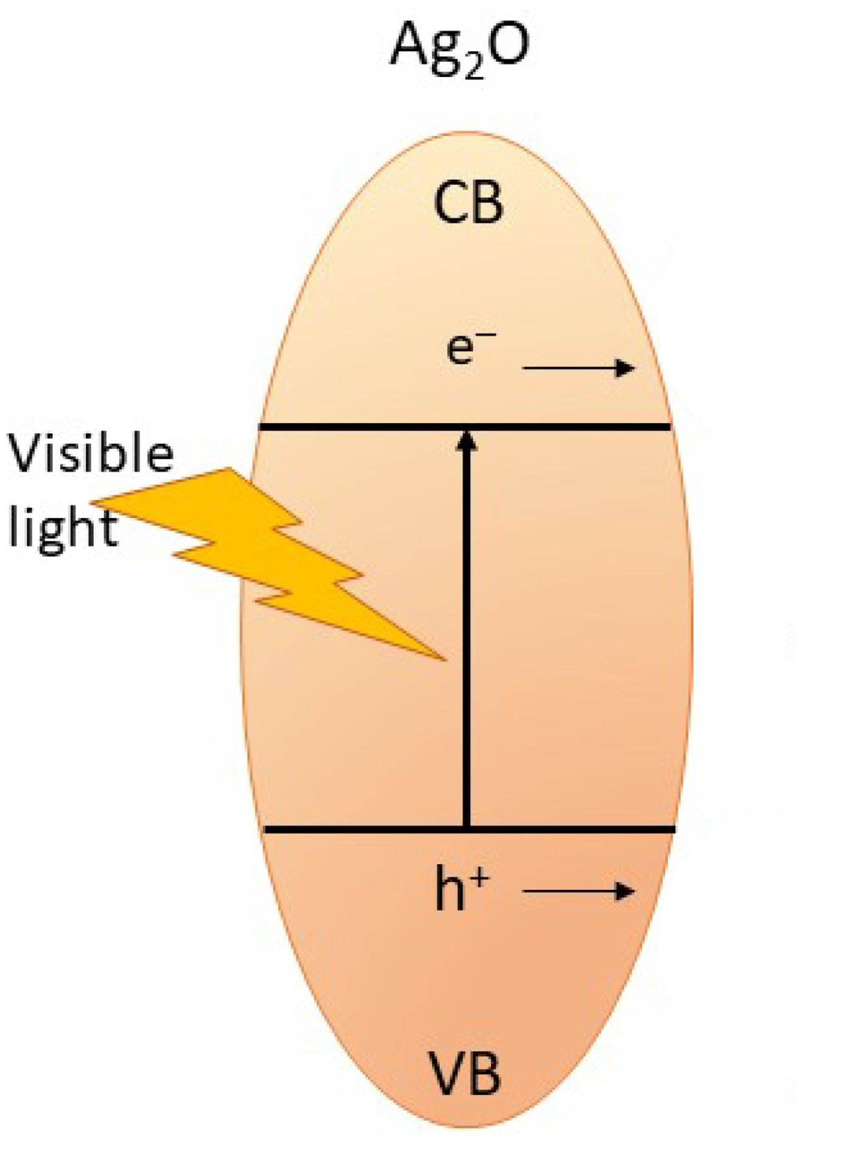
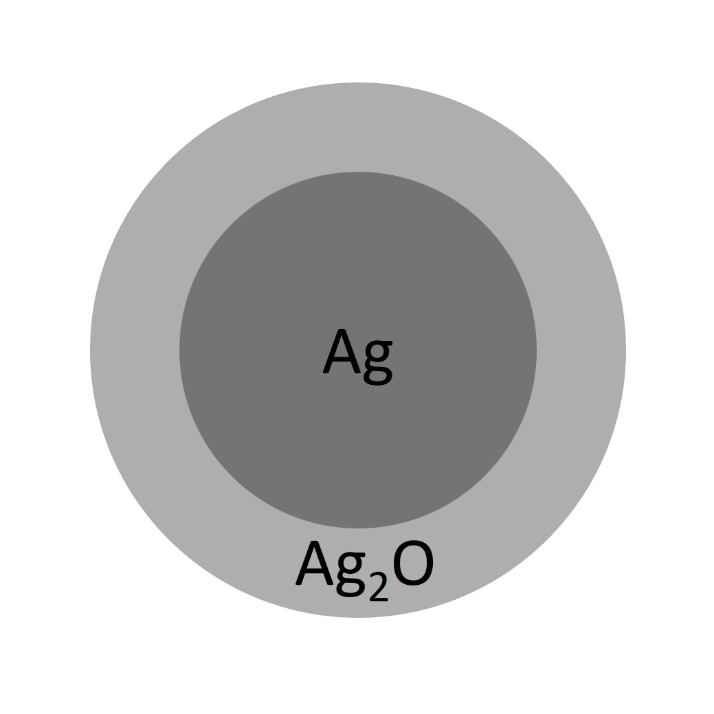
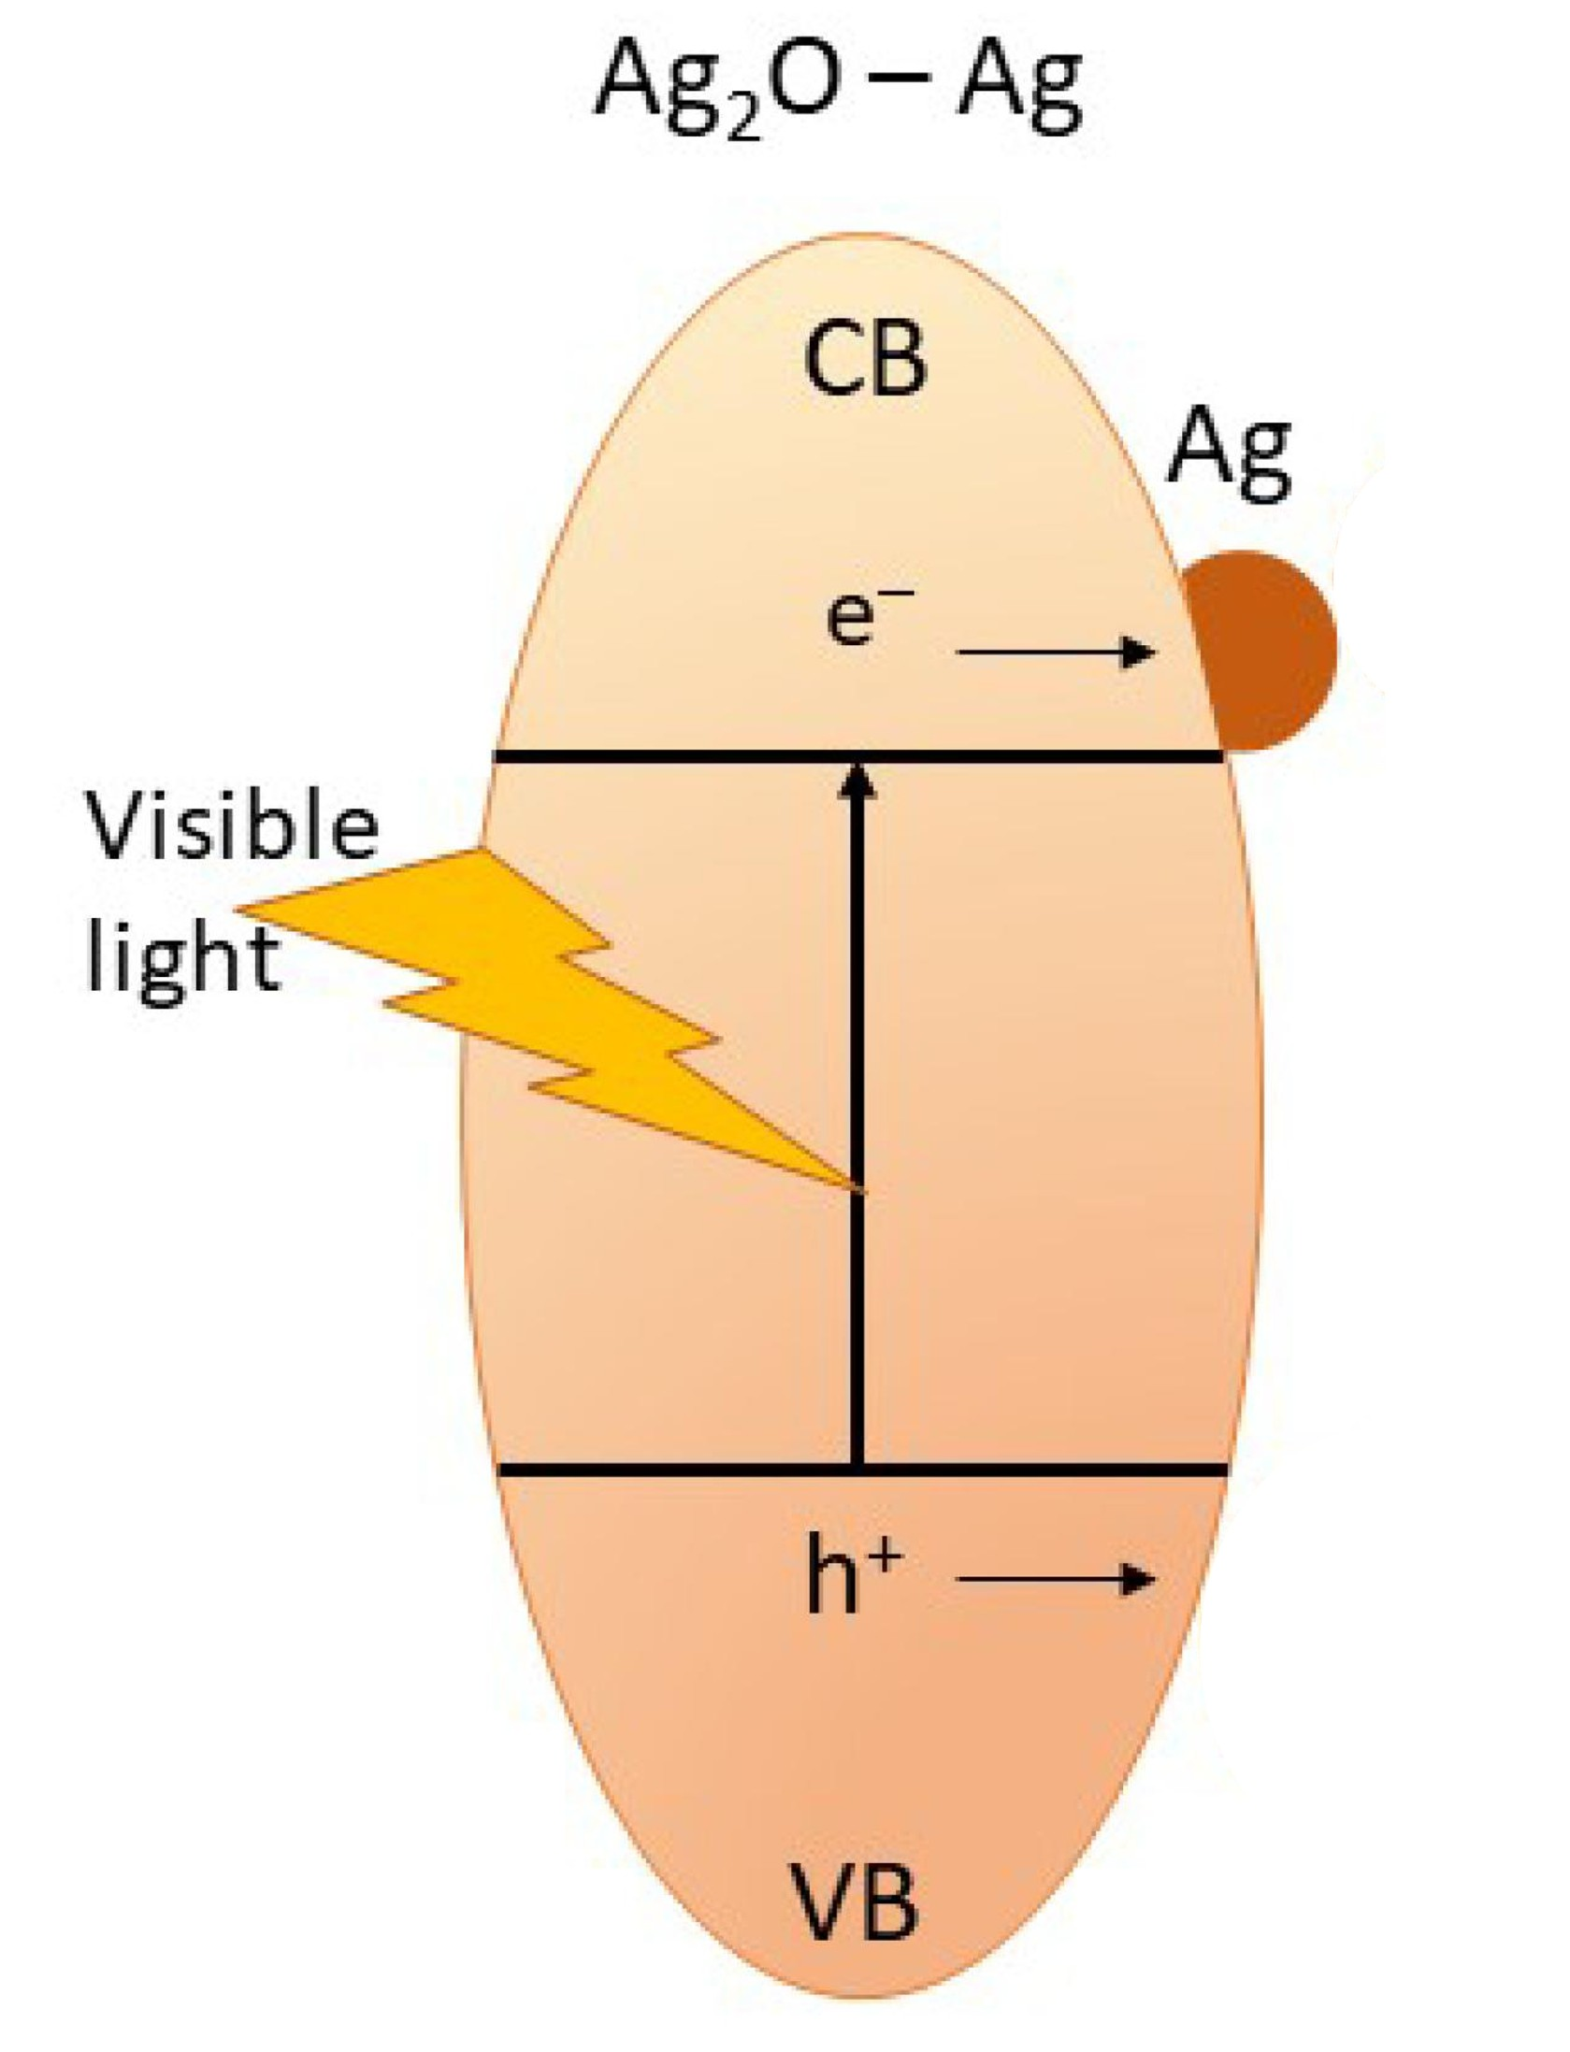
Introduction & Aim
Ag@Ag₂O core-shell nanoparticles (NPs) combine the plasmonic properties of metallic silver with the semiconducting properties of silver oxide. This combination offers opportunities for plasmon-enhanced optical processes, sensing, photocatalysis and optoelectronics.
Semiconducting Ag₂O
shell: optical excitation and
generation of charge carriers
Ag@Ag₂O core-shell NPs:
Integration of metallic and
semiconducting components
Localized surface plasmon resonance (LSPR)
of the Ag core under optical excitation
Objective: To synthesize Ag@Ag₂O nanoparticle thin films and investigate the relationships between their structure, morphology, optical properties and photoluminescence response.
Key question: How does the Ag core influence the optical and photoluminescence behavior of the Ag₂O shell?

Slide 3


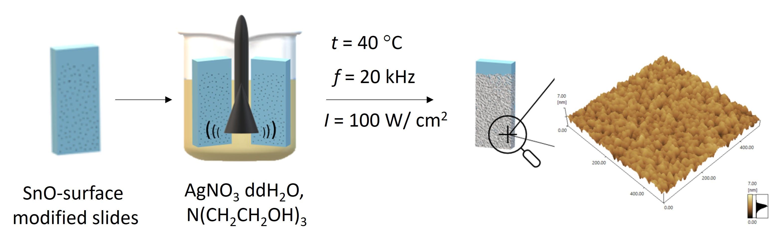



Experimental
US-assisted synthesis of
Ag@Ag₂O NP thin films:
Characterization methods:
XRD, SAED:
Crystal structure and
phase identification
HRTEM:
Core-shell morphology
AFM:
Surface and
topography analysis
Raman
spectroscopy:
SERS response
${Ag}^{+}+ R^{∙}→ {Ag}^{0}$
${Ag}^{+}+ H^{∙}→ {Ag}^{0}$
UV-Vis
spectroscopy:
LSPR, optical properties
$Ag+{HO_{2}}^{∙}→AgO+OH^{∙}$
Photoluminescence
spectroscopy:
Photoluminescence
properties
$2AgO+{HO_{2}}^{∙}→{Ag}_{2}O+OH^{∙}+ O_{2}$

Slide 4
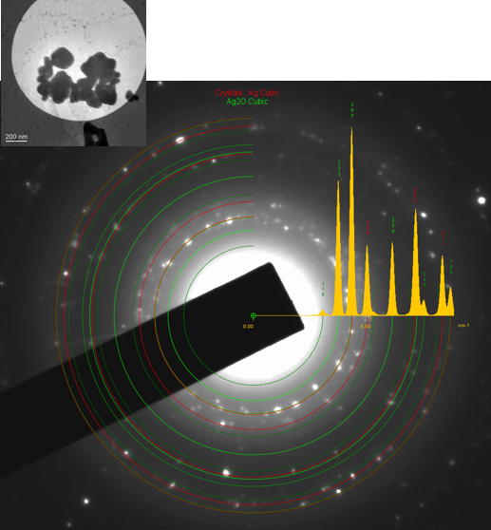
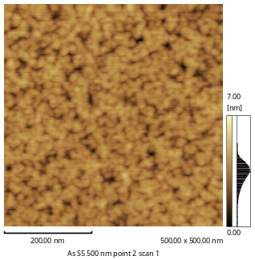
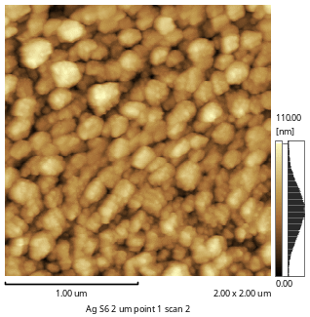
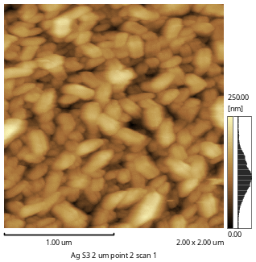
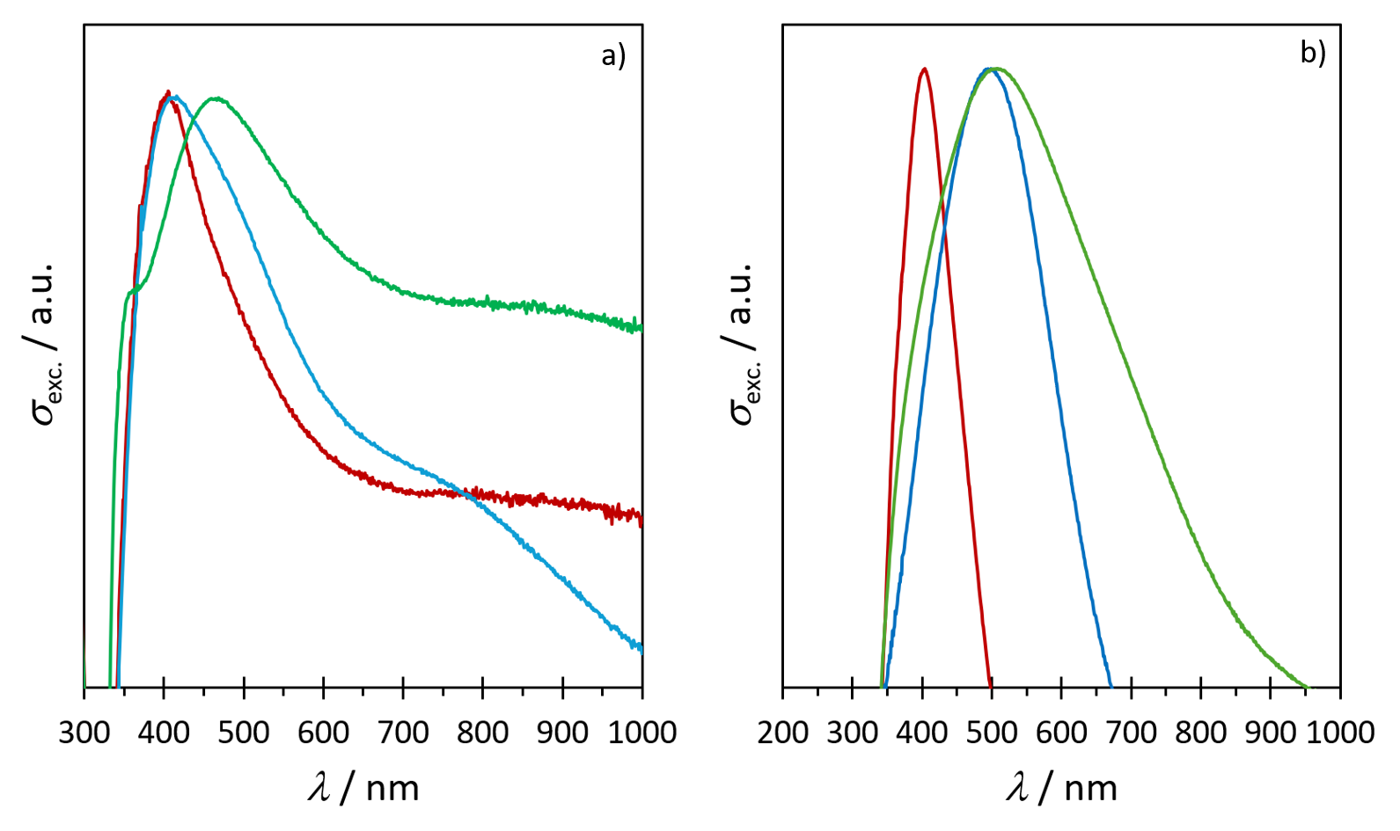
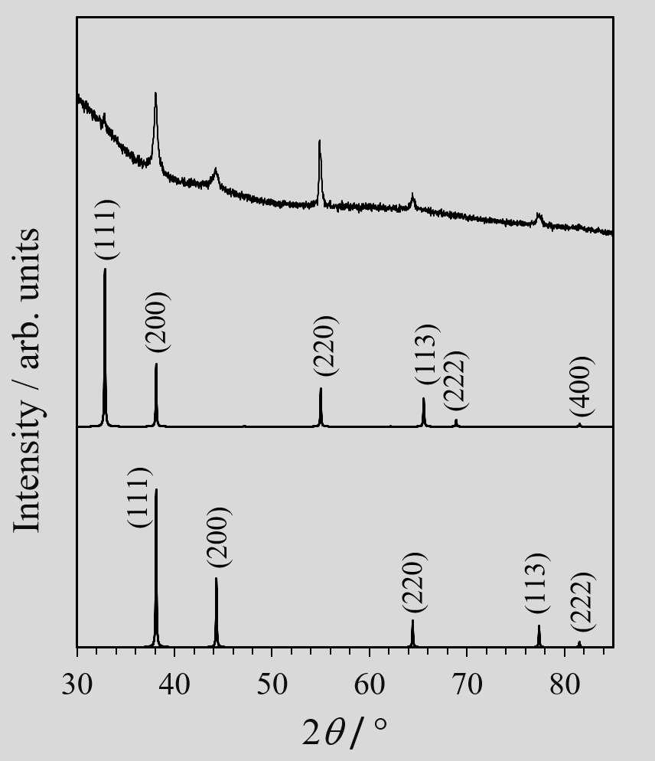
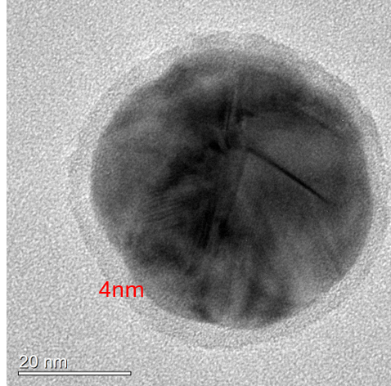
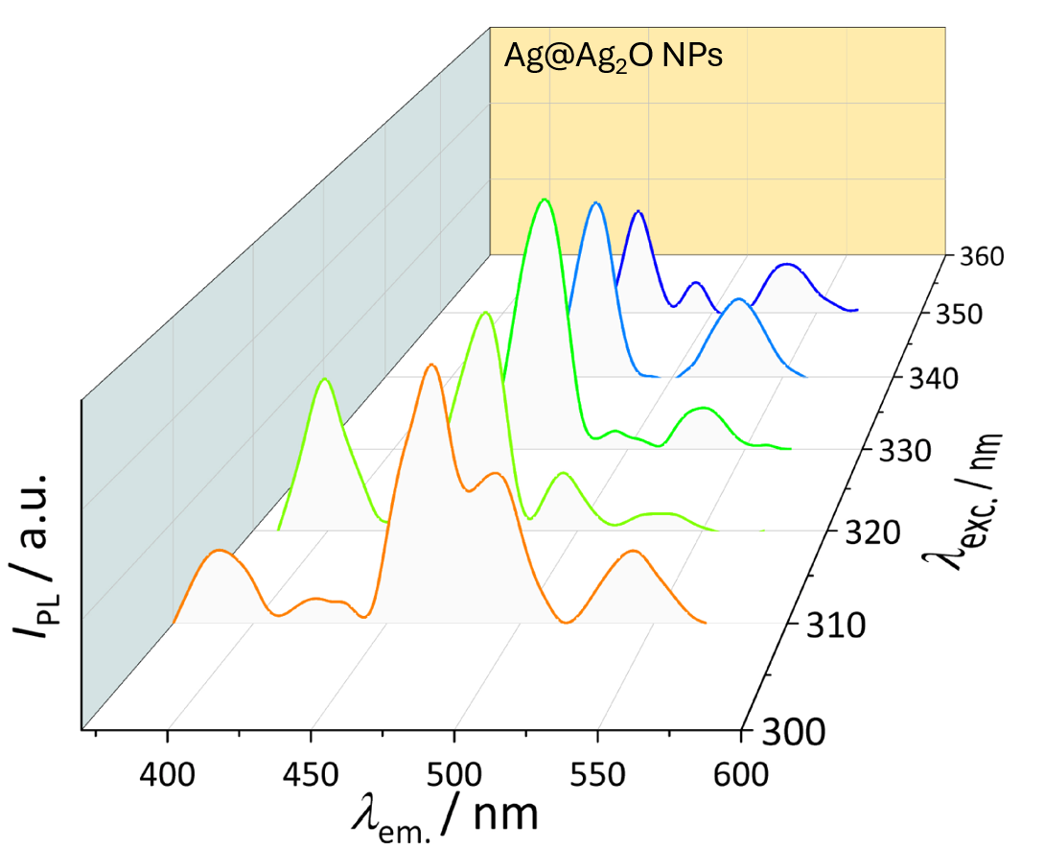
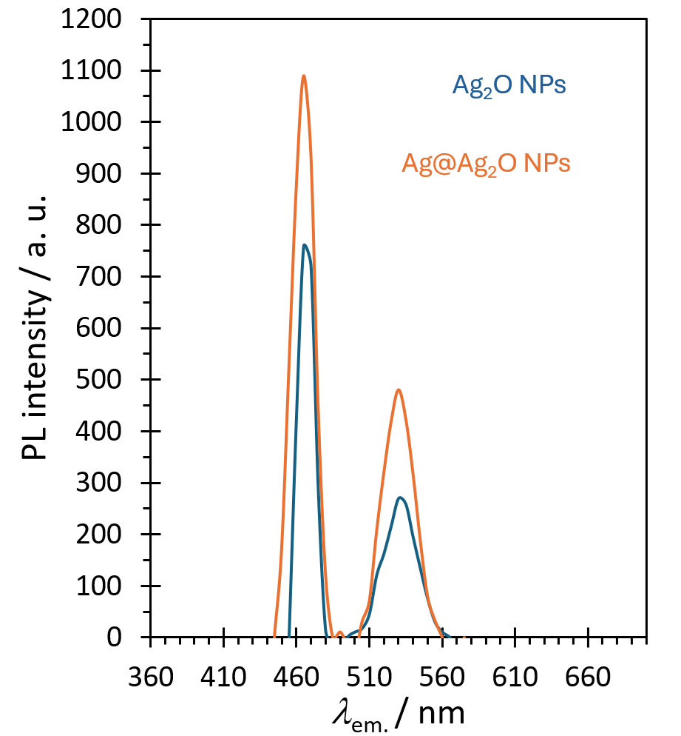
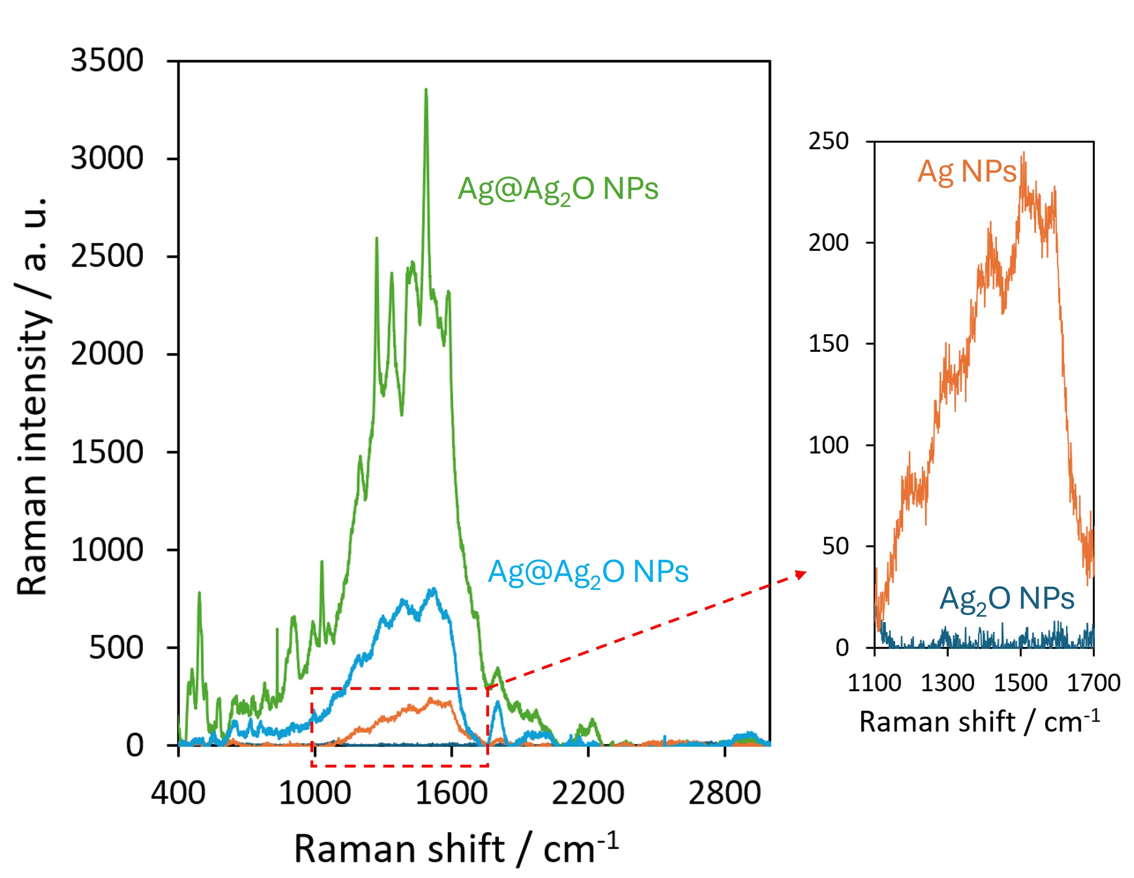
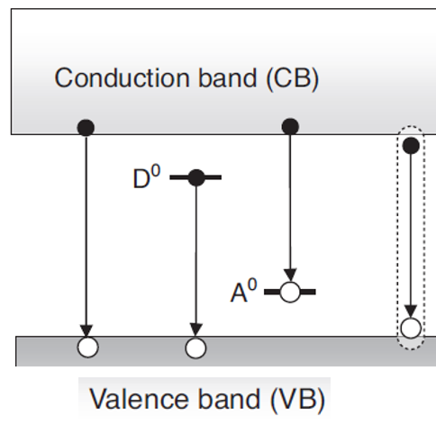
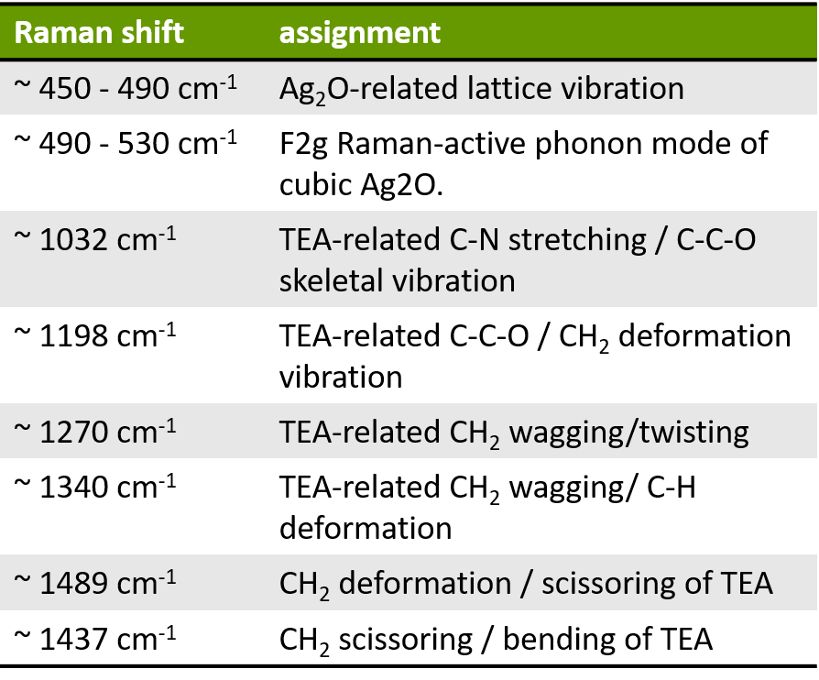
Results and discussions
Structural and morphological characterization
Surface topography
Optical properties
a)
b)
c)
S_{q} = 0.78 ± 0.29 nm
S_{q} = 5.89 ± 2.42 nm
S_{q} = 34.88 ± 7.73 nm
The pronounced LSPR band
progressively red-shifts and
broadens with increasing Ag
core radius (a) and Ag₂O shell
thickness (b).
Height AFM images of Ag@Ag₂O NP thin films
prepared under identical sonication (25 min)
and different pre-sonication conditions:
a) 5 min; b) 10 min and c) 20 min.
XRD and SAED confirm the
coexistence of metallic Ag
and Ag₂O phase.
HRTEM reveals Ag
core surrounded
by an Ag₂O shell.
Photoluminescence enhancement
Raman and SERS response
λ_{exc.} = 340 nm
The enhanced PL intensity, relative to pure Ag₂O nanostructures, is
attributed to the coupling between electronic transitions in the Ag₂O
shell and the LSPR field generated by the Ag core.
The enhanced Raman response indicate the strong localized
electromagnetic fields generated by Ag core demonstrating
the potential of the Ag@Ag₂O NP thin films as SERS substrates.

Slide 5
Conclusions
Ag@Ag₂O NP thin films (with different geometrical parameters of the core and shell) were successfully synthesized.
XRD, SAED, Raman spectroscopy and electron microscopy confirmed the coexistence of metallic Ag and Ag₂O and the formation of core-shell nanostructures.
The films exhibit a pronounced Ag-related LSPR and enhanced Raman response, indicating potential for SERS applications.
Ag@Ag₂O NP thin films show enhanced photoluminescence compared with pure Ag₂O nanostructures, consistent with plasmon-exciton coupling.
The results highlight the potential of Ag@Ag₂O nanostructures for plasmon-enhanced photonic and sensing applications.

