Slide 1


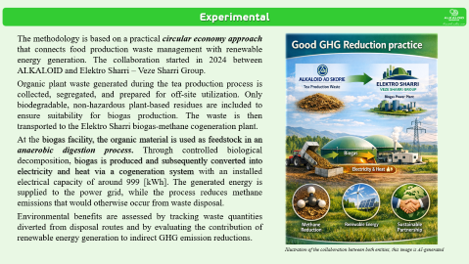
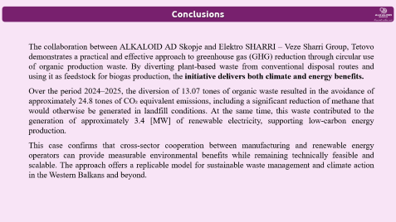
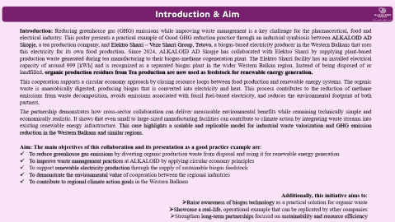
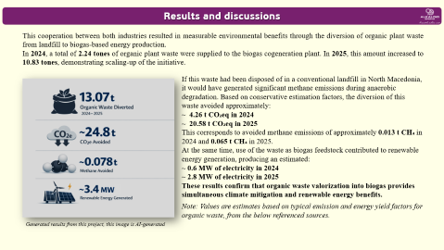
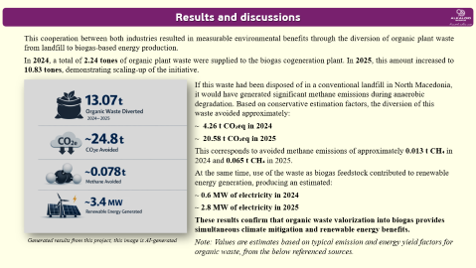
28th Congress of SCTM, 23-26 September, Ohrid, Macedonia
000
Good ghg reduction practice
Irena Mukaetova Velichkov¹, Sonja Spirovska Burchevska², Olivera Paneva³
¹ ALKALOID AD Skopje, N.Macedonia, ivelichkov@alkaloid.com.mk, ² ALKALOID AD Skopje, N.Macedonia, ³ ALKALOID AD Skopje, N.Macedonia

Slide 2

Introduction & Aim
Introduction: Reducing greenhouse gas (GHG) emissions while improving waste management is a key challenge for the pharmaceutical, food and electrical industry. This poster presents a practical example of Good GHG reduction practice through an industrial symbiosis between ALKALOID AD Skopje, a tea production company, and Elektro Sharri – Veze Sharri Group, Tetovo, a biogas-based electricity producer in the Western Balkans that uses this electricity for its own food production. Since 2024, ALKALOID AD Skopje has collaborated with Elektro Sharri by supplying plant-based production waste generated during tea manufacturing to their biogas-methane cogeneration plant. The Elektro Sharri facility has an installed electrical capacity of around 999 [kWh] and is recognized as a separated biogas plant in the wider Western Balkan region. Instead of being disposed of or landfilled, organic production residues from Tea production are now used as feedstock for renewable energy generation.
This cooperation supports a circular economy approach by closing resource loops between food production and renewable energy systems. The organic waste is anaerobically digested, producing biogas that is converted into electricity and heat. This process contributes to the reduction of methane emissions from waste decomposition, avoids emissions associated with fossil fuel-based electricity, and reduces the environmental footprint of both partners.
The partnership demonstrates how cross-sector collaboration can deliver measurable environmental benefits while remaining technically simple and economically realistic. It shows that even small to large-sized manufacturing facilities can contribute to climate action by integrating waste streams into existing renewable energy infrastructure. This case highlights a scalable and replicable model for industrial waste valorization and GHG emission reduction in the Western Balkans and similar regions.
Aim: The main objectives of this collaboration and its presentation as a good practice example are:
To reduce greenhouse gas emissions by diverting organic production waste from disposal and using it for renewable energy generation
To improve waste management practices at ALKALOID by applying circular economy principles
To support renewable electricity production through the supply of sustainable biogas feedstock
To demonstrate the environmental value of cooperation between the regional industries
To contribute to regional climate action goals in the Western Balkans
Additionally, this initiative aims to:
Raise awareness of biogas technology as a practical solution for organic waste
Showcase a real-life, operational example that can be replicated by other companies
Strengthen long-term partnerships focused on sustainability and resource efficiency

Slide 3
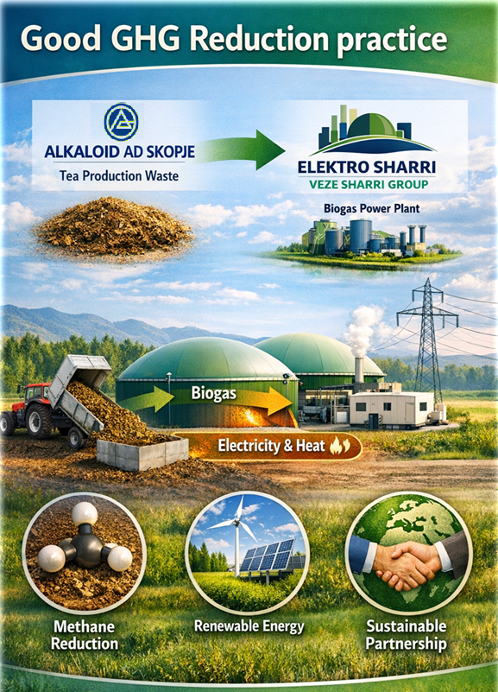
Experimental
The methodology is based on a practical circular economy approach that connects food production waste management with renewable energy generation. The collaboration started in 2024 between ALKALOID and Elektro Sharri – Veze Sharri Group.
Organic plant waste generated during the tea production process is collected, segregated, and prepared for off-site utilization. Only biodegradable, non-hazardous plant-based residues are included to ensure suitability for biogas production. The waste is then transported to the Elektro Sharri biogas-methane cogeneration plant.
At the biogas facility, the organic material is used as feedstock in an anaerobic digestion process. Through controlled biological decomposition, biogas is produced and subsequently converted into electricity and heat via a cogeneration system with an installed electrical capacity of around 999 [kWh]. The generated energy is supplied to the power grid, while the process reduces methane emissions that would otherwise occur from waste disposal.
Environmental benefits are assessed by tracking waste quantities diverted from disposal routes and by evaluating the contribution of renewable energy generation to indirect GHG emission reductions.
Illustration of the collaboration between both entities, this image is AI-generated

Slide 4
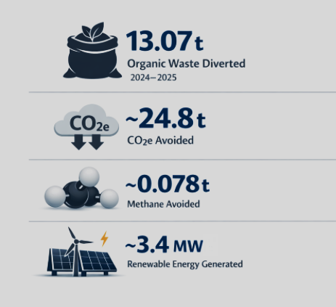
Results and discussions
This cooperation between both industries resulted in measurable environmental benefits through the diversion of organic plant waste from landfill to biogas-based energy production.
In 2024, a total of 2.24 tones of organic plant waste were supplied to the biogas cogeneration plant. In 2025, this amount increased to 10.83 tones, demonstrating scaling‑up of the initiative.
If this waste had been disposed of in a conventional landfill in North Macedonia, it would have generated significant methane emissions during anaerobic degradation. Based on conservative estimation factors, the diversion of this waste avoided approximately:
~ 4.26 t CO₂eq in 2024
~ 20.58 t CO₂eq in 2025
This corresponds to avoided methane emissions of approximately 0.013 t CH₄ in 2024 and 0.065 t CH₄ in 2025.
At the same time, use of the waste as biogas feedstock contributed to renewable energy generation, producing an estimated:
~ 0.6 MW of electricity in 2024
~ 2.8 MW of electricity in 2025
These results confirm that organic waste valorization into biogas provides simultaneous climate mitigation and renewable energy benefits.
Note: Values are estimates based on typical emission and energy yield factors for organic waste, from the below referenced sources.
Generated results from this project, this image is AI-generated

Slide 5
Conclusions
The collaboration between ALKALOID AD Skopje and Elektro SHARRI – Veze Sharri Group, Tetovo demonstrates a practical and effective approach to greenhouse gas (GHG) reduction through circular use of organic production waste. By diverting plant‑based waste from conventional disposal routes and using it as feedstock for biogas production, the initiative delivers both climate and energy benefits.
Over the period 2024–2025, the diversion of 13.07 tones of organic waste resulted in the avoidance of approximately 24.8 tones of CO₂ equivalent emissions, including a significant reduction of methane that would otherwise be generated in landfill conditions. At the same time, this waste contributed to the generation of approximately 3.4 [MW] of renewable electricity, supporting low‑carbon energy production.
This case confirms that cross‑sector cooperation between manufacturing and renewable energy operators can provide measurable environmental benefits while remaining technically feasible and scalable. The approach offers a replicable model for sustainable waste management and climate action in the Western Balkans and beyond.

