Slide 1




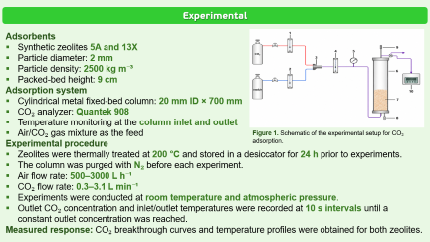
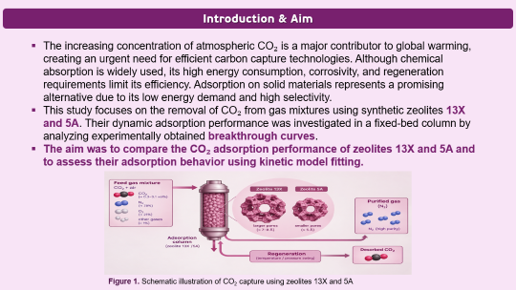
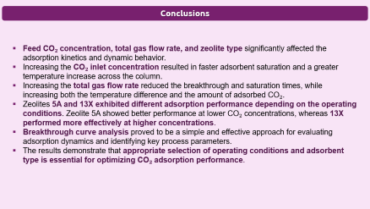
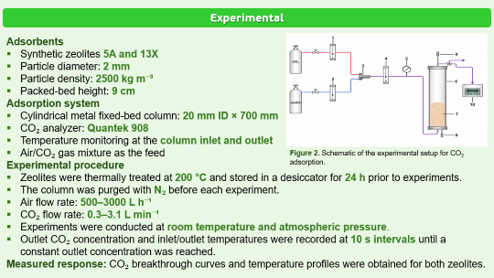
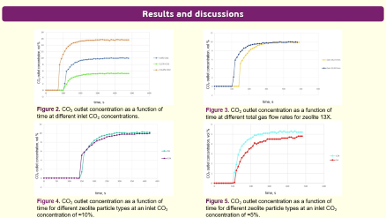
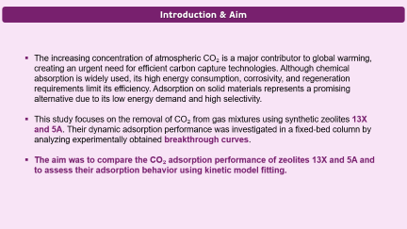

28th Congress of SCTM, 23-26 September, Ohrid, Macedonia
000
EXPERIMENTAL STUDY OF CO₂ ADSORPTION KINETICS ON ZEOLITES USING THE BREAKTHROUGH CURVE METHOD
Dunja Šijaković¹, Katarina Šućurović², Darko Jaćimovski², Danica Brzić³, Mihal Đuriš², Zorana Arsenijević², Nevenka Bošković-Vragolović³, Tatjana Kaluđerović Radoičić³
¹ Innovation Center, Faculty of Technology and Metallurgy, Belgrade, Serbia, ² Institute of Chemistry, Technology and Metallurgy, University of Belgrade, Belgrade, Serbia, ³ Faculty of Technology and Metallurgy, University of Belgrade, Belgrade, Serbia

Slide 2
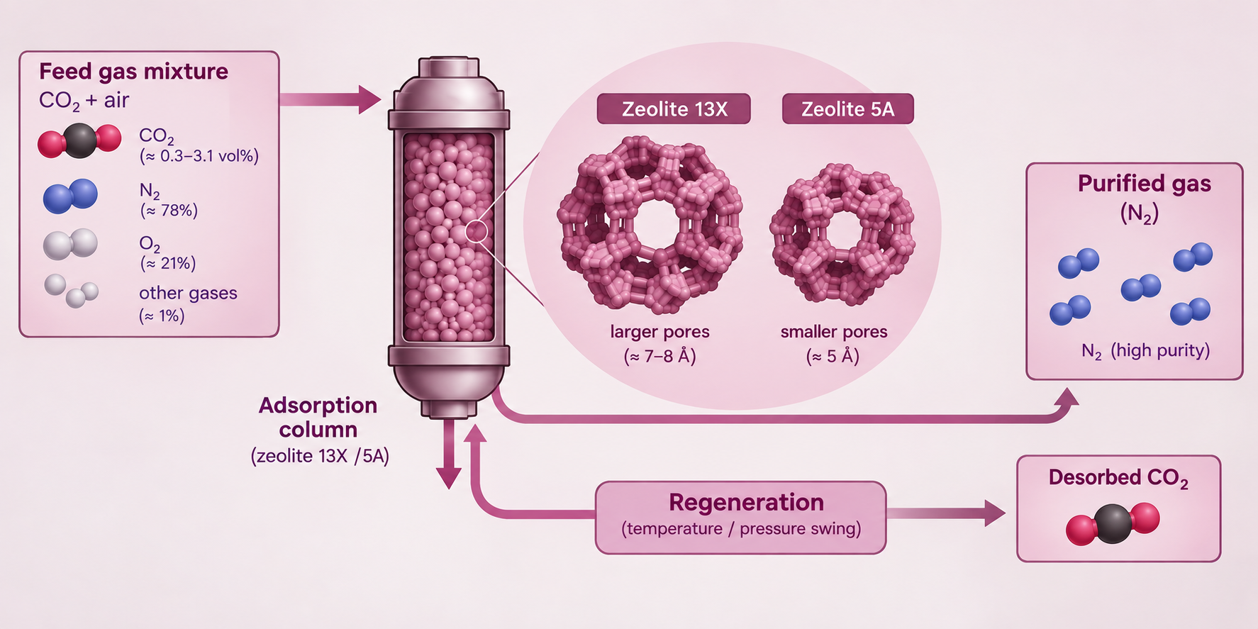
Introduction & Aim
The increasing concentration of atmospheric CO₂ is a major contributor to global warming, creating an urgent need for efficient carbon capture technologies. Although chemical absorption is widely used, its high energy consumption, corrosivity, and regeneration requirements limit its efficiency. Adsorption on solid materials represents a promising alternative due to its low energy demand and high selectivity.
This study focuses on the removal of CO₂ from gas mixtures using synthetic zeolites 13X and 5A. Their dynamic adsorption performance was investigated in a fixed-bed column by analyzing experimentally obtained breakthrough curves.
The aim was to compare the CO₂ adsorption performance of zeolites 13X and 5A and to assess their adsorption behavior using kinetic model fitting.
Figure 1. Schematic illustration of CO₂ capture using zeolites 13X and 5A

Slide 3
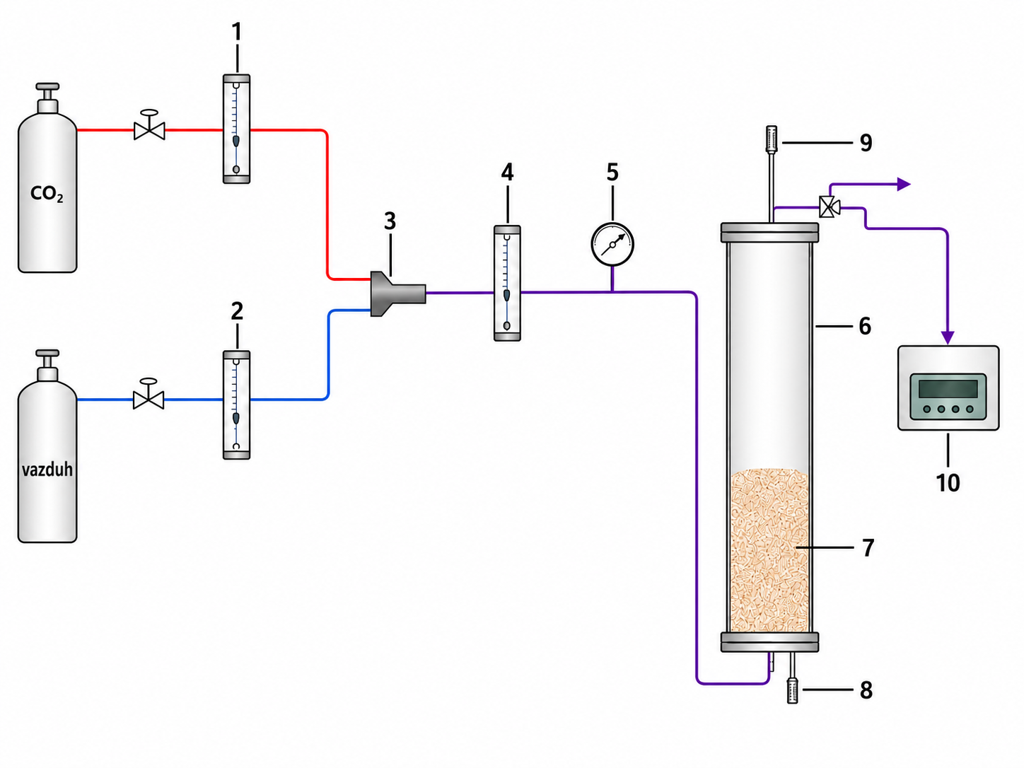
Experimental
Adsorbents
Synthetic zeolites 5A and 13X
Particle diameter: 2 mm
Particle density: 2500 kg m⁻³
Packed-bed height: 9 cm
Adsorption system
Cylindrical metal fixed-bed column: 20 mm ID × 700 mm
CO₂ analyzer: Quantek 908
Temperature monitoring at the column inlet and outlet
Air/CO₂ gas mixture as the feed
Experimental procedure
Zeolites were thermally treated at 200 °C and stored in a desiccator for 24 h prior to experiments.
The column was purged with N₂ before each experiment.
Air flow rate: 500–3000 L h⁻¹
CO₂ flow rate: 0.3–3.1 L min⁻¹
Experiments were conducted at room temperature and atmospheric pressure.
Outlet CO₂ concentration and inlet/outlet temperatures were recorded at 10 s intervals until a constant outlet concentration was reached.
Measured response: CO₂ breakthrough curves and temperature profiles were obtained for both zeolites.
Figure 2. Schematic of the experimental setup for CO₂ adsorption.

Slide 4
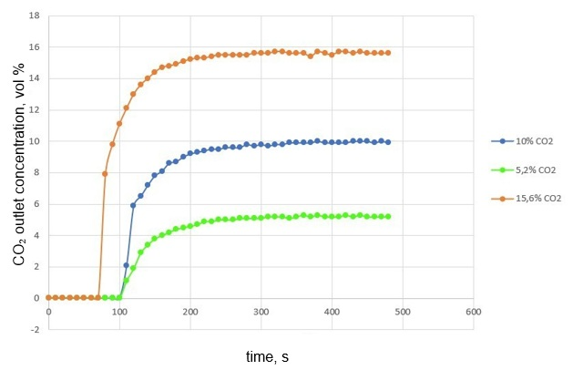
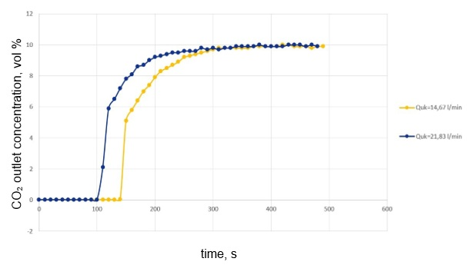
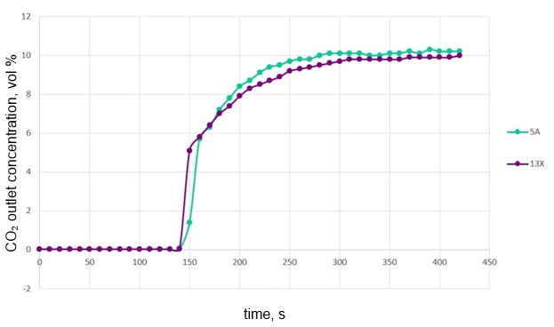
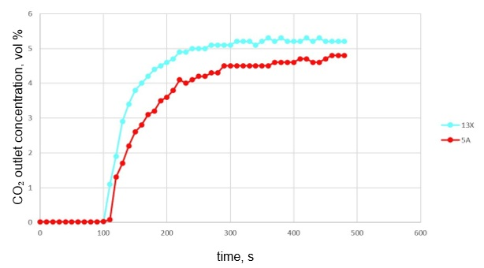
Results and discussions
Figure 3. CO₂ outlet concentration as a function of time at different inlet CO₂ concentrations.
Figure 4. CO₂ outlet concentration as a function of time at different total gas flow rates for zeolite 13X.
Figure 5. CO₂ outlet concentration as a function of time for different zeolite particle types at an inlet CO₂ concentration of ≈10%.
Figure 6. CO₂ outlet concentration as a function of time for different zeolite particle types at an inlet CO₂ concentration of ≈5%.

Slide 5
Conclusions
Feed CO₂ concentration, total gas flow rate, and zeolite type significantly affected the adsorption kinetics and dynamic behavior.
Increasing the CO₂ inlet concentration resulted in faster adsorbent saturation and a greater temperature increase across the column.
Increasing the total gas flow rate reduced the breakthrough and saturation times, while increasing both the temperature difference and the amount of adsorbed CO₂.
Zeolites 5A and 13X exhibited different adsorption performance depending on the operating conditions. Zeolite 5A showed better performance at lower CO₂ concentrations, whereas 13X performed more effectively at higher concentrations.
Breakthrough curve analysis proved to be a simple and effective approach for evaluating adsorption dynamics and identifying key process parameters.
The results demonstrate that appropriate selection of operating conditions and adsorbent type is essential for optimizing CO₂ adsorption performance.

